Slide 1
A Diverse and Connected World
Image source PNG Tree
Stage 3 geography
Alice Vigors 2020

Slide 2
Key Inquiry Questions
How do places, people and cultures differ across the world?
What are Australia’s global connections?
How do people’s connections to places affect their perception of them?
Diversity Across Asia
The World’s Cultural Diversity
Global Connections
Connections Shape Perceptions
Alice Vigors 2020

Slide 3
Diversity Across Asia
Source: Inquisitive
How do places, people and cultures differ across the world?

Slide 4
Source: Nat Geo Kids
Alice Vigors 2020
TUNING IN

Slide 5
Think Puzzle Explore – Thinking Routine
What do you think you know about the Asian region?
What questions or puzzles do you have about this region and our connection to it?
How might we categorise and explore the questions we have?
Alice Vigors 2020
TUNING IN

Slide 6
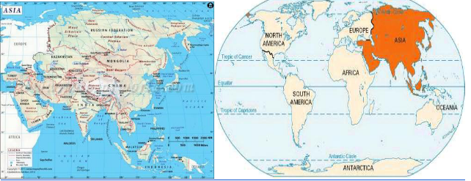
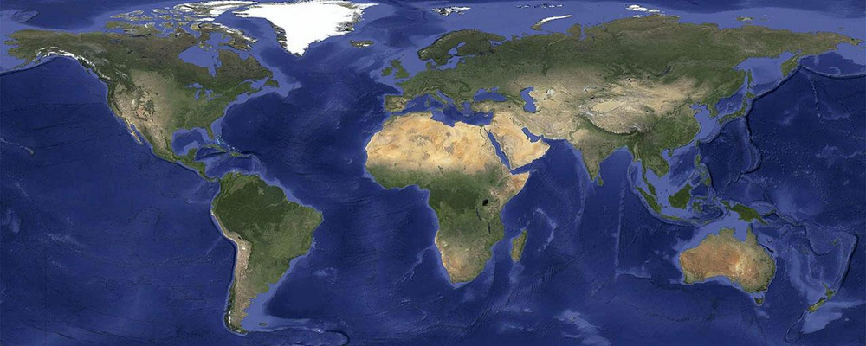
Where in the world is Asia?
Locate the region of Asia on a world map
Locate any countries you already know in the Asia region.
Identify the furthest countries in the region to the North, South, East and West
Choose 3-4 countries and determine the direction and distance from Tumut, Australia
Use compass point directions
Record using appropriate units of measurement
Alice Vigors 2020
SHARED INQUIRY

Slide 7
What does Diversity mean?
How might a country or region be diverse?
Source: Julia Maudlin Photography
SHARED INQUIRY

Slide 8
Source: World Geography
Alice Vigors 2020
SHARED INQUIRY

Slide 9
Vocabulary Exploration
region
equator
seismic
archipelago
fertile
unstable
terrain
plateau
tropical
subtropical
uninhabitable
densely populated
Alice Vigors 2020
SHARED INQUIRY

Slide 10
Characteristics and Features of Asia
What are the unique characteristics and features of Asia?
Why might Asia be divided into 5 major land areas? What purpose does/ might this serve?
What are the defining features of the 5 major land areas? How are they different?
Why do you think ⅗ of the world's population calls Asia and the Pacific home?
Why do you think most people rely on farming for their livelihoods?
What questions or puzzles do you have?
Source: Lonely Planet
Assessment For Learning
SHARED INQUIRY

Slide 11
Vocabulary Exploration
economic
demographic
Gross Domestic Product (GDP)
lifestyle
population
employment
Alice Vigors 2020
SHARED INQUIRY

Slide 12
Research Task
Success Criteria:
Clearly identify the two chosen countries
Acknowledge all sources used to gather information and data
Research and gather appropriate information relating to the focus areas
Record all information in your own words
Use graphs to show comparisons between the two chosen countries
Present information and data in a clear, easy-to read and engaging way
Include appropriate images, text and graphs to support your research
Actively listen to the presentations of others.
Choose two different Asian countries that are also found in different regions.
Research and gather information and data to show the following for each country, in your own words:
Region of Asia it is located in
Land area of the country
Defining characteristics of the country
Population
Types of employment and unemployment rate
Lifestyle
Gross Domestic Product (GDP)
Examine and compare the data between the two countries, representing some of the data using graphs.
Present findings using Google Slides, making sure you acknowledge all sources.
Assessment For Learning
SHARED INQUIRY

Slide 13
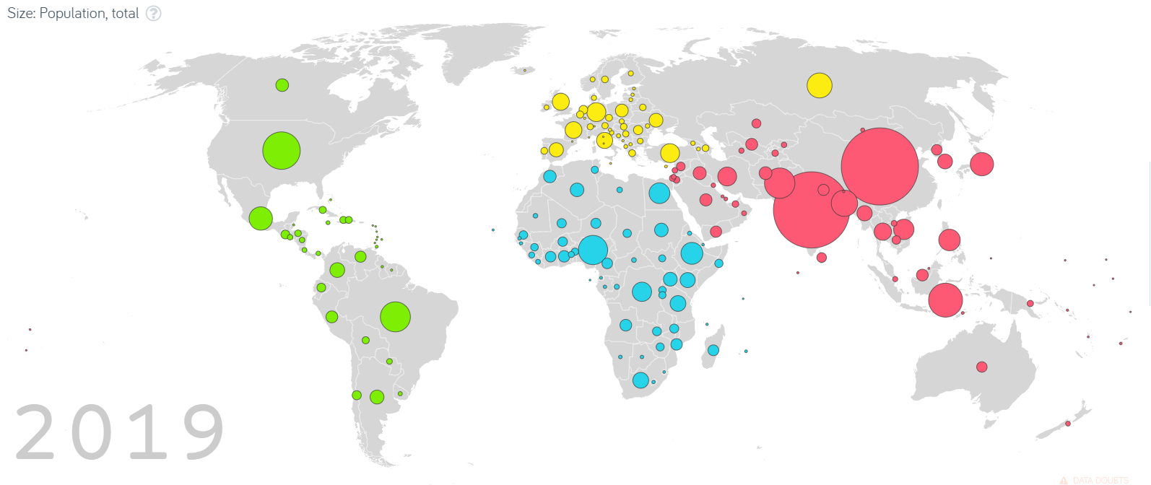
Source: Gapminder
What do you see, observe or notice about the data?
What do you think contributes to growth in some places/ regions compared to others?
What does the data make you wonder?
See Think Wonder
-Thinking Routine
Alice Vigors 2020
SHARED INQUIRY

Slide 14
Exploring Population Density
Country | Total Population | Land Area (km²) | Population Density (per km²)
Australia |  | 7 559 861 km² | 3 per km²
Tuvalu |  | 30 km² | 331 per km²
China |  | 9 326 961 km² | 147 per km²
Mongolia |  | 1 553 556 km² | 2 per km²
Monaco |  | 2 km² | 18866 per km²
*
*
*
*
What do you see, observe or notice about the data?
Which country is the most densely populated?
Why might this be?
Which country is the least densely populated?
Why might this be?
Alice Vigors 2020
SHARED INQUIRY

Slide 15
How might population growth impact different countries?
Source: BRS
SHARED INQUIRY

Slide 16
Reflecting On Learning
Connect Extend Challenge – Thinking Routine
How did our learning connect to what you already knew about Asia?
How was your understanding of Asia extended by our learning?
What still challenges you about Asia? What do you still wonder?
Source: Human Resources Online
Assessment As Learning
SHARED INQUIRY

Slide 17
The World’s Cultural Diversity
Source: Inquisitive
Source: Inquisitive
How do places, people and cultures differ across the world?

Slide 18
Source: Survival International
Alice Vigors 2020
TUNING IN

Slide 19
Think Puzzle Explore – Thinking Routine
What do you think makes this tribe Indigenous?
Do you think contact should be made with this tribe? What makes you say that?
What questions or puzzles do you have about Indigenous peoples of the world?
How might we explore and categorise our wonderings?
Alice Vigors 2020
TUNING IN

Slide 20
There are approximately 370 million indigenous peoples in the world. They live in all regions of the world and represent more than 5000 different groups. Each indigenous group is significant to the area they inhabit and has a unique culture.
Source: WebStock Review
SHARED INQUIRY

Slide 21
Research Task
Maori Inuit Sami Orang Asli Yami
Ainu American Indian Moken Dayak
Aboriginal and Torres Strait Islander Bunun
Choose one indigenous tribe to explore
Locate which country they live in and highlight on a world map
Gather information about your chosen Indigenous tribe, and record information in your own words. Including information about:
Customs
Beliefs
History
Social organisation
Language
Dress
Music
Outline some of the challenges the Indigenous people face in maintaining their traditions and way of life in contemporary society.
Present your research as a booklet or ebook, acknowledging the sources you used.
Success Criteria:
Clearly identify the chosen Indigenous tribe
Acknowledge all sources used to gather information
Research and gather appropriate information relating to the focus areas
Record all information in your own words
Present information and data in a clear, easy-to read and engaging way
Include appropriate images, text and graphs to support your research
Actively listen to the presentations of others.
Assessment For Learning
Source: Bluethumb Art Gallery
SHARED INQUIRY

Slide 22
Compare and Contrast
Country:
How are they similar?
Country:
How is this country different?
How is this country different?
Assessment Of Learning
Alice Vigors 2020
SHARED INQUIRY

Slide 23
How are indigenous peoples and other groups around the world protected?
Source: United Nations
SHARED INQUIRY

Slide 24
Research Task
What is the United Nations?
Create a timeline to show when the following declarations were put into place.
Human rights
Rights of Indigenous Peoples
International cooperation in the exploration of outer space
Human clothing
The prevention of nuclear catastrophe
The Indian Ocean as a zone of peace
What do you notice about when the declaration of the rights of indigenous peoples was made? Why do you think this might be? What is your opinion about this?
4 countries originally chose not to sign the declaration for the rights of Indigenous peoples. Who were they? What reasons might the countries have had for not signing the declaration? What impact would this decision have had on the Indigenous peoples of that country?
Assessment For Learning
Source: United Nations
SHARED INQUIRY

Slide 25
Reflecting On Learning
Connect Extend Challenge – Thinking Routine
How did our learning connect to what you already knew about Indigenous Peoples?
How was your understanding of Indigenous Peoples extended by our learning?
What still challenges you about Indigenous Peoples? What do you still wonder?
Source: Culture Ready
Assessment As Learning
SHARED INQUIRY

Slide 26
Global Connections
Source: ANU Australian Studies Institute
Source: Inquisitive
What are Australia’s global connections?

Slide 27
Think Puzzle Explore – Thinking Routine
How do you think we are connected to other countries?
Why do you think connections to other countries are important to Australia?
What questions or puzzles do you have about our connections?
How might we categorise and explore these connections further?
Alice Vigors 2020
TUNING IN

Slide 28
Vocabulary Exploration
trade
export
import
Alice Vigors 2020
SHARED INQUIRY

Slide 29
Trade Investigation
Identify Australia’s top 10 trading partners.
Locate each country on a world map.
Choose one country and gather information about the types of goods we import and export to and from that country.
What goods do we import?
What goods do we export?
Why do you think the trade connections with this country are important to Australia?
What would happen if this trade connection was lost?
What questions do you have about the connection with this country?
Assessment For Learning
Source: University of Pennsylvania
SHARED INQUIRY

Slide 30
Chalk Talk – Thinking Routine
How the Chalk Talk works:
Groups will visit one page at a time for a pre-determined amount of time.
Each member of the group silently reads and responds to the question on the page simultaneously.
As other people begin to respond, think about:
Does an idea need to be elaborated further? Add an elaboration to an idea by drawing a line off it and adding your thought.
Does this idea have a connection to your idea? If so, how? Add your connection by drawing a line to your idea and writing how they connect on the connecting line you drew.
Do you agree with and support the idea of another person? If so, why? Add a tick to show you agree and explain why you agree with this idea.
After visiting all the prompts, return to the starting prompt and as a group discuss the ideas written on the page and highlight the big ideas or most important ideas that address the question on the page. Share findings with the class.
Here are today’s question prompts:
What is meant by the word Tourism?
Why is the tourism industry growing?
What reasons might people have for travelling?
In what ways might people travel? Why?
What connections do you have to travelling to another destination?
Alice Vigors 2020
SHARED INQUIRY

Slide 31
Predict the countries you think make the top 10 list of countries visited by Australians in 2019
Justify why you think this country would be in the top 10
Investigate the top 10 countries visited by Australians in 2019
How does travelling to places overseas help to build connections between Australia and other countries?
What are the impacts of tourism on Australia or other countries?
What are the most popular overseas destinations for Australians?
Source: Travel Guides
SHARED INQUIRY

Slide 32
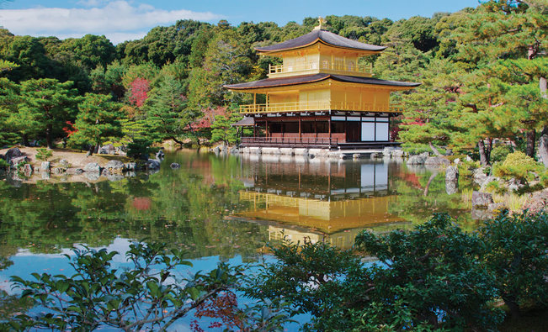
3 2 1 Bridge – Thinking Routine
What are three things you think you know about Japan?
What two questions do you have about this Asian country?
What is one thing that challenges you?
Source: National Geographic
Alice Vigors 2020
SHARED INQUIRY

Slide 33
Japan will play host to the 2020/2021 Olympic Games in Tokyo.
What are the 3 Olympic values?
What are the 5 educational themes of olympism?
How might we strive to live out these values in our everyday lives?
Source: Olympic.org
SHARED INQUIRY

Slide 34
What impact did their actions have on others?
What was the result of their actions?
Why do you think they chose to continue?
What message does this send to other athletes and spectators around the world?
Source: Olympic Channel
Alice Vigors 2020
SHARED INQUIRY

Slide 35
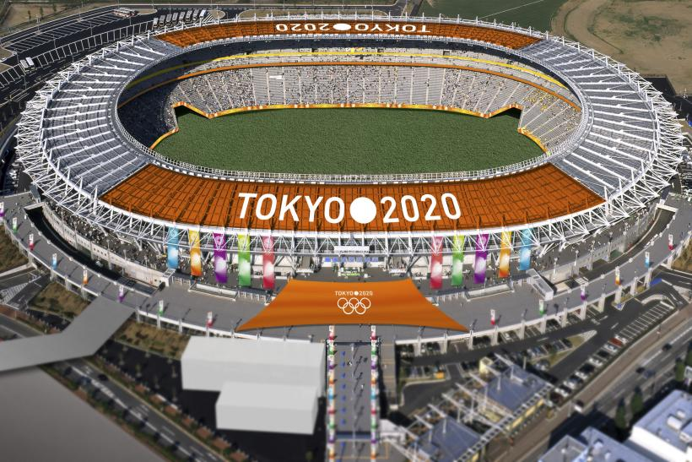
Olympic Games Impact
Explore the positive and negative impacts of the Olympic Games on different people and places.
Athletes from the host country
Athletes from around the world
Citizens of the country
Governments and Olympic Committees/ officials
The construction/ building industry
Tourism industry
Citizens of the local area
Indigenous peoples
The environment
Assessment For Learning
Source: University of Pennsylvania
SHARED INQUIRY

Slide 36
How does the emblem promote the theme Unity in Diversity?
Why is the theme important in our world today?
How can we promote Unity in Diversity here at school?
Challenge: Use the Tokyo Olympic emblem as inspiration to design an emblem for our class.
Source: Olympic Channel
Alice Vigors 2020
SHARED INQUIRY

Slide 37
Connections Shape Perceptions
Source: Inquisitive
Source: Inquisitive
How do people’s connections to places affect their perception of them?

Slide 38
Source: ABC Education
Alice Vigors 2020
TUNING IN

Slide 39
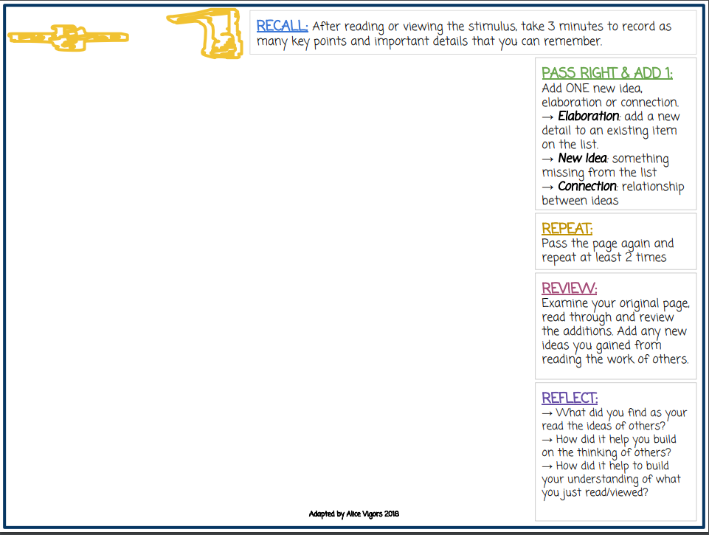
Plus One – Thinking Routine
Why might Australians be apprehensive about furthering connections with our trade partners?
What might be the cause of these perceptions?
Alice Vigors 2020
TUNING IN

Slide 40
Connections Shape Perceptions
What is a perception?
How does it impact the way we connect and interact with other people and countries?
Alice Vigors 2020
SHARED INQUIRY

Slide 41
Source: Inquisitive
Alice Vigors 2020
SHARED INQUIRY

Slide 42
Think Puzzle Explore – Thinking Routine
What perceptions do you think you hold about other countries?
What questions or puzzles do you have?
How might we categorise and explore the questions we have?
Alice Vigors 2020
SHARED INQUIRY

Slide 43
Source: Inquisitive
Alice Vigors 2020
SHARED INQUIRY

Slide 44
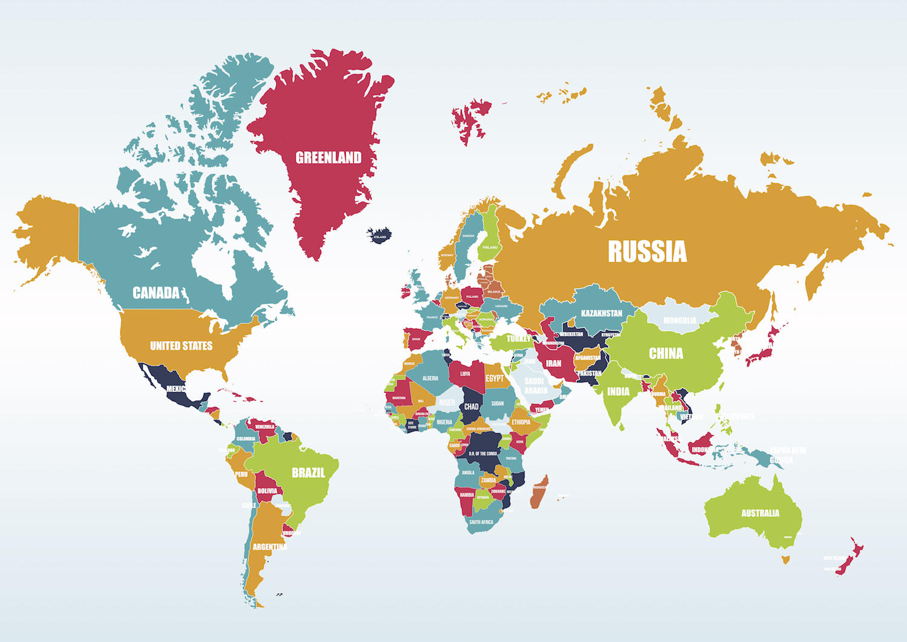
Research Task Many Eyes: One Country
Choose one you currently have perceptions about.
Locate the country on a map of the world.
Identify the connections between your chosen country and Australia, e.g. trade, tourism, aid
Survey a range of people to find out their perceptions about your chosen country. Represent results in a T chart showing positive and negative perceptions.
Gather a range of images or other media that represents different aspects of the country, ensuring to acknowledge sources
Gather evidence from headlines, media articles, government websites and/or travel brochures that highlight how this country is portrayed to the world
Explain the impact these portrayals and stereotypes have on the way people perceive this country?
Present research as an ebook using Book Creator
Success Criteria:
Clearly identify the chosen country
Acknowledge all sources used to gather information.
Research and gather appropriate information relating to the focus areas
Record all information in your own words.
Survey a range of people and accurately record responses.
Present information and data in a clear, easy-to read and engaging way.
Include appropriate images, text and graphs to support your research.
Actively listen to the presentations of others.
Assessment Of Learning
SHARED INQUIRY

Slide 45
Reflecting On Learning
Connect Extend Challenge – Thinking Routine
How did your research connect to what you already knew about your chosen country?
How was your understanding of your chosen country extended through research?
What still challenges you about the way you perceive this country? What do you still wonder?
Image source PNG Tree
Assessment As Learning
SHARED INQUIRY

