Slide 1
Angles
Stage 3
Alice Vigors
2017

Slide 2
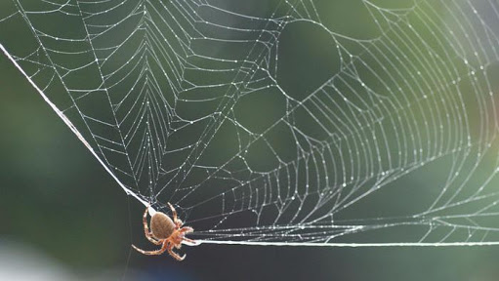
Teaching and Learning Sessions
Can we recognise and name different types of angles in everyday situations?
Can we investigate angles on a straight line, angles at a point and vertically opposite angles?
Can we identify and investigate adjacent angles?
Can we identify and describe angles in Art?
NB: links with Visual Arts outcomes
Describes and represents mathematical situations in a variety of ways using mathematical terminology and some conventions MA3-1WM
Measures and constructs angles, and applies angle relationships to find unknown angles MA3-16MG
Alice Vigors 2017
Notes:
Indicators Addressed:
Investigate, with and without the use of digital technologies, angles on a straight line, angles at a point, and vertically opposite angles; use the results to find unknown angles
Identify and name angle types formed by the intersection of straight lines, including right angles, 'angles on a straight line', 'angles at a point' that form an angle of revolution, and 'vertically opposite angles'
Recognise right angles, angles on a straight line, and angles of revolution embedded in diagrams (Reasoning)
Identify the vertex and arms of angles formed by intersecting lines (Communicating)
Recognise vertically opposite angles in different orientations and embedded in diagrams (Reasoning)
Investigate, with and without the use of digital technologies, adjacent angles that form a right angle and establish that they add to 90°
Investigate, with and without the use of digital technologies, adjacent angles on a straight line and establish that they form a straight angle and add to 180°
Investigate, with and without the use of digital technologies, angles at a point and establish that they form an angle of revolution and add to 360°

Slide 3
Session One
Can we recognise and name different types of angles in everyday situations?
Alice Vigors 2017

Slide 4
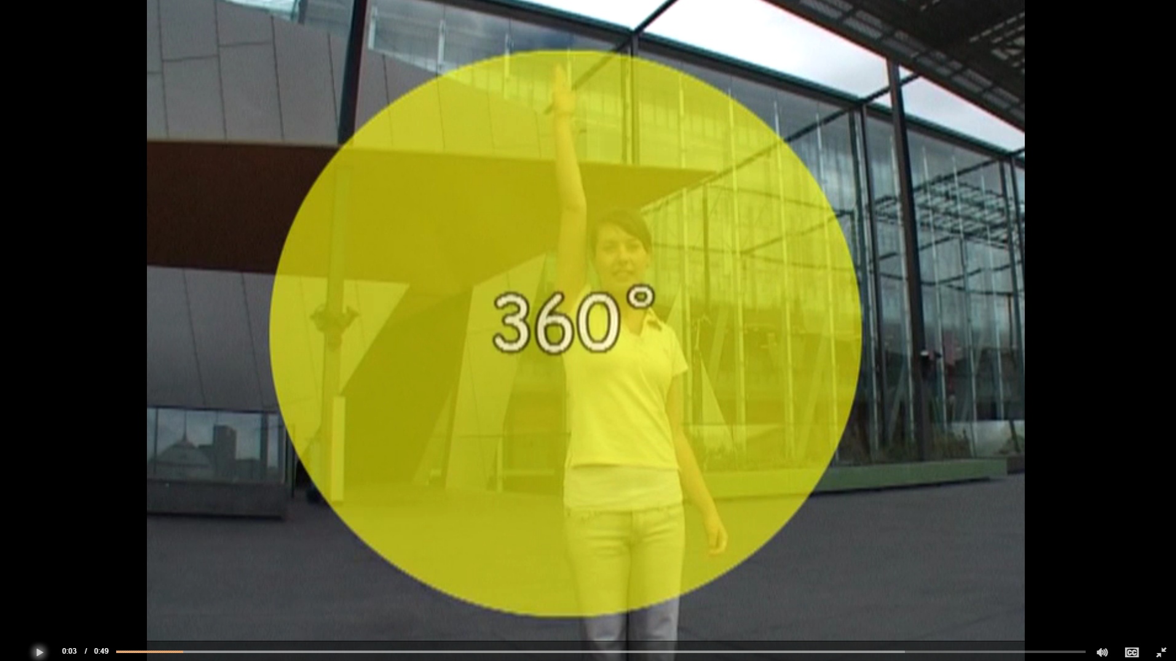
Can we recognise and name different types of angles in everyday situations?
Alice Vigors 2017
Notes:
→Watch: Angles are nice but are they cute? http://splash.abc.net.au/home#!/media/1244916/angles-are-nice-but-are-they-cute-

Slide 5
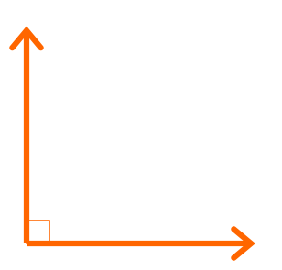
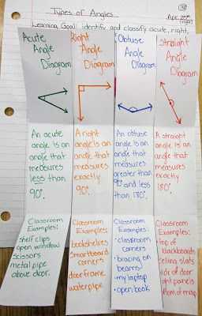
Can we recognise and name different types of angles in everyday situations?
Can you define the following terms:
Right angle:
Acute angle:
Obtuse angle:
Straight angle:
Revolution:
Alice Vigors 2017
Notes:
→Define right-angle, acute, obtuse, straight angles and revolutions.

Slide 6
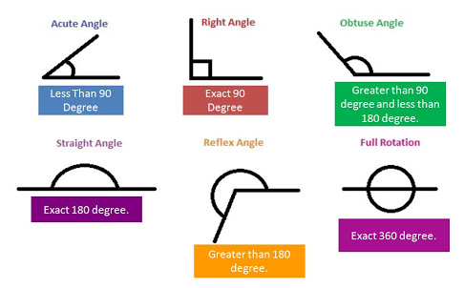
Alice Vigors 2017

Slide 7
Can we recognise and name different types of angles in everyday situations?
Small Group Investigation:
Find examples in the school environment of different types of angles.
Use an app to present these examples, including the use of voice over to explain why this example shows this type of angle, and write/draw over to highlight the angle.
Share your group work on Seesaw with the class and wider community.
Alice Vigors 2017
Notes:
→Investigation: Small groups use iPad or Chromebook devices to record examples in the school environment of the different types of angles. Use an app to present these examples, including the use of voice over to explain why this example shows this type of angle (write over to highlight the angle). Students upload their group’s example to one of three sharing mediums →Seesaw, Class Dojo student story or Google Classroom. Share creations with the class as well as the wider community.

Slide 8
Can we recognise and name different types of angles in everyday situations?
Why is being able to create accurate angles important in everyday life?
Exit Ticket
I Used to think …
Now I think…
Alice Vigors 2017

Slide 9
Session Two
Can we investigate angles on a straight line, angles at a point and vertically opposite angles?
Alice Vigors 2017

Slide 10
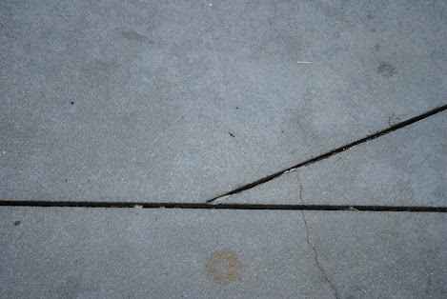
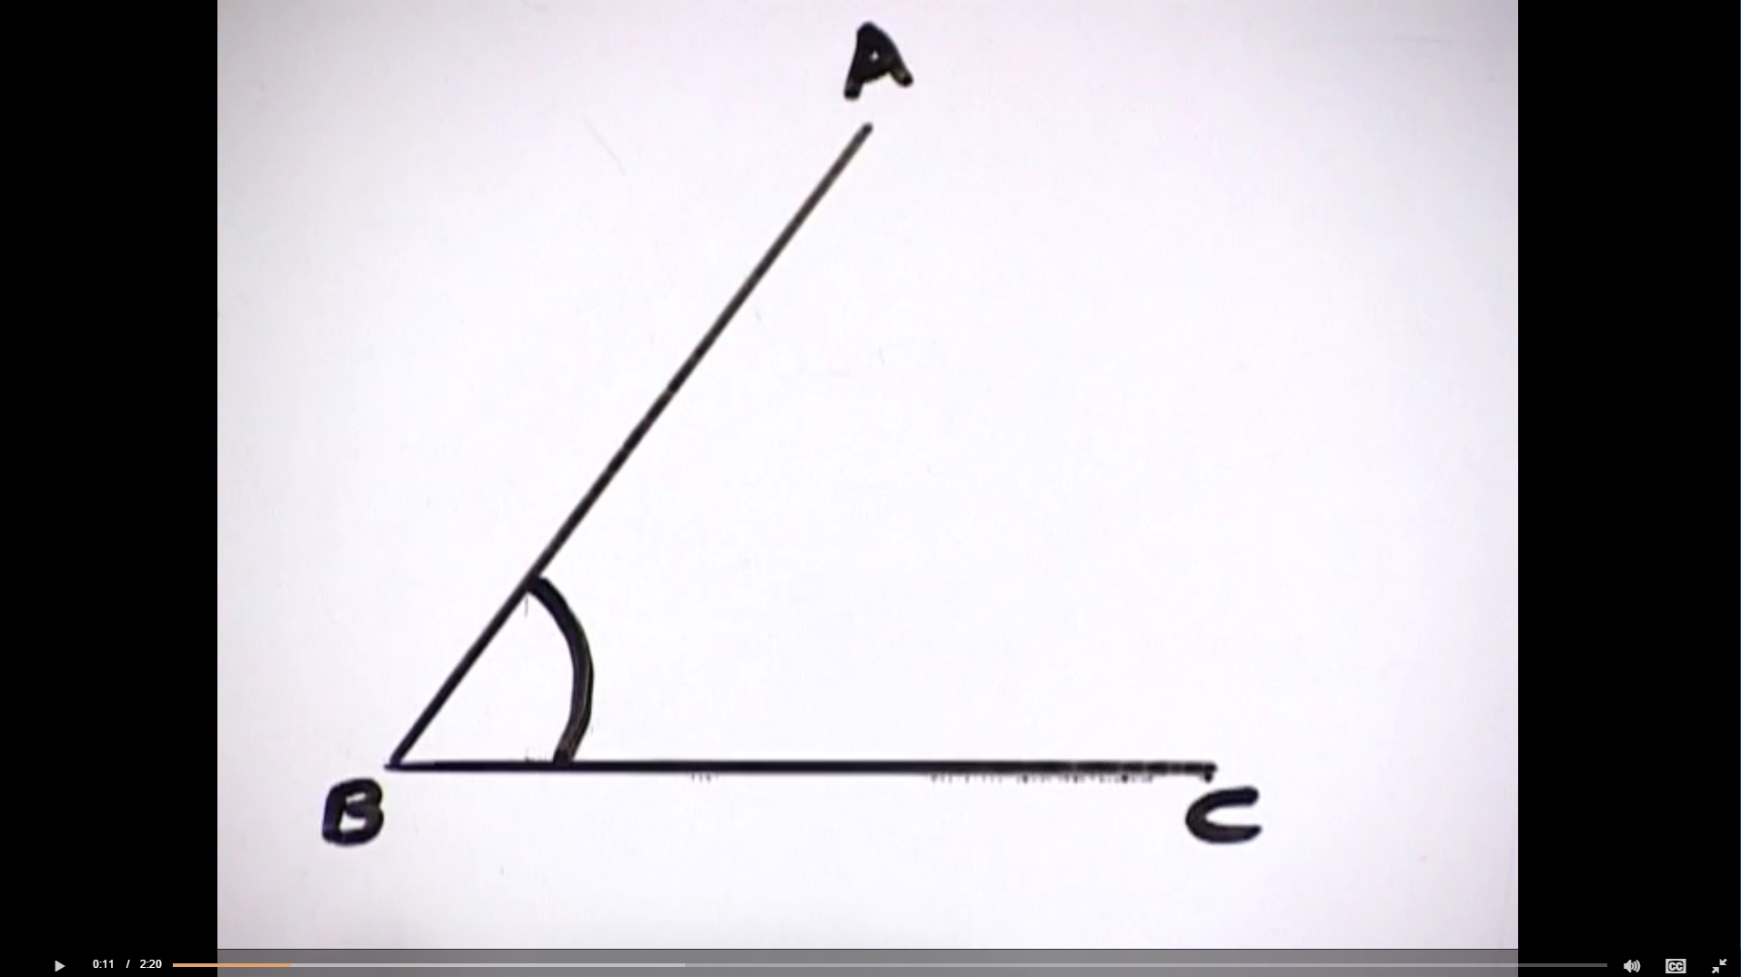
Can we investigate angles on a straight line, angles at a point and vertically opposite angles?
How might we measure the size of an angle?
Alice Vigors 2017
Notes:
→Ask: How might we measure the size of an angle?
→Watch How do you measure angles? http://splash.abc.net.au/home#!/media/1244938/how-do-you-measure-angles-

Slide 11
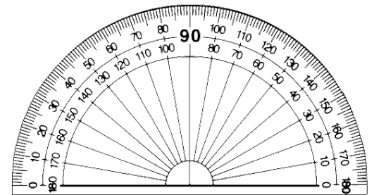
Can we investigate angles on a straight line, angles at a point and vertically opposite angles?
Experiment with using a protractor to determine the size of different angles.
Alice Vigors 2017
Notes:
→Model using a protractor to determine the size of different angles.

Slide 12
Can we investigate angles on a straight line, angles at a point and vertically opposite angles?
Experiment with drawing angles of different sizes using a protractor.
Alice Vigors 2017
Notes:
→Experiment with drawing angles of different sizes, e.g. 80º, 45º, 120 º, 180 º etc.

Slide 13
Can we investigate angles on a straight line, angles at a point and vertically opposite angles?
I want to find out the size of these angles. Can you identify which ones are angles? How would I work out the size of each angle?
Alice Vigors 2017
Notes:
→Introduce the term Vertically Opposite angles.

Slide 14
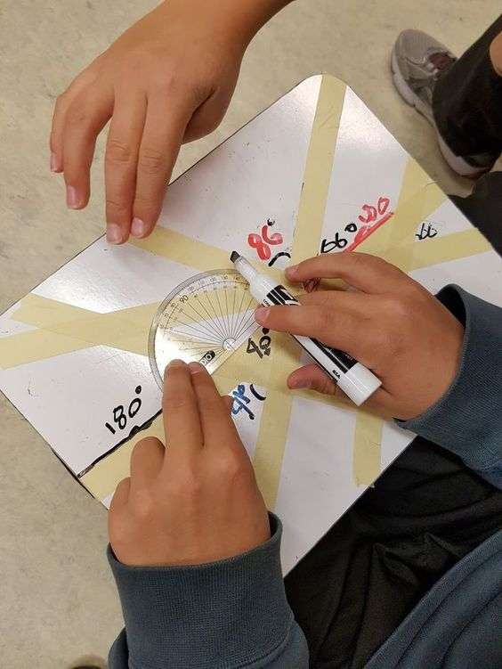
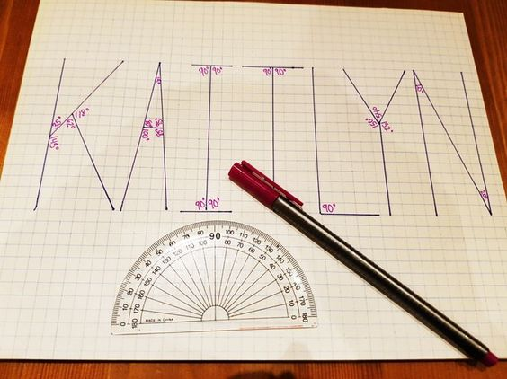
Can we investigate angles on a straight line, angles at a point and vertically opposite angles?
Pair Task:
Using masking tape, create a series of lines that intersect on a mini whiteboard or desk. Use a protractor and whiteboard markers to identify each of the different angles
IndependentTask:
Use a protractor to identify the angles in the letters of
your first name. What kind of angles do you find?
Alice Vigors 2017
Notes:
→

Slide 15
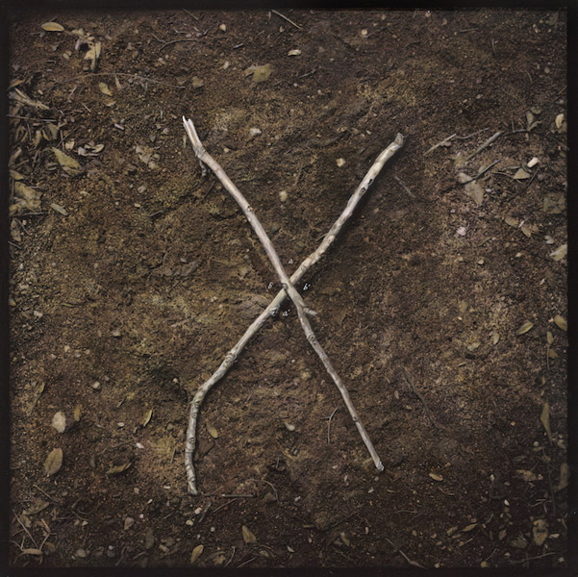
Can we investigate angles on a straight line, angles at a point and vertically opposite angles?
Why is it important to know how to identify and measure different angles?
Exit Ticket
I Used to think …
Now I think…
Alice Vigors 2017
Notes:
→

Slide 16
Session Three
Can we identify and investigate adjacent angles?
Alice Vigors 2017
Assessment: MA3-16MG

Slide 17
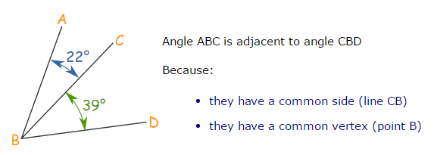
Can we identify and investigate adjacent angles?
What is an adjacent angle?
Two angles are adjacent when they have a common side and a common vertex (corner point) and don’t overlap.
Alice Vigors 2017
Notes:
→Record examples

Slide 18
Can we identify and investigate adjacent angles?
Assessment – MA3-16MG
Pair Task:
Investigate adjacent angles that involve right angles, straight lines and angles of revolution.
Identify the angle formed by the two outer lines (e.g. A & D). How does this help you determine the value of the adjacent angles on the inside?
Alice Vigors 2017
Notes:
→Record examples

Slide 19
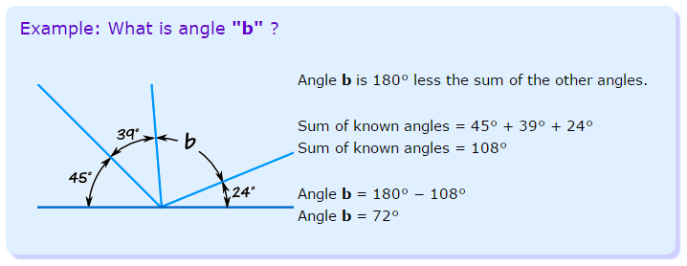
Can we identify and investigate adjacent angles?
Assessment – MA3-16MG
Alice Vigors 2017
Notes:
→Record examples

Slide 20
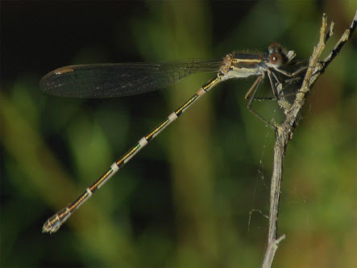
Can we identify and investigate adjacent angles?
Exit Ticket
How did this connect to what I already know…
What challenged or extended my thinking…
What questions or puzzles do I still have?
Alice Vigors 2017
Notes:
→

Slide 21
Session Four
Visual Arts Links: VAS3.1, VAS3.2, VAS3.3, VAS3.4
Can we identify and describe angles in Art?
Assessment: MA3-16MG
Alice Vigors 2017

Slide 22
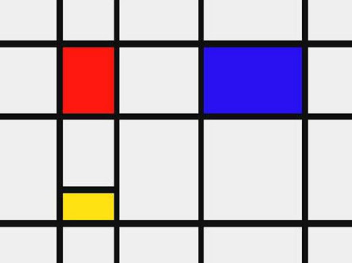
Can we identify and describe angles in Art?
What types of angles are evident in this Piet Mondrian artwork?
Alice Vigors 2017
Notes:
Examine these artworks in small groups or as a whole class.

Slide 23
Can we identify and describe angles in Art?
What types of angles are evident in this artwork by Vans the Omega?
Alice Vigors 2017

Slide 24
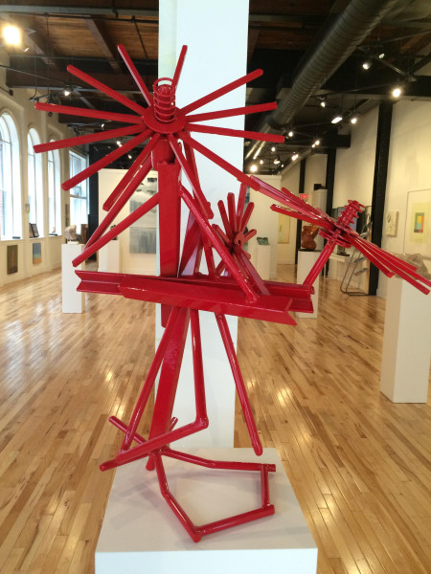
Can we identify and describe angles in Art?
What types of angles are evident in this sculpture by Judy O’Donnell?
Alice Vigors 2017

Slide 25
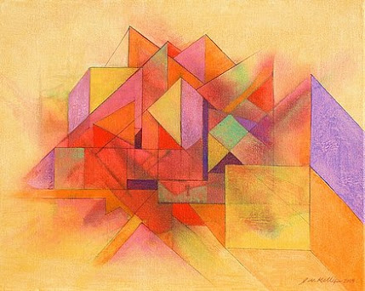
Can we identify and describe angles in Art?
What types of angles are evident in this artwork by J.W. Kelly?
Alice Vigors 2017

Slide 26
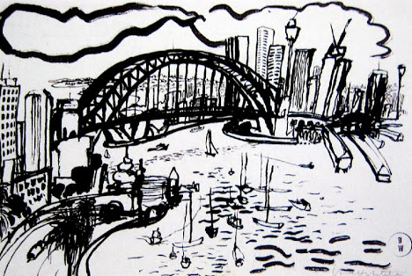
Can we identify and describe angles in Art?
What types of angles are evident in this artwork by Brett Whiteley?
Alice Vigors 2017

Slide 27
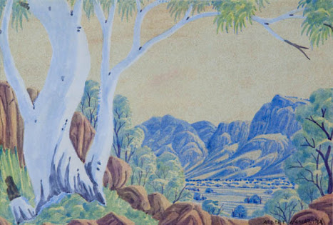
Can we identify and describe angles in Art?
What types of angles are evident in this artwork by Albert Namatjira?
Alice Vigors 2017

Slide 28
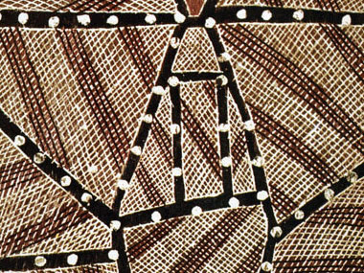
Can we identify and describe angles in Art?
What types of angles are evident in this Aboriginal artwork?
Alice Vigors 2017

Slide 29
Can we identify and describe angles in Art?
Independent Task:
Use tape to create angles in a piece of art paper.
Use different colours to highlight different sized angles. Which medium will you use? e.g. paint, water colour, oil pastels, pencils, texta
Assessment – MA3-16MG
Apply your knowledge:
Capture the image using a device
Use the draw tool to identify the different angles
Use the recording tool to explain and reason with
evidence. I know the angle is …. because…
Upload your work to Seesaw
Alice Vigors 2017

