Slide 1
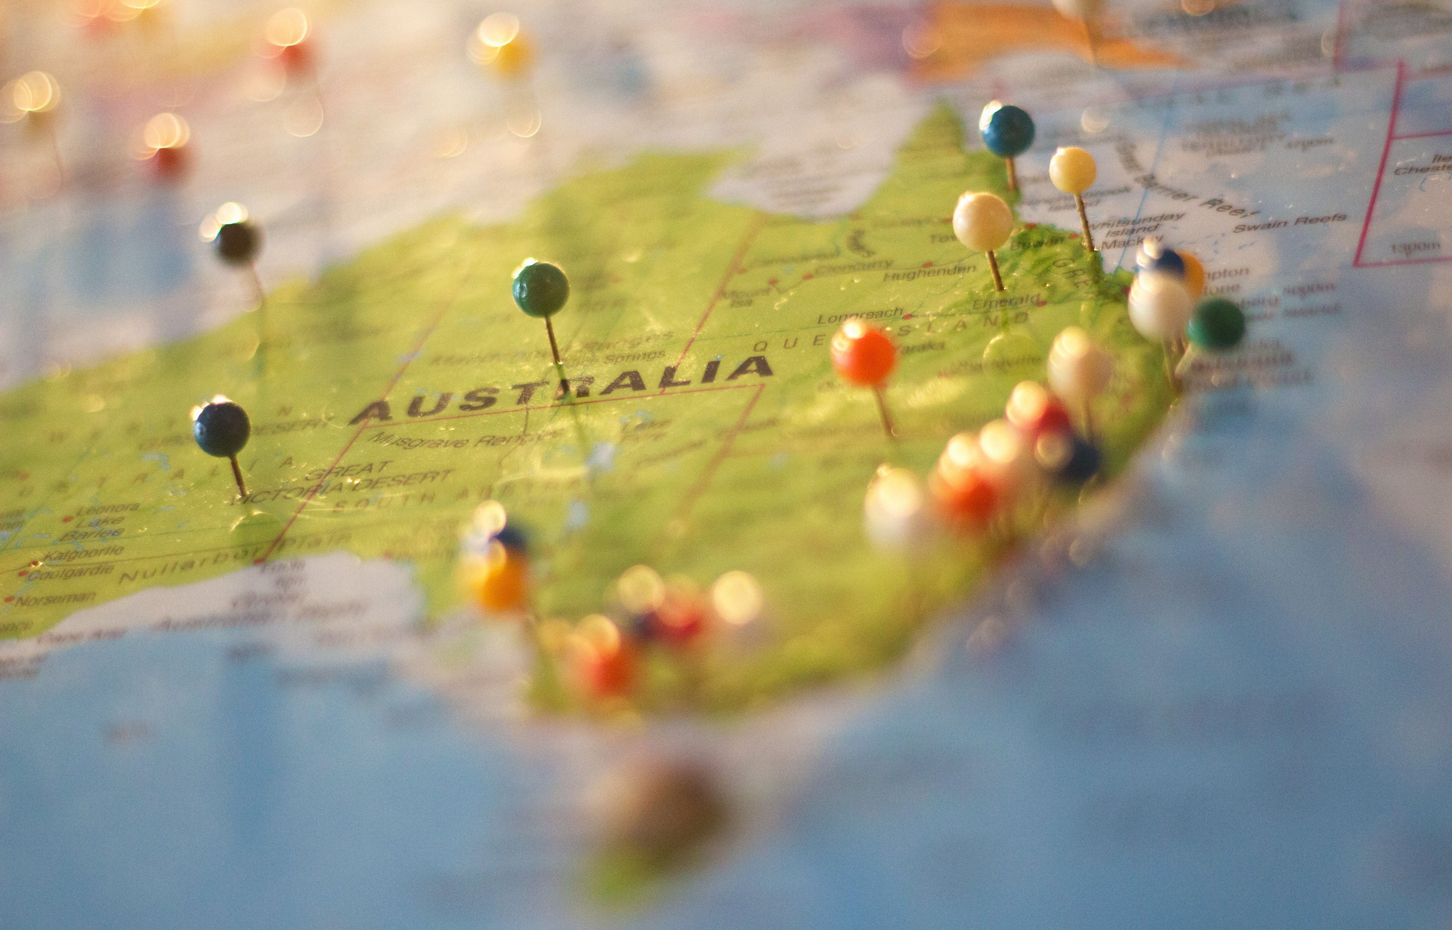
Australia As A Nation
Stage Three, Year 6
Powerpoint: Alice Vigors
Unit of Work: Alice Vigors, Maree Sawyer, Karly Castellas and Tanya Hannan

Slide 2
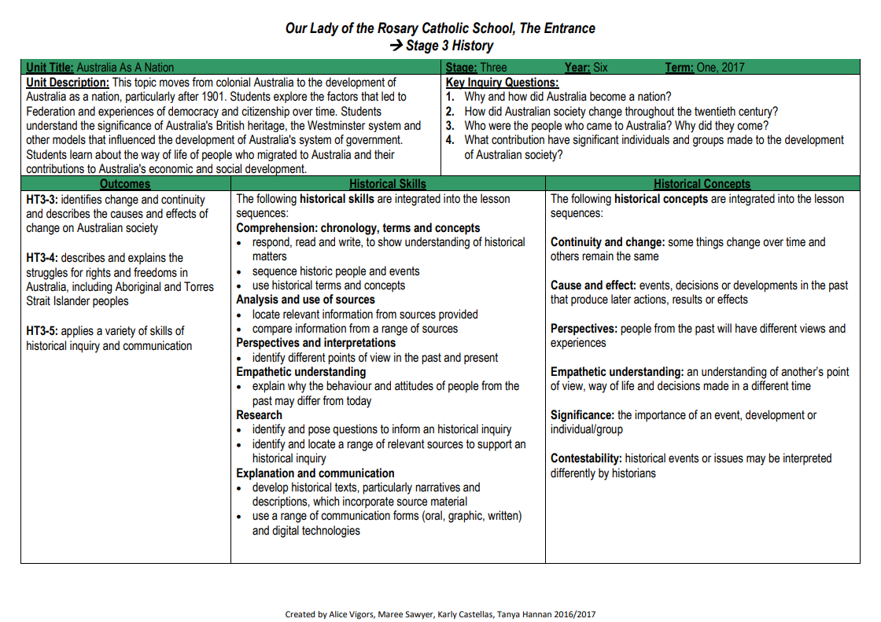
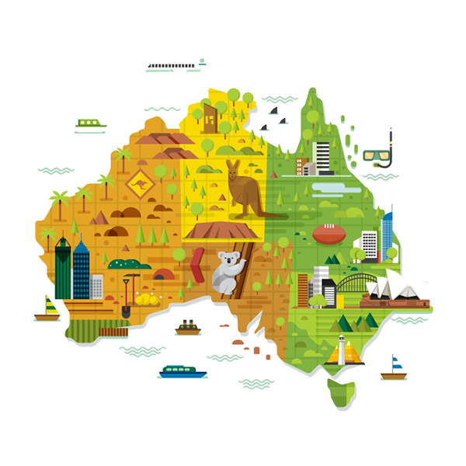
Unit Overview
This unit moves from colonial Australia to the development of Australia as a nation, particularly after 1901. Students explore the factors that led to Federation and experiences of democracy and citizenship over time. Students understand the significance of Australia's British heritage, the Westminster system and other models that influenced the development of Australia's system of government. Students learn about the way of life of people who migrated to Australia and their contributions to Australia's economic and social development.
HISTORY OUTCOMES
HT3-3: identifies change and continuity and describes the causes and effects of change on Australian society
HT3-4: describes and explains the struggles for rights and freedoms in Australia, including Aboriginal and Torres Strait Islander peoples
HT3-5: applies a variety of skills of historical inquiry and communication
Alice Vigors 2018

Slide 3
Historical Concepts & Skills
Historical Concepts
The following historical concepts are integrated into the lesson sequences:
Continuity and change: some things change over time and others remain the same
Cause and effect: events, decisions or developments in the past that produce later actions, results or effects
Perspectives: people from the past will have different views and experiences
Empathetic understanding: an understanding of another’s point of view, way of life and decisions made in a different time
Significance: the importance of an event, development or individual/group
Contestability: historical events or issues may be interpreted differently by historians
Historical Skills
The following historical skills are integrated into the lesson sequences:
Comprehension: chronology, terms and concepts
respond, read and write, to show understanding of historical matters
sequence historic people and events
use historical terms and concepts
Analysis and use of sources
locate relevant information from sources provided
compare information from a range of sources
Perspectives and interpretations
identify different points of view in the past and present
Empathetic understanding
explain why the behaviour and attitudes of people from the past may differ from today
Research
identify and pose questions to inform an historical inquiry
identify and locate a range of relevant sources to support an historical inquiry
Explanation and communication
develop historical texts, particularly narratives and descriptions, which incorporate source material
use a range of communication forms (oral, graphic, written) and digital technologies
Alice Vigors 2018

Slide 4
Essential Inquiry Questions
Why and how did Australia become a nation?
How did Australian society change throughout the twentieth century?
Who were the people who came to Australia? Why did they come?
What contribution have significant individuals and groups made to the development of Australian society?
Alice Vigors 2018

Slide 5
Unit Content
Australia’s Federation & system of law and government
identify the influences of Britain and the USA on Australian democracy
examine Australian human rights, past and present, affecting Aboriginal and/or Torres Strait Islander peoples, migrants, women and children
Migration & Contributions to Australian society
use sources such as oral history to research stories of migration to Australia, including the experiences of ONE Asian family, explaining reasons for migration
Australian democracy & citizenship
sequence key figures and events and explain their significance in the development of Australian democracy, eg Sir Henry Parkes, Edmund Barton, Louisa Lawson, Vida Goldstein
outline local, state and federal government structures and responsibilities
explain how Australian society has changed throughout the twentieth century for these groups
investigate the significance of ONE of the following in the struggle for the rights and freedoms of Aboriginal and Torres Strait Islander peoples
Stolen generation
Right to vote federally 1962
1967 referendum
Mabo decision
explain how migrants have contributed to Australian society
using a range of sources, research and describe the contribution of Aboriginal and Torres Strait Islander peoples and other groups to Australian society
Alice Vigors 2018

Slide 6
Unit Navigation
Think Puzzle Explore
PEO: Federation clip
+1 routine
What are rights?
Push and pull factors
Think Puzzle Explore
BTN: Federation clip
What do we know about…
Federation leaflet
Assessment: Key figures of Federation
What is democracy?
Australian Parliament
Different Levels of Government
Assessment: Who represents me and how?
Chalk Talk
Magna Carta
The right to vote
Assessment: Struggles for Rights and Freedoms
Why might people migrate
BTN: migrants & refugees
Who came to our country?
Migrant stories
Assessment: understanding migration
Significant Contributions
Assessment: Significant contributions
Australian Federation & Systems of Law & Government
Migration & Contributions to Society
Tuning In
Australian Democracy & Citizenship
Alice Vigors 2018

Slide 7
Tuning In to the Inquiry
Powerpoint: Alice Vigors
Unit of Work: Alice Vigors, Maree Sawyer, Karly Castellas and Tanya Hannan
Notes:
FOR THE TEACHER:
▪ How can we assess students’ prior knowledge and experience in relation to this context?
▪ How will we record this information for later assessment?
▪ What can we do to PROVOKE interest/enthusiasm/curiosity/motivation?
▪ How can we assist students to make “conceptual connections” and see relationships to and links with their own lives?
Teaching and Learning Sequence:
Examine a range of images depicting Australia’s vastly different environments
□ Use the thinking routine See Think Wonder to explore and discuss Australia’s natural environments o What do you see, observe or notice about each of these environments?
o What does it make you think about Australia’s natural environments?
o What does it make you think about how we influence the environment and the environment influences us?
o What do you wonder?
□ Watch Land Beyond Time – Australia (stop at 9:30) https://youtu.be/b9_Ie60pxe0
□ Explore student thinking and wonderings. Categorise wonderings into the three key content areas.
□ Pairs or small groups choose a wondering and discuss ways they might be able to explore this question.
EXTRA:
□ Australia the beautiful episode 1: desert & wetlands https://www.youtube.com/watch?v=EPKSDwXxWAY

Slide 8
Think Puzzle Explore- Thinking Routine
Think What do you think you know about Australia’s system of law and government? | Puzzle What questions or puzzles do you have? | Explore Examine the puzzles. Choose one or two. How might we explore these puzzles? How might we go about answering them?
Adapted from Ron Ritchhart
Alice Vigors 2018

Slide 9
Shared Inquiry Teaching & Learning Sequence
Powerpoint: Alice Vigors
Unit of Work: Alice Vigors, Maree Sawyer, Karly Castellas and Tanya Hannan

Slide 10
Australian Federation & Systems of Law and Government
Why and how did Australia become a nation?
Alice Vigors 2018

Slide 11
PEO: Federation Snapshot
Alice Vigors 2018
Notes:
https://www.peo.gov.au/multimedia/videos/snapshots-federation/snapshots-federation-popup.html

Slide 12
BTN: Federation
Alice Vigors 2018
Notes:
http://www.abc.net.au/btn/story/s3962777.htm

Slide 13
+1 - Thinking Routine
Recall After viewing the video clip, take 3 minutes to record as many key points and important details that you can remember.
 | Pass Right & Add 1 Add ONE new idea, elaboration or connection. →Elaboration: add a new detail to an existing item on the list. →New Idea: something missing from the list. →Connection: relationship between ideas.
 | Repeat Pass the page again and repeat at least 2 times.
 | Review Examine your original page, read through and review the additions. Add any new ideas you gained from reading the work of others.
 | Reflect →What did you find as you read the ideas of others? →How did it help you build on the thinking of others? →How did it help to build your understanding of what you just viewed?
Adapted from Ron Ritchhart
Alice Vigors 2018

Slide 14
What do we know about…
Why did Australia want to unite as one people?
Before, federation how many states did Australia have?
Who was Henry Parkes?
Why were initial attempts to become a Federation rejected?
What role did Alfred Deakin play in Australia becoming a Federation?
How did Federation impact on Indigenous people and migrants?
Why did the Queen have to sign off on Australia’s constitution?
What was the purpose of the constitution?
In what year, did Australia become a nation?
Who was Australia’s first prime minister?
Alice Vigors 2018

Slide 15
Federation Leaflet
Alice Vigors 2018
Does the author support or oppose Federation? How do you know?
What point of view does the author express about the impact of Federation on NSW? What reasons
does he give?

Slide 16
Key Figures of Federation
ASSESSMENT
Alice Vigors 2018
Notes:
https://olrlearning.weebly.com/

Slide 17
What is democracy?
Alice Vigors 2018

Slide 18
BTN: What is Democracy?
Alice Vigors 2018
Notes:
http://www.abc.net.au/btn/story/s4460249.htm

Slide 19
+1 - Thinking Routine
Recall After viewing the video clip, take 3 minutes to record as many key points and important details that you can remember.
 | Pass Right & Add 1 Add ONE new idea, elaboration or connection. →Elaboration: add a new detail to an existing item on the list. →New Idea: something missing from the list. →Connection: relationship between ideas.
 | Repeat Pass the page again and repeat at least 2 times.
 | Review Examine your original page, read through and review the additions. Add any new ideas you gained from reading the work of others.
 | Reflect →What did you find as you read the ideas of others? →How did it help you build on the thinking of others? →How did it help to build your understanding of what you just viewed?
Adapted from Ron Ritchhart
Alice Vigors 2018

Slide 20
Australian Parliament vs. US Government
Similarities | Differences
Alice Vigors 2018

Slide 21
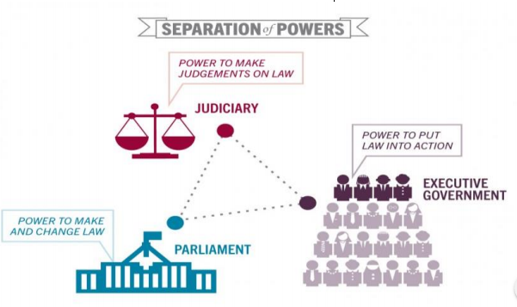
What is the constitution?
Alice Vigors 2018

Slide 22
PEO: What is Parliament?
Alice Vigors 2018
Notes:
https://www.peo.gov.au/multimedia/videos/about-parliament-what-is-parliament/about-parliament-what-is-parliament-popup.html

Slide 23
PEO: What is Parliament?
Alice Vigors 2018

Slide 24
House of Representatives
Alice Vigors 2018
Notes:
https://www.peo.gov.au/multimedia/videos/about-parliament-the-house-of-representatives.html

Slide 25
Senate
Alice Vigors 2018
Notes:
https://www.peo.gov.au/multimedia/videos/about-parliament-the-senate.html

Slide 26
Virtual Tour of Parliament House
Alice Vigors 2018
Notes:
http://virtualtour.aph.gov.au/#?

Slide 27
What are the different levels of government responsible for?
Alice Vigors 2018
Notes:
https://www.peo.gov.au/multimedia/videos/snapshots-three-levels-of-government/snapshots-three-levels-of-government-popup.html

Slide 28
What are the different levels of government responsible for?
Why is it important to have different levels of government?
Describe a situation in which more than one level of government would have a role to play?
Alice Vigors 2018

Slide 29
What are the different levels of government responsible for?
Alice Vigors 2018
Notes:
http://www.abc.net.au/btn/story/s4469199.htm

Slide 30
Who represents me and how?
ASSESSMENT
Alice Vigors 2018
Notes:
https://olrlearning.weebly.com/

Slide 31
Australian Democracy & Citizenship
How did Australian society change throughout the twentieth century?
Alice Vigors 2018

Slide 32
What are rights?
Alice Vigors 2018

Slide 33
What are the responsibilities that come with rights?
Alice Vigors 2018
Notes:
https://www.humanrights.gov.au/introhumanrights/?__utma=1.334227547.1484018852.1484018852.1484018852.1&__utmb=1.1.10.1484018852&__utmc=1&__utmx=-&__utmz=1.1484018852.1.1.utmcsr=google%7Cutmccn=(organic)%7Cutmcmd=organic%7Cutmctr=(not%20provided)&__utmv=-&__utmk=22577083dia/videos/snapshots-three-levels-of-government/snapshots-three-levels-of-government-popup.html

Slide 34
Chalk Talk
What are human rights?
Why do you think human rights might be important?
Who do you think has human rights?
Shelly Beach
Alice Vigors 2018
Notes:
Use the thinking routine Chalk Talk (non-silent) to have students unpack a variety of different environments in pairs, using words and/or illustrations. For example: deserts, coastal, rainforests, grasslands, mountains. Pairs need to examine:
o What are the characteristics or main qualities of these environments?
o What factors might change and/or influence these environments?
o Are there any connections you can make?
The teacher should model what this process looks like prior to asking students to unpack a variety of different environments. Use an image of an environment you know students will be familiar with. The above image is of Shelly Beach on the Central Coast. An environment that my students are very familiar with.

Slide 35
Magna Carta – The Story of our Freedom
Alice Vigors 2018
Notes:
https://www.humanrights.gov.au/magnacarta/video/

Slide 36
The Right to Vote
Alice Vigors 2018
Notes:
http://www.abc.net.au/btn/story/s4464749.htm

Slide 37
The Right to Vote
Use your knowledge of the history of voting in Australia to match significant voting events against each point in time. Cut around each box and paste them in a timeline format.
Indigenous Australians right to vote
All indigenous Australians are given the right to vote.
1895
1856
Voting Age
The minimum voting age was lowered from 21 years to 18.
Compulsory Voting
Compulsory voting was introduced and this resulted in a dramatic increase in voter turnout at the following election.
Secret Ballot
The secret ballot is first introduced in Australia.
First Federal Election
The nation of Australia was born, with a federal parliament to govern it.
1924
1901
Women’s Suffrage
The first women in Australia are given the right to vote. South Australian Parliament agreed and the remaining colonies gradually came to the same view.
1962
1973
Alice Vigors 2018
Notes:
http://www.abc.net.au/btn/story/s4464749.htm

Slide 38
Struggles For Rights and Freedoms
ASSESSMENT
Alice Vigors 2018
Notes:
https://olrlearning.weebly.com/

Slide 39
Migration & Contributions to Australian Society
Who were the people who came to Australia? Why did they come?
What contributions have significant individuals and groups made to the development of Australian society?
Alice Vigors 2018

Slide 40
Think Puzzle Explore- Thinking Routine
Think What do you think you know about migrants and refugees? | Puzzle What questions or puzzles do you have? | Explore Examine the puzzles. Choose one or two. How might we explore these puzzles? How might we go about answering them?
Adapted from Ron Ritchhart
Alice Vigors 2018

Slide 41
Why might people migrate to Australia?
Alice Vigors 2018
Notes:
www.abc.net.au/btn/story/s4526308.htm

Slide 42
BTN: Refugees and Migrants
Alice Vigors 2018
Notes:
www.abc.net.au/btn/story/s4526308.htm

Slide 43
Push and Pull Factors
Alice Vigors 2018
Notes:
http://education.abc.net.au/statistics-game/#/view/country-of-birth/big-picture

Slide 44
Who came to our country?
Alice Vigors 2018
Notes:
https://youtu.be/BVPJ842-fEk

Slide 45
Migration Stories
Cuc Lam’s Suitcase
The William’s Family
The Italian Experience
T
The Nguyen Family
Johnson Maker
Where did they migrate from?
Why did they migrate?
How might they have felt?
Why might the challenges have been?
Alice Vigors 2018
Notes:
https://youtu.be/BVPJ842-fEk

Slide 46
Understanding Migration
ASSESSMENT
Alice Vigors 2018
Notes:
https://olrlearning.weebly.com/

Slide 47
Contributions to Australian Society
Research one of these people/group to find out about their significant contribution to Australian society
Migrants and the Snowy Mountains Scheme http://www.abc.net.au/btn/story/s4560038.htm | Chinese Migration: Captain John Egge http://www.abc.net.au/btn/story/s4178063.htm | John Hemmes – Australian fashion & hospitality
Anh Do – Author, Comedian | Dr Karl Kruszelnicki – scientist | Richard Pratt - Visy
Aliir Aliir – AFL football player | Julia Gillard – former Australian Prime Minister | Waleed Aly – Australian radio and television presenter
Richie Benaud – Cricket commentator | Fred Hollows – Eye Surgeon | Barry Humphries/ Dame Edna Everidge
Cyril Callister – Founder of Vegemite | Caroline Chisholm – humanitarian | Tony Abbott – former Australian Prime Minister
Vincent Lingiari – Aboriginal rights activist | Eddie Mabo – Indigenous land rights campaigner | Rupert Murdoch – media mogul
Frank Lowy – chairman of Westfield corporation | Sir Donald Bradman – Australia cricketer | Cathy Freeman – Olympic athlete & advocate
Sir Charles Kingsford Smith - aviator | Saint Mary MacKillop | Ian Kiernan – Clean Up Australia founder
Surf Life Saving Australia
How did these people contribute to Australian society?
Alice Vigors 2018

Slide 48
Contributions to Australian Society
ASSESSMENT
Alice Vigors 2018
Notes:
https://olrlearning.weebly.com/

Slide 49
Thankyou for using this powerpoint to support student learning. Share examples at thinkingpathways@gmail.com Visit the website: https://thinkingpathwayz.weebly.com/
Alice Vigors 2018

