Slide 1
Data
Alice Vigors
2017
Stage 3, Year 6

Slide 2
Teaching and Learning Sessions
Can we interpret secondary data?
Can we interpret and critically evaluate secondary data?
describes and represents mathematical situations in a variety of ways using mathematical terminology and some conventions MA3-1WM
gives a valid reason for supporting one possible solution over another MA3-3WM
uses appropriate methods to collect data and constructs, interprets and evaluates data displays, including dot plots, line graphs and two-way tables MA3-18SP
Alice Vigors 2017
Notes:
Interpret secondary data presented in digital media and elsewhere
interpret data representations found in digital media and in factual texts
interpret tables and graphs from the media and online sources, eg data about different sports teams (Reasoning)
identify and describe conclusions that can be drawn from a particular representation of data (Communicating, Reasoning)
critically evaluate data representations found in digital media and related claims
discuss the messages that those who created a particular data representation might have wanted to convey (Communicating)
identify sources of possible bias in representations of data in the media by discussing various influences on data collection and representation, eg who created or paid for the data collection, whether the representation is part of an advertisement (Communicating, Reasoning)
identify misleading representations of data in the media, eg broken axes, graphics that are not drawn to scale (Reasoning)

Slide 3
Session One
Can we interpret secondary data?
Alice Vigors 2017

Slide 4
Can we interpret secondary data?
Data was collected from 200 people from ages 10-99 and this article claims that: Over sixties eat more junk food than teens!
Alice Vigors 2017
Notes:
→Data was collected from 200 people from ages 10-99 and this article claims that: Over sixties eat more junk food than teens!
(sourced from http://www.scootle.edu.au/ec/viewing/L2625/index.html )
→What kind of data might they have collected?
→How might they have collected the data?

Slide 5
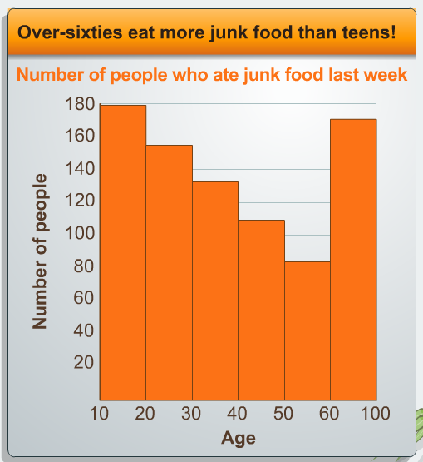
Can we interpret secondary data?
Claim: Over sixties eat more junk food than teens!
Support:
Examine the data collected and analyse how it has been represented.
Does the data support this claim?
Does the data mislead the viewer? If so, in what ways?
What might be a more accurate headline for this article?
Question:
What questions arose for you as you interpreted the data?
Alice Vigors 2017
Notes:
→Examine the data collected and analyse how it has been represented. Does the data support this claim? Does the data mislead the viewer? If so, in what ways? What might be a more accurate headline for this article? What questions arose for you as you interpreted the data?
NB: This structure employs the scaffold of the thinking routine Claim Support Question

Slide 6
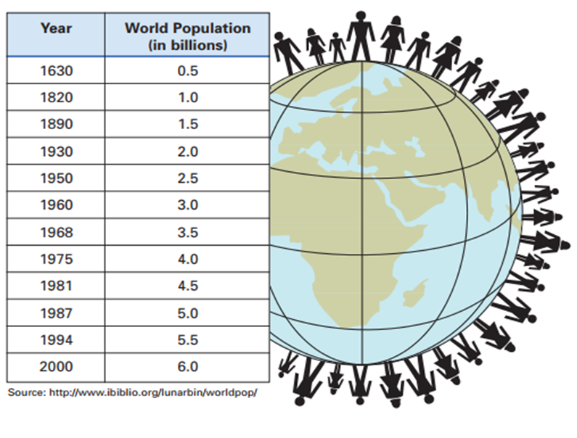
Can we interpret secondary data?
Examine the world population data from 1630 to 2000.
Draw a graph to represent the data from the table.
Based on this data what would you expect the world population to be in the current year?
How does the actual population for the current year compare to your answer?
What do you think the world population was in 1985? Explain your thinking.
Which estimate of the world population do you think will be more accurate: your estimate for 1985 or an estimate for 2025? Gives reasons with evidence.
Alice Vigors 2017
Notes:
→Examine world population data from 1630 to 2000.
Draw a graph to represent the data from the table.
Based on this data what would you expect the world population to be in the current year?
How does the actual population for the current year compare to your answer?
What do you think the world population was in 1985? Explain your thinking.
Which estimate of the world population do you think will be more accurate: your estimate for 1985 or an estimate for 2025? Gives reasons with evidence.

Slide 7
Session Two
Can we interpret and critically evaluate secondary data?
Alice Vigors 2017

Slide 8
Can we interpret and critically evaluate secondary data?
Data was gathered about the real cost of petrol from 1980 to 2005 and this article claims that: Petrol cheaper than ever!
Alice Vigors 2017
Notes:
→Data was gathered about the real cost of petrol from 1980 to 2005 and this article claims: Petrol cheaper than ever!
(sourced from http://www.scootle.edu.au/ec/viewing/L2627/index.html )
→What kind of data might they have collected?
→How might they have collected the data?

Slide 9
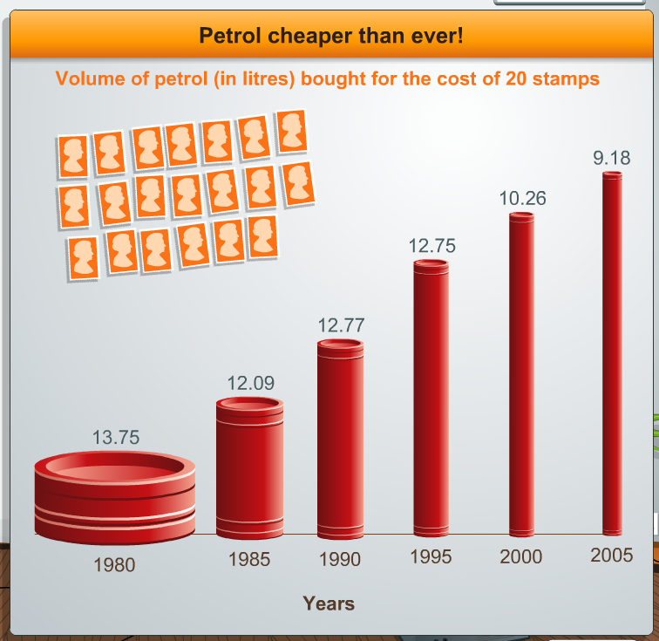
Can we interpret and critically evaluate secondary data?
Claim: Petrol cheaper than ever!
Support:
Examine the data collected and analyse how it has been represented.
Does the data support this claim?
Does the data mislead the viewer? If so, in what ways?
What might be a more accurate headline for this article?
Question:
What questions arose for you as you interpreted the data?
Alice Vigors 2017
Notes:
→Examine the data collected and analyse how it has been represented. Does the data support this claim? Does the data mislead the viewer? If so, in what ways? What might be a more accurate headline for this article? What questions arose for you as you interpreted the data?
NB: This structure employs the scaffold of the thinking routine Claim Support Question

Slide 10
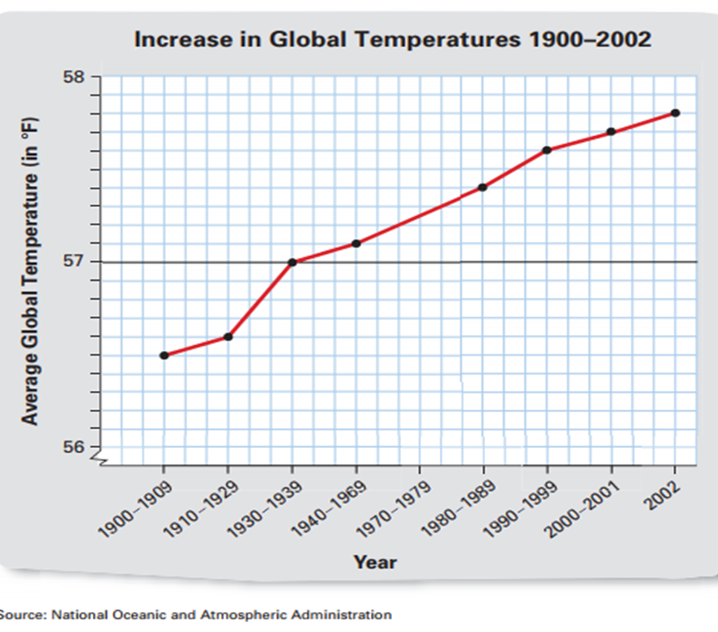
Can we interpret and critically evaluate secondary data?
The following data represents the average global temperature from 1900 to 2002.
Does the graph give you a good representation of the change in temperature? Explain your thinking.
How do the scales of the graph affect your impression?
What kind of message do the creators what to portray? Is it an accurate message? Explain your thinking.
Use the thinking routine Claim Support Question to examine the claim: The Earth is warmer than ever before!
Why is it important for a graph to be an accurate representation of data?
How could data mislead the intended audience?
Alice Vigors 2017
Notes:
→Examine data representing the average global temperature from 1900 to 2002.
Does the graph give you a good representation of the change in temperature? Explain your thinking.
How do the scales of the graph affect your impression?
Use the thinking routine Claim Support Question to examine the claim: The Earth is warmer than ever before!
Why is it important for a graph to be an accurate representation of data?
How could data mislead the intended audience?
Claim Support Question routine – information found at https://sites.google.com/dbb.catholic.edu.au/thinkingpathways/routines-for-digging-deeper-into-ideas/claim-support-question?authuser=0

