Slide 1



Earth and Space
Alice Vigors 2018
Year 5
Science & Technology

Slide 2



Unit Navigation
Unit Overview
Essential Question 2:
How do sudden geographical changes & extreme weather events affect the Earth’s surface?
Tuning In
Essential Question 1:
How does the Earth compare to other planets in the solar system?
Alice Vigors 2018

Slide 3
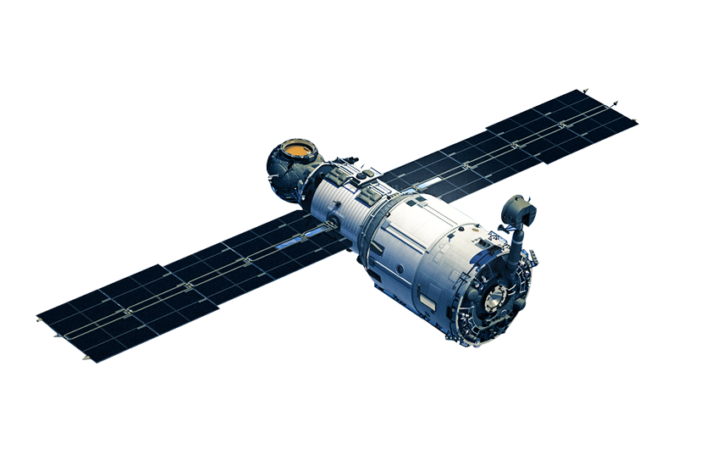
1
Unit Overview…
In this unit students will focus on Earth’s place in the solar system, changes on its surface caused by natural disasters and the exploration of how these may be mitigated. This unit aims to further develop students’ understanding of the Earth, its position in the solar system and as a dynamic part of a complex, interrelated system.
Unit Outcomes
ST3-1WS-S:
Plans and conducts scientific investigations to answer testable questions, and collects and summarises data to communicate conclusions.
GE3-2:
Explains regular events in the solar system and geological events on the Earth’s surface.
Alice Vigors 2018

Slide 4
Content Focus
Earth’s place in our solar system
Changes to the Earth’s surface
Identify that Earth is part of a system of planets orbiting around a star (the Sun)
Investigate the role of light energy in how we observe the Sun, Moon and planets
Compare the key features of the planets of our solar system, for example:
  Time it takes for the planets to revolve around the Sun
  Size of the planets
  Distance of the planets from the Sun
Research and communicate how Aboriginal and/or Torres Strait Islander Peoples use observations of the night sky to inform decisions about resources and significant cultural events, for example:
  Gathering food
  Ceremonies
  Song lines
  Navigation
Examine and discuss current developments in astronomy, space and planetary science, particularly related to making observations and gathering data
Investigate the effects of sudden geological changes and extreme weather events on the Earth’s surface, for example:
  Earthquakes, volcanic eruptions, tsunamis
  Cyclones, storms, drought and floods
Investigate ways that advances in science and technology have assisted people to plan for and manage natural disasters to minimise their effect, for example:
  Design and construction of buildings and roads
  Detection systems for tsunamis
  Digital flood and fire warning systems
Alice Vigors 2018

Slide 5
Skills Focus
Working Scientifically
Design and Production
Processing and Analysing Data
Construct and use a range of representations, including tables and graphs, to represent and describe observations, patterns or relationships in data
Employ appropriate technologies to represent data
Compare data with predictions
Present data as evidence in developing explanations
Communication
Communicate ideas, explanations and processes, using scientific representations including multimodal forms
Researching and Planning
research, identify and define design ideas and processes for an audience
consider functional and aesthetic needs in planning a design solution
develop, record and communicate design ideas, decisions and processes using appropriate technical terms
produce labelled and annotated drawings including digital graphic representations for an audience
consider sustainability of resources when researching and planning design solutions
manage projects within time constraints
Alice Vigors 2018

Slide 6
Curriculum Links
Mathematics
English
Time I (MA3-13MG)
Tell time to the minute and investigate relationship between units of time
Time II (MA3-13MG)
Convert between units of time
Fractions & Decimals (MA3-7NA)
Model and represent unit fractions
Length (MA3-9MG)
Measure, order and compare objects using familiar metric units of length
Speaking & Listening (EN3-1A)
Respond to and compose texts
Writing & Representing/ Responding & Composing (EN3-2A/ EN3-5B)
Respond to and compose texts
Reflecting on Learning (EN3-9E)
Respond to and compose texts
Creative Arts
Visual Arts (VAS3.1, VAS3.2)
Investigate subject matter
Make artworks for different audiences
Drama (DRAS3.1, DRAS3.2, DRAS3.3)
Develop a range of roles
Interpret and convey dramatic meaning
Perform to an audience
Geography
Factors That Shape Places (GE3-1, GE3-2, GE3-3, GE3-4)
Investigate the impact of a contemporary bushfire hazard
Alice Vigors 2018

Slide 7
2
How can we assess students’ prior knowledge and experience in relation to this context?
How will we record this information for later assessment?
What can we do to PROVOKE interest/enthusiasm/curiosity/motivation?
How can we assist students to make “conceptual connections” and see relationships to and links with their own lives?
Tuning In
Alice Vigors 2018

Slide 8

Tuning In to Inquiry
Use the buttons below to navigate the resources for the tuning in phase of inquiry
Space School clip
Space Through Images
NASA: solar system overview
Think Puzzle Explore
Alice Vigors 2018

Slide 9
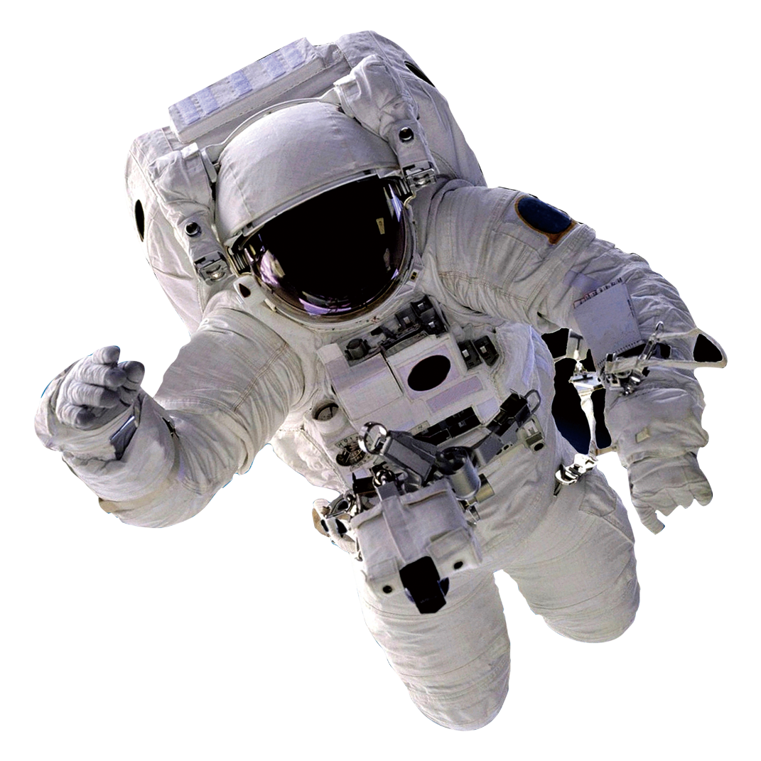

Space School
The Solar System
Alice Vigors 2018
Notes:
Watch Space School: Solar System https://www.youtube.com/watch?v=mtKNH2Y2OJM

Slide 10
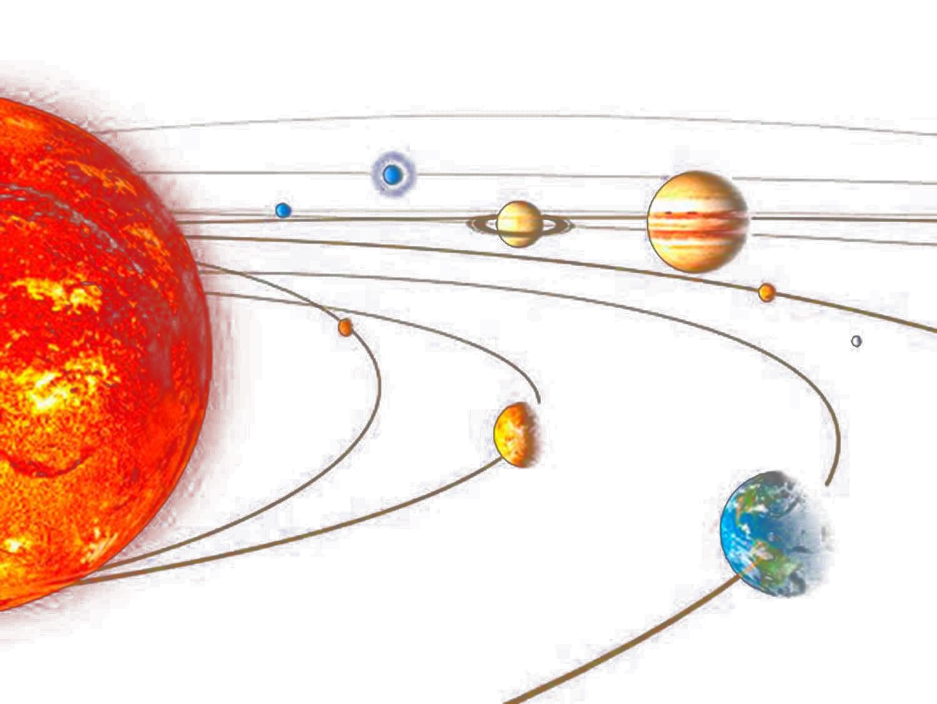

NASA
Overview of the solar system
A solar system is a star and all of the objects that travel around it—planets, moons, asteroids, comets and meteoroids. Most stars host their own planets, so there are likely tens of billions of other solar systems in the Milky Way galaxy alone. Solar systems can also have more than one star. These are called binary star systems - if there are two stars, or multi-star systems - if there are three or more stars.
The solar system we call home is located in an outer spiral arm of the vast Milky Way galaxy. It consists of the Sun (our star) and everything that orbits around it. This includes the eight planets and their natural satellites (such as our moon), dwarf planets and their satellites, as well as asteroids, comets and countless particles of smaller debris.
Alice Vigors 2018
Notes:
Read the brief overview of the solar system from NASA’s Science website https://solarsystem.nasa.gov/solar-system/our-solar-system/overview/

Slide 11
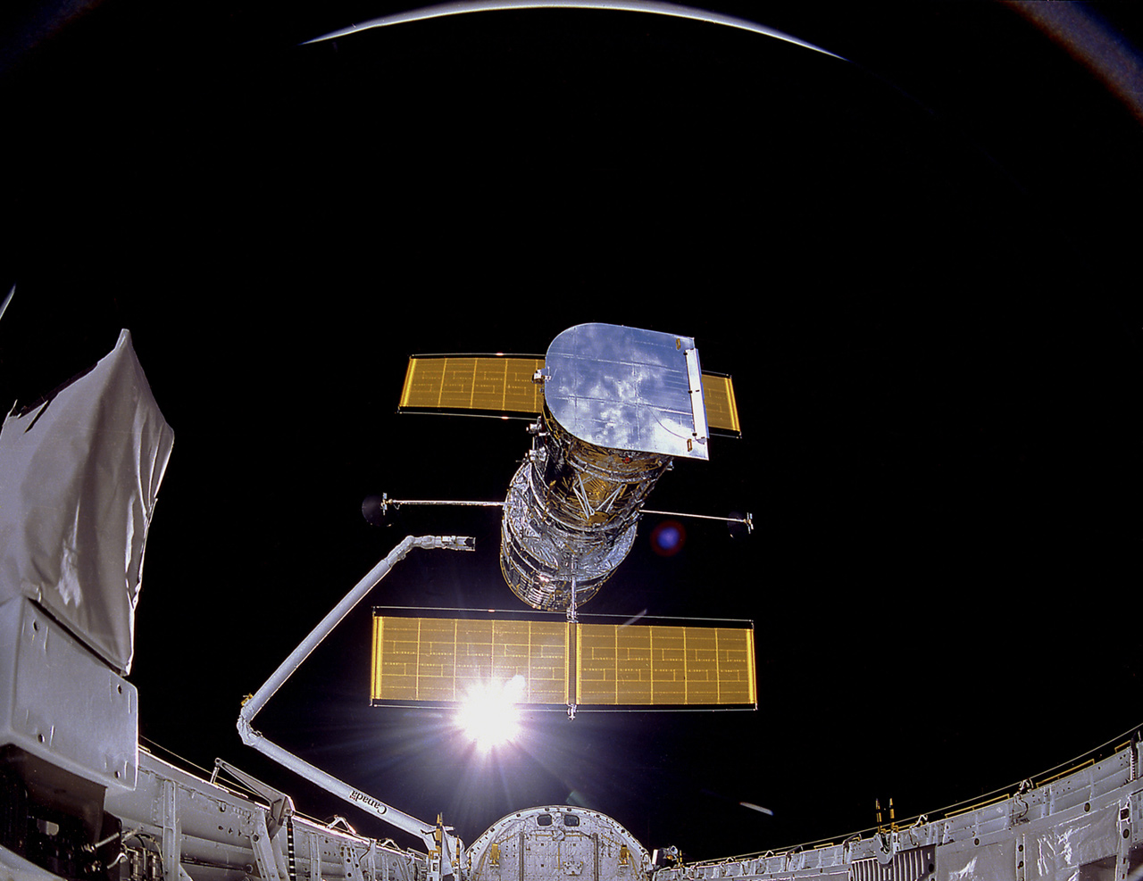
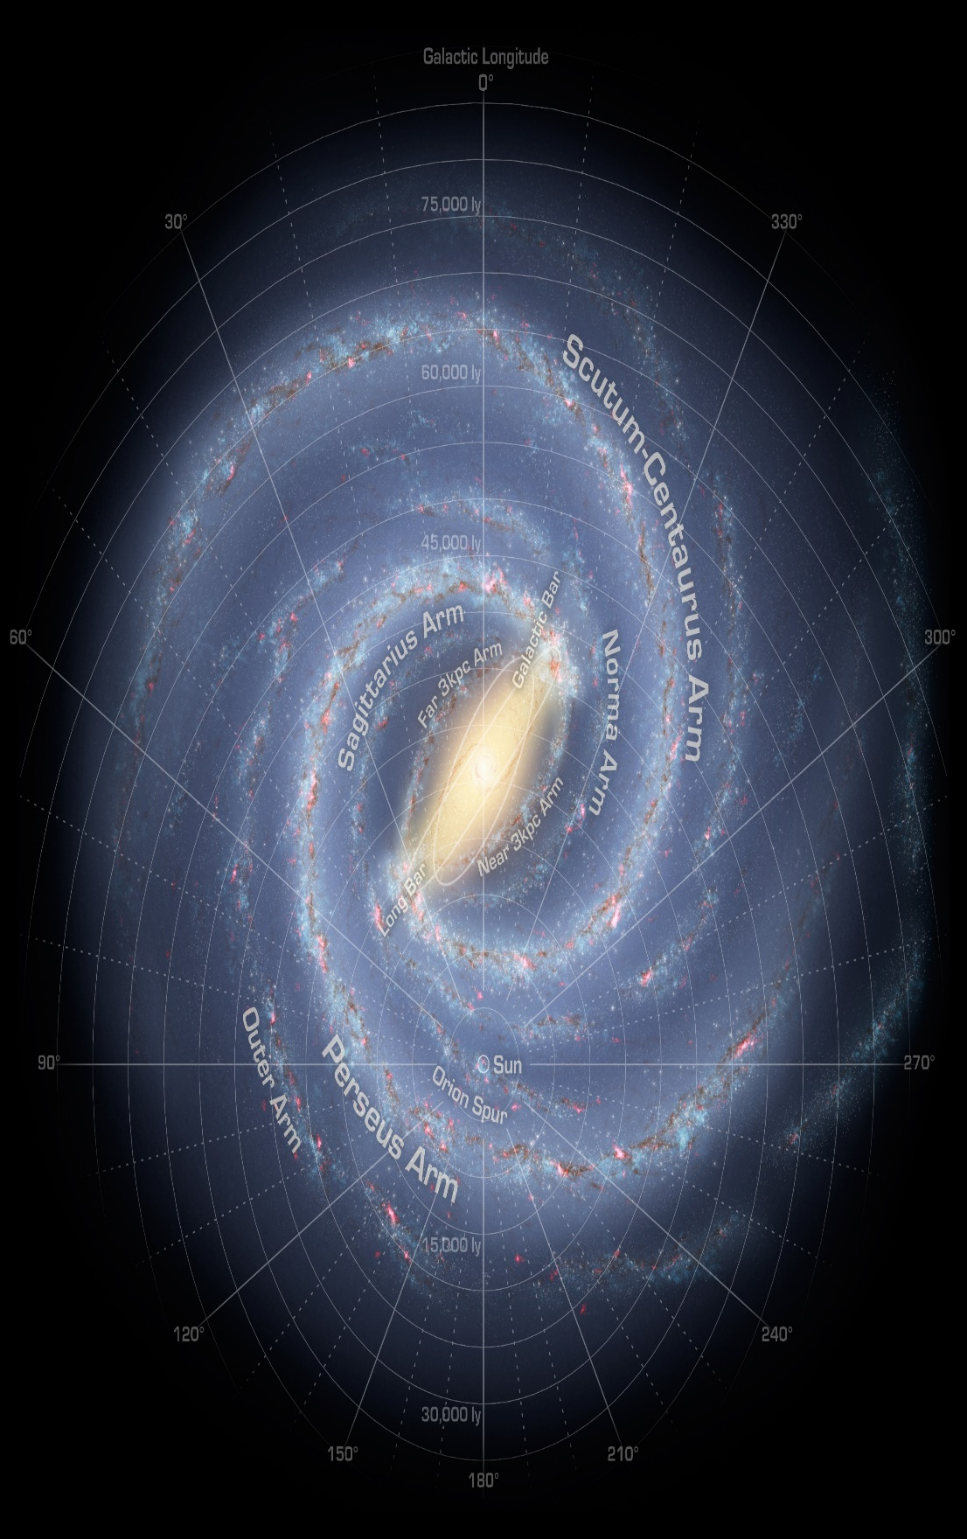
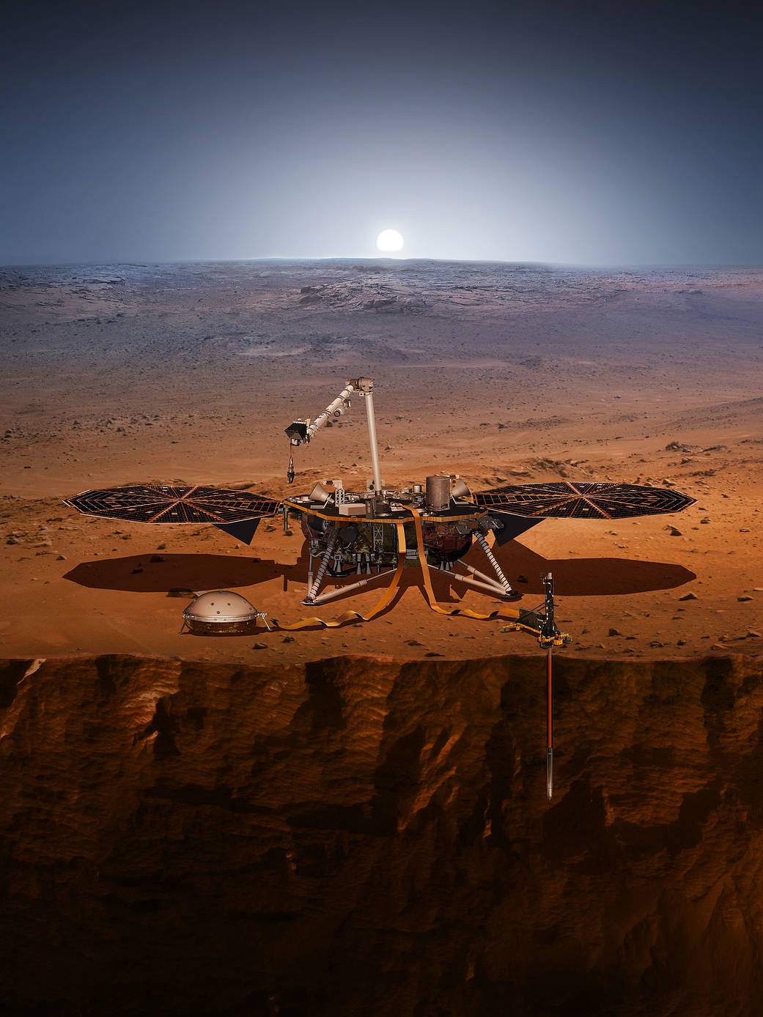
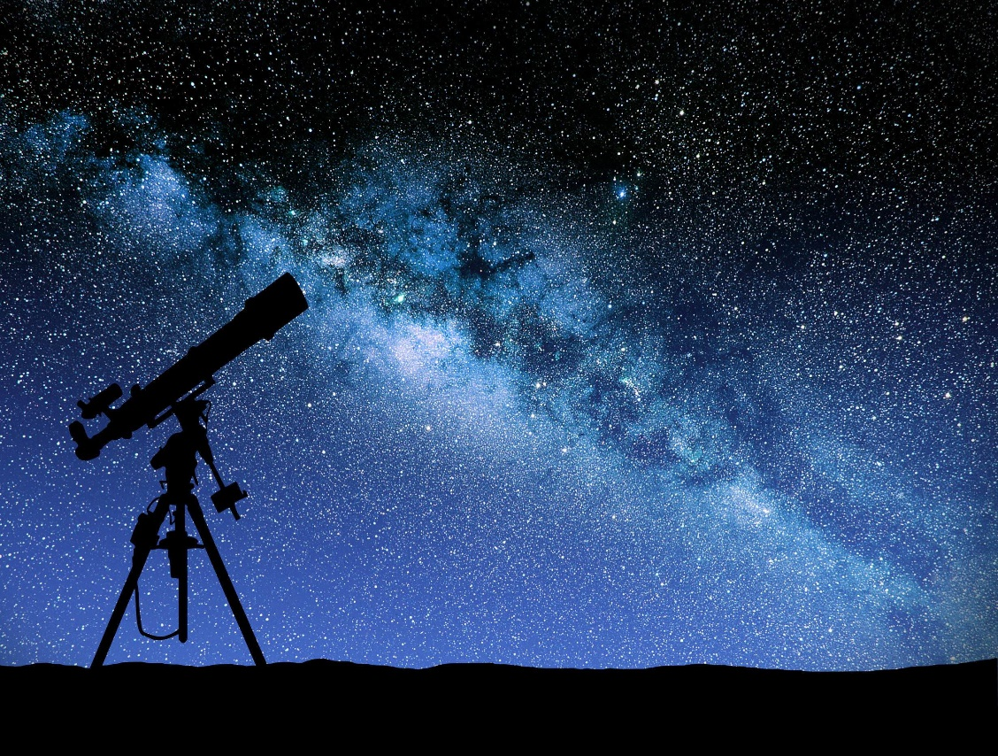
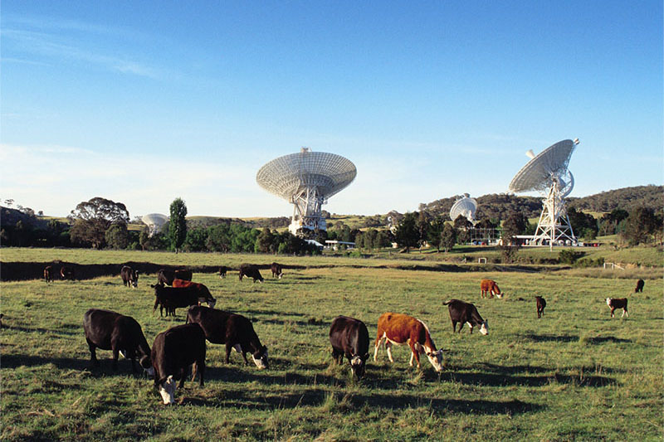

Space Through Images
Use the thinking routine See Think Wonder to unpack these provocations
Alice Vigors 2018
Images courtesy of
Notes:
Explore NASA’s Eyes interactives app to examine space exploration and data gathering (needs to be downloaded prior to learning) https://eyes.jpl.nasa.gov/eyes-on-the-solar-system.html
View a range of images relating to our solar system, astronomy and space exploration (See Think Wonder)

Slide 12
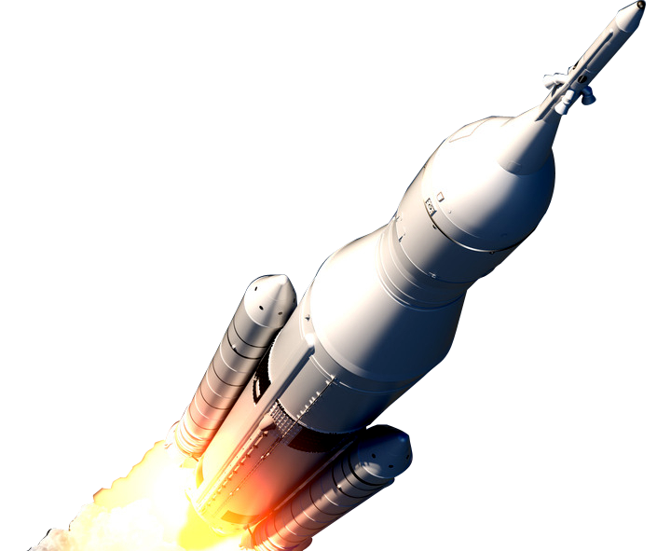
Think Puzzle Explore
Thinking Routine
What do you think you know about our solar system, astronomy and space exploration?
What questions or puzzles do you have about our solar system, astronomy and space exploration?
These question starts might help you formulate some questions:
→Why… →What are the reasons…
→What if… →What is the purpose of…
→What if we knew… →What would change if…
→How… →Suppose that…
→Where…
How might we explore the questions and puzzles we have?
Alice Vigors 2018
Notes:
Use the thinking routine Think Puzzle Explore to gauge student understandings, misconceptions and wonderings. (NB: introduce question starts to help students questioning)

Slide 13
3
How does the Earth compare to other planets in the solar system?
Essential Inquiry Question 1
Alice Vigors 2018

Slide 14
Chalk Talk
Use the thinking routine to engage with these questions
SUMMER/ WINTER
TEMPERATURE
Different planets have different temperatures, but does this temperature stay the same (e.g. on Earth)? Why do you think this is the case?
What do you notice about the sun in summer compared to winter?
DAY/ MONTH/ YEAR
DAY/ NIGHT
UNIQUE
What makes our planet unique?
What defines our days, months and years on Earth?
What is the difference between what we see in the sky during the day compared to at night?
Alice Vigors 2018
Notes:
Pose the question the following questions. Students could engage in a Chalk Talk thinking routine to record their thinking and also make connections to and elaborate on the thinking of others.
What defines our days, months and years on Earth?
What do you notice about the sun in summer compared to winter?
What is the difference between what we see in the sky during the day compared to at night? What makes you say that?
Different planets have different temperatures, but does this temperature stay the same (e.g. on Earth)? Why do you think this is the case?
What makes planet Earth unique?

Slide 15

Space School
Earth
Alice Vigors 2018
Notes:
Examine the animations Space School: Earth and Crash Course: Earth’s Rotation and Revolution

Slide 16
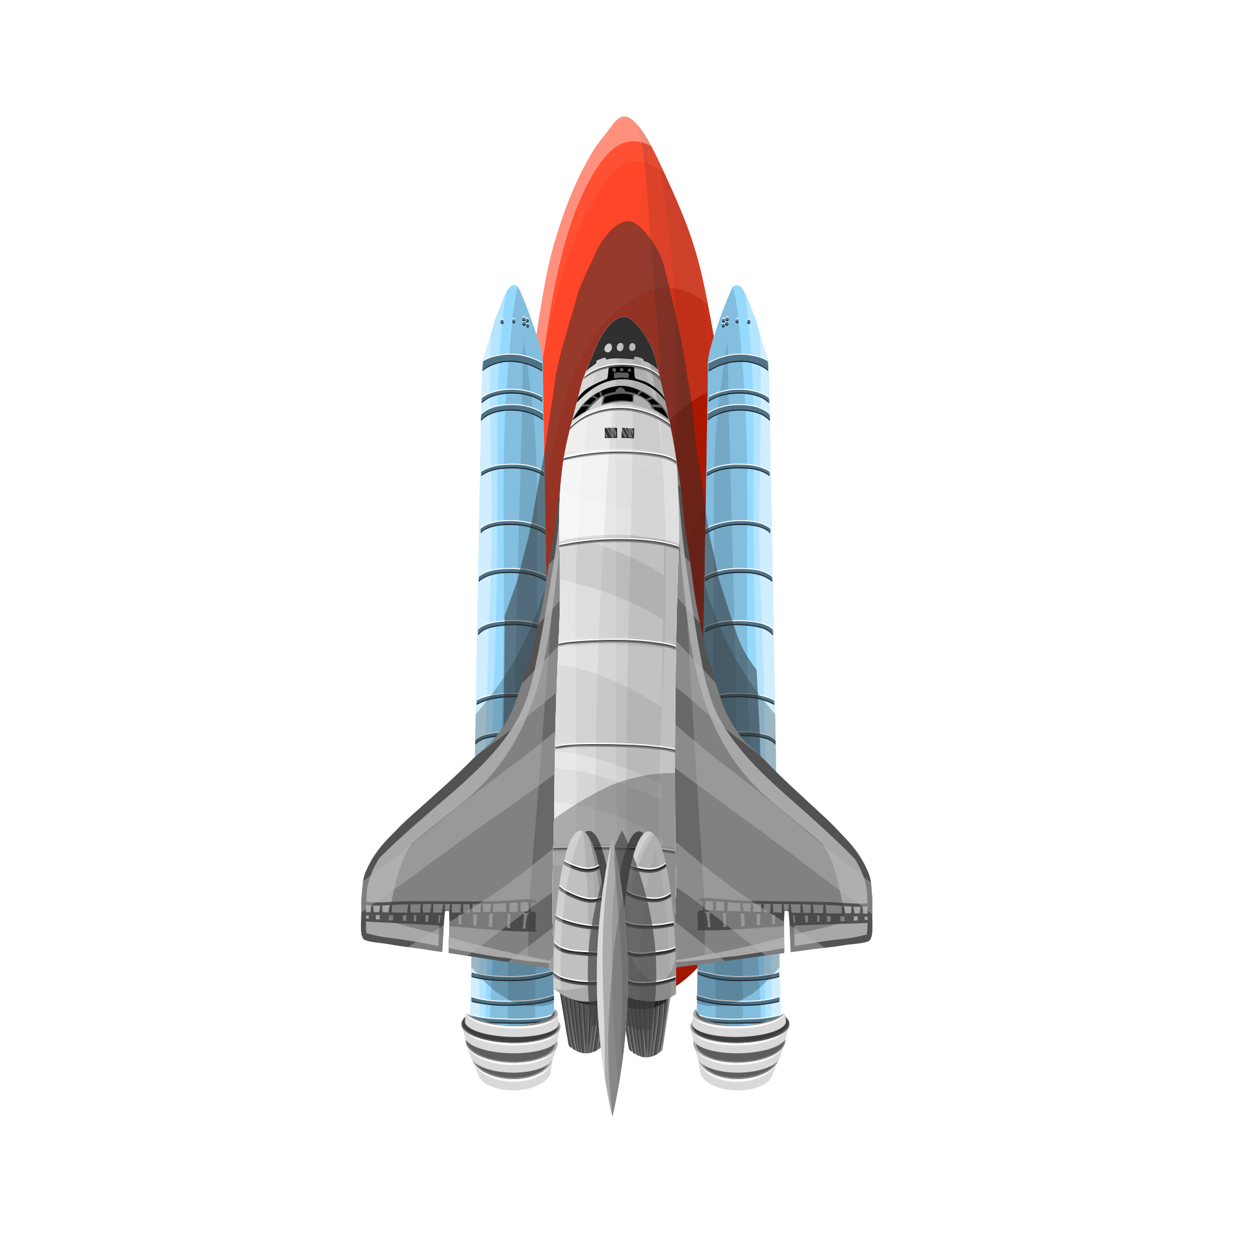
Crash Course
Earth’s rotation and revolution
Alice Vigors 2018
Notes:
Examine the animations Space School: Earth and Crash Course: Earth’s Rotation and Revolution

Slide 17
Scientific Terminology
Define these key scientific terms.
Revolution
Rotation
Orbit
A planet making one full trip around the sun.
A planet spinning on its axis.
The path a planet takes on its journey around the sun.
Alice Vigors 2018
Notes:
Define the key scientific terms: revolution, rotation and orbit
Revolution: a planet making one full trip around the sun
Rotation: a planet spinning on its axis
Orbit: the path a planet takes on its journey around the sun

Slide 18
Group Experience
Explain one of the following key ideas using a range of objects
DAY & NIGHT
How does the Earth’s rotation on its axis create day and night?
MOON
assessment
Key
Scientific
Ideas
How does light from the sun reflect off the moon, allowing us to see it in the sky?
SEASONS
How does the Earth’s tilt and orbit around the sun create the seasons?
Alice Vigors 2018
Notes:
Divide students into small groups. Have the groups use a range of objects and tools to explain one of the following key ideas:
How the Earth’s rotation on its axis creates day and night
How the Earth’s tilt and orbit around the sun creates the seasons
How light from the sun reflects off the moon, allowing us to see it in the sky
Groups present their explanations to the class – this could either be live-action or a recorded explanation. (Assessment)

Slide 19
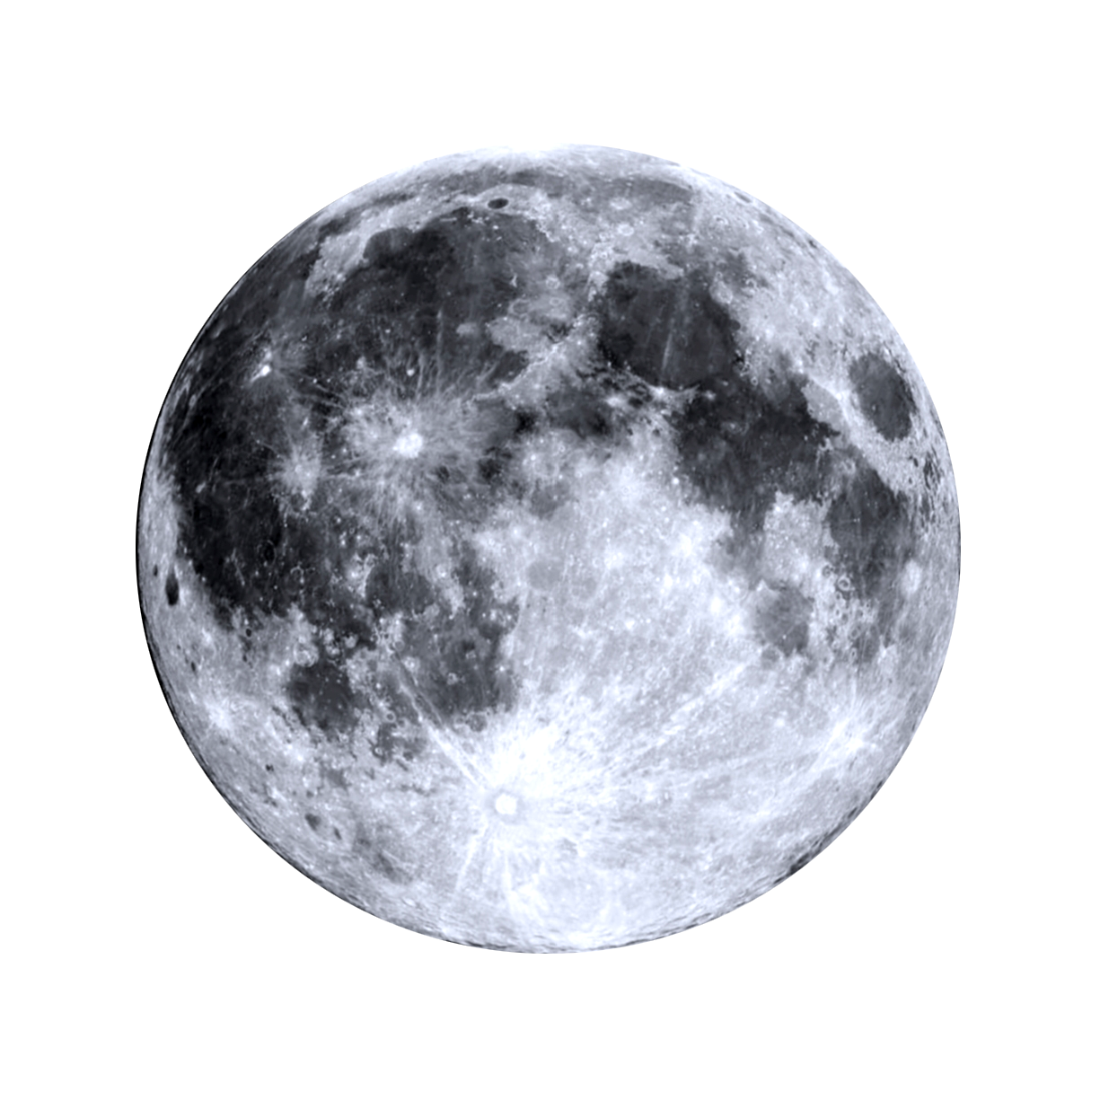
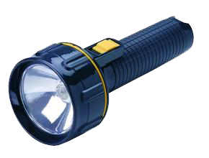


The Moon
If light from the sun reflects off the moon, why don’t we see the whole moon all of the time?
How and why does changing the position of the moon change the amount of sunlight that is reflected?
Alice Vigors 2018
Notes:
Using a ball and torch/lamp demonstrate how light can be reflected, just as it is when sunlight is reflected from the moon. Add in another ball to represent the Earth.
Investigate how changing the position of the moon changes the amount of sunlight that is reflected from the moon.
Students draw the different phases of moon and link in key terms for these phases (**OREO project) → full moon, ¼ moon, waxing/waning gibbous, waxing/waning crescent
Recall fractions and link to phases of the moon, identifying full moon as a whole number and new moon as zero. Write the fractions of light illuminated on the moon for each phase

Slide 20
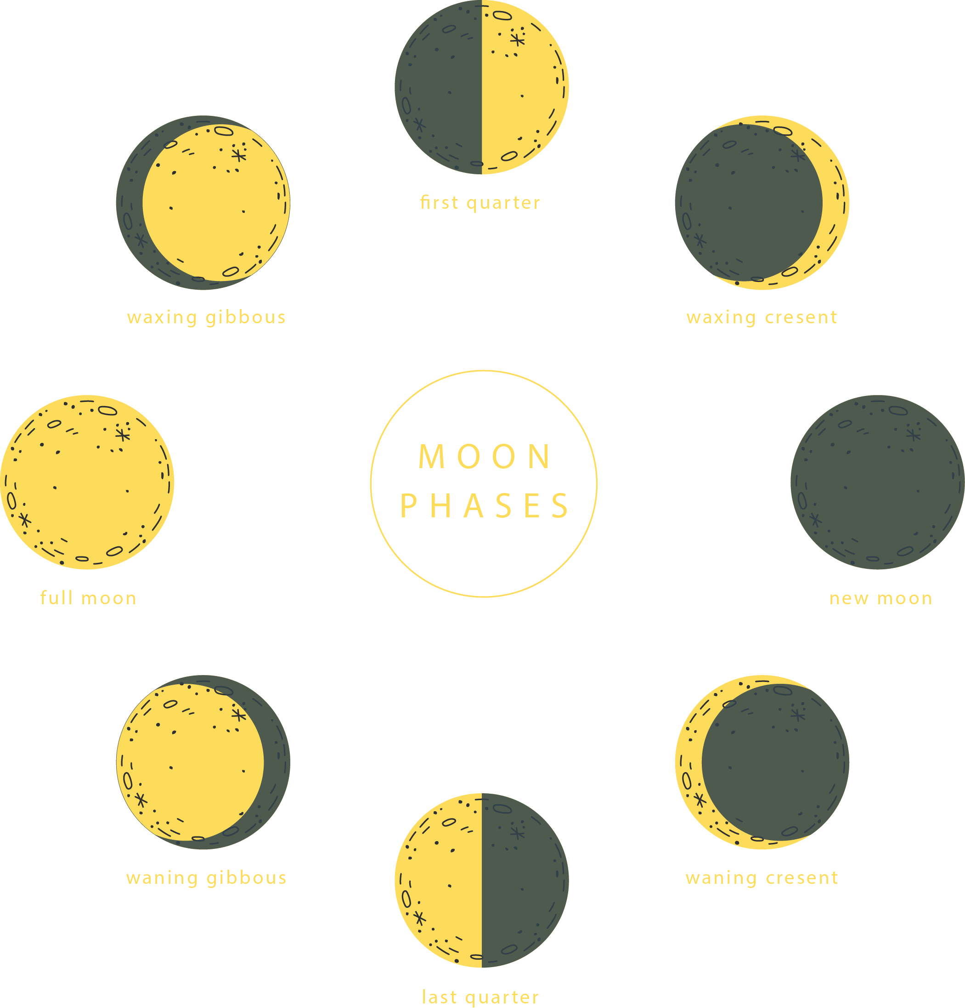
The Moon
If light from the sun reflects off the moon, why don’t we see the whole moon all of the time?
What fraction of the moon is visible during its different phases?
Alice Vigors 2018
Notes:
Using a ball and torch/lamp demonstrate how light can be reflected, just as it is when sunlight is reflected from the moon. Add in another ball to represent the Earth.
Investigate how changing the position of the moon changes the amount of sunlight that is reflected from the moon.
Students draw the different phases of moon and link in key terms for these phases (**OREO project) → full moon, ¼ moon, waxing/waning gibbous, waxing/waning crescent
Recall fractions and link to phases of the moon, identifying full moon as a whole number and new moon as zero. Write the fractions of light illuminated on the moon for each phase
HOME/SCHOOL CONNECTOR: Students investigate and record the phases of the moon for a month, identifying the key terms (full moon, ¼ moon, waxing/waning gibbous, waxing/waning crescent)
students could represent this using illustrations or capture using images
describe the moon using key terms and fractional language

Slide 21
Planetary Features
Investigating the planets in our solar system
How do the features of the planets in our solar system compare to one another?
Alice Vigors 2018
Notes:
Read the brief overview of the solar system from NASA’s Science website https://solarsystem.nasa.gov/solar-system/our-solar-system/overview/

Slide 22
Solar System
The Heliocentric Model
Alice Vigors 2018
- What do you see, observe or notice? - What does it make you think? - What does it make you wonder? -
Notes:
View the video Solar System / or NASA’s eyes application (Eyes on the Solar System) and engage students in a See Think Wonder thinking routine to make observations about the planets in our solar system.

Slide 23
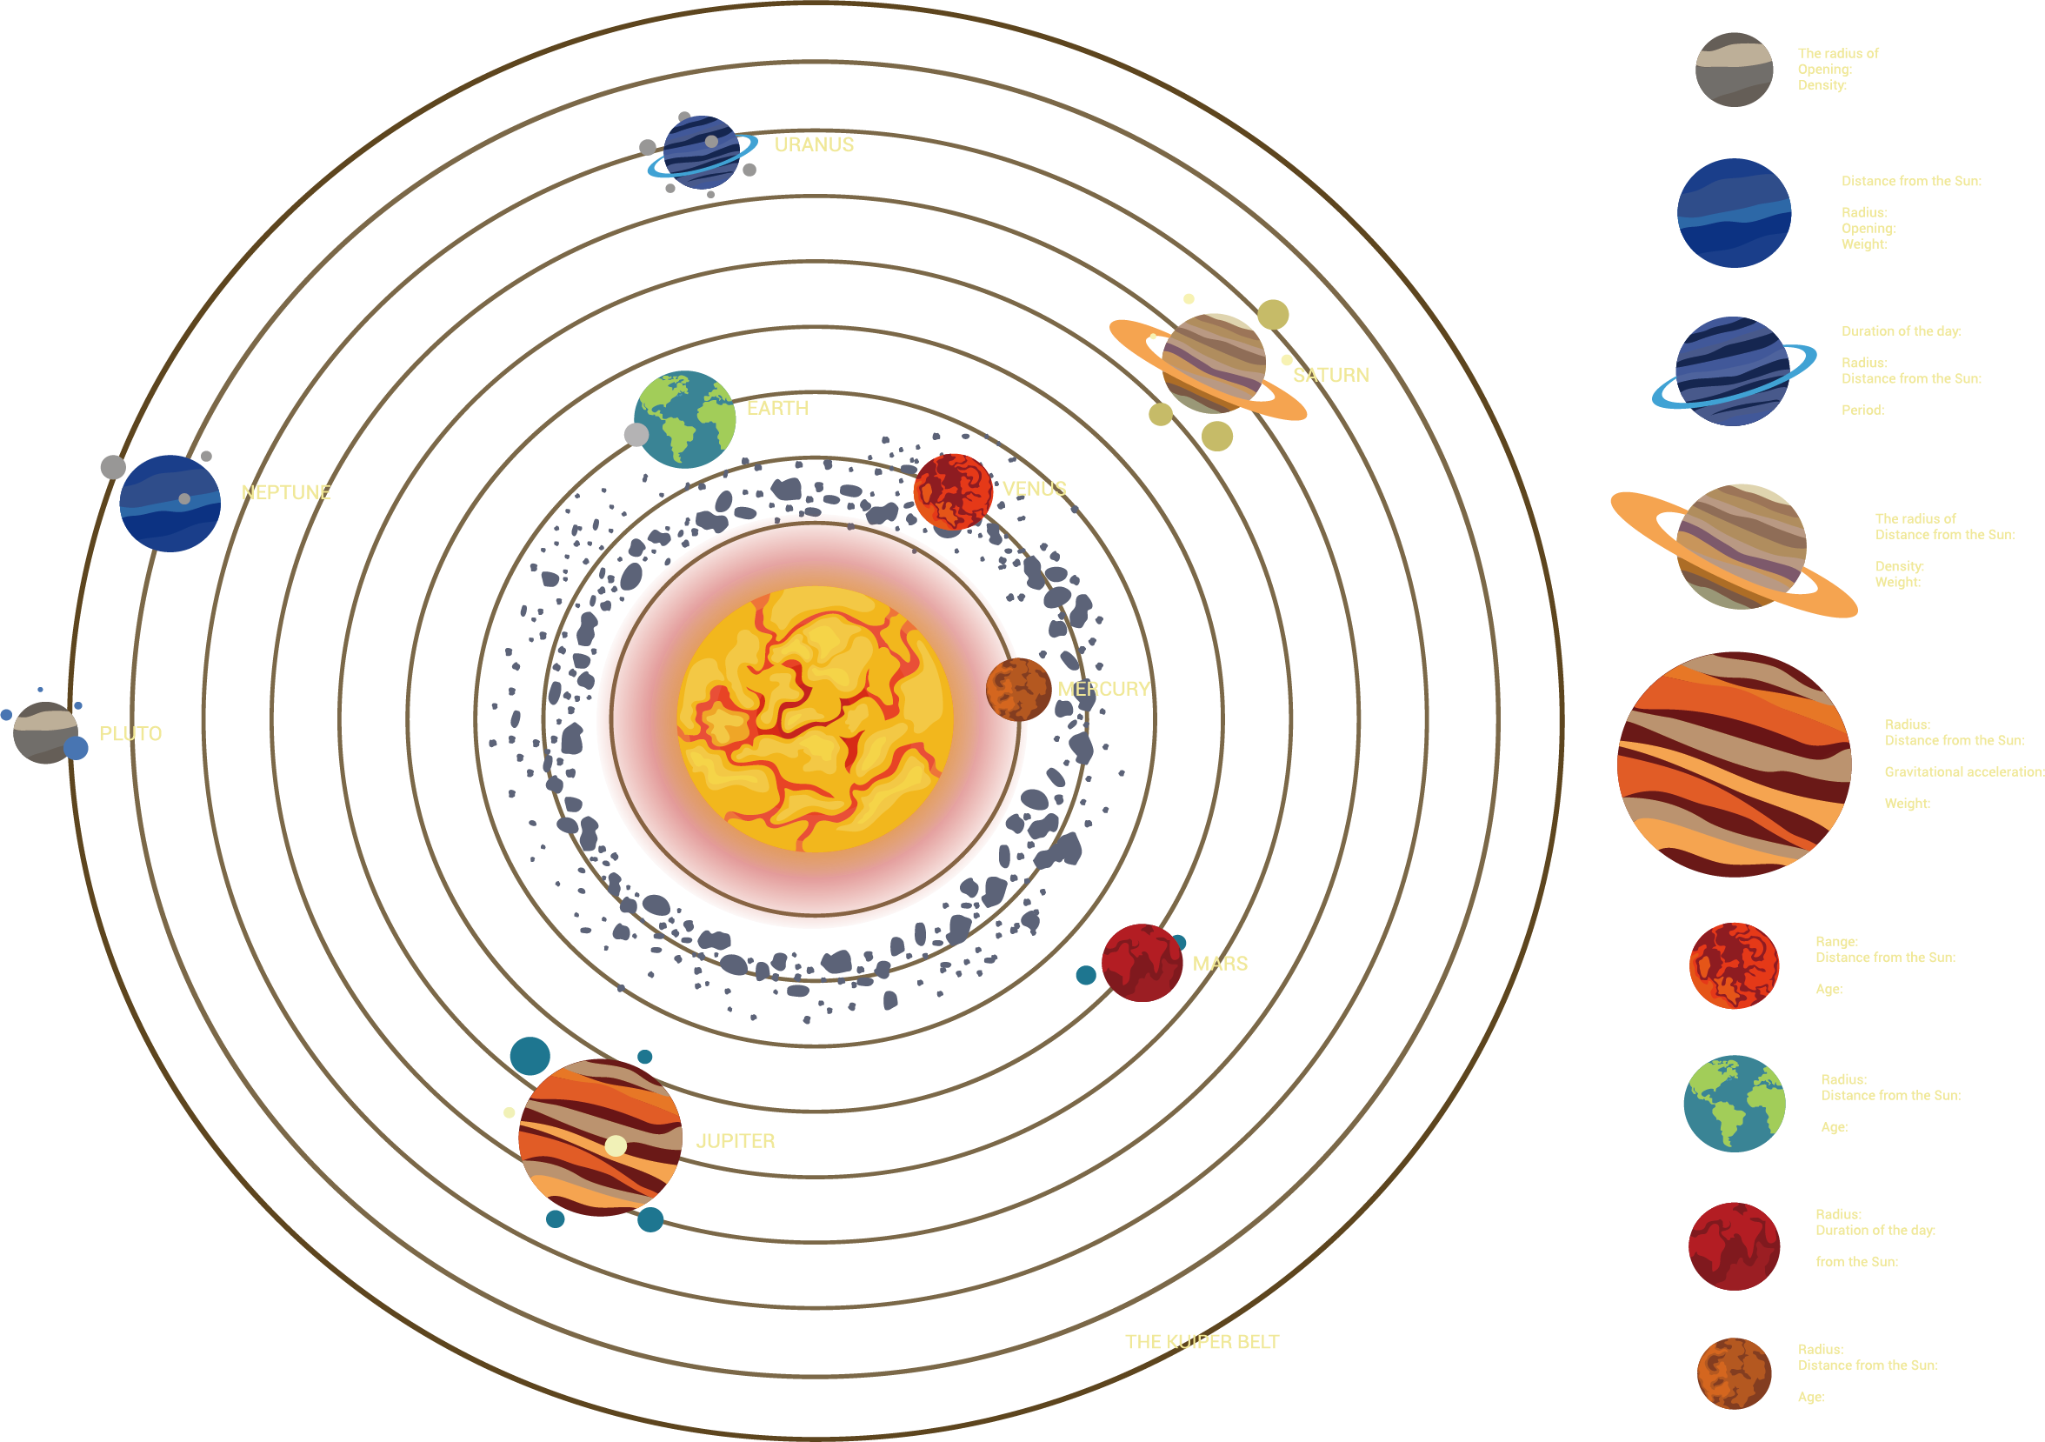
Geocentric and Heliocentric Models
Through history, there has been two major models that were simple representations of the solar system as we now know it. Both models factored in all the data available to them at the time. The original model was known as the geocentric model and was later replaced by the heliocentric model.
Geocentric Model
The term geocentric means ‘earth-centered’ which meant that people believed the Earth was at the centre of the universe. This model was developed by Ptolemy, a Greek philosopher. His model illustrated that the Earth was stationary whilst the Sun, Moon, planets and stars moved around in perfect circles. Aristotle, another prominent Greek philosopher advocated the model and it was widely accepted until the emergence of the heliocentric model in the 1500’s.
Heliocentric Model
The term heliocentric means ‘sun-centered’ which suggested that the Sun was at the centre of the universe. Nicolas Copernicus, a Polish cleric, was the first person to propose this model. He argued that it was in fact the Sun that was stationary whilst the planets revolved around it. He also suggested that stars were stationary and that the moon orbited the Earth. This theory was initially rejected by the scientific community. However, his theory gained support from Galileo and Johannes Kepler, who later proved this model was correct.
Alice Vigors 2018
Alice Vigors 2018
Notes:
Introduce the scientific term ‘Heliocentric Model’ (Helios is Greek for Sun). Read through the history of our solar system and explore the difference between the geocentric and heliocentric models.

Slide 24
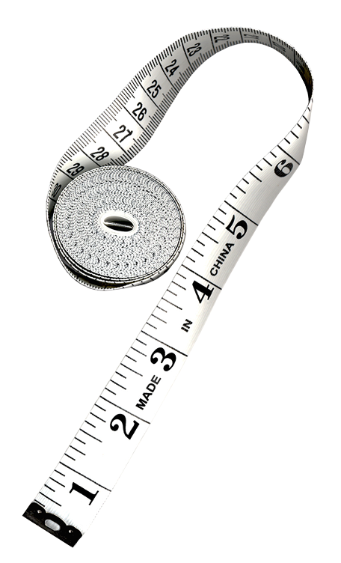

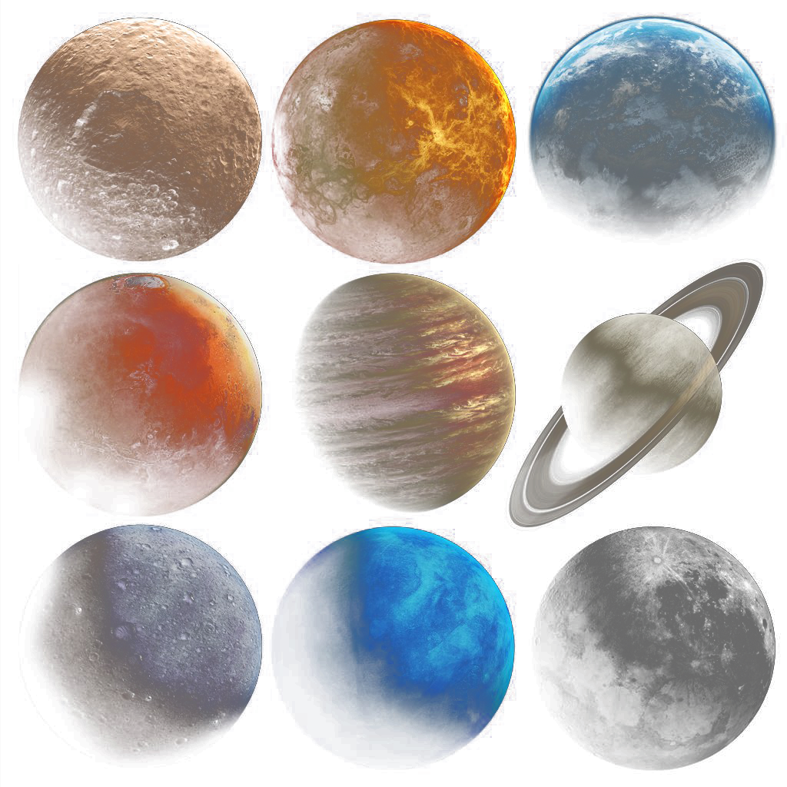
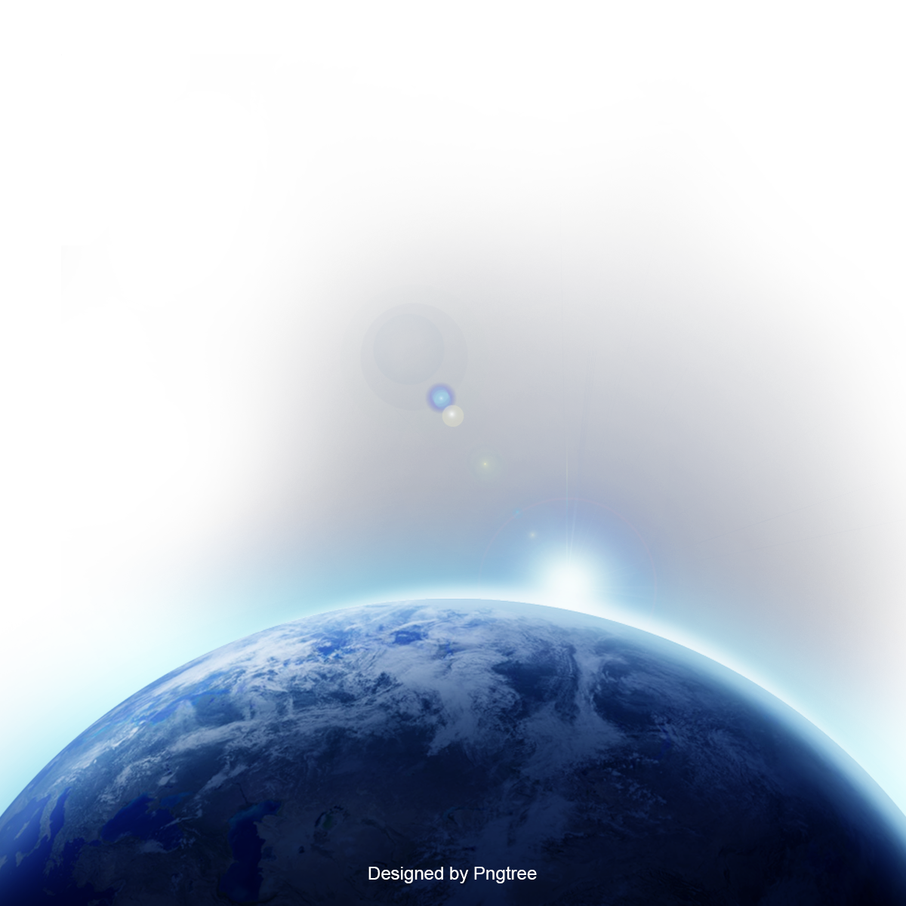
Scale Model
Investigate the distance of the planets from the Sun
Write the names of the sun and the eight planets on separate pieces of paper.
Position yourself in a large outdoor
space to show the relative position
of the planets from the Sun.
Mercury → 38 cm
Mars → 1.5 m
Saturn → 9.5 m
Neptune → 30.1 m
Earth → 1 m
Venus → 72 cm
Jupiter → 5.2 m
Uranus → 19.2 m
Alice Vigors 2018
Notes:
Small groups: Investigate the distance of the planets from the sun through the creation of a scale model in the playground.
Write names of the sun and eight planets on separate pieces of paper – Mercury, Venus, Earth, Mars, Jupiter, Saturn, Uranus, Neptune
Group members position themselves to show the relative position of the planets from the sun
PLANET
MODEL DISTANCE FROM SUN
Mercury
38cm
Venus
72 cm
Earth
1 m
Mars
1.5 m
Jupiter
5.2 m
Saturn
9.5 m
Uranus
19.2 m
Neptune
30.1 m

Slide 25
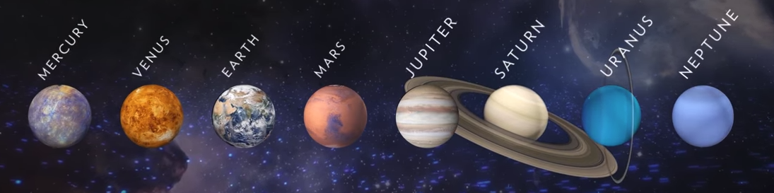
National Geographic
Solar System 101
Alice Vigors 2018
Notes:
View the video Solar System 101 and identify the 2 types of categories we divide the 8 planets into (terrestrial and jovian)

Slide 26
Collaborative Task
Research and gather information about one of the planets and collaboratively work with others to build a Google Site about the planets in our solar system.
Gather information about:
How long does it take to orbit the sun?
What does the planet look like?
How big is the planet?
What is the distance of this planet from the Sun?
What is this planet made of?
How many moons does it have?
How long is a day? a year?
What is an amazing fact about this planets
Collaborative Presentation:
assessment
Group together with people from the other 7 planets of our solar system.
Create a Google Site (website) and give editing access to all members of your group and the teacher.
Each planet has its own page of information, including images/videos to support the information.
Each Google Site needs to have an introductory page – short blurb about the solar system, as well as a page showing the sources you used.
Alice Vigors 2018
Notes:
COLLABORATIVE RESEARCH TASK: Students are given 1 of the 8 planets to investigate using the National Geographic , NASA websites and NASA Eyes application to gather information about – time taken to orbit sun, what it looks like, size of planet, distance from sun, what it is made of, number of moons, how long is a day/ year, amazing fact. Present research to the class (Assessment)

Slide 27
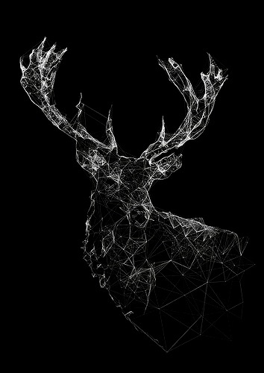
Astronomy
Exploring an Indigenous Perspective
How did the stars help Indigenous people understand their universe?
Alice Vigors 2018

Slide 28
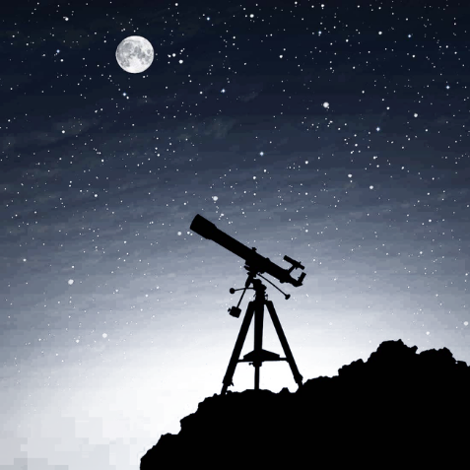
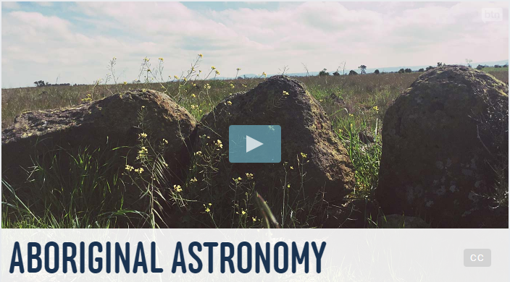
Behind The News
Aboriginal Astronomy
Alice Vigors 2018
Notes:
View the video Aboriginal Astronomy and discuss the key ideas, focusing on the Wurdi Youang stone arrangement and the seasons, storytelling through constellations, and Indigenous people as the 1st astronomers

Slide 29

Scientific Terminology
Define these key scientific terms
Astronomy
Astronomer
Constellation
Cultural Astronomy
The scientific study of celestial objects, such as stars, planets, comets and galaxies.
A scientist who studies and observes astronomical objects like planets and stars.
A group of stars that forms an imaginary outline or meaningful pattern in the night sky.
The study of the sky knowledge of ancient and traditional people.
Alice Vigors 2018
Notes:
Define the key scientific terms – astronomy, astronomer, constellation and cultural astronomy (study of the sky knowledge of ancient & traditional people)

Slide 30
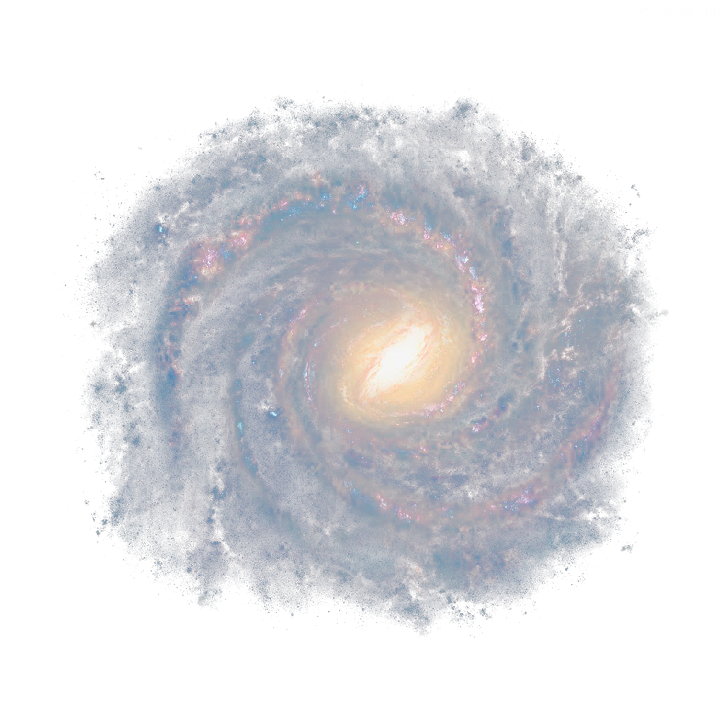
Cultural Astronomy
Exploring an Indigenous Perspective through Dreamtime stories
Emu in the sky
The canoe in Orion
Seven sisters
assessment
What can you see in the picture?
Where in the night sky can this constellation be found?
What message does this story convey?
Retell one of the traditional stories. For example, through drama/role play, illustrations, artworks, create a book etc.
Alice Vigors 2018
Notes:
Examine dreamtime stories that use the night sky and their related images, such as Emu in the Sky ,The Canoe in Orion and Seven Sisters → Use questions to prompt exploration:
What can you see in the picture?
Where in the night sky can this constellation be found?
What message does this story convey?
Retell one of the traditional stories. For example, through drama/ role play, illustrations, artworks, create a book etc.
EMU: create a table that outlines the months of the year, the location of the Emu in the sky and what this means for the people
(Assessment)
SCHOOL/COMMUNITY CONNECTION: Connect with the schools Aboriginal Education Officer or with a local Indigenous person to get a local perspective on how the night sky was used in that area

Slide 31
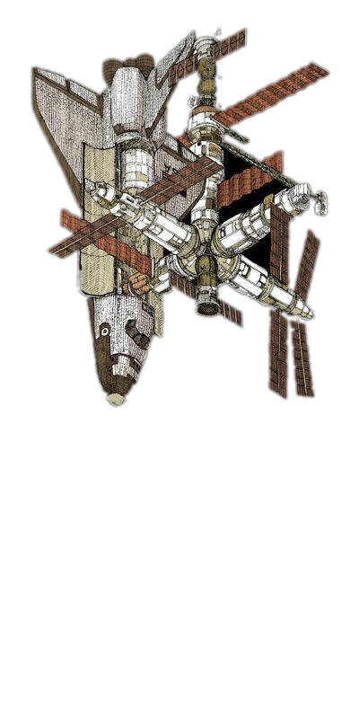
Current Developments
What developments are current developments are occurring in astronomy, space and planetary science at the moment?
Alice Vigors 2018

Slide 32
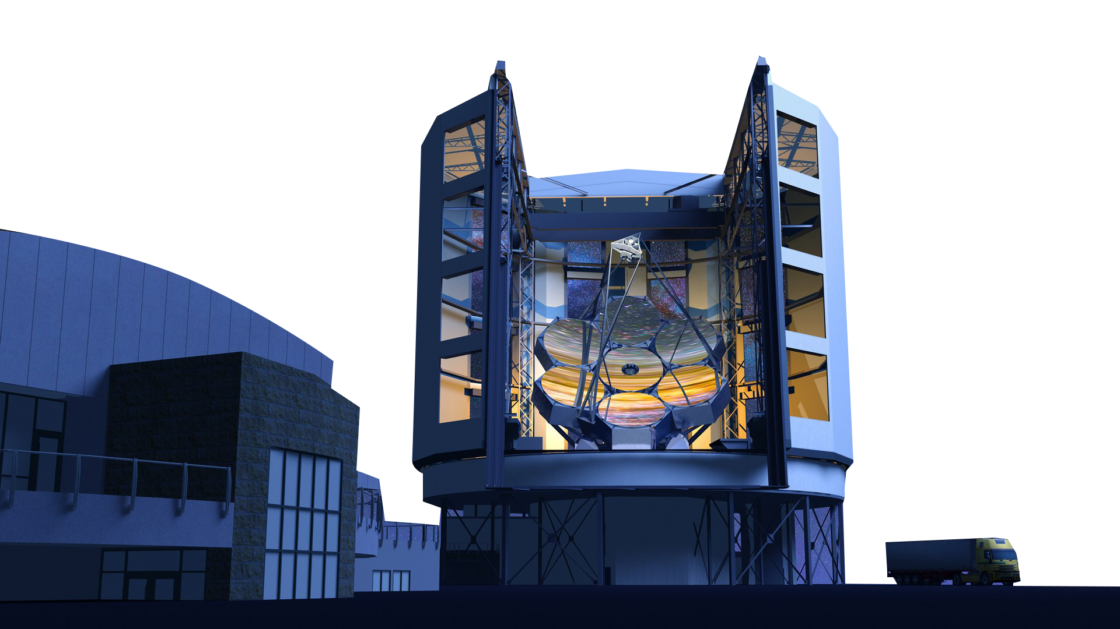
Current Developments
Examine and discuss a range of videos and texts.
Super Telescope SKA
Amateur Astronomer
What’s Next for NASA?
Space Communications
Deep Space Network
Alice Vigors 2018
Notes:
Examine and discuss a range of videos and texts about current developments:
Super Telescope SKA: http://www.abc.net.au/btn/story/s3517663.htm
Amateur Astronomer: http://www.abc.net.au/btn/story/s4183263.htm
What’s next for NASA: https://www.nasa.gov/about/whats_next.html
Space Communications: http://www.abc.net.au/catalyst/stories/2358763.htm and the Deep Space Network: https://www.cdscc.nasa.gov/

Slide 33
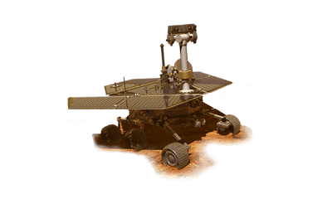
Robotics Challenge
Use the robotics kits to design and make a space robot that could travel to one of the planets in our solar system.
Consider the environment of this planet during the design phase. Draw detailed diagrams of the key features that would allow it to explore this planet.
Create and test your space robots.
Alice Vigors 2018
Notes:
ROBOTICS CHALLENGE: Use robotics kits to design and make a space robot, such as the ‘Mars Rover’.

Slide 34
4
How do sudden geological changes and extreme weather events affect the Earth’s surface?
Essential Inquiry Question 2
Alice Vigors 2018

Slide 35
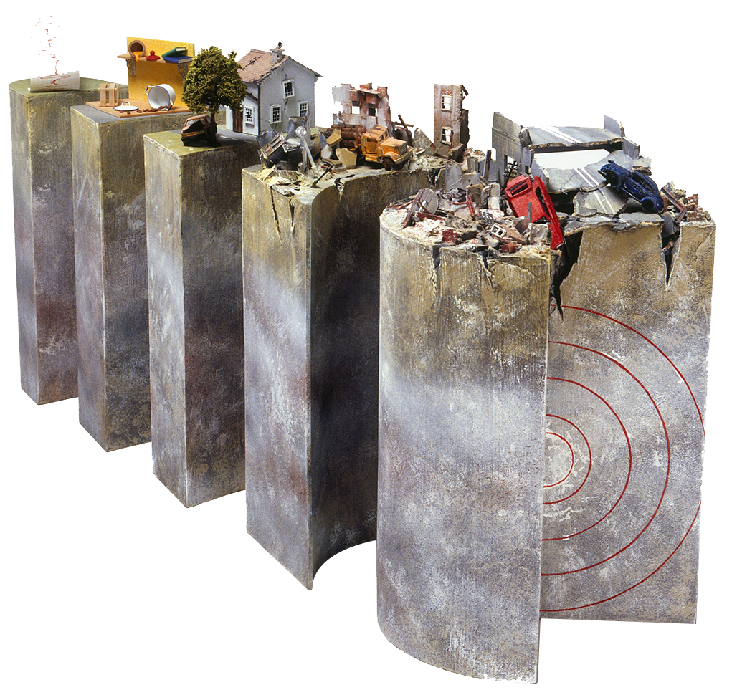
What geological changes and extreme weather events occur on the Earth?
How can we plan for and manage them to minimise their effect?
Alice Vigors 2018
Notes:
Read the brief overview of the solar system from NASA’s Science website https://solarsystem.nasa.gov/solar-system/our-solar-system/overview/

Slide 36
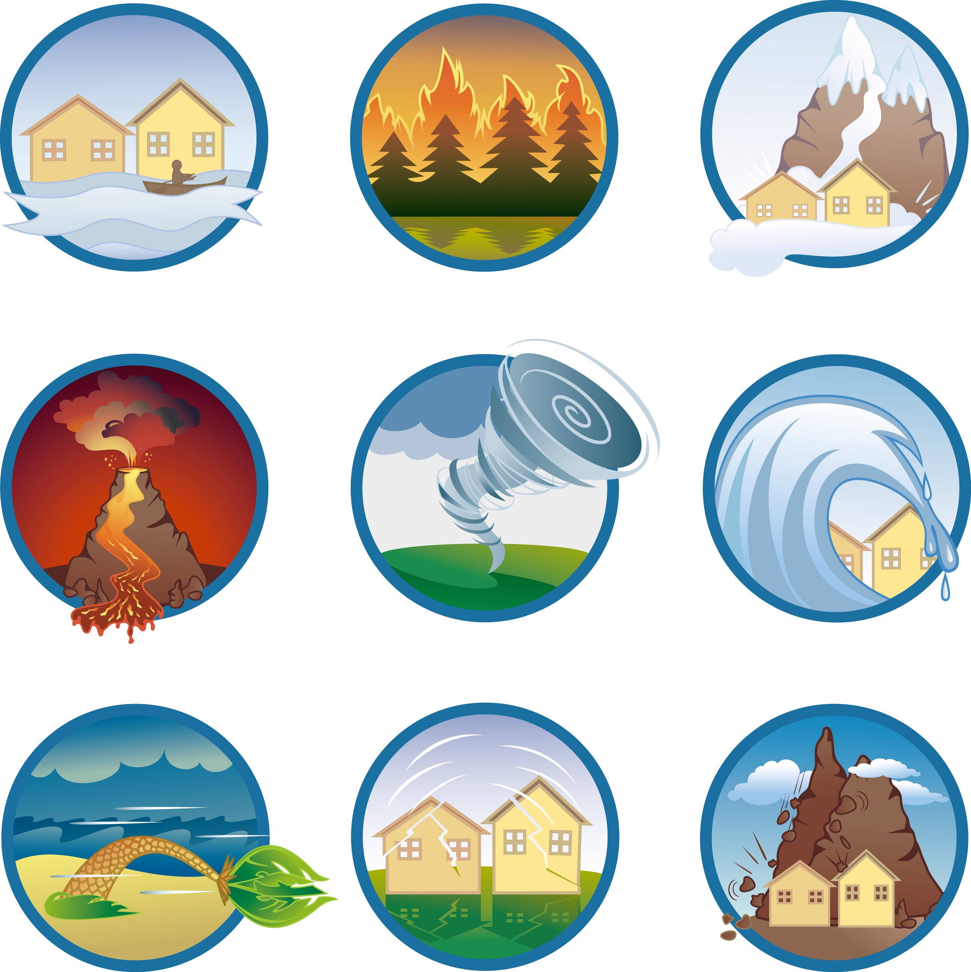
Collaborative Research Task
Each person in the group researches and uses a variety of sources to gather information about one natural disaster. Including:
  What causes this extreme event?
  What does this extreme event look like?
  What connections can you make to this event? (self, text, world)
  What impact does this extreme event have on the environment and on humans and animals?
  Where in the world does this extreme event occur?
  How do people plan for and manage this extreme event?
Groups combine their research information to create a collaborative Google Site.
Share and present research to an audience.
assessment
Alice Vigors 2018
Notes:
COLLABORATIVE RESEARCH TASK: Small groups - each person in the group researches one of the following:
Earthquakes
Volcanic eruptions
Tsunamis
Cyclones
Drought
Floods
Students research and use a variety of media sources to gather information about:
What causes this extreme event?
What does this extreme event look like?
What connections can you make to this extreme event?
(self, text, world)
What impact does this extreme event have on the environment and on humans and animals?
Where in the world does this extreme event occur?
How do people plan for and manage this extreme event?
Groups combine the information they have individually gathered to create a collaborative Google Site. Share and present research to the class and beyond (if desired). (Assessment)

Slide 37
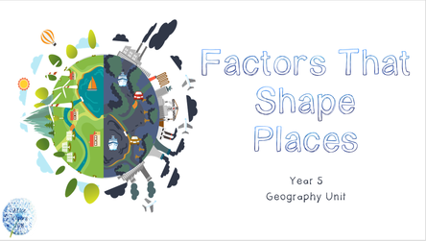
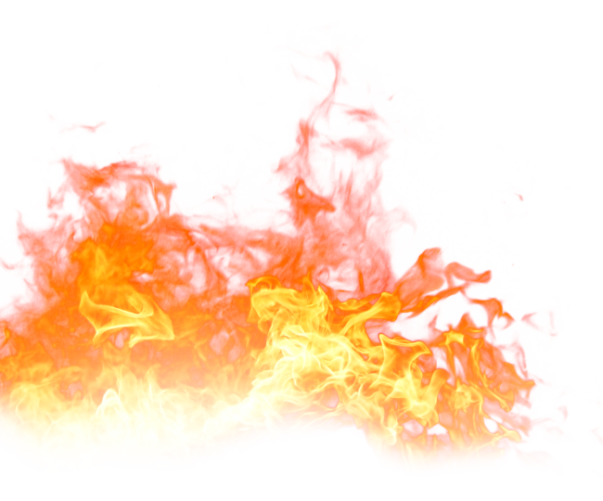
Linked Learning: Geography
How can the impact of bushfires on people and places be reduced?
The remainder of this unit follows the content area: Bushfire Hazard in the Stage 3 Geography unit ‘Factors that Shape Places’. A copy of this unit can be found by clicking the link below:
https://thinkingpathwayz.weebly.com/geography.html
Alice Vigors 2018
Notes:
GEOGRAPHY LINK: Students investigate ‘How the impact of bushfires on people and places can be reduced?’ through the Geography unit Factors that Shape Places https://thinkingpathwayz.weebly.com/geography.html

Slide 38
Thank you for using this resource to support student learning.
Share examples at:
thinkingpathways@gmail.com
Visit the website: https://thinkingpathwayz.weebly.com
Alice Vigors 2018

