Slide 1
Fractions and Decimals
Stage 3
Alice Vigors
2017

Slide 2
Teaching and Learning Sessions
Can we model fractions with different denominators?
Can we develop strategies to generate and record equivalent fractions
Can you make connections between equivalent fractions, decimals and percentages? (Assessment)
Describes and represents mathematical situations in a variety of ways using mathematical terminology and some conventions MA3-1WM
Selects and applies appropriate problem-solving strategies, including the use of digital technologies, in undertaking investigations MA3-2WM
Gives a valid reason for supporting one possible solution over another MA3-3WM
Compares, orders and calculates with fractions, decimals and percentages MA3-7NA
Alice Vigors 2017
Notes:
Indicators:
→Compare fractions with related denominators and locate and represent them on a number line
→Make connections between equivalent fractions, decimals and percentages

Slide 3
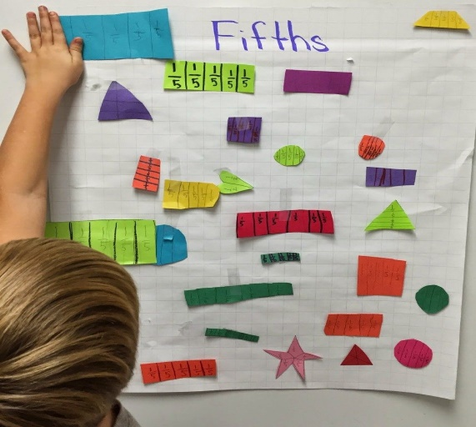
1. Can we model fractions with different denominators?
Small Group Task:
Show different ways to represent your fraction using words, numbers and visual representations.
Gallery Walk: As you walk around observing the work of others think about these questions:
How did they represent their understanding? What do you see?
How does this connect to what you knew about this fraction?
What challenged or extended your knowledge of this fraction?
What puzzled you or made you wonder about this information?
Alice Vigors 2017

Slide 4
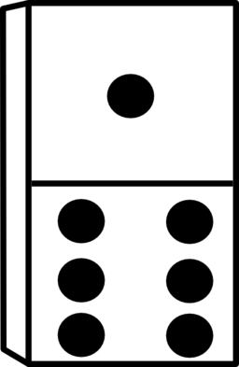
1. Can we model fractions with different denominators?
Independent Task:
Using dominoes, represent a fraction using numbers and words, including on a number line.
Extension Task: You have 48 sweets. You can choose between having 4/6 or 5/8 of the total amount. Which would you choose so that you had the largest amount? Explain your thinking and give reasons to support your answer.
Alice Vigors 2017
Notes:
Independent Task:
→Support: use cubes or counters to model fractions, e.g. with two different colours. 2/6 could be shown as 2 red cubes and 4 yellow cubes.
→Extension: provide opportunities for students to work with mixed numerals and larger fractions – exploring equivalent fractions as they go, adding fractions together etc.

Slide 5
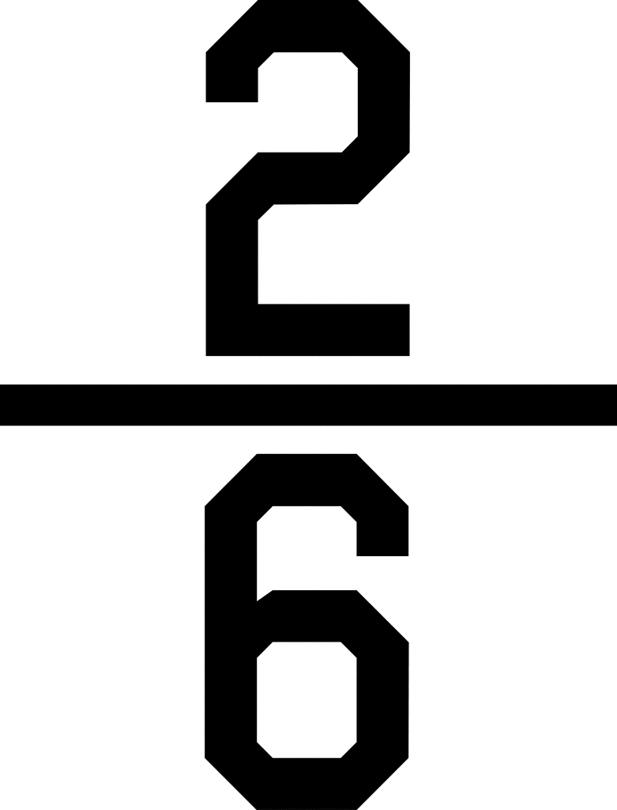
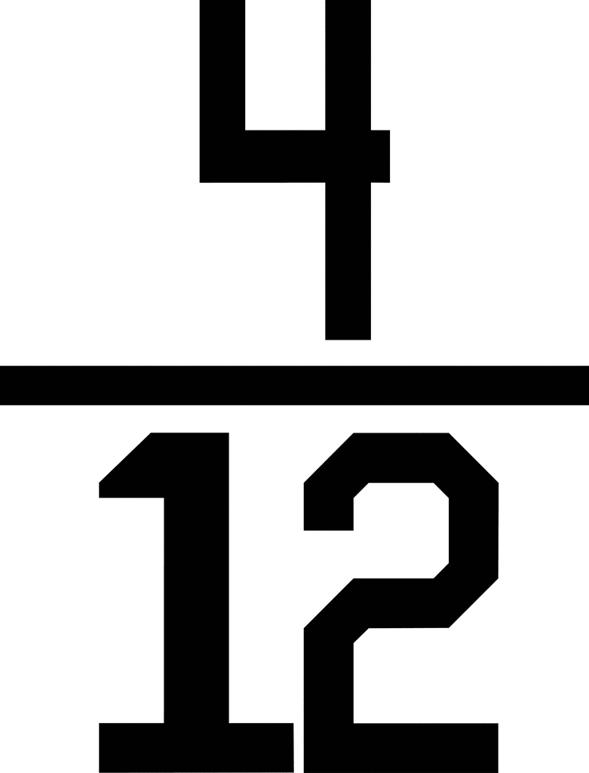
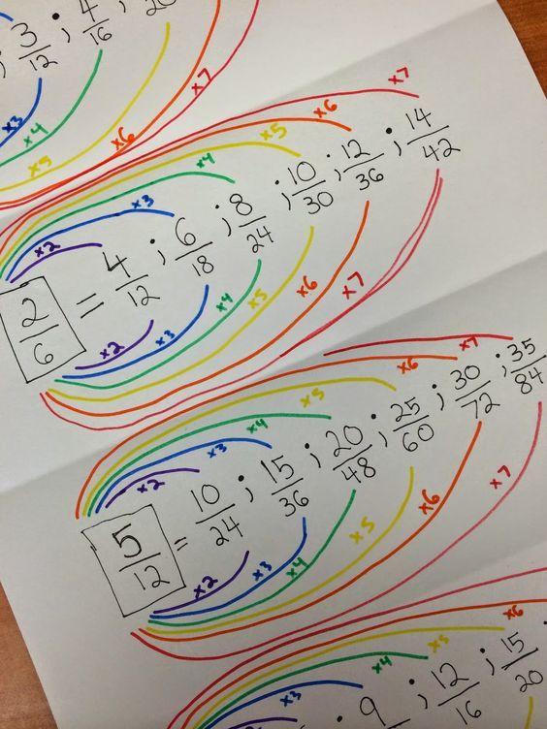
2. Can you develop strategies to generate and record equivalent fractions?
What do you see, observe or notice about these fractions?
Independent Task:
How could I use multiplication and/or division to find equivalent
fractions?
Alice Vigors 2017

Slide 6
2. Can you develop strategies to generate and record equivalent fractions?
Open-Ended Investigation:
If you had the choice between two fifths of a block of Cadbury Dairy Milk chocolate and one third, which would you choose? Explain your thinking using a variety of methods and give reasons to support your answer.
Alice Vigors 2017

Slide 7
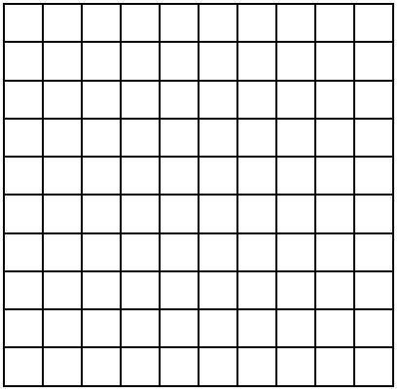
3. Can you make connections between equivalent fractions, decimals and percentages? (Assessment)
Create an artistic design on the 10x10 grid using at least 5 colours.
Alice Vigors 2017

Slide 8
3. Can you make connections between equivalent fractions, decimals and percentages? (Assessment)
Group the colours you used all together, like base-10 style.
Use this information to determine what:
Fraction
Decimal
Percentage
of each colour was used in your
design.
Challenge: Can you simplify any of the fractions to make a smaller equivalent fraction? Show and explain your thinking.
Alice Vigors 2017

Slide 9
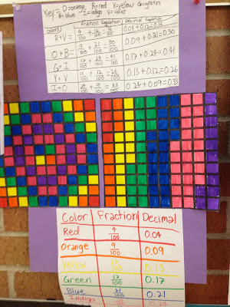
3. Can you make connections between equivalent fractions, decimals and percentages? (Assessment)
Alice Vigors 2017

Slide 10
3. Can you make connections between equivalent fractions, decimals and percentages?
Open-Ended Investigation:
You want to buy a jumper. The jumper is $42. In shop A, the jumper is priced at 5/6 of the original price. In shop B, the jumper is priced at 2/3 of the original price. In which shop would you be able to buy the jumper for the cheapest price? Explain your thinking and support with evidence.
Alice Vigors 2017

