Slide 1
Genius Hour
Project-based learning

Slide 3
Notes:
In Genius Hour book, brainstorm questions that you are curious about, or things you want to know how to make or do.

Slide 4
Obvious to you… Amazing to others…

Slide 6
What is Genius Hour?

Slide 7
Creativity takes time…

Slide 8
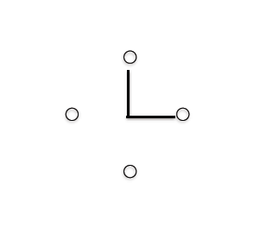

Slide 10
Examples from around the world
What are others curious about?

Slide 15
Developing our proposals
Developing thin and thick questions

Slide 16
Asking the right questions…
 | Is Are was | Did Do Does | Can | Could Should Would | Will | Might
Who
What
Where
When
How
Why
Green Zone questions often make for the best types of essential (thick) questions to base your project on.
Thin questions are used to help support our essential question.

Slide 18
Asking the right questions…
 | Is Are was | Did Do Does | Can | Could Should Would | Will | Might
Who
What
Where
When
How
Why
Green Zone questions often make for the best types of essential (thick) questions to base your project on.
Thin questions are used to help support our essential question.

Slide 19
My Genius Hour Proposal
Topic:
What supporting questions (thin) will support your inquiry?
Why are you passionate about or interested in this topic?
What essential question (thick) is driving this project?
Notes:
Link to Genius Hour blog’s https://sites.google.com/hdsb.ca/anderson/subjects/genius-hour?authuser=0

Slide 20
Using Google Effectively
Search Strategies

Slide 21
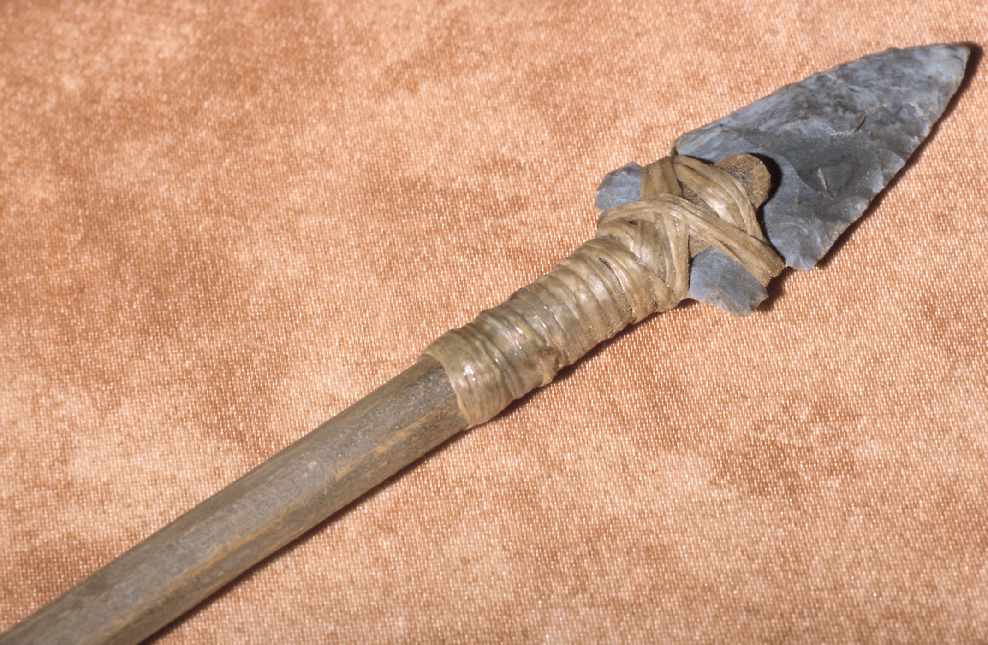
TOPIC: Ancient tools
Google matches words to websites, it doesn’t answer questions
Google will attempt to find pages that include every single word that we typed in.
Instead we should think about KEYWORDS or the most essential words about a topic.
Example: ancient spears materials
What were ancient spears made out of?
Who was allowed to use them?
Is there anywhere in the world where people still use spears today?
What were ancient spears used for?

Slide 22
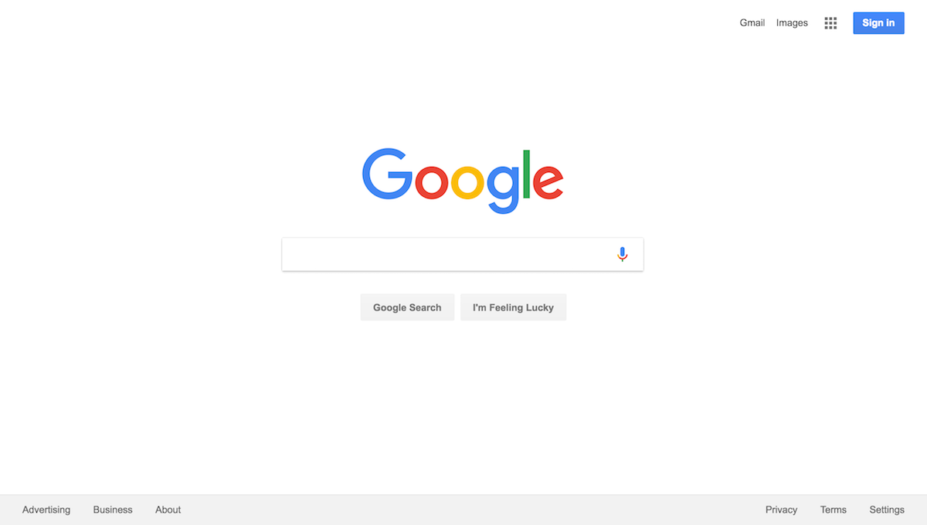
Notes:
To begin searching, we start with the most simple search term. Let’s type spears into Google. Guess what comes up? That’s right, pages and pages about Britney Spears. We have a laugh.
Then we discuss that Google doesn’t actually understand what we type. It just mindlessly matches words to webpages. We have to be very specific in our search terms to get what we want.
I introduce the “–” symbol. Placed before a word, this tells Google to exclude the word. So, spears -britney will locate sites with spears but without britney. Students now have a tool to make their searches more precise.
Precise Phrases
When we use quotes around words, Google searches for the exact phrase. If you type "ancient spears", including the quotes. the exact phrase ancient spears must appear on a page in order for Google to return it as a result.

