Slide 1
grammar
Similes
Alice Vigors 2018

Slide 2
learning intention
Identify and use a range of grammatical features effectively
success criteria
Explain what a simile is
Use similes to compose an illustration
Use similes in your writing
thinking i need
Describe what’s there
Build explanations
Alice Vigors 2018

Slide 3
what is a simile?
A simile uses the words ‘like’ or ‘as’ to compare one object or idea with another to suggest they are alike.
Similes
He eats like a pig.
He was as busy as a bee.
Tim ran as quick as lightening.
He is as quiet as a mouse.
Alice Vigors 2018

Slide 4
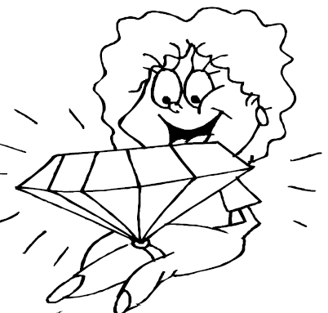
compose similes
Finish these sentences to make them similes.
Like Similes:
verb + like + noun
As Similes:
as + adjective + as + noun
Similes
The diamond shone like
The wind howled like
She swims like
The sun blazed like
The cloak was as green as
The man was as tall as
The rock was as sharp as
The bag was as heavy as
Alice Vigors 2018

Slide 5
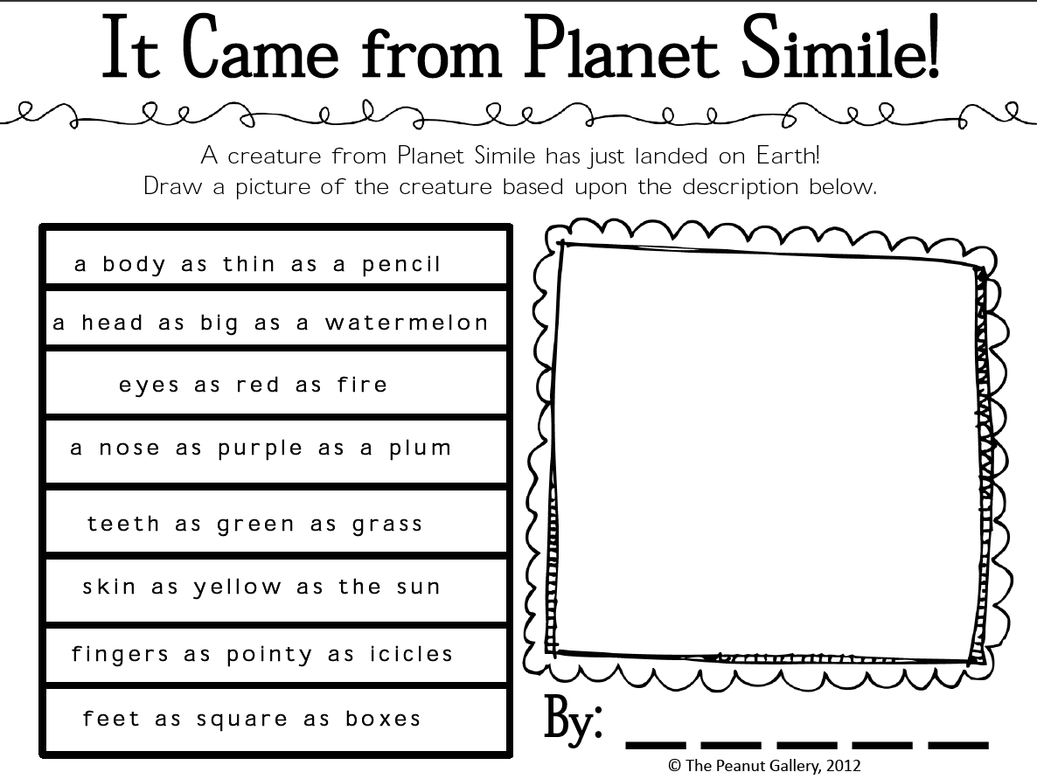

Slide 6
