Slide 1
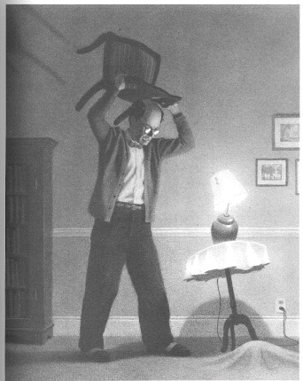
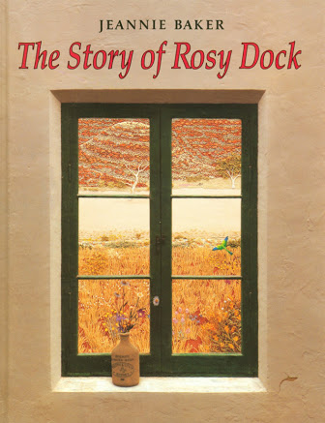
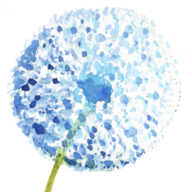
Imaginative Texts
Under the Rug
Stage 3
Alice Vigors
2017
The Story of Rosy Dock

Slide 2
Learning Experiences
Writing Block
We are learning to:
Use a range of strategies to plan an imaginative text ( 1 & 2)
Compose an imaginative text that engages a variety of audiences
Make adjustments to our writing to make it more effective
Outcomes
EN3-2A / EN3-5B / En3-4A / EN3-6B / EN3-7C / EN3-9E
EN3-1A / EN3-5B
Reading Block
We are learning to:
Activate prior knowledge
Infer meaning given clues from the author
Analyse an image and compose a complication
Identify descriptive language that creates imagery
Examine a text more deeply to determine the core message of the author
Outcomes
EN3-3A / EN3-5B / EN3-8D
Alice Vigors 2017
Modelled Reading: The Happiest Refugee (Anh Do)

Slide 3
Writing Block
Alice Vigors 2017

Slide 4
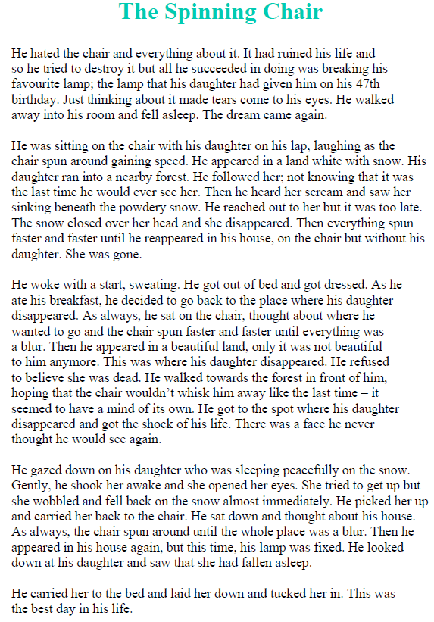
1. Learning Intention: We are learning to use a range of strategies to plan an imaginative text
Writing
Examining an exemplar text
Back
Alice Vigors 2017
Next
Notes:
Learning Experiences:
Discuss the writing purpose for this task – to create a narrative that is based on what happens before, during and after the scene in the image.
Display the image ‘Under the Rug’ and the – The Spinning Chair as an exemplar.
Identify the before (introduction), during (problem) and after (resolution/conclusion). Link this to the Hamburger Model.

Slide 5
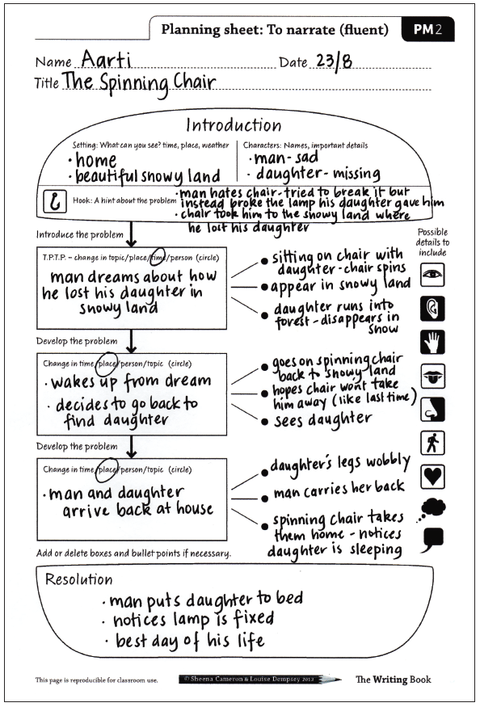
1. Learning Intention: We are learning to use a range of strategies to plan an imaginative text
Writing
Examining an exemplar text
Alice Vigors 2017
Back
Next
Notes:
Learning Experiences:
Discuss the writing purpose for this task – to create a narrative that is based on what happens before, during and after the scene in the image.
Display the image ‘Under the Rug’ and the – The Spinning Chair as an exemplar.
Identify the before (introduction), during (problem) and after (resolution/conclusion). Link this to the Hamburger Model.

Slide 6
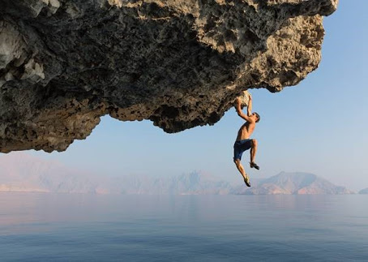
1. Learning Intention: We are learning to use a range of strategies to plan an imaginative text
Writing
Before
Planning using a visual stimulus
During
After
Back
Alice Vigors 2017
Next
Notes:
Learning Experiences:
Display a new image – students work in pairs to brainstorm before, during and after on a Y-Chart to develop ideas for their narratives.
NB: this image is also used in the reading block – students use See Think Wonder to analyse stimulus and compose a complication that builds tension.

Slide 7
2. Learning Intention: We are learning to compose an imaginative text that engages a variety of audiences.
Writing
Character(s):
How could you describe this person?
What are they doing? Why?
What impact does/will this have?
Setting:
Where does this take place?
What is this place like?
When does this occur?
Planning using a visual stimulus
Back
Alice Vigors 2017
Next
Notes:
Learning Experiences:
Discuss the character/s: Who could they be? What do they look like? What are they doing?
Discuss the setting: Where are they? What is it like? When is it?
Write to develop ideas for the setting and characters.
Display the planning sheet exemplar for the Spinning Chair – use this as a model to guide students planning for their own narrative.

Slide 8
3. Learning Intention: We are learning to compose an imaginative text that engages a variety of audiences.
Writing
Purpose:
If the purpose of an imaginative text is to entertain, what types of sentences/words would we use?
What kinds of language features would make this text effective?
Compose an imaginative Text
Success Criteria
Compose an engaging imaginative text for a variety of audiences that develops tension and intrigue over time.
Back
Alice Vigors 2017
Next
Notes:
Learning Experiences:
Review purpose of a narrative text – if the purpose is to entertain, what types of sentences/words would we use and what other descriptive language features would we use.
Develop a success criteria.
Begin composing narrative

Slide 9

3. Learning Intention: We are learning to make adjustments to our writing to make it more
effective
Writing
Proofreading & Editing:
Have you included all necessary punctuation marks?
Is your spelling correct?
Have you upgraded your vocabulary?
Have you included paragraphs?
Improve the quality of our writing
I noticed/ I saw/ I observed that you…. This was effective because…
Peer Assessment
Examine a partners writing:
Is it engaging? Do they hook you in?
Do they build tension and intrigue over time?
Have they used descriptive language? Imagery?
I think you could improve…………..because………
Back
Alice Vigors 2017
Next
Notes:
Learning Experiences:
Review purpose of a narrative text – if the purpose is to entertain, what types of sentences/words would we use and what other descriptive language features would we use.
Develop a success criteria.
Begin composing narrative

Slide 10
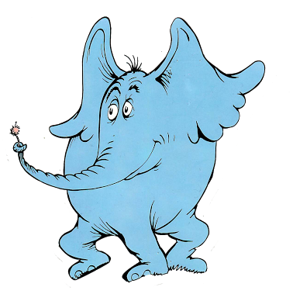

Reading Block
Alice Vigors 2017

Slide 11
Examine the following words from our History unit.
Which words connect to each other?
Explain what those connections might be.
1. Learning Intention: We are learning to activate prior knowledge
Reading
Comprehension Strategy
Edmund Barton
Constitution
Federation
Parliament
Malcolm Turnbull
Canberra
Back
Alice Vigors 2017
Next
Notes:
Learning Experiences:
Use these words to model drawing connections and explaining what those connections might be. Students will need to do this independently with words from the text The Story of Rosy Dock before reading it.

Slide 12
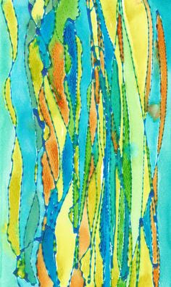
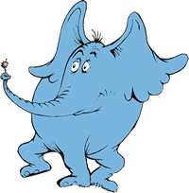

Taskboard
Monday
To activate prior knowledge
Red
Orange
Yellow
Green
Blue
SGI
Activate Prior Knowledge (Comprehension)
Activate Prior Knowledge (Comprehension)
Literature Circle
Activate Prior Knowledge (Comprehension)
Visual Literacy
Activate Prior Knowledge (Comprehension)
Chromebooks: Read Theory + Seesaw
Activate Prior Knowledge (Comprehension)
Literature Circle
Activate Prior Knowledge:
Use what you know to determine connections between words found in the text The Story of Rosy Dock.
https://readtheory.org/
Alice Vigors 2017

Slide 13
2. Learning Intention: We are learning to infer meaning given clues from the author
Reading
Inferring
Inferring is being able to ‘read between the lines’ when the author implies something but doesn’t exactly say it.
You need to use clues in the text and your own prior knowledge to help you understand.
In the text it says… | From what I already know I think it means ….
1.
2.
3.
4.
Comprehension Strategy
Back
Alice Vigors 2017
Next
Notes:
Learning Experiences:

Slide 14
https://readtheory.org/
Taskboard
Tuesday
To infer
Red
Orange
Yellow
Green
Blue
SGI
Inference Jigsaw x2 (Comprehension)
Inference Jigsaw x1 (Comprehension)
Chromebooks: Read Theory + Seesaw
Inference Jigsaw (Comprehension)
Literature Circle
Inference Jigsaw (Comprehension)
Literature Circle
Inference Jigsaw (Comprehension)
Visual Literacy
Inference Jigsaw:
What inferences can we make in The Story of Rosy Dock?
Alice Vigors 2017

Slide 15
3. Learning Intention: We are learning to analyse an image and compose a complication
Reading
Task 1: Use the See Think Wonder prompts to examine the image:
What do you see, observe, or notice? Give a detailed description.
What do you think has happened or is happening?
What questions or puzzles do you have?
Task 2: Compose a complication that builds tension and intrigue.
Visual Literacy
Back
Alice Vigors 2017
Next
Notes:
Learning Experiences:

Slide 16
Taskboard
Wednesday
To analyse an image & compose complication
Red
Orange
Yellow
Green
Blue
Visual Literacy
Visual Literacy
Chromebooks: Read Theory + Seesaw
Visual Literacy
Thinking Routine: Peel The Fruit
Visual Literacy:
Use the See Think Wonder thinking routine to examine an image. Compose a complication that builds tension and intrigue.
Alice Vigors 2017
https://readtheory.org/

Slide 17
4. Learning Intention: We are learning to identify descriptive language that creates imagery
Reading
Brainstorm descriptive language from the text ‘The Story of Rosy Dock’.
Use this language to write a paragraph which creates imagery.
Write a contrasting paragraph that uses synonyms/ antonyms.
Grammar
Back
Alice Vigors 2017
Next
Notes:
Learning Experiences:

Slide 18
https://readtheory.org/
Taskboard
Thursday
To identify descriptive language
Red
Orange
Yellow
Green
Blue
Grammar
Grammar
Grammar
Grammar
Grammar
Chromebook: Read Theory + Seesaw
(step 1)
Literature Circle
Independent Reading
Independent Reading
Literature Circle
Grammar:
Brainstorm descriptive language. Use these to compose paragraph that uses imagery.
Create a contrasting paragraph.
Alice Vigors 2017

Slide 19
5. Learning Intention: We are learning to examine a text more deeply to determine the core message of the author
Reading
Peel the Fruit
Outside Skin:
What do you see, observe or notice?
Under the Skin:
What questions or puzzles do you have?
Building Explanations:
What is this text really about?
Make a Connection:
How does this story fit with your life?
Different Viewpoints:
How could we see this from another perspective?
Capturing the Heart:
What is the central idea or message?
Thinking Deeply
Back
Alice Vigors 2017
Next
Notes:
Learning Experiences:
Thinking Routine: Peel the Fruit → Model using the thinking routine Peel the Fruit to examine the texts from different angles in order to get at the core of what the text is about. Students undertake activity on their literature circle/ reading group text.

Slide 20
https://readtheory.org/
Taskboard
Friday
To think more deeply
Red
Orange
Yellow
Green
Blue
SGI
Thinking Routine: Peel the Fruit
Thinking Routine: Peel the Fruit
Thinking Routine: Peel the Fruit
Chromebooks: Read Theory + Seesaw
Thinking Routine: Peel the Fruit
Literature Circle
Literature Circle
Independent Reading
Thinking Routine:
Use Peel the Fruit to examine your group text more deeply, including from different perspectives.
Alice Vigors 2017

