Slide 1
Locating East Timor
Examine and interpret the maps to determine the location of East Timor.
Where is East Timor located on the map?
What direction is East Timor from Australia?
Is East Timor close to Australia?
Who are East Timor’s closest neighbours?

Slide 2
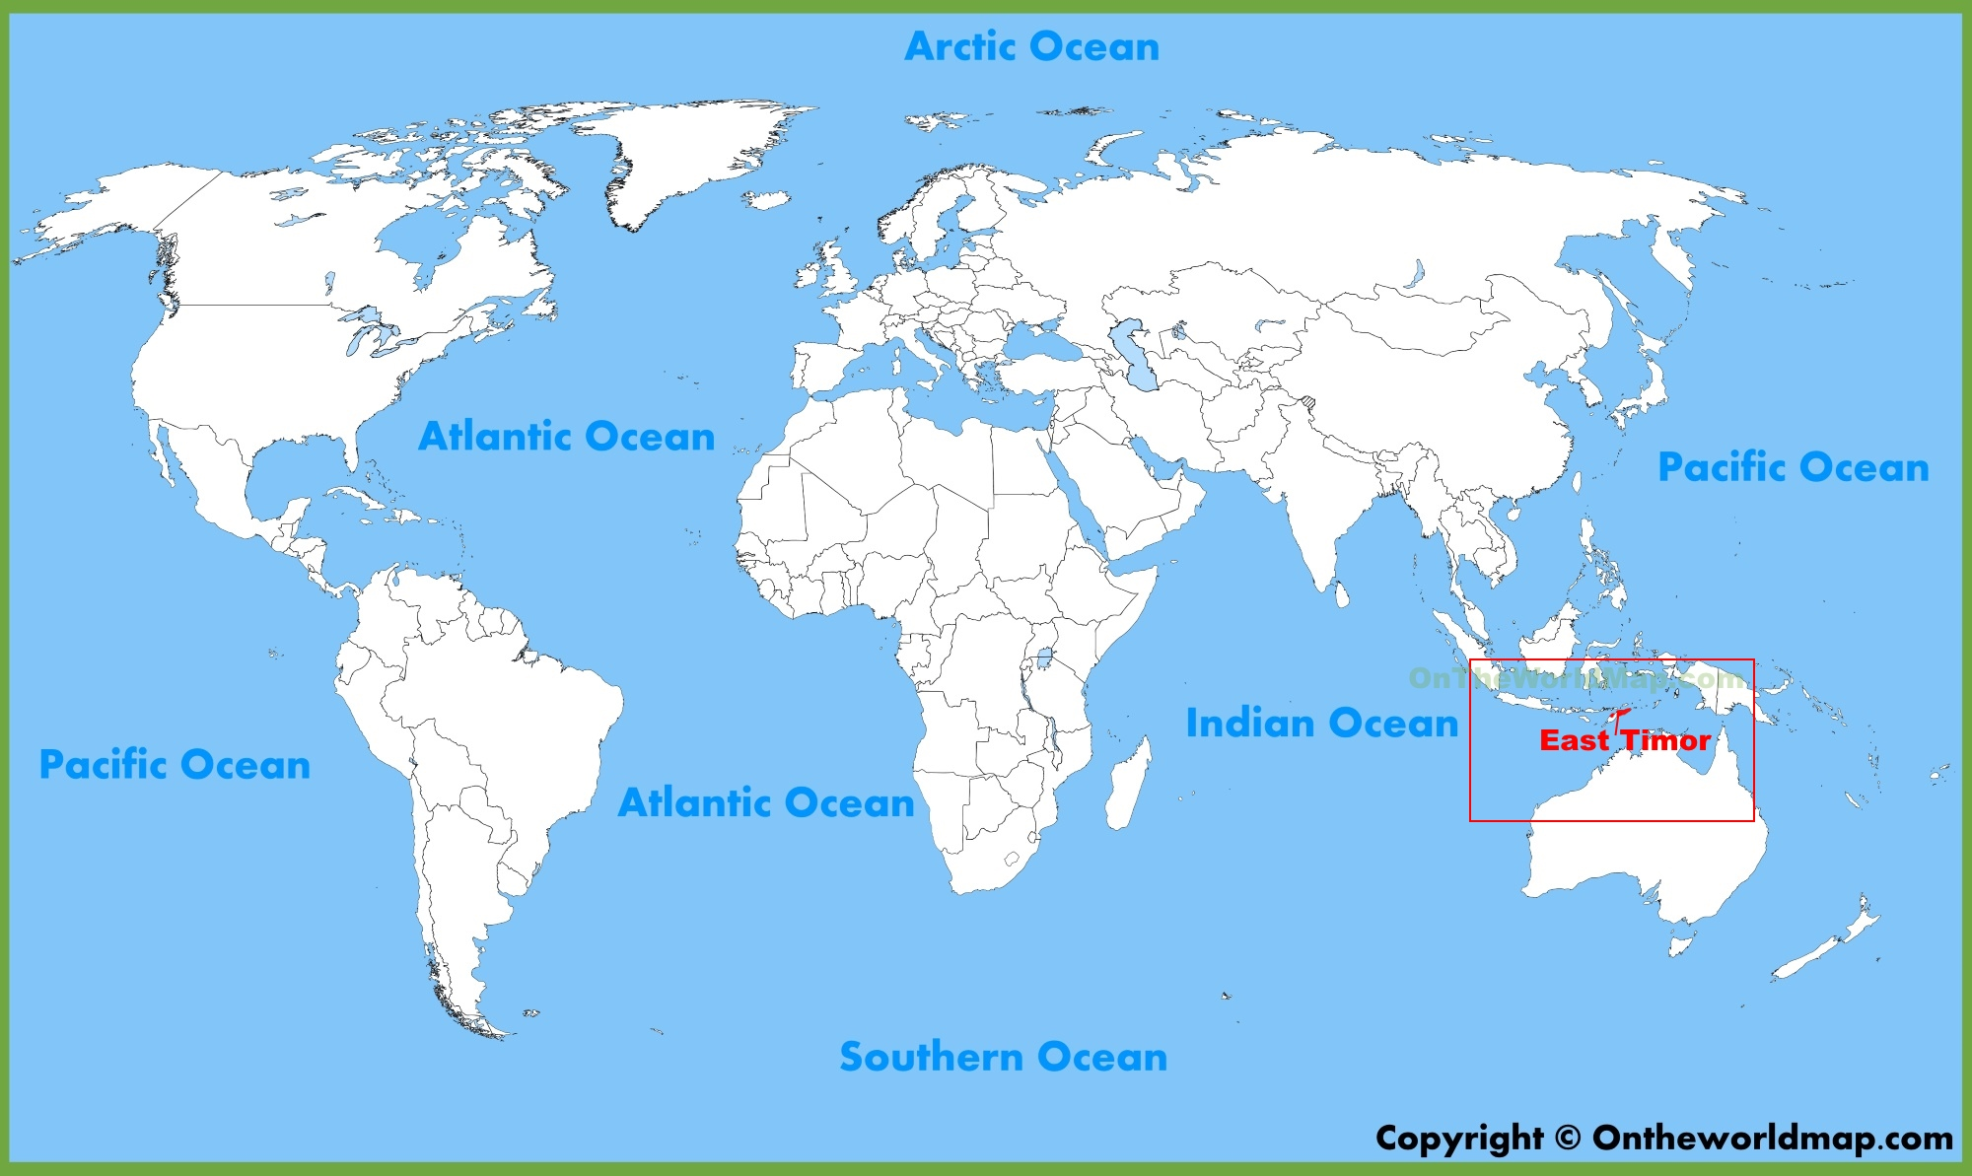

Slide 3
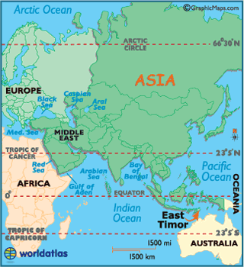

Slide 4
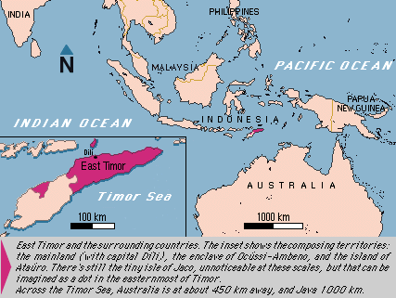

Slide 5
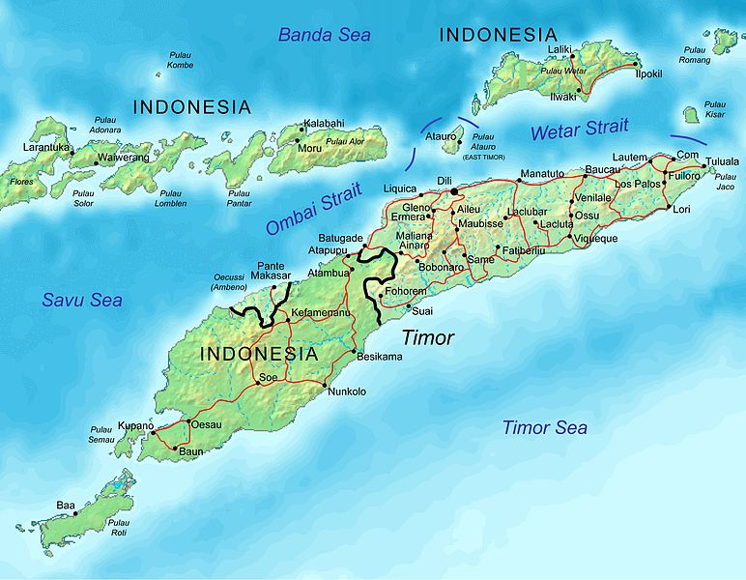

Slide 6
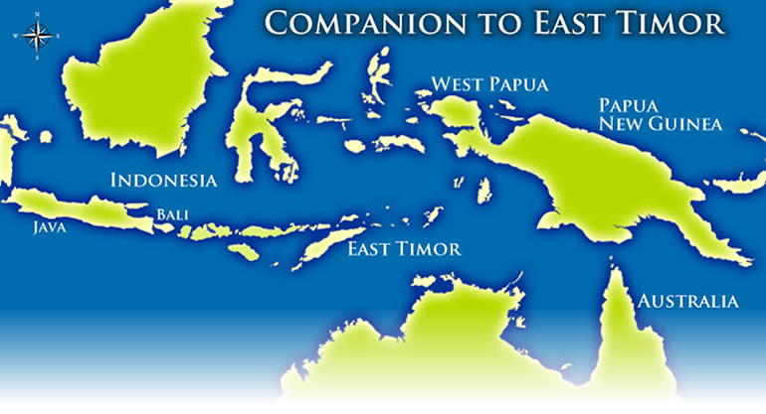

Slide 7
Locating East Timor
Examine and interpret the maps and data to determine the size and area of East Timor.
How big is the area of East Timor?
How big is East Timor compared to Australia?
What is the tallest mountain on East Timor?

Slide 8
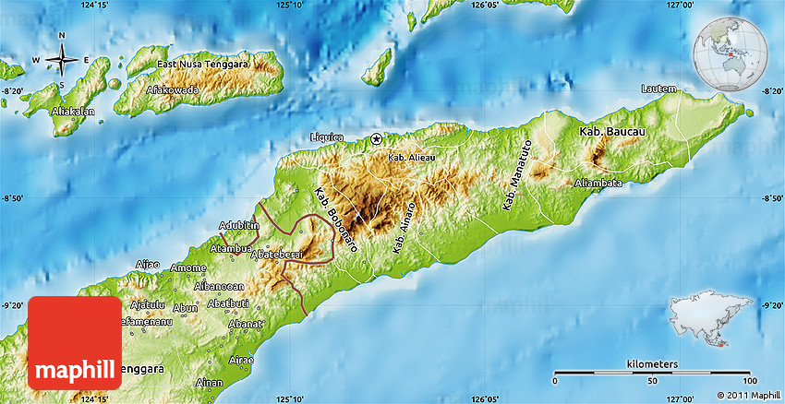

Slide 9
LOCATION, SIZE, AND EXTENT
The main land area of East Timor lies on the eastern half of Timor, an island roughly the size of the Netherlands (32,000 sq km) that forms an arc between Asia and Australia and is situated within the Nusatengarra Archipelago.
Opposite the well-travelled island of Bali, East Timor is surrounded by the Indian Ocean at the south at the Pacific Ocean at the north.
Its size rivals New Jersey or Israel, and its 15,007-km territory extends beyond its mainland to include the enclave of OcussiAmbeno in West Timor, and the islands of Atauro in the north and Jaco in the east.
Dili, a small port city on the northern coast, is the capital.

Slide 10
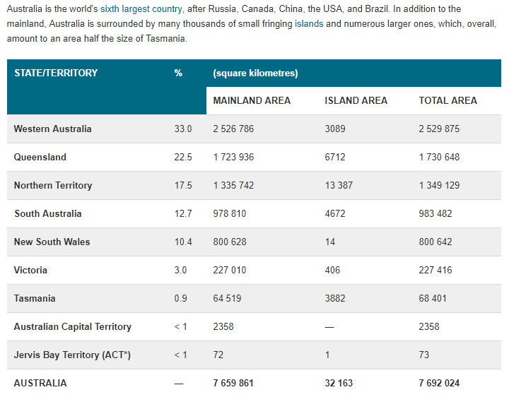

Slide 11
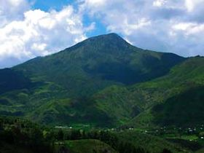
Tatamailau or Tata Mailau, sometimes referred as Mount Ramelau, is the highest mountain in East Timor and also of Timor Island at 2,986 m.
The mountain is located approximately 70 km south of the capital Dili in the district of Ainaro.

Slide 12
Locating East Timor
Examine and interpret the data to determine how long it take to travel to East Timor from Australia.
How long does it take to fly to East Timor?
What’s the fastest route?

Slide 13
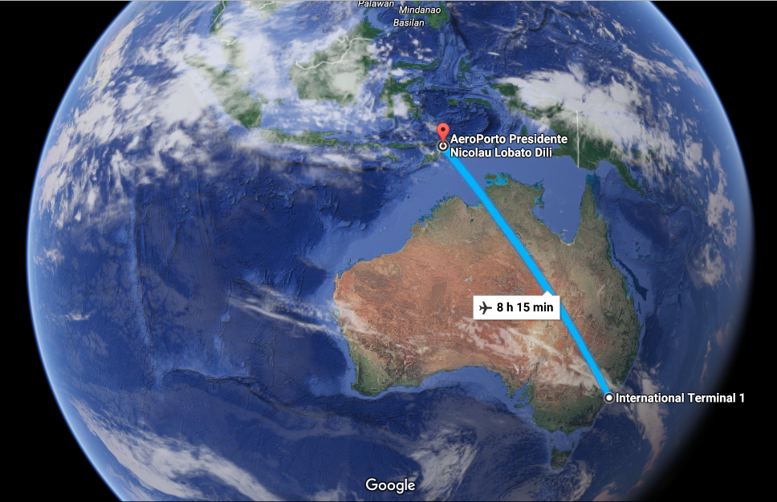

Slide 14
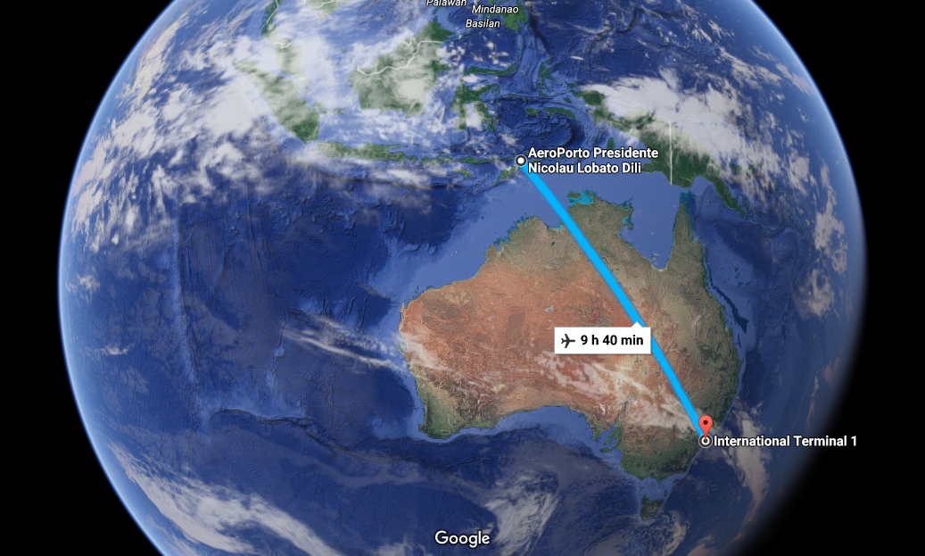

Slide 15
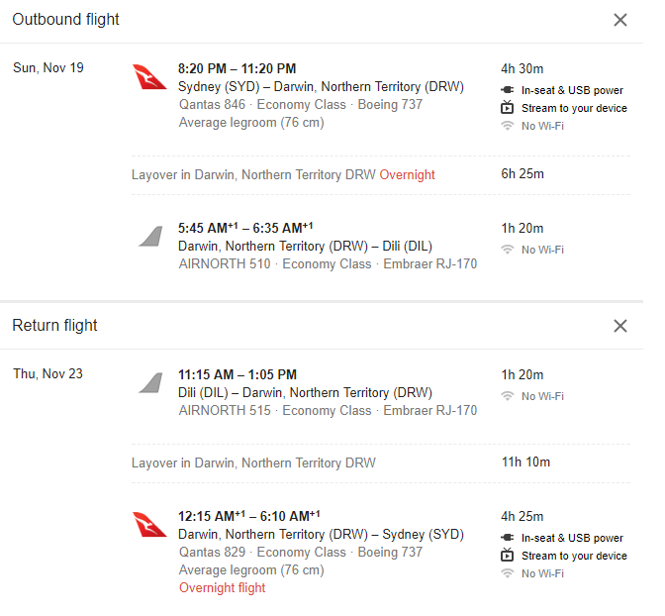

Slide 16
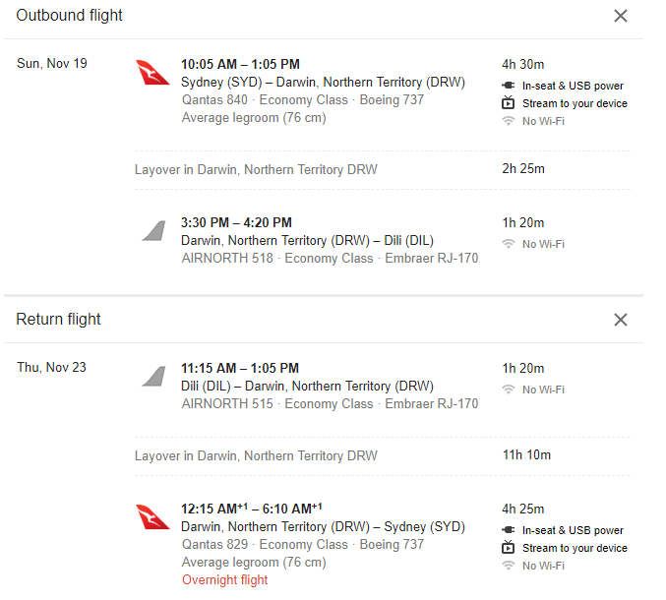

Slide 17
Locating East Timor
Examine and interpret the maps to determine which continent East Timor belongs to.
What continent are they a part of?
Which region do they belong to?

Slide 18
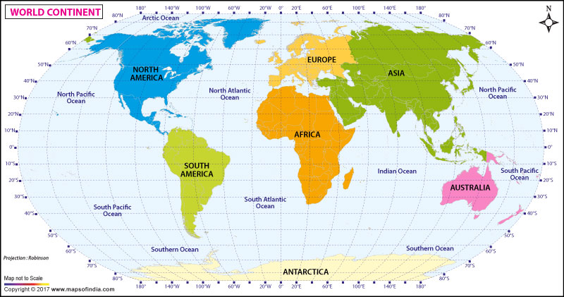

Slide 19
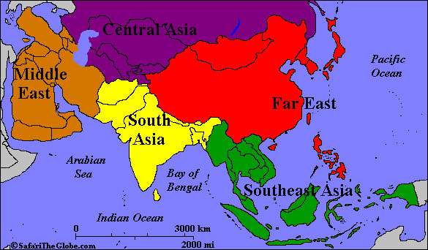

Slide 20
Locating East Timor
Examine and interpret the images to develop a description of East Timor’s landscape.
What does East Timor look like?
What might their climate be like?

Slide 21
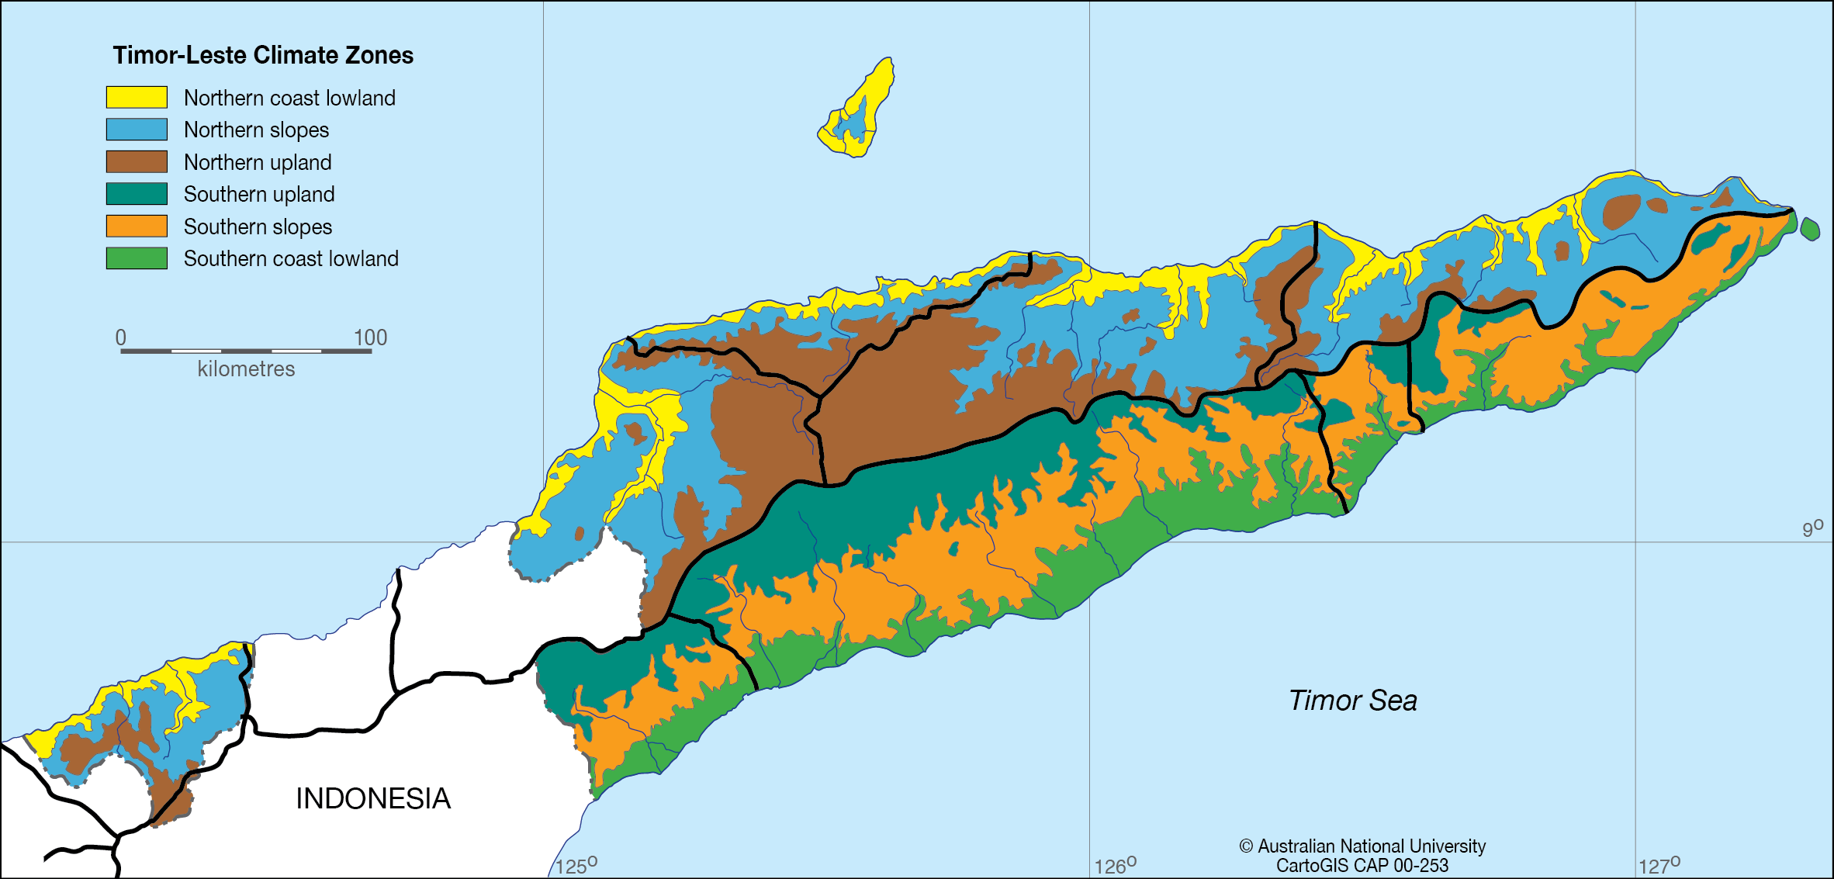

Slide 24
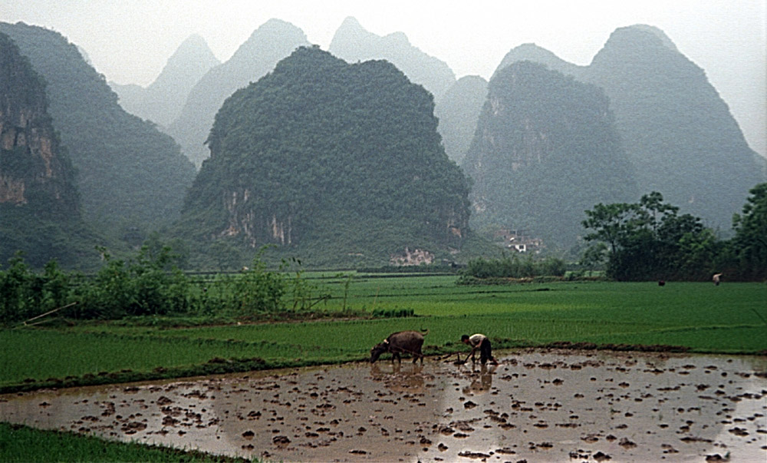

Slide 25
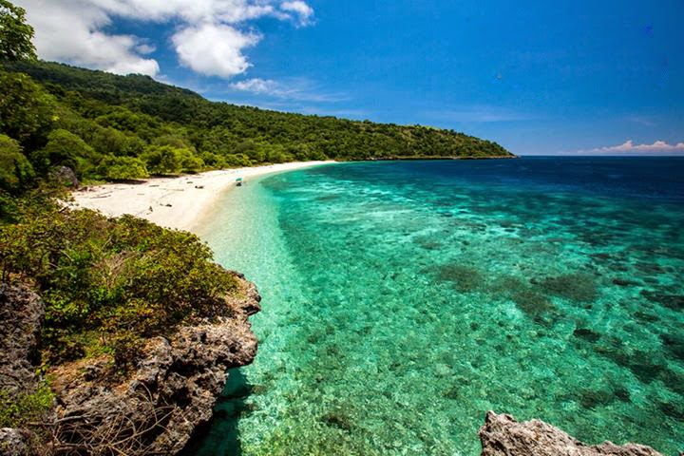

Slide 26
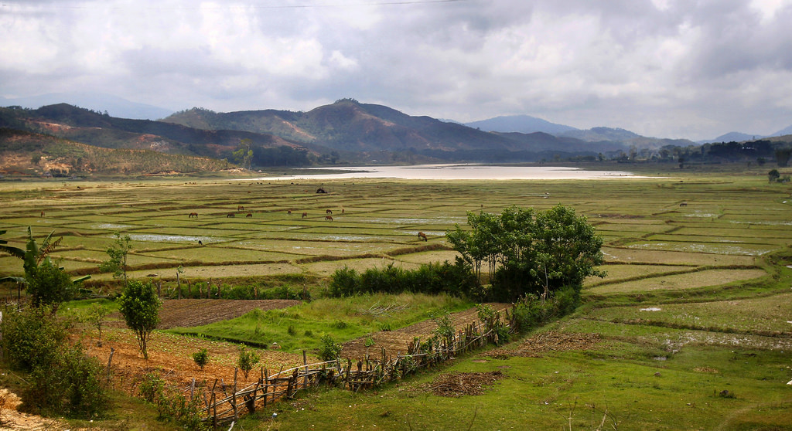

Slide 27
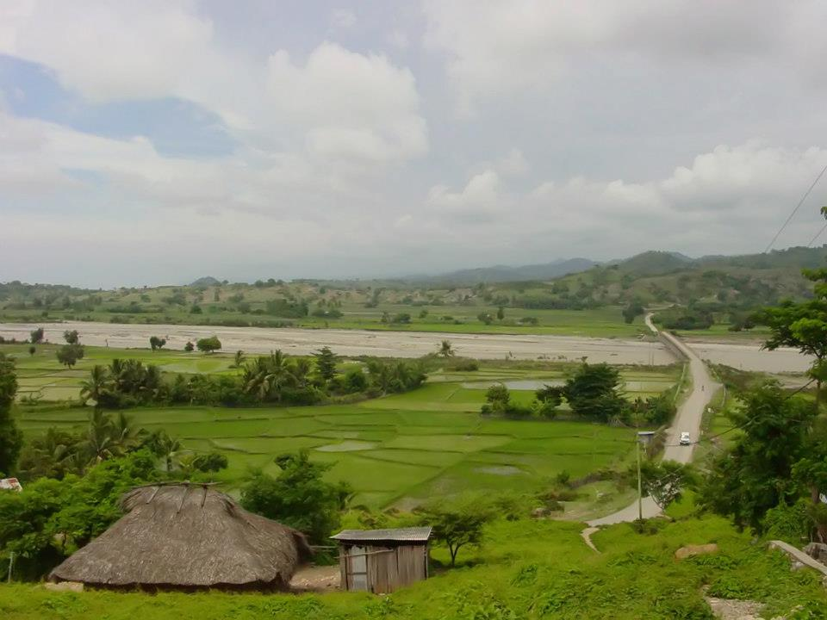

Slide 28
TOPOGRAPHY
The landscape offers a patchwork of rugged mountains, waterfalls, coastal lagoons, and diverse features that support variable vegetation, dry grasslands, savannah forests, gullies, and patches of dense rain forest.
Tata Mai Lau, a mountain that forms the highest point on East Timor, reaches 2,963 m just south of the capital city of Dili, and the Laclo river in the north stretches some 80 km, forming the longest river.

Slide 29
CLIMATE
Temperatures in the dry season, from May to November, average 20–33°c. The weather during this season is pleasant and dry.
Around October or November, oppressive humidity arrives and monsoon cloud activity builds up.
The wet season, from December to April, sees average temperatures of 29–35°c, with heavy rains and flooding.
In the mountains, daytime temperatures are warm to hot, but are cool to cold at night.
Earthquakes, tsunamis, and tropical cyclones occur.

