Slide 1
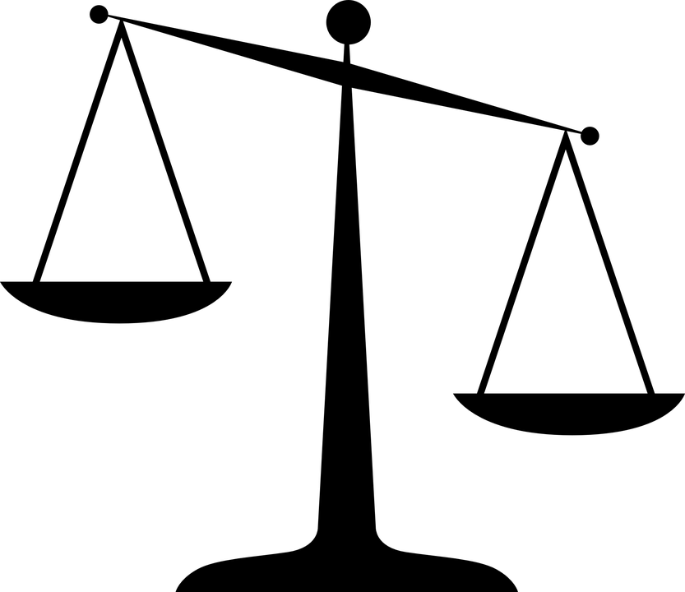
Mass
Stage 3
Alice Vigors
2017

Slide 2
Teaching and Learning Sessions
L.I: We are learning to use decimal notation to record mass and convert between units.
Session One
How much does that fruit weigh?
Session Two
How many kids to the elephant?
Outcomes:
Describes and represents mathematical situations in a variety of ways using mathematical terminology and some conventions MA3-1WM
Selects and applies appropriate problem-solving strategies, including the use of digital technologies, in undertaking investigations MA3-2WM
Selects and uses the appropriate unit and device to measure the masses of objects, and converts between units of mass MA3-12MG
Alice Vigors 2017
Notes:
Indicators Addressed:
Connect decimal representations to the metric system
recognise the equivalence of whole-number and decimal representations of measurements of mass, eg 3 kg 250 g is the same as 3.25 kg
interpret decimal notation for masses, eg 2.08 kg is the same as 2 kilograms and 80 grams
measure mass using scales and record using decimal notation of up to three decimal places, eg 0.875 kg
Convert between common metric units of mass
convert between kilograms and grams and between kilograms and tonnes
explain and use the relationship between the size of a unit and the number of units needed to assist in determining whether multiplication or division is required when converting between units, eg 'More grams than kilograms will be needed to measure the same mass, and so to convert from kilograms to grams, I need to multiply' (Communicating, Reasoning)

Slide 3
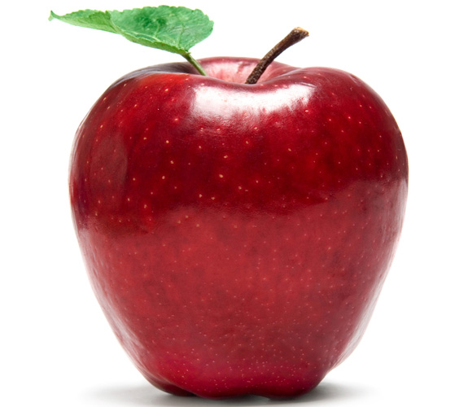
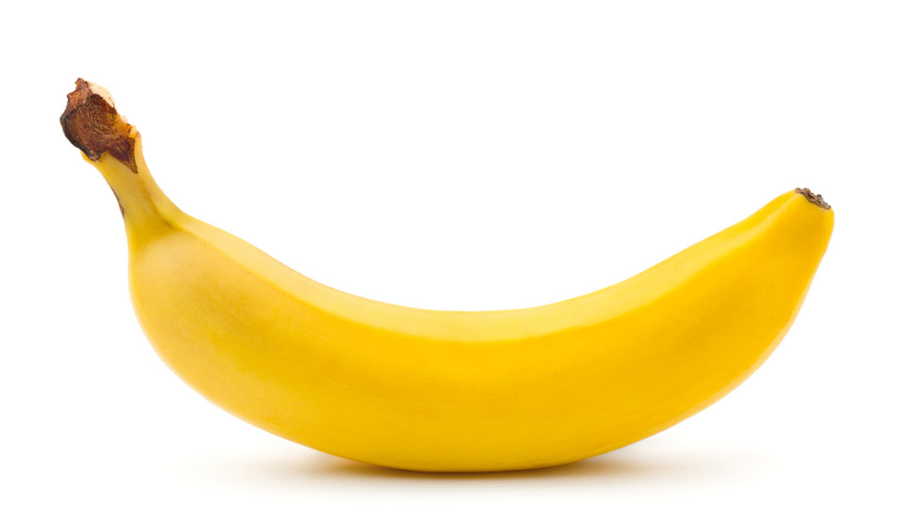
Session One
How much does that fruit weigh?
Alice Vigors 2017

Slide 4
L.I. We are learning to use decimal notation to record mass and convert between units.
What do you know about these units? Which one is heavier? Explain.
Kilogram
Gram
Tonne
Activating Prior Knowledge
Alice Vigors 2017

Slide 5
L.I. We are learning to use decimal notation to record mass and convert between units.
What is a conversion chart? Why might it be useful?
____ grams | = | _ kilogram
____ kilograms | = | _ tonne
Activating Prior Knowledge
Alice Vigors 2017

Slide 6
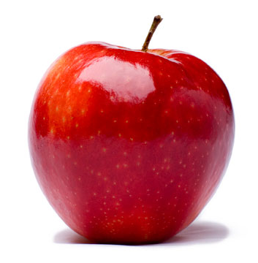
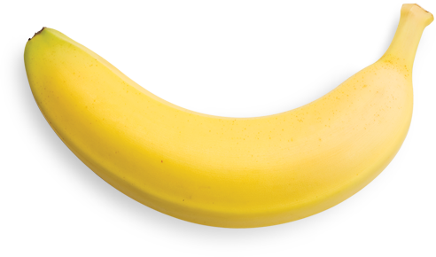
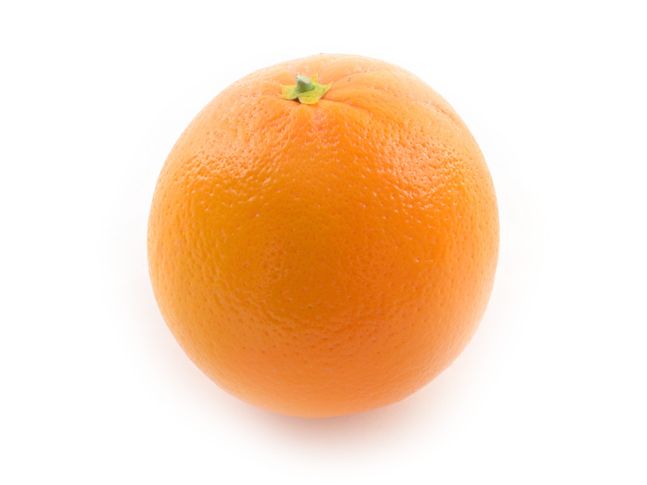
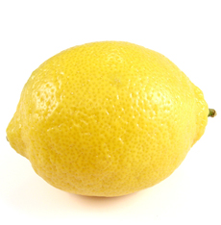
L.I. We are learning to use decimal notation to record mass and convert between units.
Assessment Item – MA3-12MG
Small Group Investigation
Which fruit ‘feels’ the heaviest?
In grams, how much does each fruit weigh? (use the kitchen scales)
Can you convert these measurements into kilograms using decimal notation?
How many pieces of each type of fruit would we need to make 1 kilogram? (closest without going over)
What would (x) number of choose fruit and (x) number of choose fruit weigh in g/kg/ t?
I need to bring fruit to the school fruit-a-thon. I have worked out I will need 1 tonne of a variety of fruit to cater for everyone. What quantities of each of these types of fruit could I purchase to make up 1 tonne?
Challenge: How much would this cost? What kinds of things could I make or
use the fruit for?
Building Explanations &
Reasoning with Evidence
Alice Vigors 2017
Notes:
Display an apple, lemon, banana and an orange.

Slide 7
L.I. We are learning to use decimal notation to record mass and convert between units.
Extension Question I: A Load of Insects
It has been estimated that the mass of insects caught by spiders in a year in Australia is equal to the mass of the human population of Australia. Assuming this population is around 24 million and the average mass of a human is 70 kg, what is the mass, in tonnes, of insects caught by spiders per year in Australia?
Building Explanations &
Reasoning with Evidence
Alice Vigors 2017

Slide 8
L.I. We are learning to use decimal notation to record mass and convert between units.
Exit Ticket: Choose two of these sentence starters to answer about today’s lesson.
Today I learnt…
This connected to what I already knew because…
This extended what I knew by…
One thing that still puzzles me is…
Reflecting on Learning
Alice Vigors 2017

Slide 9
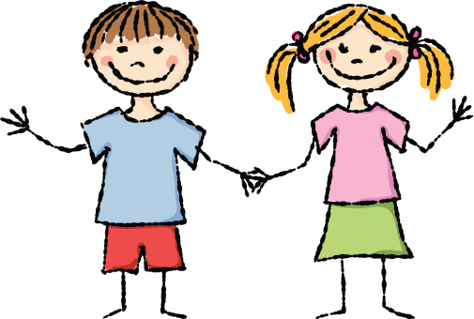
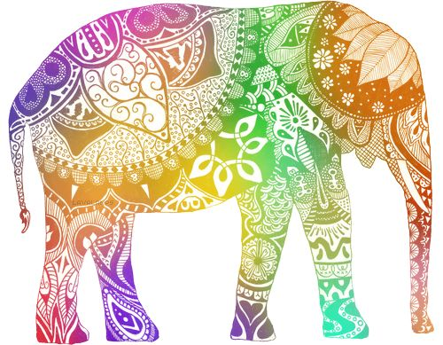
SESSION TWO
How many kids to the elephant?
Alice Vigors 2017

Slide 10
L.I. We are learning to use decimal notation to record mass and convert between units.
What do we know about the conversion chart?
____ grams | = | _ kilogram
____ kilograms | = | _ tonne
Activating Prior Knowledge
Alice Vigors 2017

Slide 11
L.I. We are learning to use decimal notation to record mass and convert between units.
Assessment Item – MA3-12MG
Convert these units of mass.
356g = ____kg | 724g = ____kg | 105g = ____kg
594kg = ____t | 234kg = ____t | 798kg = ____t
25kg = ____g | 1kg = ____g | 145kg = ____g
1t = ____kg | 89t = ____kg | 2t = ____g
2.5kg = ____g | 2.5kg = ____t | 8 ¼ t = ____kg
8 ¼ t = ____g | 63.75kg = ____g | 197.5g = ____t
Making Connections
Alice Vigors 2017
Notes:
Students may use a calculator to assist in solving these problems.

Slide 12
L.I. We are learning to use decimal notation to record mass and convert between units.
Assessment Item – MA3-12MG
Small Group Investigation: How many kids to the elephant?
Find the mass of the average student in the class.
Estimate how many students would have the same mass as an elephant (average 4 tonne)
Calculate how many students would have the same mass as an elephant.
How to calculate an average score: Add the number of scores you have. Divide the total of the scores by the number of scores to calculate the average score. Example: Data set: 100, 90, 100, 85, 95 and 80 Total of scores: 550 Average score: 550 ÷ 6 = 91.667
Building Explanations &
Reasoning with Evidence
Alice Vigors 2017
Notes:
Note: students should not be required to publicly reveal their weight. Provision should be made for them to weigh themselves and record on a piece of paper and hand this to the teacher to use for final calculation.

Slide 13
L.I. We are learning to use decimal notation to record mass and convert between units.
Extension Question II: Money Measure
You have ten identical open-topped boxes with 10 visually identical coins in each.
In nine of the boxes each of the 10 coins has a mass of 10g.
In one box the 10 coins have masses of only 9g each.
How can you find which box is the odd one out?
You have a normal mass measurer with a single pan and a scale. With just one weighing can you identify the box with the lighter coins.
Building Explanations &
Reasoning with Evidence
Alice Vigors 2017

Slide 14
L.I. We are learning to use decimal notation to record mass and convert between units.
Exit Ticket: Choose two of these sentence starters to answer about today’s lesson.
Today I learnt…
This connected to what I already knew because…
This extended what I knew by…
One thing that still puzzles me is…
Reflecting on Learning
Alice Vigors 2017

