Slide 1


Material World
- Matter
Year 5
Science & Technology

Slide 2
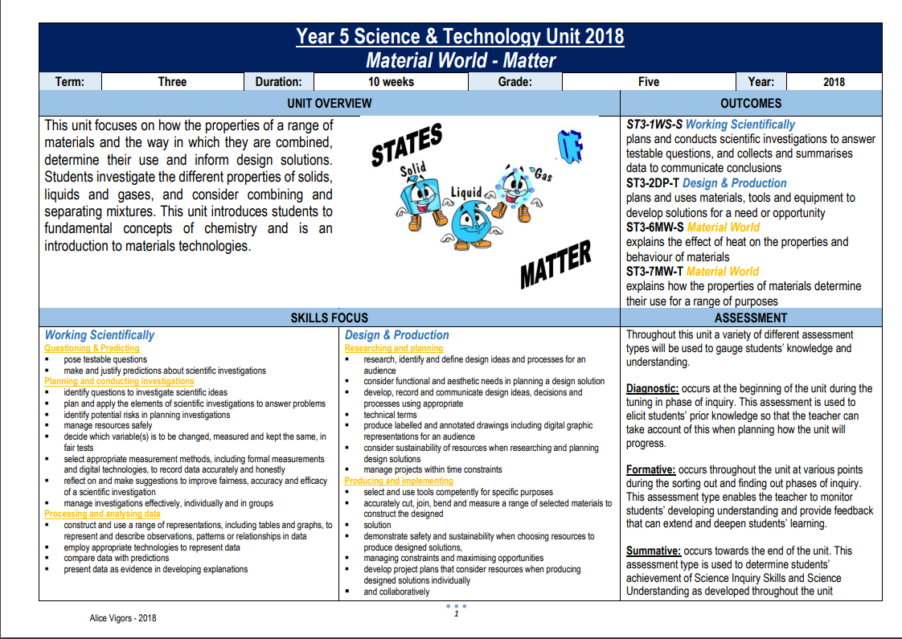

Unit Overview
This unit focuses on the properties of a range of materials and the way in which some materials can be combined and separated. Students investigate the different properties of solids, liquids and gases, and consider combining and separating mixtures. This unit introduces students to fundamental concepts of chemistry and is an introduction to materials technologies.
OUTCOMES
Working Scientifically
ST3-1WS-S plans and conducts scientific investigations to answer testable questions, and collects and summarises data to communicate conclusions
Design & Production
ST3-2DP-T plans and uses materials, tools and equipment to develop solutions for a need or opportunity
Material World
ST3-6MW-S explains the effect of heat on the properties and behaviour of materials
Alice Vigors 2018

Slide 3
Content & Skills Focus
Working Scientifically
Questioning & Predicting
  pose testable questions
  make and justify predictions about scientific investigations
Planning and conducting investigations
  identify questions to investigate scientific ideas
  plan and apply the elements of scientific investigations to answer problems
  identify potential risks in planning investigations
  manage resources safely
  decide which variable(s) is to be changed, measured and kept the same, in fair tests
  select appropriate measurement methods, including formal measurements and digital technologies, to record data accurately and honestly
  reflect on and make suggestions to improve fairness, accuracy and efficacy of a scientific investigation
  manage investigations effectively, individually and in groups
Processing and analysing data
  construct and use a range of representations, including tables and graphs, to represent and describe observations, patterns or relationships in data
  employ appropriate technologies to represent data
  compare data with predictions
  present data as evidence in developing explanations
Design & Production
Researching and planning
  research, identify and define design ideas and processes for an audience
  consider functional and aesthetic needs in planning a design solution
  develop, record and communicate design ideas, decisions and processes using appropriate technical terms
  produce labelled and annotated drawings including digital graphic representations for an audience
  consider sustainability of resources when researching and planning design solutions
  manage projects within time constraints
Producing and implementing
  select and use tools competently for specific purposes
  accurately cut, join, bend and measure a range of selected materials to construct the designed solution
  demonstrate safety and sustainability when choosing resources to produce designed solutions, managing constraints and maximising opportunities
  develop project plans that consider resources when producing designed solutions individually and collaboratively
States of Matter
investigate and compare the properties of solids, liquids and gases
Mixtures
explore that when materials are combined the result is either a mixture or a new substance, for example:
  salt and water
  bicarbonate of soda and vinegar
identify that mixtures can be separated using different techniques
Properties of Materials Determine Their Use
investigate characteristics and properties of a range of materials and evaluate the impact of their use
identify and evaluate the functional and structural properties of materials, for example:
  shade cloth for shelter
  aluminium for playground seats
  canvas for boat sails
critique needs or opportunities for designing using sustainable materials
design a sustainable product, system or environment individually and/or collaboratively considering the properties of materials
select appropriate materials, components, tools, equipment and techniques and apply safe procedures to produce designed solutions
Alice Vigors 2018

Slide 4
Essential Inquiry Questions
How can the state of materials be changed and manipulated?
What is the result of combining materials?
Alice Vigors 2018

Slide 5
Tuning In to the inquiry
Notes:
Teaching and Learning Sequence:
Small groups examine a range of 6-9 objects on a tray (e.g. rock, cup of water, balloon filled with air) that show different states of matter
▪ Use the thinking routine See Think Wonder to help students/groups scaffold their discussion, thinking and wonderings about states of matter
▪ Use the thinking routine Think Puzzle Explore to gauge understanding & misconceptions
▪ Watch Changing Water: States of Matter (stop video at 2:44) https://www.youtube.com/watch?v=tuE1LePDZ4Y
▪ Use the thinking routine +1 identify key ideas from the video and generate questions or puzzles about the concepts of matter, mixtures and materials.
Assessment (Diagnostic)
FOR THE TEACHER:
▪ How can we assess students’ prior knowledge and experience in relation to this context?
▪ How will we record this information for later assessment?
▪ What can we do to PROVOKE interest/enthusiasm/curiosity/motivation?
▪ How can we assist students to make “conceptual connections” and see relationships to and links with their own lives?

Slide 6
See Think Wonder - Thinking Routine
See What do you see, observe or notice? | Think What does it make you think? How do you think you might classify these objects? | Wonder What does it make you wonder?
Adapted from Ron Ritchhart
Alice Vigors 2018
Notes:
Small groups examine a range of 6-9 objects on a tray (e.g. rock, cup of water, balloon filled with air, things that have been mixed e.g. water and sand) that show different states of matter.
Classify the objects – solids, liquids and gases
In Science journals, students draw, describe and justify why they classified a group of objects in a particular way – including properties of the objects
Use the thinking routine See Think Wonder to help students/groups scaffold their discussion, thinking and wonderings about states of matter

Slide 7
Think Puzzle Explore - Thinking Routine
Think What do you think you know about states of matter, combining materials and how materials determine their use? | Puzzle What puzzles or questions do you have about states of matter, combining materials and/or how types of materials determine how they are used? | Explore Choose 1 or 2 puzzles. How might we explore this further? What might we need to explore this?
Adapted from Ron Ritchhart
Alice Vigors 2018
Notes:
Use the thinking routine Think Puzzle Explore to gauge understanding & misconceptions. The explore component can be sorting wonders in to topics areas

Slide 8
Shared Inquiry
Teaching & Learning Sequence
Notes:
FOR THE TEACHER:
What questions did the students pose that could help you drive learning in the shared inquiry phase?
Students need learning experiences that help them find and sort information in order to make sense and build understanding about the concept of matter and it’s uses.

Slide 9
How can the state of materials be changed and manipulated?
Alice Vigors 2018

Slide 10

Changing Water: States of Matter
Alice Vigors 2018
Notes:
Watch Changing Water: States of Matter (stop video at 2:44)
https://www.youtube.com/watch?v=tuE1LePDZ4Y

Slide 11
Key Terms
Solid
Liquid
Gas
Matter
Properties
Alice Vigors 2018
Notes:
Define key terms solid, liquid, gas, matter and properties

Slide 12

Fair Tests
What is a fair test?
What are the 3 variables to consider when conducting a Science experiment?
Alice Vigors 2018
Notes:
What is a fair test and what are the scientific variables?
Watch Scientific Variables and discuss the 3 variables. Groups could generate a poster to explain the 3 types and how they contribute to a fair test.
https://www.youtube.com/watch?v=0A55QRyJHPM

Slide 13
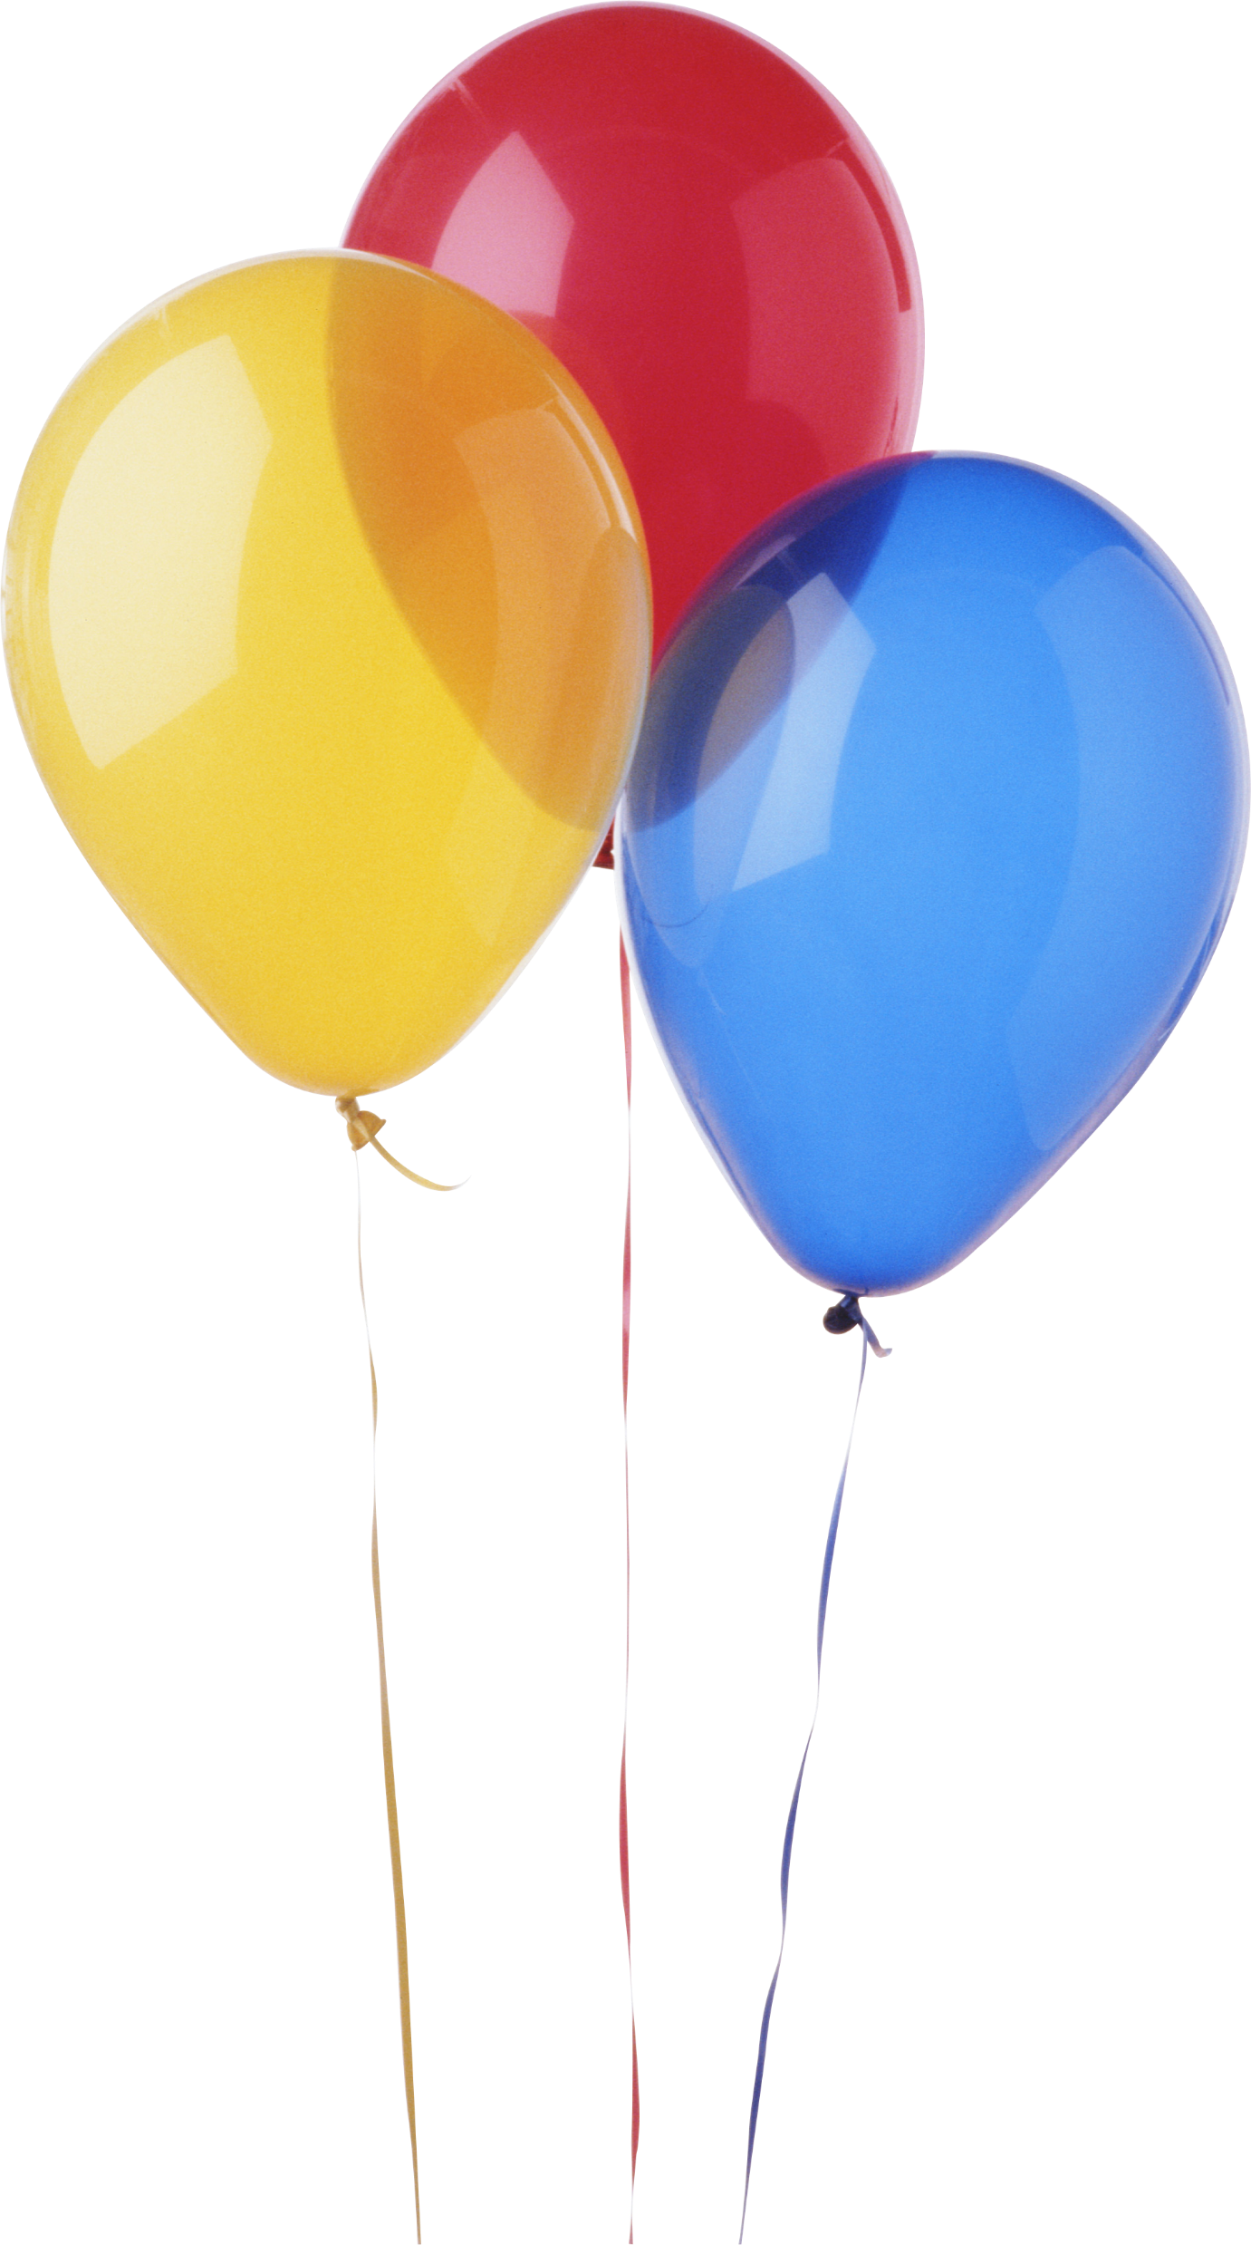
Properties of Water & Air
Hypothesis: What do you think will happen? What makes you say that?
Scientific Variables:
What will be the dependent variable? What are you going to measure?
What will be the independent variable? What are you going to change?
What variables will you need to control? What will you need to keep the same?
Alice Vigors 2018
Notes:
Small groups investigate the properties of water and air using balloons.
Hypothesis – What do you think will happen? Explain why.
Variables –
What will be the dependent variable? What are you going to measure?
What will be the independent variable? What are you going to change?
What variables will you need to control? What will you need to keep the same?
Day 1:
Fill two with water (one for freezing) and fill one with air
Label the balloons – solid liquid gas.
Make observations and predictions about each balloon using detailed diagrams.
Measure the circumference and weigh the balloons.
Place one water balloon in the freezer.
Day 2:
Add to observations and re-measure the circumference and weigh, making note of any changes making predictions as to why.
Graph data, discussing with other groups why the data is not all the same. Experiment with Google sheets to create and compare data.
Explore the behaviour of each balloon as the matter is released. One by one undo/cut the top off the balloons – pour liquid into another container, let air out & peel balloon off the ice. Draw detailed diagrams to show and explain differences Assessment (ST3-1WS-S, ST3-2DP-T, ST3-6MW-S)

Slide 14
Properties of Water & Air
Observe and draw detailed diagrams of the three balloons.
Make predictions about the changes that may occur to the solid, liquid & gas balloons over the next 24hours.
Measure the circumference of each balloon
Weigh each balloon.
Alice Vigors 2018
Notes:
Small groups investigate the properties of water and air using balloons.
Hypothesis – What do you think will happen? Explain why.
Variables –
What will be the dependent variable? What are you going to measure?
What will be the independent variable? What are you going to change?
What variables will you need to control? What will you need to keep the same?
Day 1:
Fill two with water (one for freezing) and fill one with air
Label the balloons – solid liquid gas.
Make observations and predictions about each balloon using detailed diagrams.
Measure the circumference and weigh the balloons.
Place one water balloon in the freezer.
Day 2:
Add to observations and re-measure the circumference and weigh, making note of any changes making predictions as to why.
Graph data, discussing with other groups why the data is not all the same. Experiment with Google sheets to create and compare data.
Explore the behaviour of each balloon as the matter is released. One by one undo/cut the top off the balloons – pour liquid into another container, let air out & peel balloon off the ice. Draw detailed diagrams to show and explain differences Assessment (ST3-1WS-S, ST3-2DP-T, ST3-6MW-S)

Slide 15
Properties of Water & Air
What do you see, observe or notice 24 hours on?
Measure the circumference and weigh each balloon. Why might there have been changes?
Experiment with Google Sheets to graph & compare data.
What happens when the matter is released? Draw detailed diagrams to show and explain the differences.
Alice Vigors 2018
Notes:
Small groups investigate the properties of water and air using balloons.
Hypothesis – What do you think will happen? Explain why.
Variables –
What will be the dependent variable? What are you going to measure?
What will be the independent variable? What are you going to change?
What variables will you need to control? What will you need to keep the same?
Day 1:
Fill two with water (one for freezing) and fill one with air
Label the balloons – solid liquid gas.
Make observations and predictions about each balloon using detailed diagrams.
Measure the circumference and weigh the balloons.
Place one water balloon in the freezer.
Day 2:
Add to observations and re-measure the circumference and weigh, making note of any changes making predictions as to why.
Graph data, discussing with other groups why the data is not all the same. Experiment with Google sheets to create and compare data.
Explore the behaviour of each balloon as the matter is released. One by one undo/cut the top off the balloons – pour liquid into another container, let air out & peel balloon off the ice. Draw detailed diagrams to show and explain differences Assessment (ST3-1WS-S, ST3-2DP-T, ST3-6MW-S)

Slide 16

Properties of Water & Air
Graph your data using Google sheets.
Gather data from one other group.
Graph their data.
Compare and contrast the data.
Are there differences? Why might this be?
What does this experiment tell you about different states of matter?
Alice Vigors 2018
Notes:
Small groups investigate the properties of water and air using balloons.
Hypothesis – What do you think will happen? Explain why.
Variables –
What will be the dependent variable? What are you going to measure?
What will be the independent variable? What are you going to change?
What variables will you need to control? What will you need to keep the same?
Day 1:
Fill two with water (one for freezing) and fill one with air
Label the balloons – solid liquid gas.
Make observations and predictions about each balloon using detailed diagrams.
Measure the circumference and weigh the balloons.
Place one water balloon in the freezer.
Day 2:
Add to observations and re-measure the circumference and weigh, making note of any changes making predictions as to why.
Graph data, discussing with other groups why the data is not all the same. Experiment with Google sheets to create and compare data.
Explore the behaviour of each balloon as the matter is released. One by one undo/cut the top off the balloons – pour liquid into another container, let air out & peel balloon off the ice. Draw detailed diagrams to show and explain differences Assessment (ST3-1WS-S, ST3-2DP-T, ST3-6MW-S)

Slide 17
Liquid Investigation - Shape
Why do liquids change shape?
What do you think will happen? What makes you say that?
Alice Vigors 2018
Notes:
Why do liquids change shape? What happens when you heat or cool liquids? Using a given volume of water small groups investigate what happens when water (room temperature) is poured into different containers. Groups compose an investigation report, including:
Hypothesis – What do you think will happen? Explain why.
Variables –
What will be the dependent variable? What are you going to measure?
What will be the independent variable? What are you going to change?
What variables will you need to control? What will you need to keep the same?
Draw and observe the change of shape
Make predictions about how high the water will rise in each container
Reason with evidence as to how and why liquids change shape.
Assessment (ST3-1WS-S, ST3-2DP-T, ST3-6MW-S)

Slide 18
Liquid Investigation - Shape
Scientific Variables:
What will be the dependent variable? What are you going to measure?
What will be the independent variable? What are you going to change?
What variables will you need to control? What will you need to keep the same?
Alice Vigors 2018
Notes:
Why do liquids change shape? What happens when you heat or cool liquids? Using a given volume of water small groups investigate what happens when water (room temperature) is poured into different containers. Groups compose an investigation report, including:
Hypothesis – What do you think will happen? Explain why.
Variables –
What will be the dependent variable? What are you going to measure?
What will be the independent variable? What are you going to change?
What variables will you need to control? What will you need to keep the same?
Draw and observe the change of shape
Make predictions about how high the water will rise in each container
Reason with evidence as to how and why liquids change shape.
Assessment (ST3-1WS-S, ST3-2DP-T, ST3-6MW-S)

Slide 19
Key Terms
What is viscosity?
A liquids resistance to flowing is called viscosity. Not all liquids are the same.
Some are thin and flow easily, and have a low viscosity. Others are thick and gooey and have a high viscosity.
Can you think of liquids that might have a high or low viscosity?
Alice Vigors 2018
Notes:
Introduce and define the term viscosity – a liquids resistance to flowing. Not all liquids are the same. Some are thin and flow easily – these have low viscosity. Others are thick and gooey and have a high viscosity.

Slide 20
Liquid Investigation - Viscosity
Hypothesis: What do you think will happen? What makes you say that?
Scientific Variables:
What will be the dependent variable? What are you going to measure?
What will be the independent variable? What are you going to change?
What variables will you need to control? What will you need to keep the same?
Assessment
Alice Vigors 2018
Notes:
Shared Inquiry (Activity Sequence)
Small groups investigate reasons why different liquids travel at different speeds and how heating or cooling the liquid might impact this process. Explain and explicitly model experiment for students demonstrating WILF & WAGOLL. Small groups will need to:
Assign each member a key role – e.g. group leader, timer, recorder, equipment manager
Choose 4 liquid options.
Mark aluminium trays with a start and finish lines.
Place a teaspoonful of each liquid at the start line whilst the tray is laying flat. Make sure there is space between each liquid.
Tilt tray slightly to allow liquids to run down the tray.
Record time it takes each liquid to run down the tray using a timer and record using an iPad.
Represent data gathered using a graph.
Repeat experiment with chilled and/or warm liquids. (NB: Some groups might be given cool and some might be given warm or if time permits groups explore both.)
Represent new data

Slide 21
Liquid Investigation - Viscosity
Choose 4 liquid options.
Mark aluminium trays with a start and finish line.
Place an equal amount of each liquid at the start line whilst the tray is laying flat. Space out your liquids.
Tilt tray slightly to allow liquids to run down the tray and begin the timer.
Record video of the experiment or capture in images.
Represent data using a table.
Repeat experiment two more times.
Assessment
Alice Vigors 2018
Notes:
Shared Inquiry (Activity Sequence)
Small groups investigate reasons why different liquids travel at different speeds and how heating or cooling the liquid might impact this process. Explain and explicitly model experiment for students demonstrating WILF & WAGOLL. Small groups will need to:
Assign each member a key role – e.g. group leader, timer, recorder, equipment manager
Choose 4 liquid options.
Mark aluminium trays with a start and finish lines.
Place a teaspoonful of each liquid at the start line whilst the tray is laying flat. Make sure there is space between each liquid.
Tilt tray slightly to allow liquids to run down the tray.
Record time it takes each liquid to run down the tray using a timer and record using an iPad.
Represent data gathered using a graph.
Repeat experiment with chilled and/or warm liquids. (NB: Some groups might be given cool and some might be given warm or if time permits groups explore both.)
Represent new data

Slide 22



Liquid Investigation - Viscosity
Draw comparisons & conclusions between each of their experiments and the data they gathered.
Use one or more of the following apps to record findings and answer the lesson supporting question What are the properties of liquids? What impact does viscosity have on the speed at which liquids move? group member must be observed contributing in the recorded response and use video and images from task.
  iMovie
  Shadow Puppet
  Seesaw
Post responses to Seesaw, tagging each group member
Assessment
Alice Vigors 2018
Notes:
Formative Assessment
Small groups draw comparisons and conclusions between each of their experiments and the data they gathered.
Use one or more of the following apps to record findings and answer the lesson supporting question What are the properties of liquids? What impact does changing temperature have on the speed at which liquids travel? group member must be observed contributing in the recorded response and use video and images from task.
iMovie
Shadow Puppet
Seesaw
Post responses to Seesaw, tagging each group member
View videos as a class and discuss findings and conclusions made by each group. Explore reasons why groups may have differing data and drawn different conclusions during the experiment. Teacher records key findings made by the groups to be used in plenary
Share recordings with parents (via the app)
Success Criteria:
→utilise experiment information and data gathered during their investigation
→make accurate comparisons between data
→draw scientific conclusions about the properties of liquids and how they are impacted by temperature with growing confidence
→ensure all members of the group contribute to a variety of aspects during the experiment and recording phases
→plan, compose, edit and present a logical and coherent explanation supported by evidence that answers the supporting questions What are the properties of liquids? What impact does changing temperature have on the speed at which liquids travel?
→actively engage in discussions about data and conclusion discrepancies between groups and explore reasons for these

Slide 23
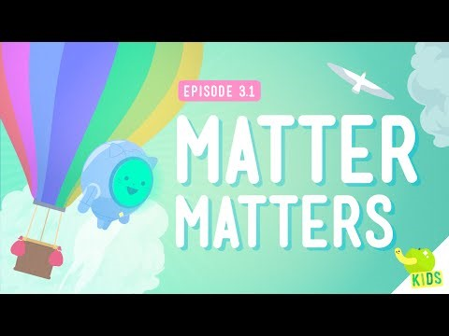
What’s Matter?
Alice Vigors 2018

Slide 24
Gases Investigation
Hypothesis: What do you think will happen? What makes you say that?
Scientific Variables:
What will be the dependent variable? What are you going to measure?
What will be the independent variable? What are you going to change?
What variables will you need to control? What will you need to keep the same?
Alice Vigors 2018
Notes:
Investigate the difference between hot air and cold air. Compile an investigation report that includes:
Hypothesis – What do you think will happen? Explain why.
Variables –
What will be the dependent variable? What are you going to measure?
What will be the independent variable? What are you going to change?
What variables will you need to control? What will you need to keep the same?
Investigation sequence:
Place a balloon on top of an empty small plastic bottle.
Stand the bottle in warm water and observe what happens. Why might this occur?
Remove the bottle from the water placing it into chilled water, allowing it to cool. What happens now? Why does this happen?
What conclusions can you draw about hot and cold air? What might this mean for the weather??

Slide 25
Gases Investigation
What is the difference between hot and cold air?
What do you see, observe or notice?
Why do you think this might be?
What conclusions can you draw about hot and cold air?
What might this mean for the weather?
Alice Vigors 2018
Notes:
Investigate the difference between hot air and cold air. Compile an investigation report that includes:
Hypothesis – What do you think will happen? Explain why.
Variables –
What will be the dependent variable? What are you going to measure?
What will be the independent variable? What are you going to change?
What variables will you need to control? What will you need to keep the same?
Investigation sequence:
Place a balloon on top of an empty small plastic bottle.
Stand the bottle in warm water and observe what happens. Why might this occur?
Remove the bottle from the water placing it into chilled water, allowing it to cool. What happens now? Why does this happen?
What conclusions can you draw about hot and cold air? What might this mean for the weather??

Slide 26
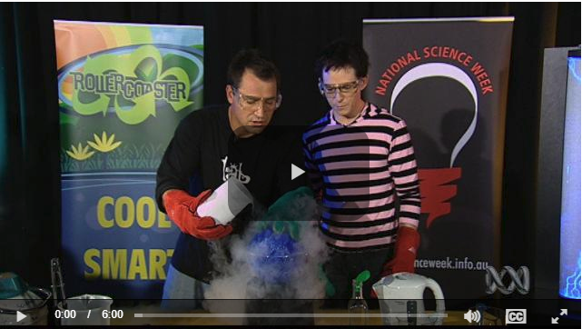
Air Experiment
http://education.abc.net.au/home#!/media/103418/
Alice Vigors 2018

Slide 27
Claim Support Question- Thinking Routine
Claim What is the claim? | Support What evidence have we gathered to support this claim? | Question What questions do we still have about states of matter?
Assessment
Adapted from Ron Ritchhart
Alice Vigors 2018
Notes:
Examine the essential question. How might we go about answering this? What evidence have we gathered to support our responses? What questions do we still have about states of matter? The thinking routine Claim Support Question would be a useful tool to scaffold student thinking.
Assessment (Summative)

Slide 28
What is the result of combining materials?
Alice Vigors 2018

Slide 29
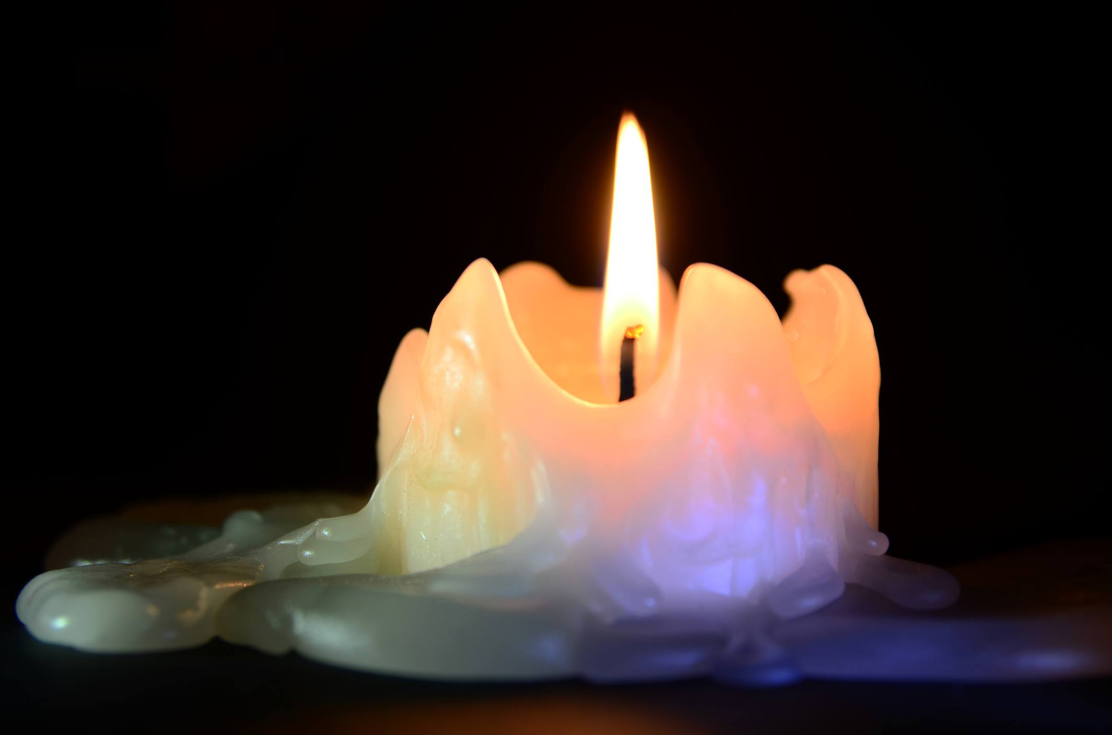
Key Terms
What is the difference between reversible changes in matter and irreversible changes in matter?
Reversible:
Irreversible:
Alice Vigors 2018
Notes:
Discuss what are reversible and irreversible changes in matter and define the key terms.
Burning paper (irreversible) – demonstrate and discuss how when paper is burnt it turns to ash and cannot be returned to its former state.
Burning a candle (reversible) – demonstrate and discuss how when you burn a candle the wax turns into a liquid. However, it can be moulded back into its original form.

Slide 30
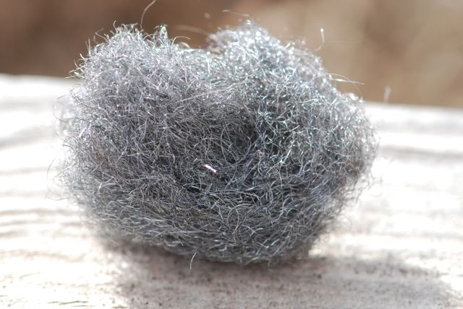
Steel Wool Experiment
What happens to steel wool when it comes into contact with other materials, over a period of time?
Alice Vigors 2018
Notes:
Steel wool rust investigation – explain that the class will be observing the effects of different products on steel wool over a period of time.
Using 3 jars – fill one with water, one with water with salt added and one with water that has had either vinegar or bleach added to it.
Place a piece of steel wool into each jar.
Have students predict what effects they think the solutions will have on the steel wool, if any. Examine the changes to the steel wool over time in different solutions (Record observations daily on class chart).

Slide 31
Combination Investigations
Salt and Water
Bicarb Soda and Vinegar
Water, Vegetable Oil, Food Colouring and Soluble Aspirin
Corn Starch, Water and Food Colouring
Lemonade and Sultanas
What occurred in each of the experiments?
Why do you think this occurred?
Draw and label diagrams to show the reactions.
Assessment
Alice Vigors 2018
Indicates hyperlink
Notes:
Investigate the reactions that occur when two different materials are combined, in small groups. Some examples could include:
o salt and water
o bicarb soda & vinegar – produces lots of froth
o lemonade and sultanas – watch the sultanas dance up and down as the gas lifts them to the surface, pops, escapes and allows them to drop to the bottom.
o Water, vegetable oil, food colouring and soluble aspirin (DIY Lava Lamp: instructions and video (click link)
o Use a device to record the experiment reactions
o Corn starch, water and food colouring (makes slime - Mythbusters Walking on water video link)
Investigation Sequence: make predictions about what might occur, determine the variables to make it a fair test, draw and label diagrams to show reactions, explain what occurred during each experiment and reason with evidence as to why they think this might be.
Assessment (ST3-1WS-S, ST3-2DP-T, ST3-6MW-S)

Slide 32
Key Terms
Mixing:
Separating:
Filtration:
Alice Vigors 2018
Notes:
Discuss what are reversible and irreversible changes in matter and define the key terms.
Burning paper (irreversible) – demonstrate and discuss how when paper is burnt it turns to ash and cannot be returned to its former state.
Burning a candle (reversible) – demonstrate and discuss how when you burn a candle the wax turns into a liquid. However, it can be moulded back into its original form.

Slide 33
Filtration
How can materials be mixed together and then separated?
How might we add sand to water and then remove it again?
Alice Vigors 2018
Notes:
How can materials be mixed together and then separated?
o Mix water and sand together
o Small groups examine how the process of filtration can be used to separate the sand from the water

Slide 34
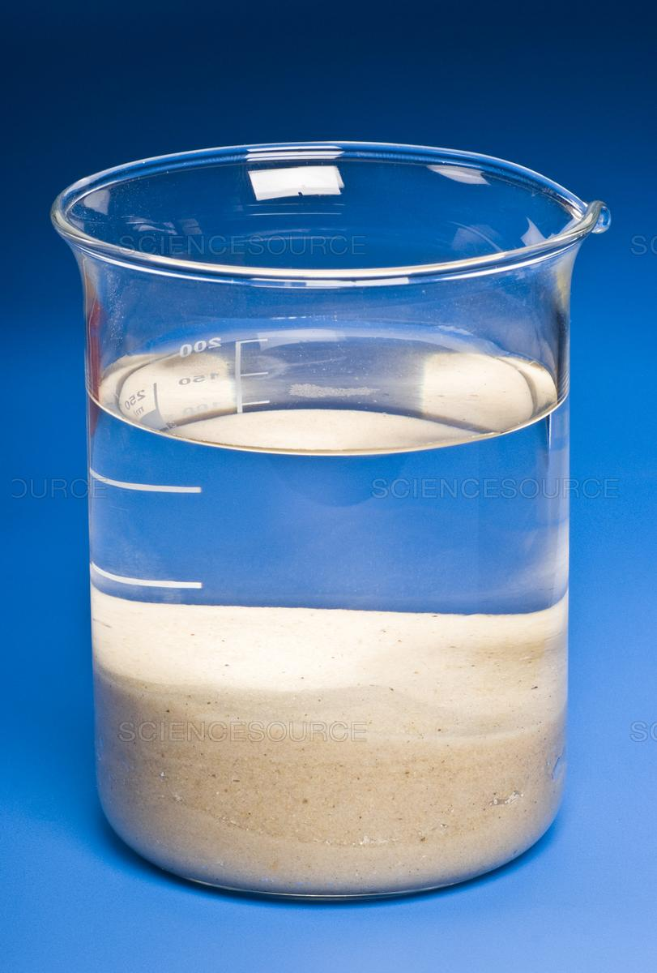
Filtration
Alice Vigors 2018
Hypothesis: What do you think will happen? What makes you say that?
Scientific Variables:
What will be the dependent variable? What are you going to measure?
What will be the independent variable? What are you going to change?
What variables will you need to control? What will you need to keep the same?
Notes:
How can materials be mixed together and then separated?
o Mix water and sand together
o Small groups examine how the process of filtration can be used to separate the sand from the water

Slide 35
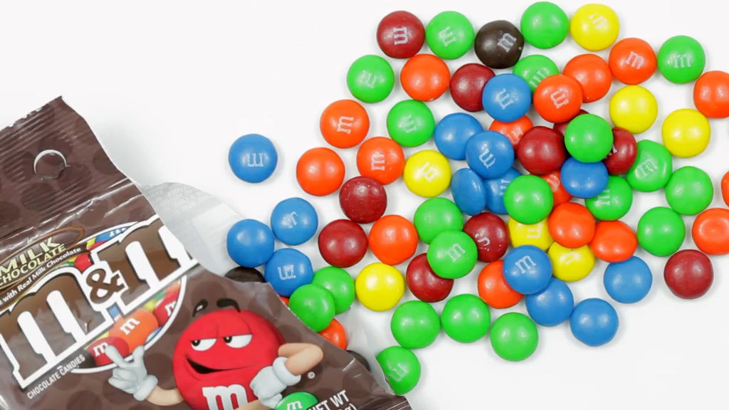
M&M Experiment
How might I separate the sugar coating from the chocolate?
What do you see, observe or notice?
Why do you think this happens?
What questions do you have?
Alice Vigors 2018
Notes:
M&M experiment. Can I separate the sugar coating from the chocolate?
o Small groups investigate what happens when M7M’s are combined with water.
□ Place a small dish with water on a table
□ Place different coloured M&M’s in a circular pattern in the water, with one on the centre
□ Make predictions and record observations about what occurs and why this happens
□ Video: http://education.abc.net.au/home#!/media/103792/from-chocolate-buttons-to-magic-patterns

Slide 36
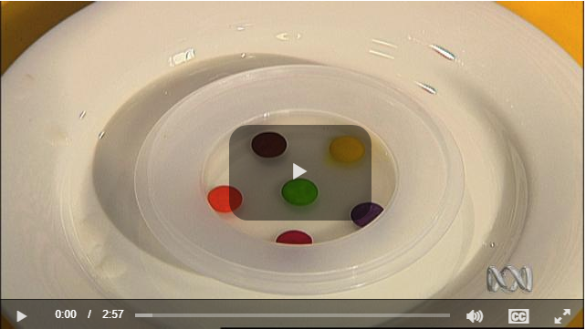
M&M Experiment
http://education.abc.net.au/home#!/media/103792/from-chocolate-buttons-to-magic-patterns
Alice Vigors 2018

Slide 37
Experiment Design Challenge
What is the result of combining materials?
Small groups design a simple experiment to demonstrate combining or separating mixtures.
Present experiment to the class along with an explanation about the result of combining materials. Use reasoning and evidence from learning to support explanation.
Presentations will be recorded and uploaded to Seesaw.
Assessment
Alice Vigors 2018

Slide 38
Thankyou for using this powerpoint to support student learning.
Share examples at thinkingpathways@gmail.com
Visit the website: https://thinkingpathwayz.weebly.com/
Alice Vigors 2018

