Slide 1
Physical World ~ Forces ~
Stage 2
Alice Vigors 2020

Slide 2
Key Inquiry Questions
How can objects affect each other with or without touching them?
How can we use forces and energy in a product or system?
Alice Vigors 2020

Slide 3
Tuning In
Activating Prior Knowledge
Alice Vigors 2020

Slide 4
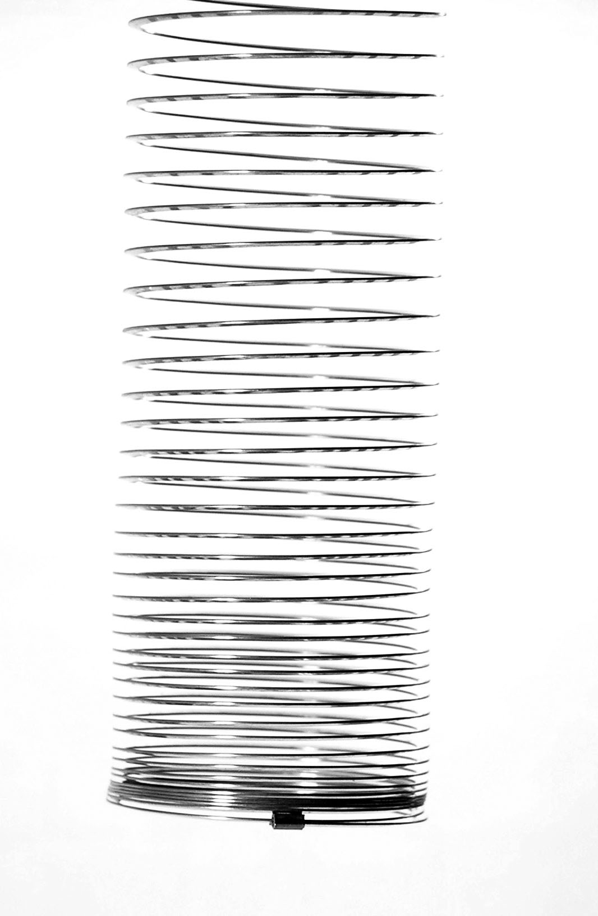
Imagine …
Imagine holding a slinky by the top end, with the bottom end dangling in mid-air.
What do you think would happen when you let it go?
Make
a prediction about what will happen
Draw a diagram to support what you think
Alice Vigors 2020

Slide 5
The physics of a slinky drop!
Source:
ABC Education
Alice Vigors 2020

Slide 6
Shared Inquiry
How can objects affect each other with or without touching them?
Alice Vigors 2020

Slide 7
What is a force?
Source:
Novel Learning Centre
Alice Vigors 2020

Slide 8
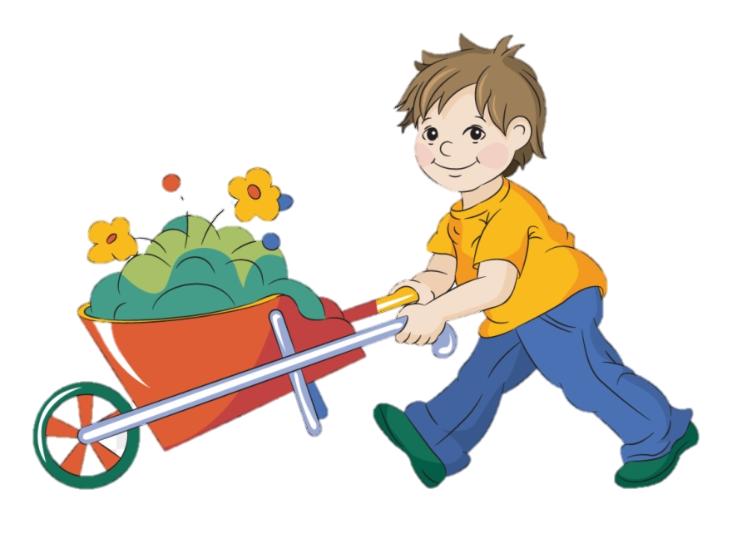
What is a force?
A push or a pull.
A force cannot be seen.
A force can move a stationary object, stop a moving object, change its direction, change the speed of an object or change its shape.
How can we put forces into a category?
Contact Force
Non-Contact Force
What examples of forces can we see in the world around us?
Alice Vigors 2020

Slide 9
Forces can push and pull
Source:
Jack Hartmann Kids Music
Alice Vigors 2020

Slide 10
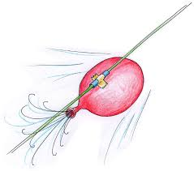
Balloon Rocket
How do different forces affect the movement of a balloon?
Equipment
Each group will need to gather the following essential equipment:
String
Straws
Masking tape
Balloon
In your group:
Draw a diagram of how you might use the equipment to make a balloon rocket, including length of the string.
Make a prediction in words about what you think is happening during this experiment.
Test your prediction by setting up your experiment.
Draw a diagram and write a short explanation to explain what happened and what forces were being used during the experiment.
Assessment For Learning
Alice Vigors 2020

Slide 11
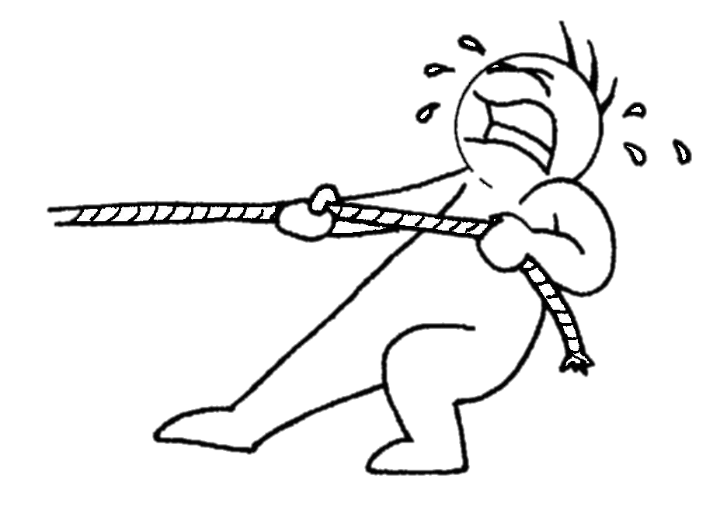
Weight and Forces
How does an object's weight affect the force required to move it?
Equipment
Each group will need to gather the following essential equipment:
String
Cup
Object
Small weights
In your group:
Draw a diagram of how you might use the equipment to test how much weight is needed to make your object move.
Make a prediction in words about what you think is happening during this experiment.
Test your prediction by setting up your experiment.
Draw a diagram and write a short explanation to explain what happened and what forces were being used during the experiment.
Assessment For Learning
Alice Vigors 2020

Slide 12
Aboriginal and Torres Strait Islander Perspective
Source:
Cassidy
Alice Vigors 2020

Slide 13
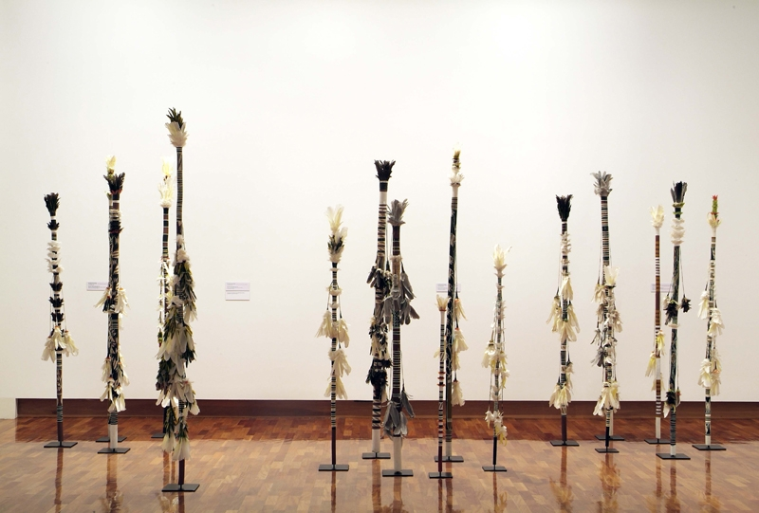
How did Aboriginal and Torres Strait Islander people understand the force of gravity? How did they communicate their understanding through dreamtime stories? Why are dreamtime stories important? How does this connect to what we already know about forces?
Aboriginal and Torres Strait Islander Perspective
Source: Arthur Beau Palmer – Banumbirr Morning Star Poles
Alice Vigors 2020

Slide 14
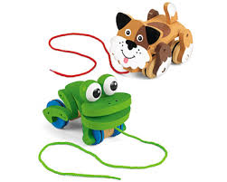
Shared Inquiry
How can we use forces and energy in a product or system?
Alice Vigors 2020

Slide 15
How can Science be applied to creating toys?
I used to think …
Now I think …
So next I will …
Alice Vigors 2020

Slide 16
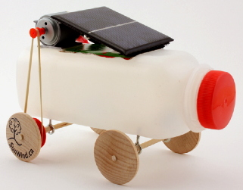
Design & Produce Task
Task: Create a Science toy and investigate the forces used by the toy or to make the toy move.
Equipment
Your group will need a variety of materials to create your toy
In groups of 3:
Draw a design of your toy and label its parts.
Make a prediction in words about the kind of forces the toy will use or those needed to make it move.
Build and Test your toy.
Create an advertising poster you could use to promote your toy. It needs to include a diagram of the forces involved in your toy.
Assessment Of Learning
Alice Vigors 2020

Slide 17
Reflecting on Learning
Reflection Routine: Traffic Light Reflection
What challenged you during the design and produce task?
How did you overcome the obstacles during the task?
In what ways were you successful in this task?
Assessment As Learning
Alice Vigors 2020

