Slide 1
Portraiture & The Archibald Prize
Stage 3
Alice Vigors
2017

Slide 2
Teaching and Learning Sequence
1. Looking and Responding to Portraiture
2. Introducing the Archibald Prize
3. Andy Warhol inspired portraiture
5. Pablo Picasso inspired portraiture
4. Exploring expressionism through portraiture
Theory: What is portraiture?
Art Appreciation: examining a range of portraits
Theory: What is the Archibald Prize?
Art Appreciation: exploring prize winning artworks and finalists
Brief for school Archibald competition (Week 10)
Art appreciation: Shot Marilyn by Andy Warhol (1964)
Experiment with the use of colour and photography (repeated images)
Art appreciation: The Scream by Edvard Much (1893)
Theory: What is expressionism?
Create an artwork that depicts an emotion
Art appreciation: The Weeping Woman by Pablo Picasso (1937)
Create an artwork that uses shapes to depict a portrait
Alice Vigors 2017
Notes:
Visual Arts Outcomes
Making:
VAS3.1 – investigates subject matter in an attempt to represent likenesses of things in the world
VAS3.2 - makes artworks for different audiences, assembling materials in a variety of ways
Appreciating:
VAS3.3 – acknowledges that audiences respond in different ways to artworks and that there are different opinions about the value of artworks
VAS3.4 – communicates about the ways in which subject matter is represented in artworks

Slide 3
Looking & Responding to Portraiture
We are learning to understand the role of portraiture in art
Alice Vigors 2017

Slide 4
We are learning to understand the role of portraiture in art
What do you think you know about portraiture?
What puzzles or questions do you have about portraiture?
How can we explore these puzzles?
Mitch Cairns –2013
self portrait
Finalist 2013 Archibald Prize
Alice Vigors 2017
Notes:
Use the thinking routine Think, Puzzle, Explore to determine students level of understanding of portraiture.
What do you think you know about portraiture?
What puzzles or questions do you have about portraiture? NB: additional questions can be used to push thinking further: What are you wondering about? Are there things about this topic about which you are curious? What would be interesting to learn more about?
How can we explore these puzzles? Use prompts such as, Who could we ask? Where could we get further information? How could we phrase our key search words? What sources might be useful to use? What could we do other than looking up information? How could you find ways to answer your own puzzles? to guide the discussion.

Slide 5
We are learning to understand the role of portraiture in art
What is portraiture? How could we define it?
Does a portrait always need to be a painting?
Sian Luck – 2016
Untitled
Finalist 2016 Young Archie (9-12 yr olds)
Alice Vigors 2017
Notes:
Use responses from the thinking routine and a dictionary (the art of making portraits) to develop a class definition of portraiture.
Watch https://www.youtube.com/watch?v=aPHKjVLix7M
Does a portrait always need to be painted?

Slide 6
We are learning to understand the role of portraiture in art
Where might we find portraits?
Why do artists create portraits?
Aliki Tsopanian– 2016
Untitled
Finalist 2016 Young Archie (13-15 yr olds)
Alice Vigors 2017

Slide 7
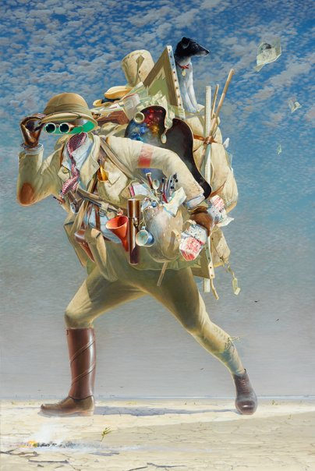
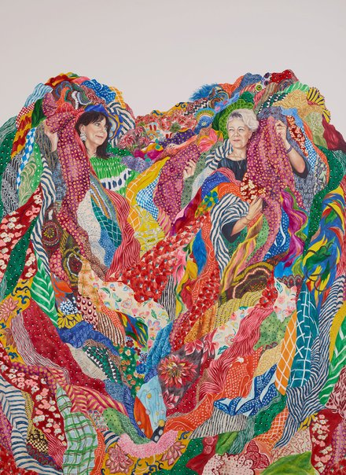
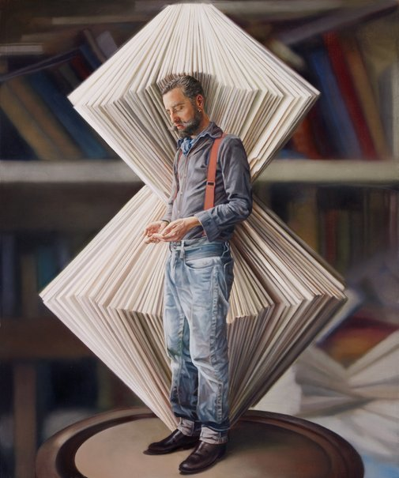
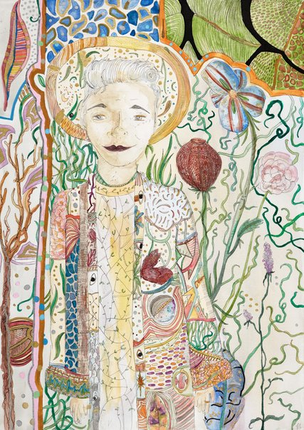
We are learning to understand the role of portraiture in art
What do portraits show us about the subject and their life?
Tim Storrier – 2012
The Historic Wayfarer
2012 Archibald Prize Winner
Monica Rohan – 2016
Easton Pearson
2016 Archibald Prize Finalist
Julia Ciccarone– 2013
Portrait of Nicholas Jones
2013 Archibald Prize Finalist
James Stibilj – 2016
Untitled
2016 Young Archie Finalist (13-15)
Alice Vigors 2017
Notes:
All images are hyperlinked to NSW Art Gallery Website where you can find out more information about each artwork

Slide 8
Introducing the Archibald prize
We are learning to identify the role and significance of the Archibald prize in art
Alice Vigors 2017

Slide 9
We are learning to identify the role and significance of the Archibald prize in art
What is the Archibald Prize?
How long has it been running for?
Who can enter?
Alice Vigors 2017

Slide 10
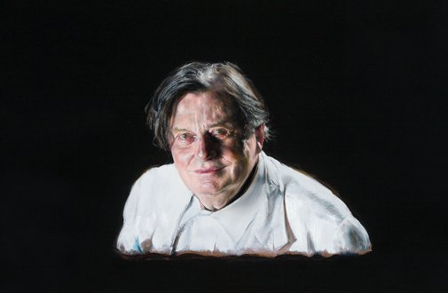
We are learning to identify the role and significance of the Archibald prize in art
What do you see, observe or notice?
How does this portrait make you feel?
What gains your attention first? Why do you think that is?
What mood is created by the portrait?
What does it make you think?
What questions or puzzles do you have about this portrait?
Louise Hearman – 2016
Barry Humphries
2016 Archibald Prize Winner
Alice Vigors 2017
Notes:
Image is hyperlinked

Slide 11
We are learning to identify the role and significance of the Archibald prize in art
Alice Vigors 2017

Slide 12
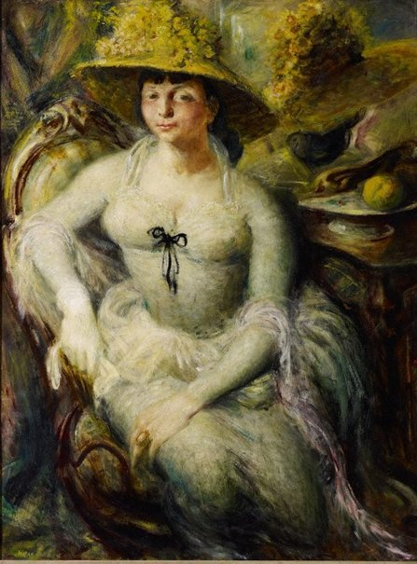
We are learning to identify the role and significance of the Archibald prize in art
What do you see, observe or notice?
How does this portrait make you feel?
What gains your attention first? Why do you think that is?
What mood is created by the portrait?
What does it make you think?
What questions or puzzles do you have about this portrait?
William Dobell – 1948
Margaret Olley
1948 Archibald Prize Winner
Alice Vigors 2017
Notes:
Image is hyperlinked

Slide 13
We are learning to identify the role and significance of the Archibald prize in art
Alice Vigors 2017

Slide 14
OLR Archibald Prize
Choose someone who has influenced your life (e.g. family, friends, sporting hero) or draw a self-portrait of you
Create a portrait of this person
Choose the size of your work – either A4 or A3 art paper
Choose what medium you will use:
Pencils
Paints
Charcoal
Watercolours
Oil pastels
Submit your artwork by the end of Week 9 ready for the school Archibald Prize in Week 10.
Write a short piece explaining why this person is influential in your life.
Alice Vigors 2017

Slide 15
Andy Warhol inspired portraiture
We are learning to use photography to create portraits
Alice Vigors 2017

Slide 16
We are learning to use photography to create portraits
What do you see, observe or notice?
How does this portrait make you feel?
What gains your attention first? Why do you think that is?
What mood is created by the portrait?
What does it make you think?
What questions or puzzles do you have about this portrait?
Andy Warhol– 1964
Marilyn Monroe
‘Pop Art’
Alice Vigors 2017

Slide 17
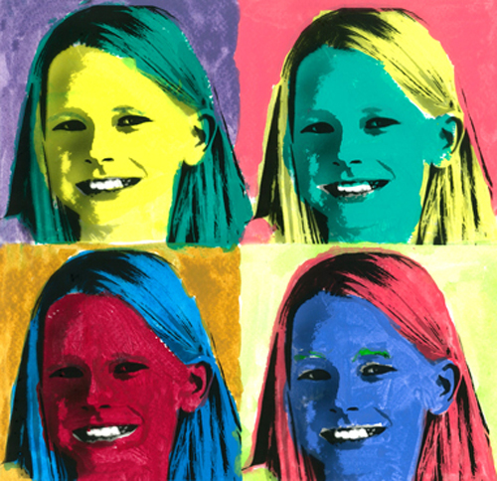
We are learning to use photography to create portraits
Artwork Instructions:
Take portrait photographs of each student.
You can choose to use all of the same images (set of 4-6) or have each image a different face or pose (set of 4-6).
Print images out in black and white with all four – six on one page.
Experiment with the use of colour to make each image different and stand out. You should refer back to the colour wheel to explore contrasting colours.
Medium = watercolour
Display
Alice Vigors 2017
Notes:
Artwork Instructions:
Take portrait photographs of the students. They can choose to use all of the same images (set of 4-6) or have each image a different face or pose (set of 4-6).
Print images out in black and white with all four – six on one page.
Students experiment with the use of colour to make each image different and stand out. Students should refer back to the colour wheel to explore contrasting colours. Medium = watercolour
Display

Slide 18
Exploring expressionism through portraiture
We are learning to explore expressionism in portraits
Alice Vigors 2017

Slide 19
We are learning to explore expressionism in portraits
What do you see, observe or notice?
How does this portrait make you feel?
What gains your attention first? Why do you think that is?
What mood is created by the portrait?
What does it make you think?
What questions or puzzles do you have about this portrait?
Edvard Munch – 1863
The Scream
‘Expressionism’
Alice Vigors 2017

Slide 20
We are learning to explore expressionism in portraits
What is expressionism?
A style of art in which the intention is not to produce a subject accurately, but instead to portray it in such a way as to express an emotion.
Sidney Nolan – 1942
Farmer, Dimboola
‘Expressionism’
Alice Vigors 2017

Slide 21
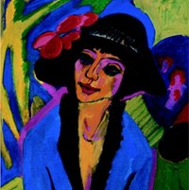
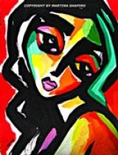
We are learning to explore expressionism in portraits
How do these artworks show emotion?
Noel Counihan – 1954
The Magistrate
Ernst Kirchner – 1914
Portrait of Gerda
Martina Shapiro – 2008
Feminine Emotion
Nb: click on image to watch it being made
Alice Vigors 2017

Slide 22
We are learning to explore expressionism in portraits
Artwork Instructions:
Choose an emotion to portray
Brainstorm ways that emotion could be depicted in art
Decide which medium you will use → watercolour, paint, oil pastel, pencil, charcoal etc.
Create and display artwork
Alice Vigors 2017
Notes:
Artwork Instructions:
Create an artwork that depicts an emotion
Choose an emotion to portray
Brainstorm ways that emotion could be depicted in art
Decide which medium you will use → watercolour, paint, oil pastel, pencil, charcoal etc.
Create and display artwork

Slide 23
Pablo Picasso inspired portraiture
We are learning to use shapes to create portraits
Alice Vigors 2017

Slide 24
We are learning to use shapes to create portraits
What do you see, observe or notice?
How does this portrait make you feel?
What gains your attention first? Why do you think that is?
What mood is created by the portrait?
What does it make you think?
What questions or puzzles do you have about this portrait?
Pablo Picasso – 1937
The Weeping Woman
‘Cubism’
Alice Vigors 2017

Slide 25
We are learning to use shapes to create portraits
What is cubism?
A style of art that uses lots of shapes and interesting colours to show ordinary objects.
Watch this video about Pablo Picasso and Cubism
Alice Vigors 2017

Slide 26
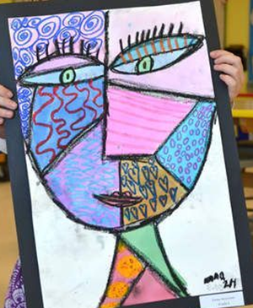
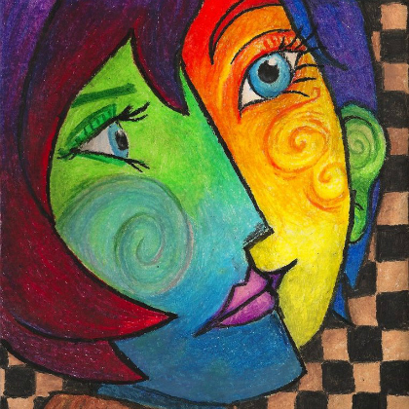
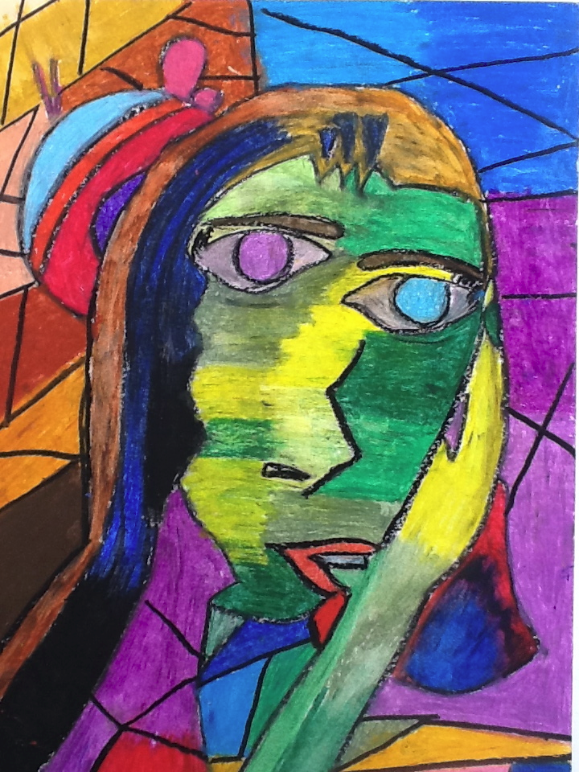
We are learning to explore expressionism in portraits
Artwork Instructions:
Create a portrait the uses shapes to depict a person
Decide which medium you will use → watercolour, paint, oil pastel, pencil, charcoal etc.
Create and display artwork
Alice Vigors 2017
Notes:
Artwork Instructions:

