Slide 1
punctuation
Why do we use a comma in writing?
Alice Vigors 2018

Slide 2
learning intention
Identify and use a range of grammatical features effectively
success criteria
Identify commas in a series of sentences
Explain why it was used in each sentence
Compose sentences containing a comma
Alice Vigors 2018

Slide 3
what is a comma?
A comma is a punctuation mark used within a sentence.
It helps to make the meaning of a sentence clear by separating words into clauses and phrases.
There are some simple rules we follow when using commas in our writing.
Alice Vigors 2018

Slide 4
Commas are used to separate items in a list.
I ate cake lollies and chips at the party.
LIST
Commas are used before coordinating conjunctions in a compound sentence.
I don’t like eating pizza but I love pasta.
COORDINATING CONJUNCTIONS
Commas are also used when a sentence begins with a subordinating conjunction.
Until the drought breaks it will continue to be dry and dusty.
SUBORDINATING CONJUNCTIONS
Alice Vigors 2018
Notes:
I ate cake, lollies and chips at the party.
I don’t like eating pizza, but I love pasta.
Until the drought breaks, it will continue to be dry and dusty.

Slide 5
Commas are used to separate beginning clauses from the rest of the sentence.
At first light we began our ascent up the mountain.
CLAUSES
EXTRA INFORMATION FROM THE MAIN IDEA
Commas are used to separate extra information from the main idea.
The troll his eyes wild and blazing raced towards the castle.
TWO OR MORE ADJECTIVES OR ADVERBS ARE USED
Commas are also used when 2 or more adjectives are used to describe a noun; or adverbs to describe a verb.
It was the brightest shiniest star.
The tide crept silently gracefully towards the sand.
Alice Vigors 2018
Notes:
At first light, we began our ascent up the mountain.
The troll, his eyes wild and blazing, raced towards the castle.
It was the brightest, shiniest star.
The tide crept silently, gracefully towards the sand.

Slide 6
Where does the comma go?
Lisa tried her best yet didn’t win the race.
Unless we get a move on we are going to be seriously late for the movies.
That was one rough bumpy terrifying plane ride!
I’m going to wear my pyjamas all day since it is school holidays.
I love chocolate hot chips and cups of tea.
The sun bright and blazing began to set in the distance.
Alice Vigors 2018

Slide 7
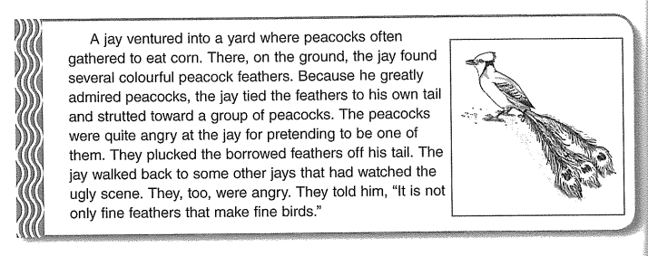
learning intention
success
criteria
Identify and use a range of grammatical features effectively
Identify commas in a series of sentences
Explain why it was used in each sentence
Compose sentences containing a comma
Alice Vigors 2018

