Slide 1
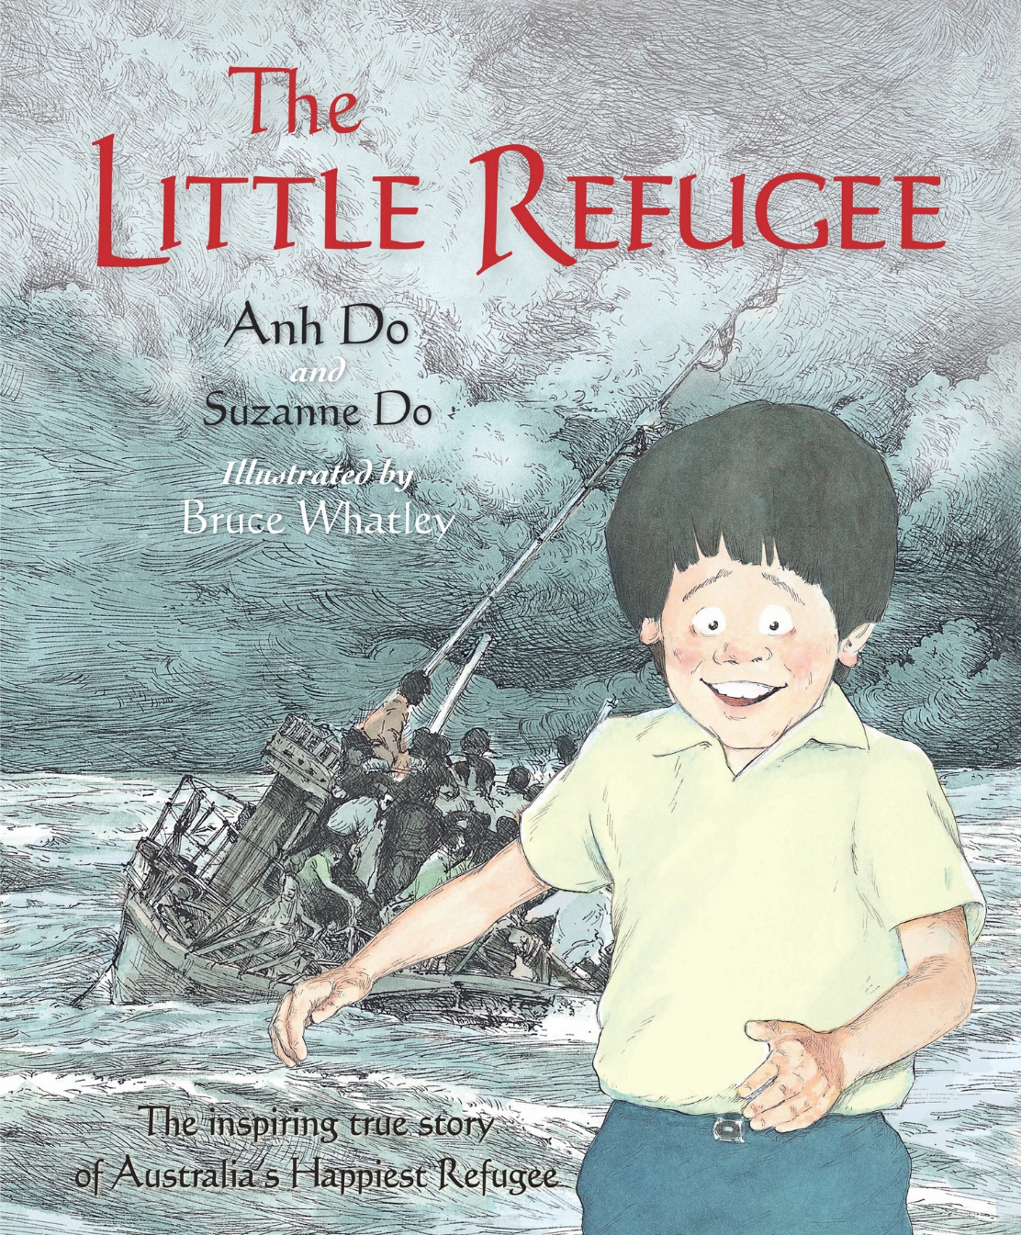
The little refugee
Alice Vigors
2017
Stage Three

Slide 2
Teaching & Learning sessions
Writing
Reading
To examine the themes and implications of a text
To draw connections between texts
To compose an informative piece of writing
To use tension when writing
To examine character motives
To build vocabulary knowledge
To comprehend
Alice Vigors 2017

Slide 3
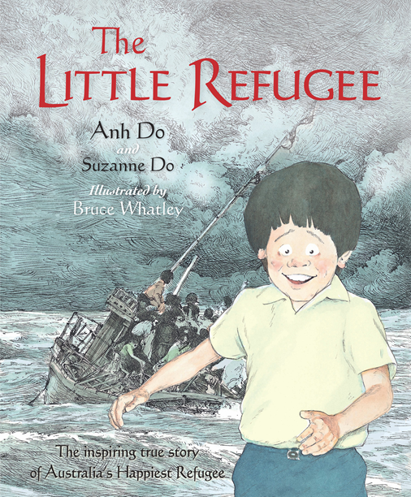
We are learning to examine the themes and implications of a text.
What do you see, observe or notice?
What does it make you think this book is going to be about?
What questions or puzzles do you have about this book?
How might this book relate to migration and the text Ziba came on a boat?
Alice Vigors 2017
Notes:
Examine the front cover & back blurb of the text The Little Refugee; and use the thinking routine See Think Wonder to make predictions about the text. How might this relate to migration and the text Ziba came on a boat? Whole class discussion → record responses

Slide 4
We are learning to examine the themes and implications of a text.
In the text it says… | From what I already know I think it means…
Identify inferences the author makes throughout the text and build explanations about what the author is really saying…
‘Even though we were poor and the house was crowded, I was happy because there were always lots of people to play with me.’
Alice Vigors 2017
Notes:
Identify inferences the author is making and compose an explanation of what it means (use inference jigsaw structure to support).

Slide 5
We are learning to examine the themes and implications of a text.
Explore the themes and implications presented by the author:
What did the author and artist really want us to think about?
What is really going on in this situation?
How were they feeling at the time? (different viewpoints)
How does this situation connect to our world today? What is similar?
Alice Vigors 2017
Notes:
Examine the front cover & back blurb of the text The Little Refugee; and use the thinking routine See Think Wonder to make predictions about the text. How might this relate to migration and the text Ziba came on a boat? Whole class discussion → record responses

Slide 6
We are learning to use tension when writing.
Text:
Kalo Li’s New Country
Chapters: 3 -4
Small Group Instruction
Independent Writing using a stimulus
(click here)
Text:
Five Times Dizzy & Dancing in the Anzac Deli
Chapters: 4 -7
Word Study
Literature Circle
Text:
Girl Underground
Chapters: 5 -8
Independent Writing using a stimulus
Independent Reading of text
Independent Reading of text
Grammar: Similes
Text:
Boy Overboard
Chapters: 6 -10
Independent Writing using a stimulus
Text:
Boy Overboard
Chapters: 6 -10
Chromebooks: Read Theory
Alice Vigors 2017
Notes:
Small Group Instruction / Literature Circle: working with teacher on a shared text at point of need teaching and learning. *Introduce new roles to group*
Independent Reading: Read Lit Circle/ SGI novel
Chromebooks: Complete comprehension questions using the website Read Theory.
Independent Writing: Use the thinking routine See Think Wonder to examine the image. Compose an imaginative piece that uses descriptive language and builds tension.
Word Study: Examine the words of the week. Identify the spelling strategy, find the meaning and write each word in its own descriptive sentence - refugee, strange, crowded, fighting, escape, neighbours, ruined, miserable, doubtful, disappointed, precious
Comprehension: Character Inference Chart (pg 106) exploring the motives of the pirates or father in The Little Refugee
Rotational Activities:
dictionary/thesaurus work.
word study.
stimulus writing/quick writes.
editing activity.
independent reading.
book study.
story board.
grammar activities.
chrome books/computers.
spelling activities.

Slide 7
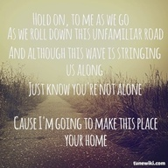
We are learning to draw connections between texts.
Analyse the song and identify the central theme or message
Which line in this song captures the core idea? Explain why.
Which phrase moved, engaged or provoked you? Why?
Which word grabbed your attention? Why
Home – Phillip Phillips
Alice Vigors 2017
Notes:
Listen to Home by Phillip Phillips → give ss a copy of the lyrics.
Analyse the song and identify the central theme or message – could use SPW routine
Use the thinking routine 4C’s to examine connections between song and text
Compose an informative text about Vietnam

Slide 8
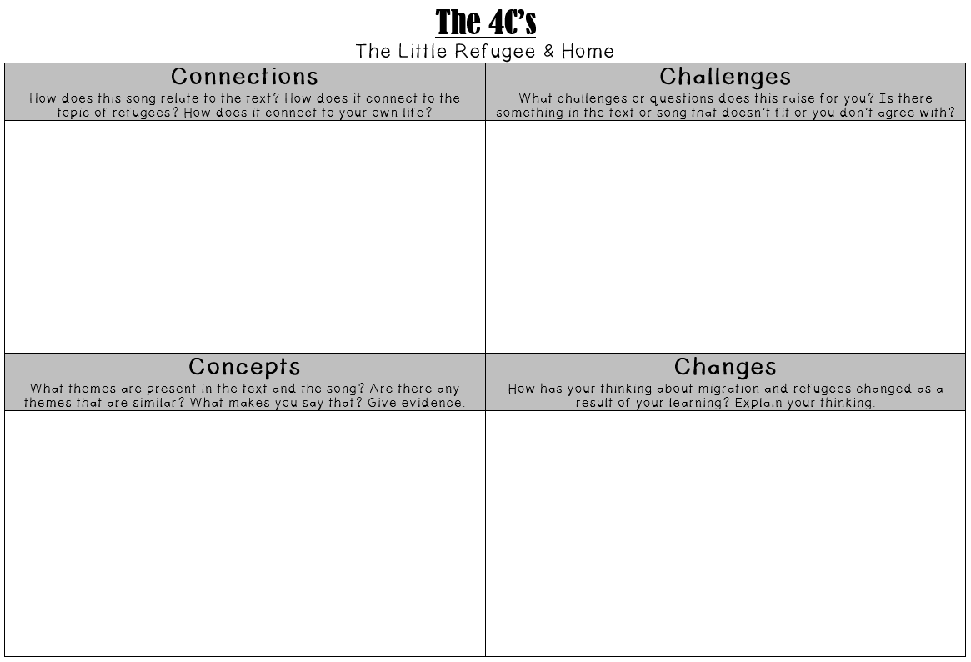
We are learning to draw connections between texts.
Alice Vigors 2017
Use the thinking routine The 4C’s to examine the connections between The Little Refugee and the song Home
Notes:
Listen to Home by Phillip Phillips → give ss a copy of the lyrics.
Analyse the song and identify the central theme or message – could use SPW routine
Use the thinking routine 4C’s to examine connections between song and text
Compose an informative text about Vietnam

Slide 9
We are learning to examine character motives.
Text:
Kalo Li’s New Country
Chapters: 3 -4
Small Group Instruction
Comprehension
Text:
Five Times Dizzy & Dancing in the Anzac Deli
Chapters: 4 -7
Chromebooks: Read Theory
Independent Reading of text
Text:
Girl Underground
Chapters: 5 -8
Comprehension
Literature Circle
Grammar: Similes
Independent Reading of Text
Text:
Boy Overboard
Chapters: 6 -10
Comprehension
Text:
Boy Overboard
Chapters: 6 -10
Independent Writing using a stimulus
Alice Vigors 2017
Notes:
Small Group Instruction / Literature Circle: working with teacher on a shared text at point of need teaching and learning. *Introduce new roles to group*
Independent Reading: Read Lit Circle/ SGI novel
Chromebooks: Complete comprehension questions using the website Read Theory.
Independent Writing: Use the thinking routine See Think Wonder to examine the image. Compose an imaginative piece that uses descriptive language and builds tension.
Word Study: Examine the words of the week. Identify the spelling strategy, find the meaning and write each word in its own descriptive sentence - refugee, strange, crowded, fighting, escape, neighbours, ruined, miserable, doubtful, disappointed, precious
Comprehension: Character Inference Chart (pg 106) exploring the motives of the pirates or father in The Little Refugee
Rotational Activities:
dictionary/thesaurus work.
word study.
stimulus writing/quick writes.
editing activity.
independent reading.
book study.
story board.
grammar activities.
chrome books/computers.
spelling activities.

Slide 10
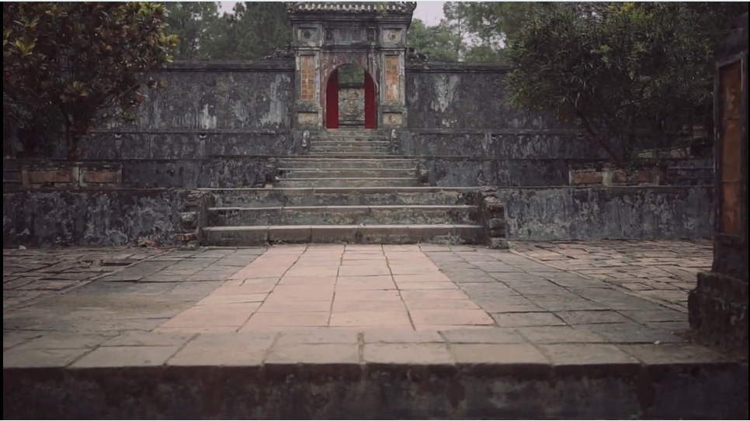
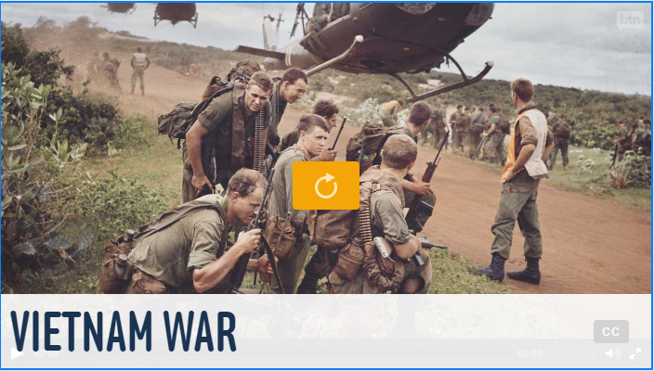
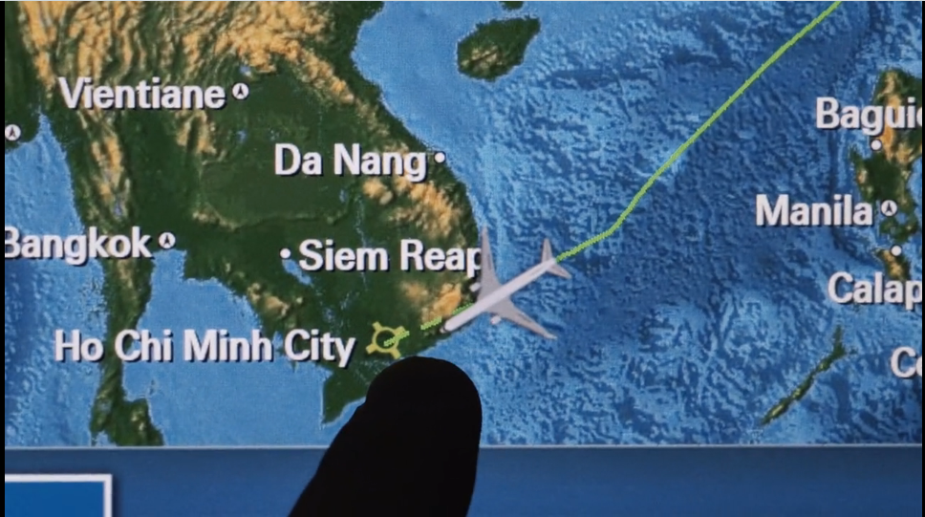
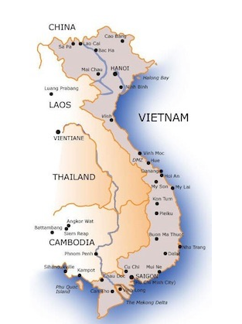
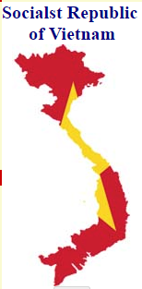
We are learning to compose an informative piece of writing.
Use information sources to compose an informative text about Vietnam.
Alice Vigors 2017
Notes:
Compose an informative text about Vietnam using a variety of information sources
Fact Sheets:
http://www.kidcyber.com.au/vietnam-facts-and-history/
http://www.atozkidsstuff.com/vietnam.html
http://easyscienceforkids.com/all-about-vietnam/
Videos:
http://www.abc.net.au/btn/story/s4522233.htm
https://vimeo.com/153237132
https://www.lonelyplanet.com/Vietnam
https://vimeo.com/126747807

Slide 11
We are learning to examine character motives.
Text:
Kalo Li’s New Country
Chapters: 3 -4
Word Study
Grammar: Similes
Text:
Five Times Dizzy & Dancing in the Anzac Deli
Chapters: 4 -7
Independent Writing using a stimulus
Grammar: Similes
Text:
Girl Underground
Chapters: 5 -8
Grammar: Similes
Chromebooks: Read Theory
Literature Circle
Word Study
Text:
Boy Overboard
Chapters: 6 -10
Literature Circle
Text:
Boy Overboard
Chapters: 6 -10
Comprehension
Alice Vigors 2017
Notes:
Small Group Instruction / Literature Circle: working with teacher on a shared text at point of need teaching and learning. *Introduce new roles to group*
Independent Reading: Read Lit Circle/ SGI novel
Chromebooks: Complete comprehension questions using the website Read Theory.
Independent Writing: Use the thinking routine See Think Wonder to examine the image. Compose an imaginative piece that uses descriptive language and builds tension.
Word Study: Examine the words of the week. Identify the spelling strategy, find the meaning and write each word in its own descriptive sentence - refugee, strange, crowded, fighting, escape, neighbours, ruined, miserable, doubtful, disappointed, precious
Comprehension: Character Inference Chart (pg 106) exploring the motives of the pirates or father in The Little Refugee
Rotational Activities:
dictionary/thesaurus work.
word study.
stimulus writing/quick writes.
editing activity.
independent reading.
book study.
story board.
grammar activities.
chrome books/computers.
spelling activities.

Slide 12
We are learning to compose an informative piece of writing.
Use information sources to compose an informative text about Vietnam.
Alice Vigors 2017
Notes:
Compose an informative text about Vietnam using a variety of information sources
Fact Sheets:
http://www.kidcyber.com.au/vietnam-facts-and-history/
http://www.atozkidsstuff.com/vietnam.html
http://easyscienceforkids.com/all-about-vietnam/
Videos:
http://www.abc.net.au/btn/story/s4522233.htm
https://vimeo.com/153237132
https://www.lonelyplanet.com/Vietnam
https://vimeo.com/126747807

Slide 13
We are learning to examine character motives.
Text:
Kalo Li’s New Country
Chapters: 3 -4
Chromebooks: Read Theory
Independent Reading of text
Text:
Five Times Dizzy & Dancing in the Anzac Deli
Chapters: 4 -7
Literature Circle
Comprehension
Text:
Girl Underground
Chapters: 5 -8
Word Study
Literature Circle
Independent Reading of text
Independent Reading of Text
Text:
Boy Overboard
Chapters: 6 -10
Chromebooks: Read Theory
Text:
Boy Overboard
Chapters: 6 -10
Word Study
Alice Vigors 2017
Notes:
Small Group Instruction / Literature Circle: working with teacher on a shared text at point of need teaching and learning. *Introduce new roles to group*
Independent Reading: Read Lit Circle/ SGI novel
Chromebooks: Complete comprehension questions using the website Read Theory.
Independent Writing: Use the thinking routine See Think Wonder to examine the image. Compose an imaginative piece that uses descriptive language and builds tension.
Word Study: Examine the words of the week. Identify the spelling strategy, find the meaning and write each word in its own descriptive sentence - refugee, strange, crowded, fighting, escape, neighbours, ruined, miserable, doubtful, disappointed, precious
Comprehension: Character Inference Chart (pg 106) exploring the motives of the pirates or father in The Little Refugee
Rotational Activities:
dictionary/thesaurus work.
word study.
stimulus writing/quick writes.
editing activity.
independent reading.
book study.
story board.
grammar activities.
chrome books/computers.
spelling activities.

Slide 14
Alice Vigors 2017
Notes:
Image sourced from Once Upon a Picture: https://www.onceuponapicture.co.uk/

Slide 15
Words of the Week:
refugee
strange
crowded
fighting
escape
precious
neighbours
ruined
miserable
doubtful
disappointed
Alice Vigors 2017

