Slide 1
Ziba came on a boat
Alice Vigors
2017
Stage Three

Slide 2
Teaching and learning sessions
Monday
Writing: To build a collective understanding of a text
Text Prediction: See Think Wonder
Small group task: See Think Wonder and Sentence Phrase Word
Reading: To predict
Text Prediction: See Think Wonder
Tuesday
Writing: To build a collective understanding of a text
Explore themes and implications of text
Character exploration: Step Inside
Reading: To activate prior knowledge
History: Think Puzzle Explore about Refugees & Migration
Wednesday
Writing: To compose an imaginative piece that builds tension
Reading: To synthesise
Visual stimulus: See Think Wonder
Imaginative text
Thursday
Writing: To compose an imaginative piece that builds tension
Reading: To synthesise
Visual stimulus: See Think Wonder
Imaginative text
Friday
Writing: To compose an informative text
Purpose of a journal entry
Informative text
Reading: To build vocabulary knowledge
Word Study
Alice Vigors 2017

Slide 3
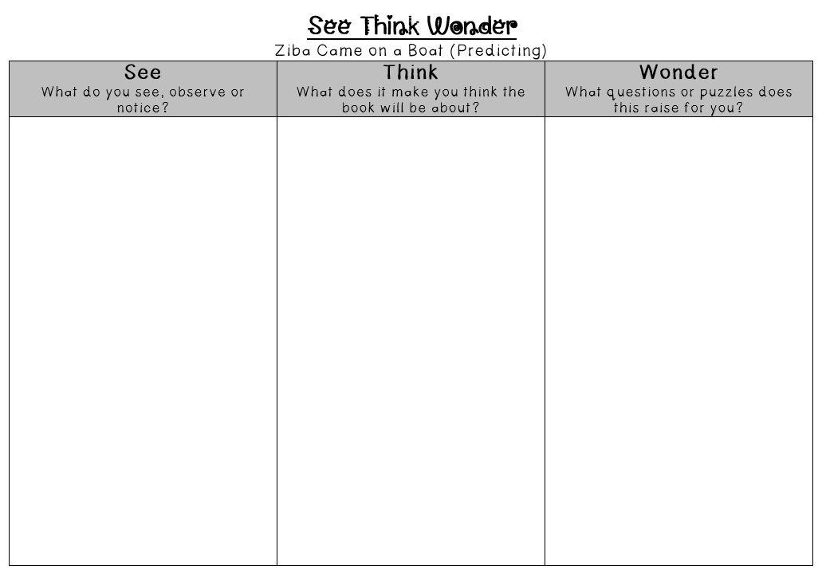
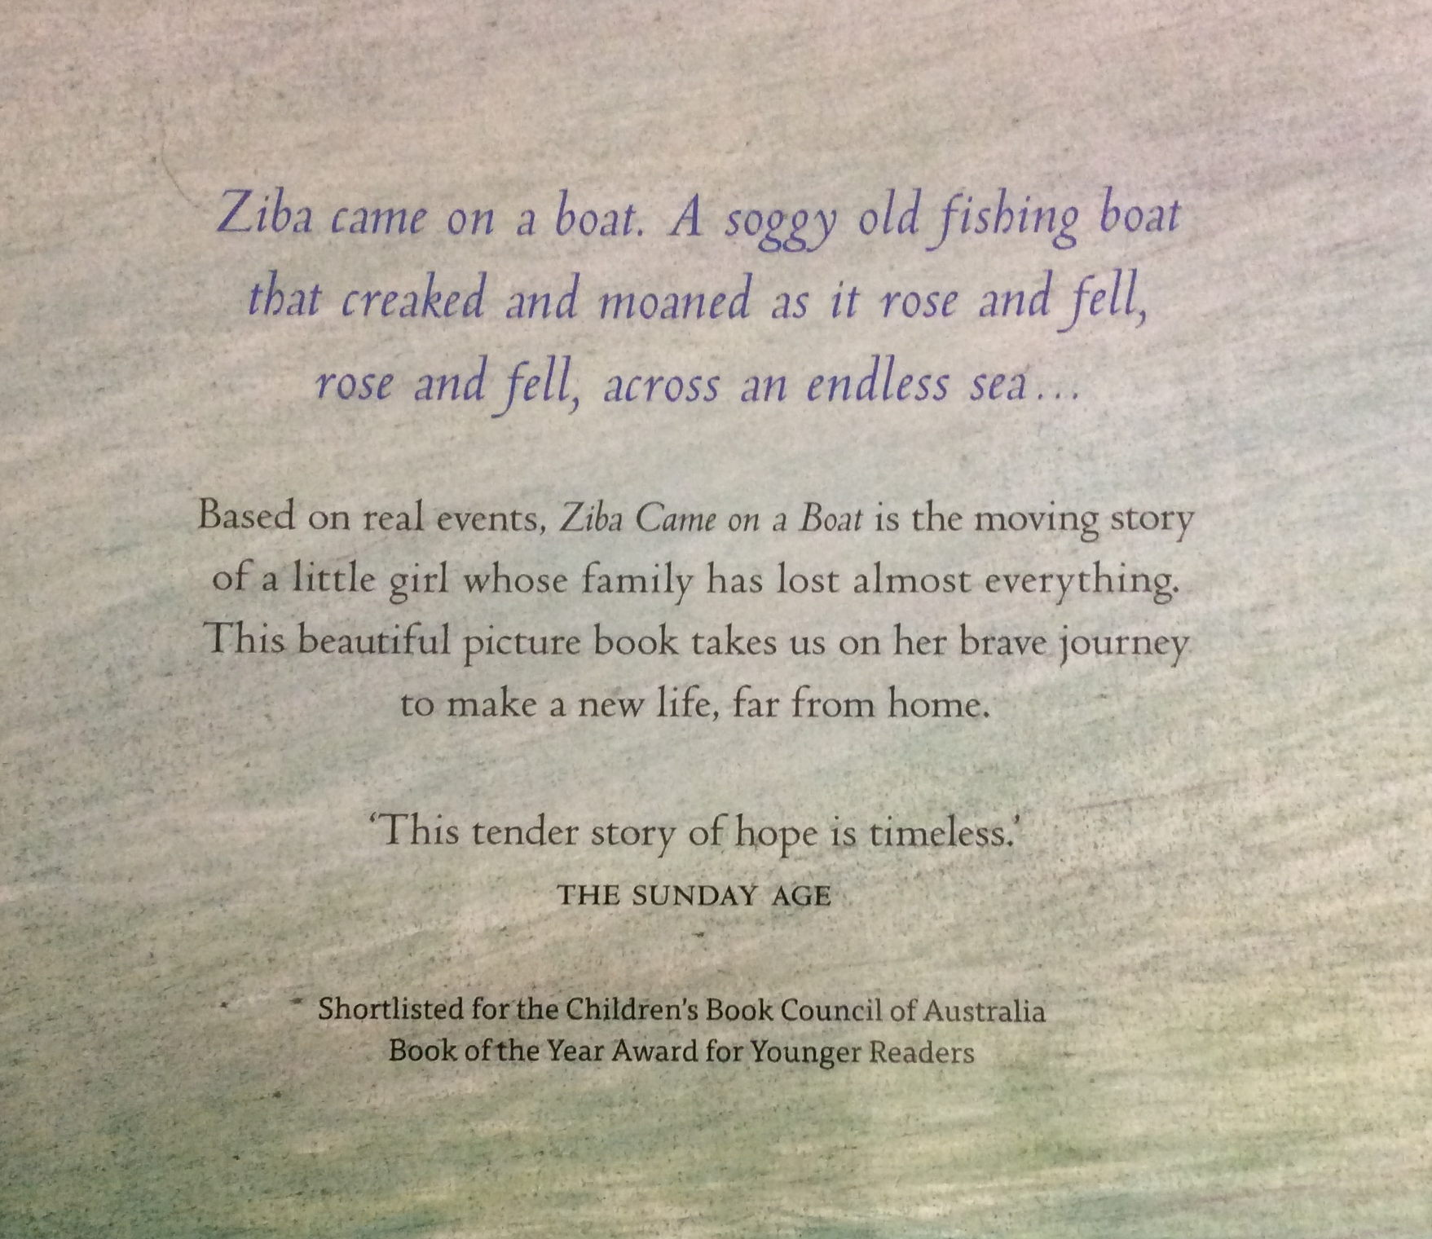
We are learning to build a collective understanding of a text.
Use the thinking routine See Think Wonder to make predictions about the text.
Alice Vigors 2017
Notes:
Examine the front cover & back blurb of the text Ziba Came on a Boat; and use the thinking routine See Think Wonder to make predictions about the text. What do you see, observe or notice? What does it make you think the book will be about? What questions or puzzles does this raise for you?

Slide 4
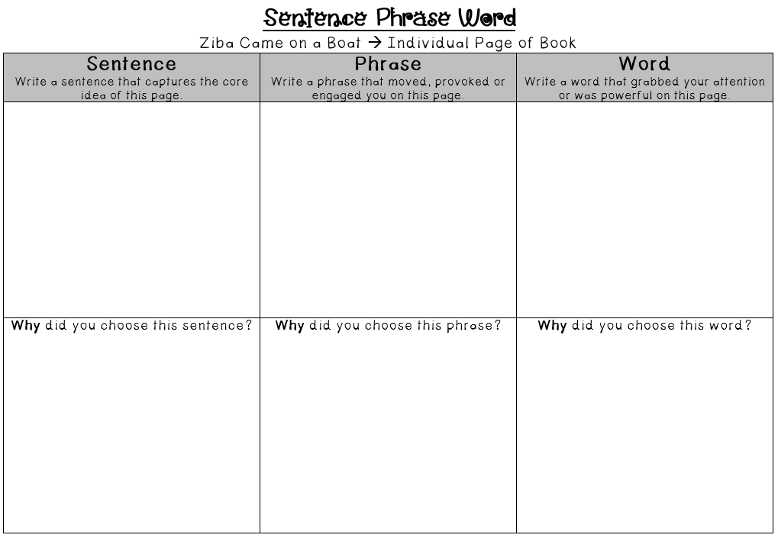
We are learning to build a collective understanding of a text.
Use the thinking routine See Think Wonder to discuss the image on your page of the text. Read the text to add further meaning and use the thinking routine Sentence Phrase Word to identify the core message of that page.
Alice Vigors 2017
Notes:
Small groups examine a page of the text and use the thinking routine See Think Wonder to discuss the image on that page.
Read the text to add further meaning and use the thinking routine Sentence Phrase Word to identify the core message of that page + explanation of their choices to each other.

Slide 5
We are learning to predict.
Text:
Kalo Li’s New Country
Chapters: 1 -2
Small Group Instruction
+
Predicting text
(See Think Wonder)
Independent Reading of text
Text:
Five Times Dizzy & Dancing in the Anzac Deli
Chapters: 1 -3
Predicting text
(See Think Wonder)
Literature Circle
Text:
Girl Underground
Chapters: 1 -4
Predicting Text
(See Think Wonder)
Independent Reading of text
Independent Reading of text
Independent Reading of text
Text:
Boy Overboard
Chapters: 1 -5
Predicting Text
(See Think Wonder)
Text:
Boy Overboard
Chapters: 1 -5
Predicting Text
(See Think Wonder)
Alice Vigors 2017
Notes:
Small Group Instruction / Literature Circle: working with teacher on a shared text at point of need teaching and learning. *Introduce new roles to group*
Predicting: Use the thinking routine See Think Wonder to make predictions about their Lit. Circle novel. What do you see, observe or notice? What does it make you think the book will be about? What questions or puzzles does this raise for you?
Independent Reading: Read Lit Circle/ SGI novel

Slide 6
We are learning to build a collective understanding of a text.
Explore the themes and implications presented by the author:
What did the author and artist really want us to think about?
What’s really going on in this situation?
How were they feeling at the time? (different viewpoints)
How does this situation connect to our world today? What is similar?
Alice Vigors 2017
Notes:
Groups share the understanding they gained from their section of the book.
Explore the themes and implications presented by the author:
What did the author and artist really want us to think about?
What’s really going on in this situation?
How were they feeling at the time? → different viewpoints
How does this situation connect to our world today? What is similar?
Use the thinking routine Step Inside to build a deeper understanding of one of the characters – Ziba, Mum, Dad

Slide 7
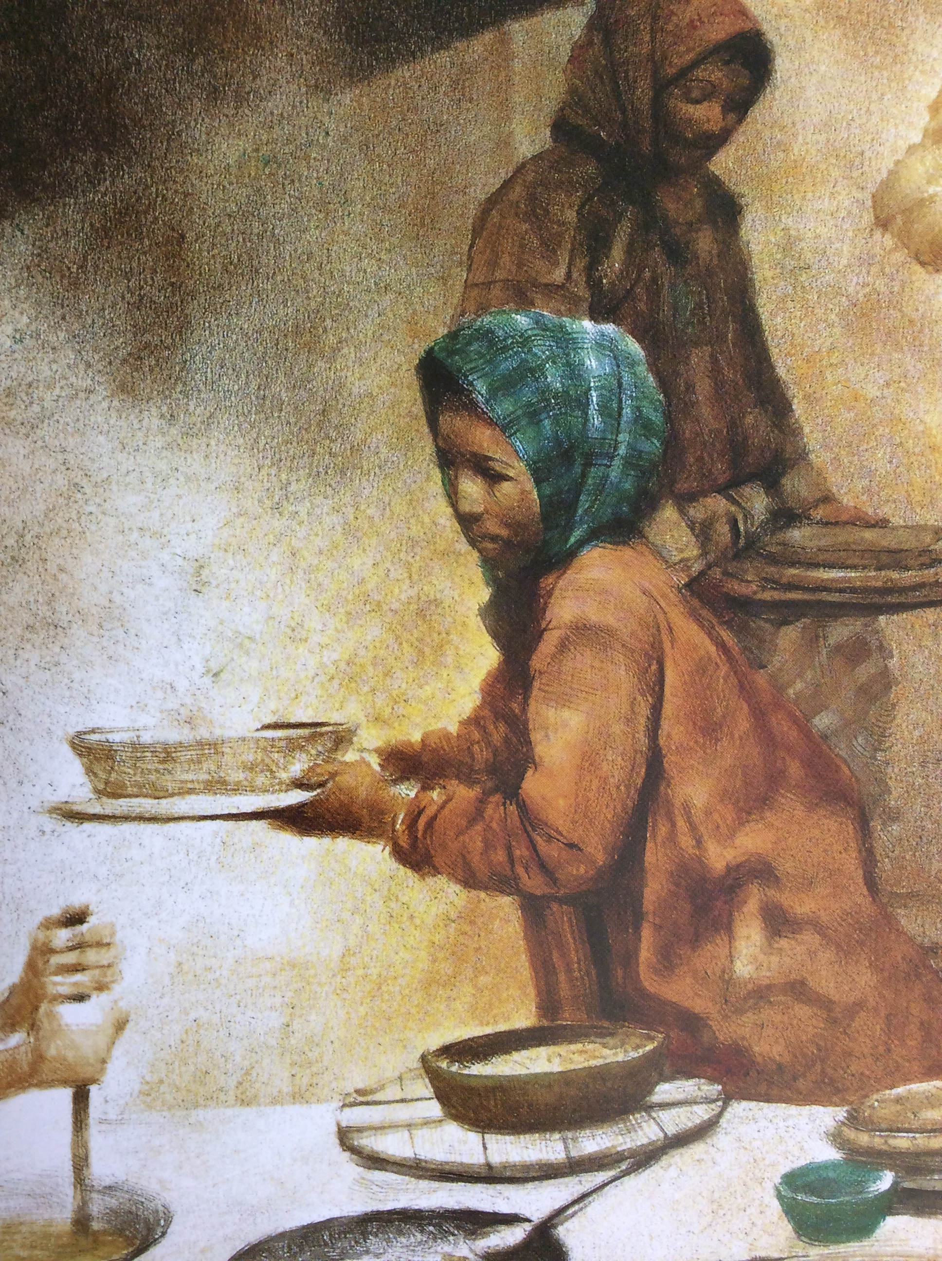
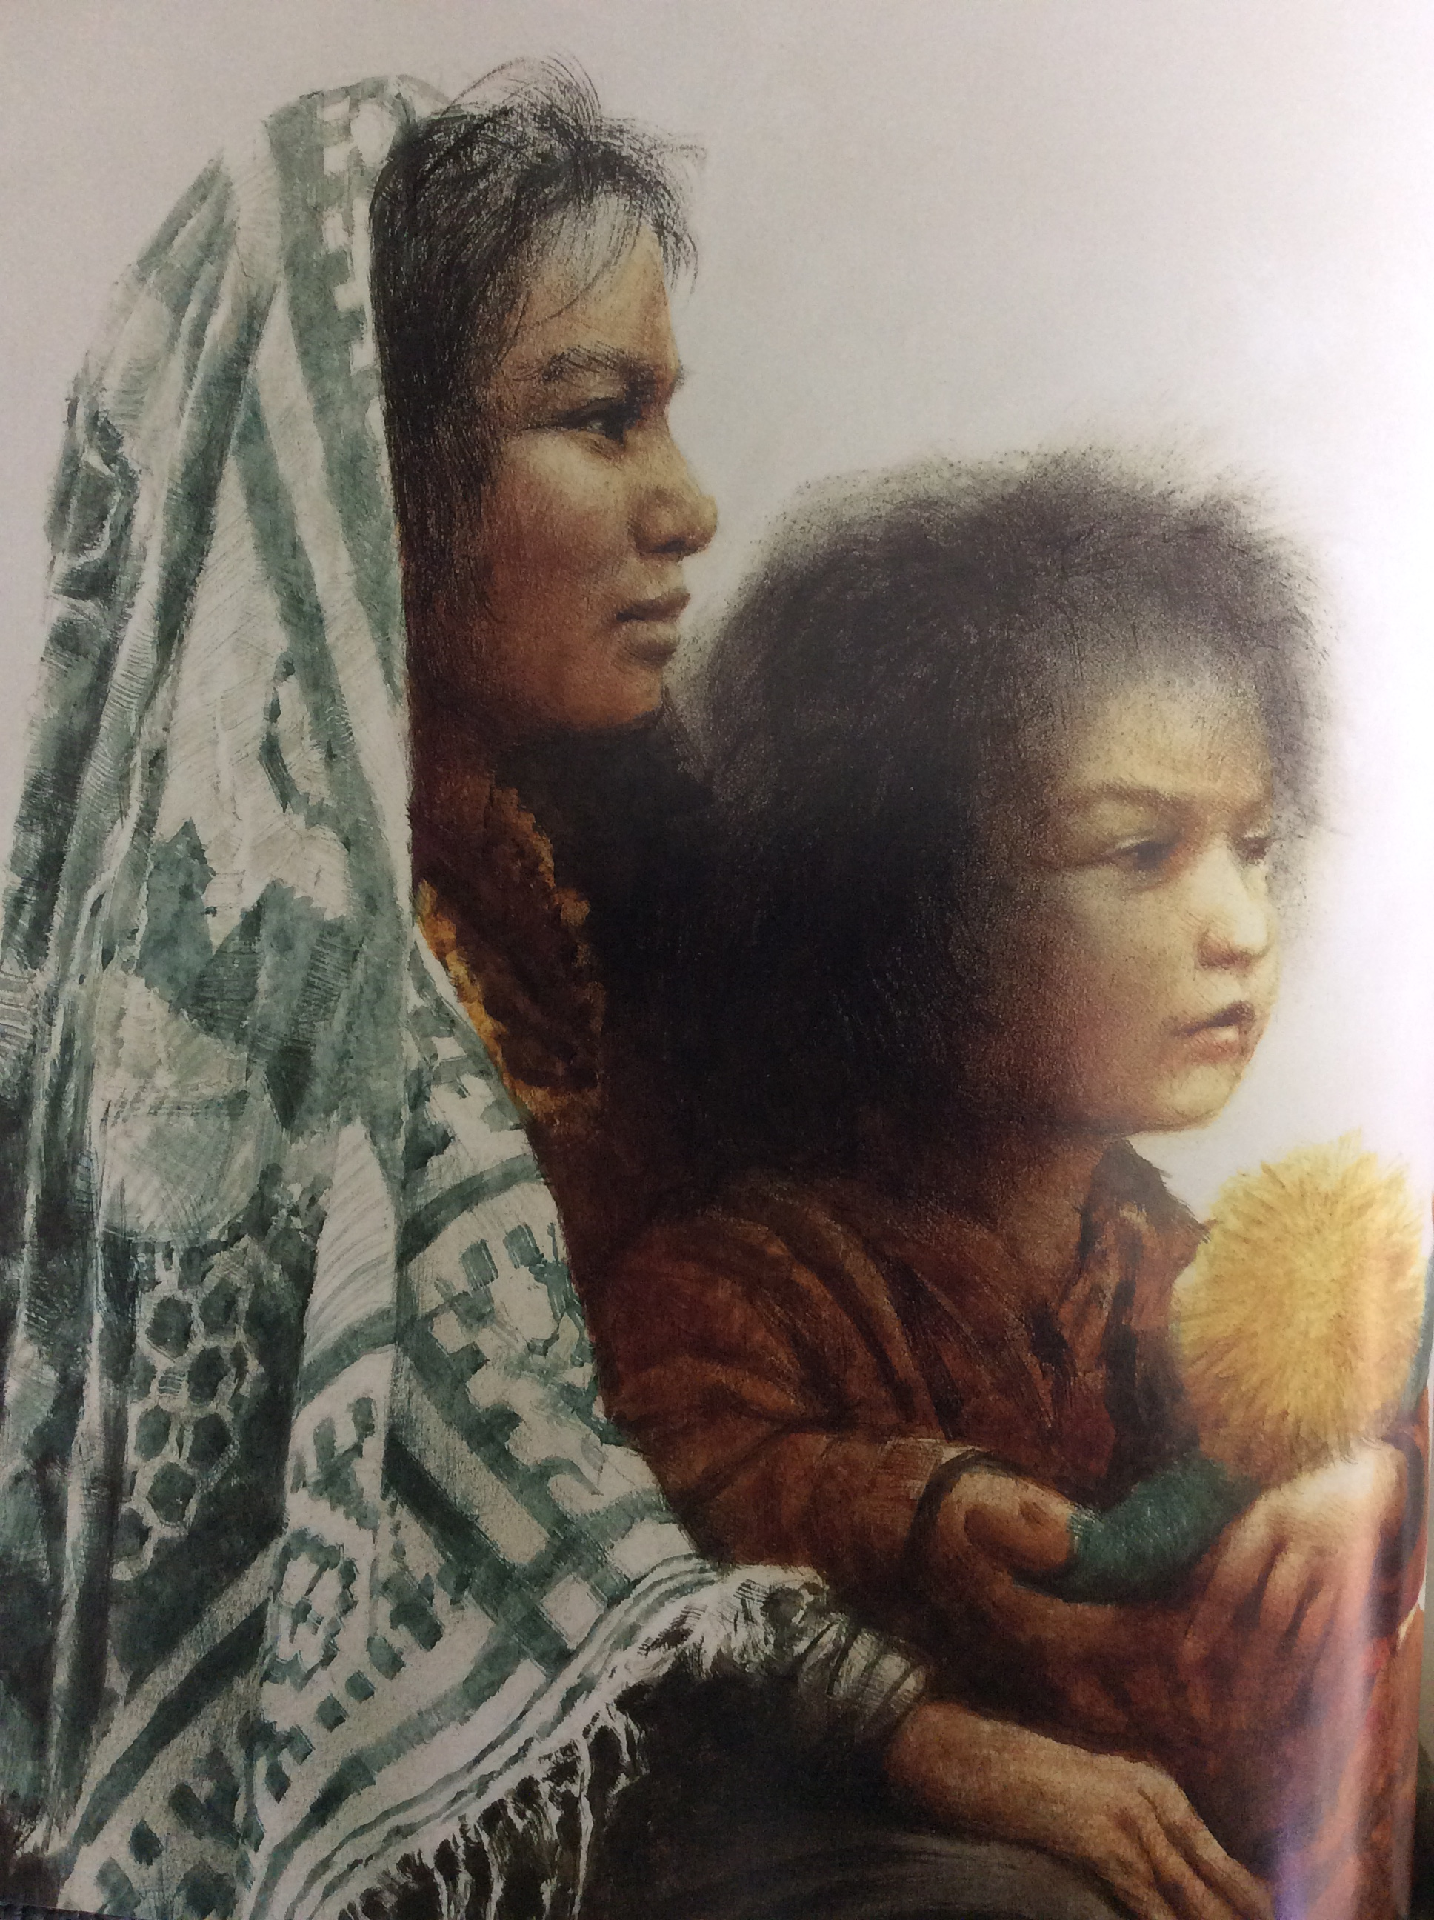
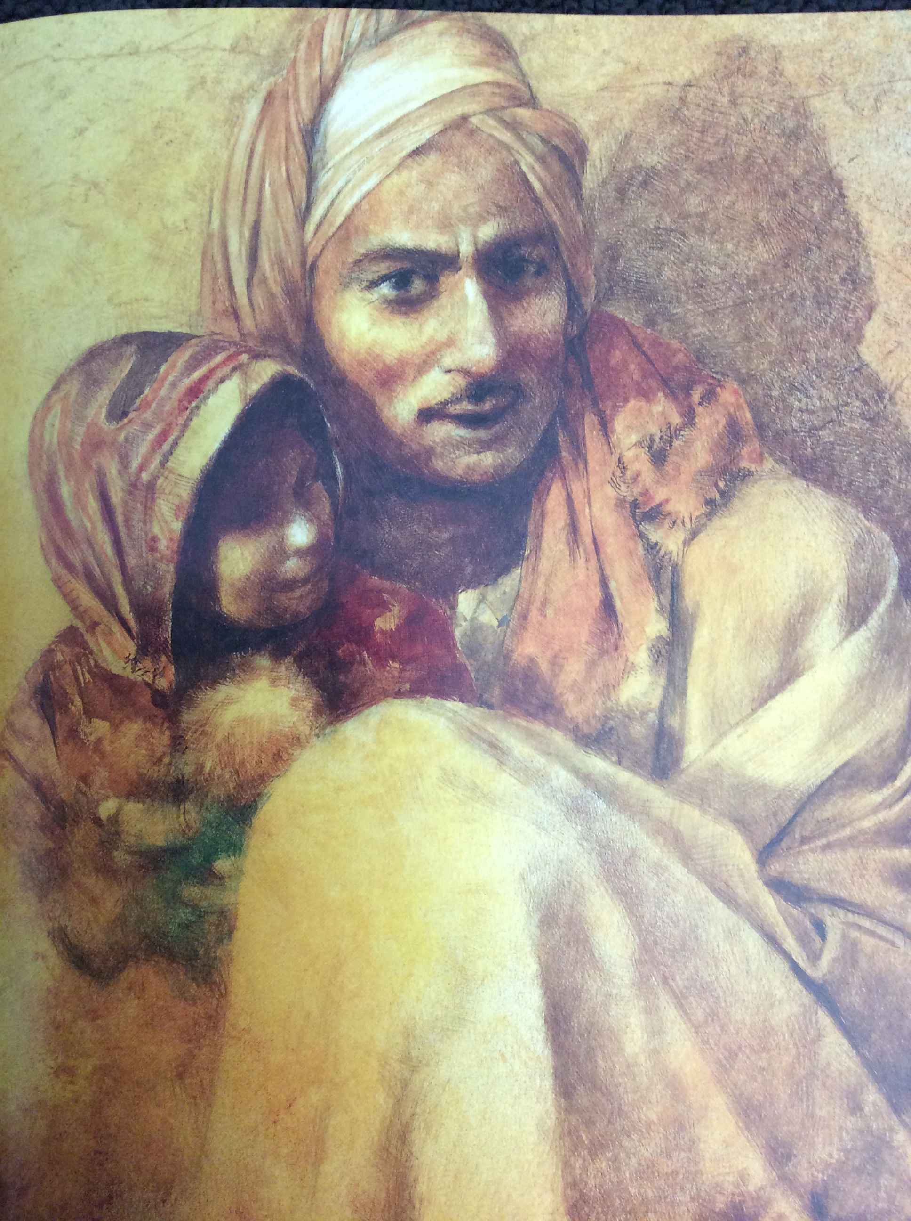
We are learning to build a collective understanding of a text.
Use the thinking routine Step Inside to build a deeper understanding of one of the characters:
Ziba Mum Dad
Alice Vigors 2017
Notes:
Groups share the understanding they gained from their section of the book.
Explore the themes and implications presented by the author:
What did the author and artist really want us to think about?
What’s really going on in this situation?
How were they feeling at the time? → different viewpoints
How does this situation connect to our world today? What is similar?
Use the thinking routine Step Inside to build a deeper understanding of one of the characters – Ziba, Mum, Dad

Slide 8
We are learning to activate prior knowledge.
Text:
*
Chapters: 1 -2
Small Group Instruction
History
(Think Puzzle Explore)
Text:
Five Times Dizzy & Dancing in the Anzac Deli
Chapters: 1 -3
History
(Think Puzzle Explore)
Independent Reading of text
Text:
Girl Underground
Chapters: 1 -4
History
(Think Puzzle Explore)
Literature Circle
Chromebooks: Read Theory
Independent Reading of text
Text:
Boy Overboard
Chapters: 1 -5
History
(Think Puzzle Explore)
Text:
Boy Overboard
Chapters: 1 -5
History
(Think Puzzle Explore)
Alice Vigors 2017
Notes:
Small Group Instruction / Literature Circle: working with teacher on a shared text at point of need teaching and learning. *Introduce new roles to group*
Independent Reading: Read Lit Circle/ SGI novel
Chromebooks: Complete comprehension questions using the website Read Theory.
History: Use the thinking routine Think Puzzle Explore to gauge students background knowledge and understanding about migrants and refugees.

Slide 9
We are learning to compose an imaginative piece that builds tension.
Use the thinking routine See Think Wonder to examine a visual stimulus:
What do you see, observe or notice?
What do you think is happening in this image?
What questions or puzzles does this raise for you?
How does this relate to migration?
Compose an imaginative piece that uses descriptive language and builds tension.
Alice Vigors 2017
Notes:
Examine the visual stimulus
Use the thinking routine See Think Wonder to examine the image.
What do you see, observe or notice?
What do you think is happening in this image?
What questions or puzzles does this raise for you?
How does this relate to migration?

Slide 10
We are learning to synthesise.
Text:
*
Chapters: 1 -2
Visual Literacy
Independent Reading of text
Text:
Five Times Dizzy & Dancing in the Anzac Deli
Chapters: 1 -3
Visual Literacy
Independent Reading of text
Text:
Girl Underground
Chapters: 1 -4
Visual Literacy
Chromebooks:
Read Theory
Literature Circle
Visual Literacy
Text:
Boy Overboard
Chapters: 1 -5
Literature Circle
Text:
Boy Overboard
Chapters: 1 -5
Visual Literacy
Alice Vigors 2017
Notes:
Small Group Instruction / Literature Circle: working with teacher on a shared text at point of need teaching and learning. *Introduce new roles to group*
Independent Reading: Read Lit Circle/ SGI novel
Chromebooks: Complete comprehension questions using the website Read Theory.
Visual Literacy: Use the thinking routine See Think Wonder to examine the image. Compose an imaginative piece that uses descriptive language and builds tension.

Slide 11
We are learning to compose an imaginative piece that builds tension.
Use the thinking routine See Think Wonder to examine a visual stimulus:
What do you see, observe or notice?
What do you think is happening in this image?
What questions or puzzles does this raise for you?
How does this relate to migration?
Compose an imaginative piece that uses descriptive language and builds tension.
Alice Vigors 2017
Notes:
Examine the visual stimulus
Use the thinking routine See Think Wonder to examine the image.
What do you see, observe or notice?
What do you think is happening in this image?
What questions or puzzles does this raise for you?
How does this relate to migration?

Slide 12
We are learning to synthesise.
Text:
*
Chapters: 1 -2
Visual Literacy
Chromebooks:
Read Theory
Text:
Five Times Dizzy & Dancing in the Anzac Deli
Chapters: 1 -3
Literature Circle
Word Study
Text:
Girl Underground
Chapters: 1 -4
Visual Literacy
Literature Circle
Independent Reading of text
Chromebooks: Read Theory
Text:
Boy Overboard
Chapters: 1 -5
Visual Literacy
Text:
Boy Overboard
Chapters: 1 -5
Visual Literacy
Alice Vigors 2017
Notes:
Small Group Instruction / Literature Circle: working with teacher on a shared text at point of need teaching and learning. *Introduce new roles to group*
Independent Reading: Read Lit Circle/ SGI novel
Chromebooks: Complete comprehension questions using the website Read Theory.
Visual Literacy: Use the thinking routine See Think Wonder to examine the image. Compose an imaginative piece that uses descriptive language and builds tension.
Word Study: Examine the words of the week. Identify the spelling strategy, find the meaning and write each word in its own descriptive sentence.
migration, moaned, surge, murky, swirling, fierce, abandoned, dangerous, vessel, adrenaline, debris, vicious

Slide 13
We are learning to compose an informative text.
Based on the book and the Step Inside activity, what do we know about each of these characters?
Alice Vigors 2017
Notes:
Examine students understanding of each of the characters in the text Ziba Came on a Boat.
Discuss the purpose of writing a journal entry and the structure.
Model writing a journal entry from the point of view of one of the characters in the text.
Write a series of journal entries (2-3) from the point of view of the character examined in the Step Inside.

Slide 14
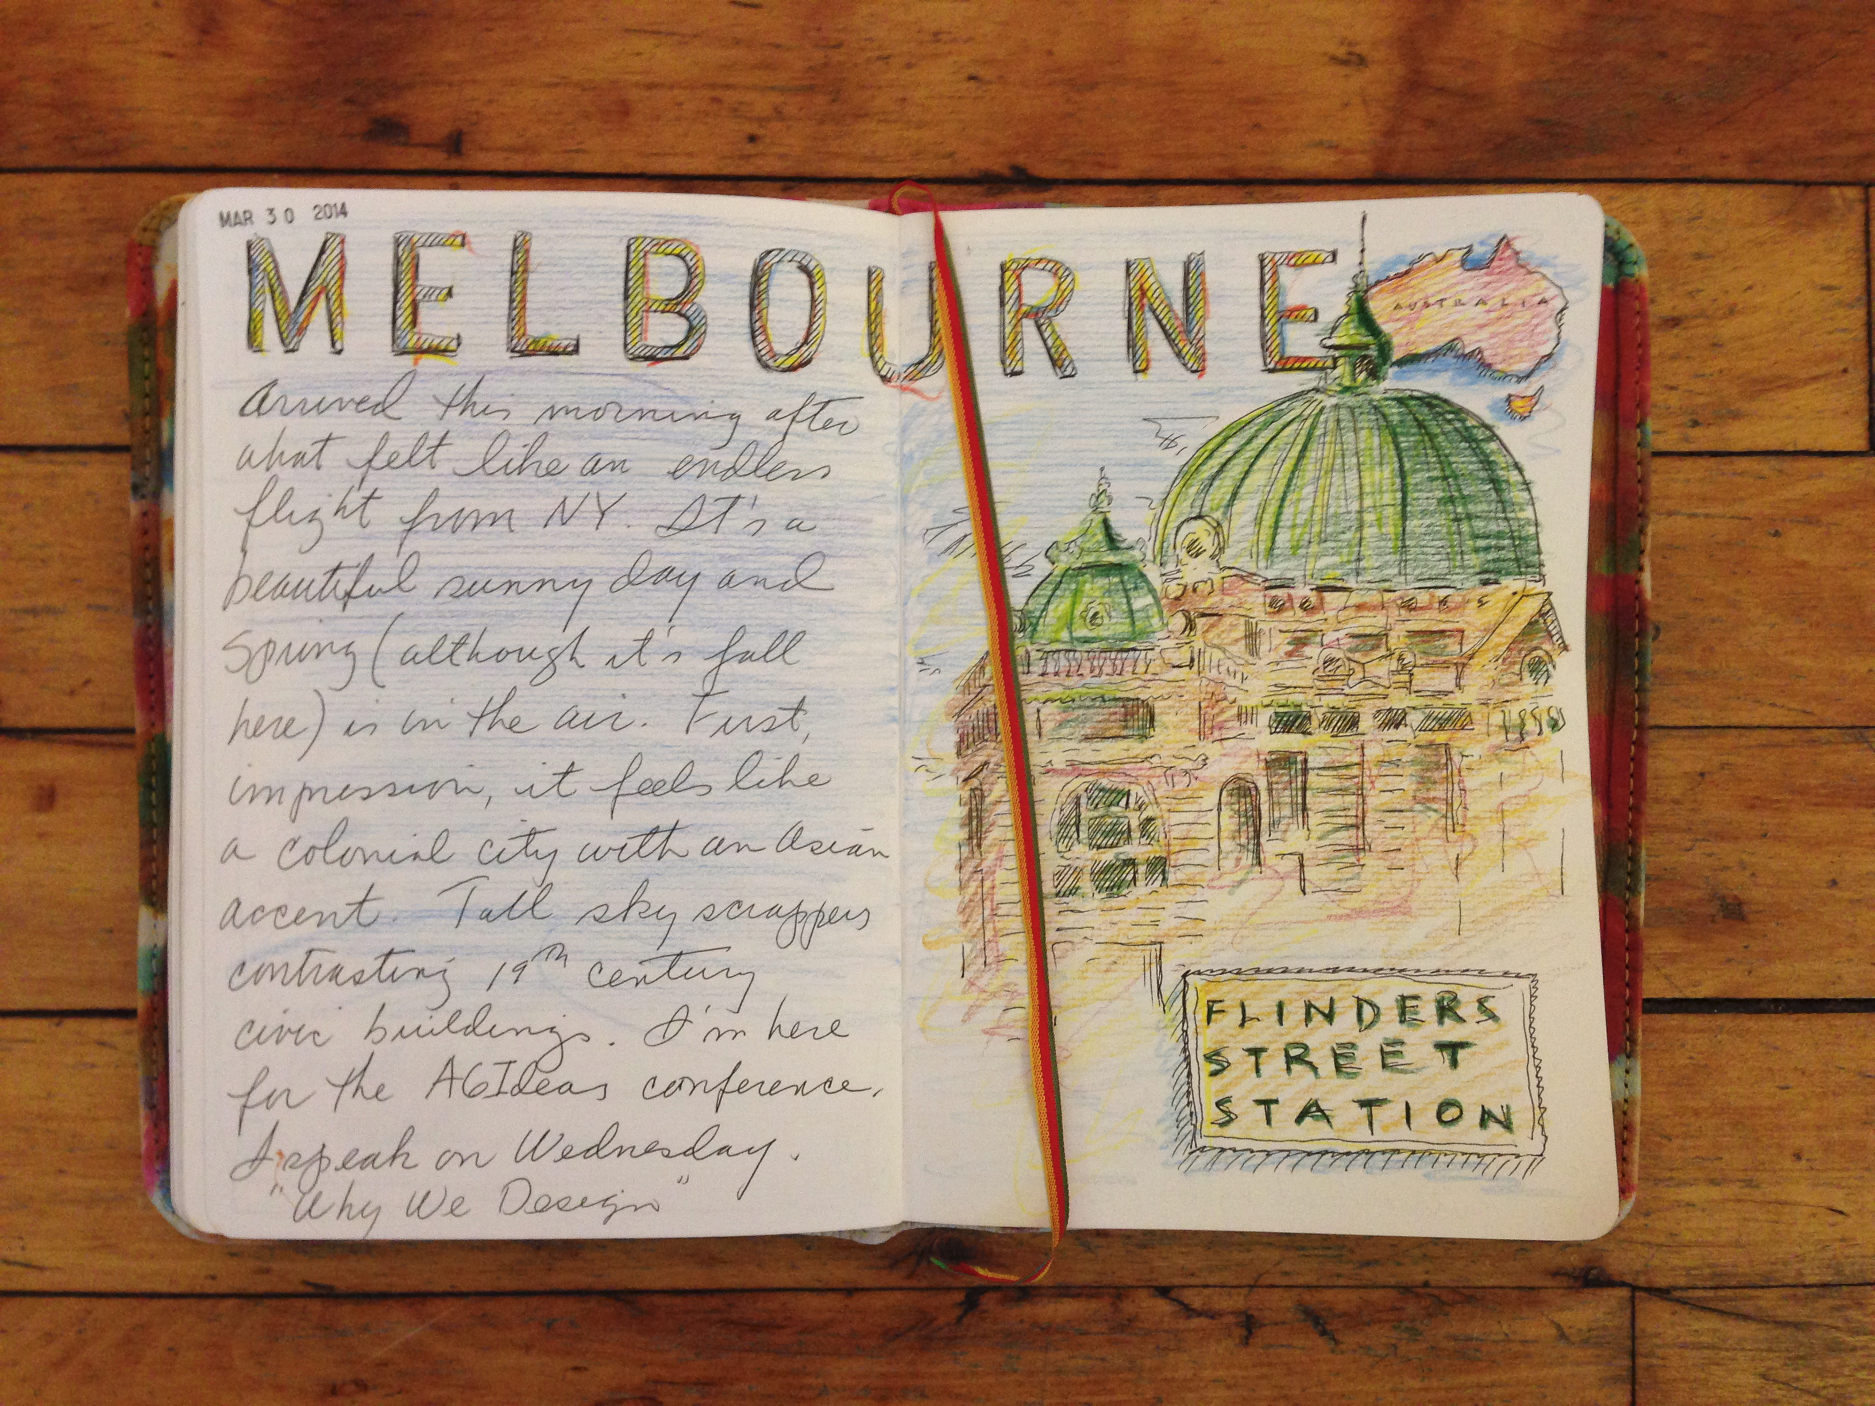
We are learning to compose an informative text.
What is the purpose of writing a journal entry?
Write a series of detailed journal entries (2-3) from the point of view of the character you examined in the Step Inside.
Alice Vigors 2017
Notes:
Examine students understanding of each of the characters in the text Ziba Came on a Boat.
Discuss the purpose of writing a journal entry and the structure.
Model writing a journal entry from the point of view of one of the characters in the text.
Write a series of journal entries (2-3) from the point of view of the character examined in the Step Inside.

Slide 15
We are learning to build vocabulary knowledge.
Text:
*
Chapters: 1 -2
Small Group Instruction
Word Study
Text:
Five Times Dizzy & Dancing in the Anzac Deli
Chapters: 1 -3
Visual Literacy
Chromebooks: Read Theory
Text:
Girl Underground
Chapters: 1 -4
Word Study
Independent Reading
Independent Reading of text
Literature Circle
Text:
Boy Overboard
Chapters: 1 -5
Word Study
Text:
Boy Overboard
Chapters: 1 -5
Word Study
Alice Vigors 2017
Notes:
Small Group Instruction / Literature Circle: working with teacher on a shared text at point of need teaching and learning. *Introduce new roles to group*
Independent Reading: Read Lit Circle/ SGI novel
Chromebooks: Complete comprehension questions using the website Read Theory.
Visual Literacy: Use the thinking routine See Think Wonder to examine the image. Compose an imaginative piece that uses descriptive language and builds tension.
Word Study: Examine the words of the week. Identify the spelling strategy, find the meaning and write each word in its own descriptive sentence.
migration, moaned, surge, murky, swirling, fierce, abandoned, dangerous, vessel, adrenaline, debris, vicious

