Slide 1
Addition and Subtraction
Alice Vigors
2017

Slide 2
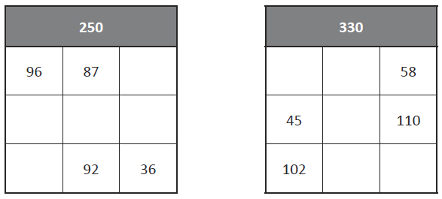
Warm-Up: Magic Squares
Each row and column adds to give the number in the top grey square.
Alice Vigors 2017

Slide 3
Can you solve problems involving decimal notation?
Alex bought three magazines for $6.25, $3.25 and $4.95. How much did he spend altogether?
Alice Vigors 2017

Slide 4
Can you solve problems involving decimal notation?
Calculate the total of these bills:
Café Uno Mochaccino $ 3 . 2 5 Ham & Cheese Toastie $ 7 . 5 0 Choc Chip Cookie $ 2 . 7 5 | Bill’s Burgers Coke $ 2 . 5 0 Double Cheese Burger $ 7 . 0 0 Fries $ 3 . 7 5 Ice Cream $ 3 . 6 0
Sushi Heaven Teriyaki Chicken $ 4 . 6 0 Avocado & Salmon $ 5 . 1 5 Cucumber & Tuna $ 4 . 2 5 | Pete’s Pizza Hawaiian Pizza $ 9 . 2 5 Vegetarian Pizza $ 8 . 7 5 Margarita Pizza $ 8 . 5 0
Alice Vigors 2017

Slide 5
Can you solve problems involving decimal notation?
Use the bills to find the answers to the following questions:
Which was cheaper, eating at Bill’s Burgers or Pete’s Pizza? By how much?
If you ate at Café Uno, Sushi Heaven and Pete’s Pizza all in 1 week, how much would you spend eating out?
Which restaurant bill was the cheapest and which was the most expensive? What is the difference in price?
Alice Vigors 2017

Slide 6
Can you solve problems involving decimal notation?
Extension: Alison’s cinema has 100 seats. One day, she notices that her cinema is full, and she has taken exactly $100.00. How many adults, pensioners, children were present?
The prices were:
-Adults $3.50
-Pensioners $1.00
-Children: $0.85
She knows that not everyone in the audience was a pensioner.
Alice Vigors 2017

Slide 7
Warm-Up: Magic Squares
Each row and column adds to give the number in the top grey square.
620
110 | 348
28 | 146
Alice Vigors 2017

Slide 8
Can you solve addition and subtraction word problems?
You have $98.00. The total of the groceries is $67.00. How much change will you get after you pay for your groceries?
Alice Vigors 2017

Slide 9
Can you solve addition and subtraction word problems?
Use a range of strategies to solve these word problems, including showing your working out.
1 382 people arrived at the pop concert by car and 4 553 arrived by train. How many people attended the concert?
6 009 people are at a football match and 648 people are working at the ground. How many people are there altogether?
Last month 1550 fans supported the local football tournament. This month there are 568 more fans. How many fans supported the local tournament this month?
Your mum gives you $10.00 to go to the bakery to buy morning tea. You buy 3 items at the bakery for a total cost of $8.25. You have a discount voucher worth $1.05. How much change will you get back?
Over the past 18 months, Chan spent lots of money on computer games. Last year, he spent $1928 and this year, he has already spent $1562. How much has he paid for computer games so far?
At the 2006 census, Australia’s population consisted of 9,799,252 males and 10,056,036 females. What was the total population? How many more females than males were there?
Alice Vigors 2017

Slide 10
Can you solve addition and subtraction word problems?
Use a range of strategies to solve these word problems, including showing your working out.
Archie, Molly and Matilda have a combined mass of 119 kg. If Archie weighs 45 kg and Molly weighs 2.5 kg less than him, how much does Matilda weigh? Mum weighs 63 kg and Dad’s mass is Archie’s and Matilda’s combined. What is the mass of the whole family?
Mars is 206 670 000 km from the Sun and Earth is 147 100 000 km from the sun. What is the difference between these distances?
Harry used his old building blocks to build a staircase. He used 78 blocks on the bottom row. He then used 13 less blocks every time in each row after that. How many blocks had he used by the time he had built 6 rows?
Keiran and Adam were given the same amount of money for their birthdays. When they went shopping together, Keiran found a CD that he liked but it cost $18.75, which was more money than he had. Adam lent him his money as well. When he paid, Keiran received $13.25 in change which he gave back to Adam. How much money had they each received for their birthdays? How much does he still owe Adam?
Alice Vigors 2017

Slide 11
Can you solve addition and subtraction word problems?
How much will you save if you buy an item on sale that was $76.95 and is now $68.99?
Alice Vigors 2017

Slide 12
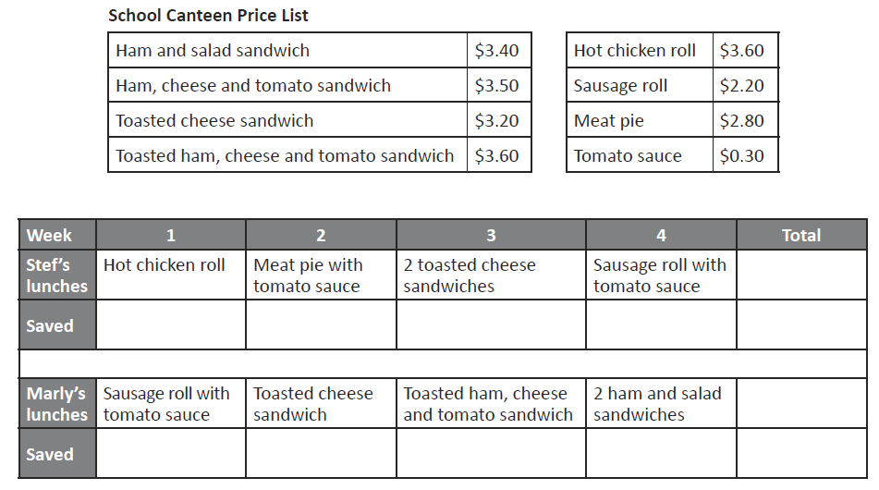
Can you solve addition and subtraction word problems?
Use a range of strategies to solve these word problems, including showing your working out.
Stef and Marly’s parents give each of them $10 pocket money each week. They must use some of it to buy their lunch from the school canteen every Friday.
If they both save the pocket money left over from buying Friday lunches, who will have saved the most by the end of 4 weeks? Use this canteen price list and the tables below.
Alice Vigors 2017

Slide 13
Can you solve addition and subtraction word problems?
Use a range of strategies to solve these word problems, including showing your working out.
• How much did each girl spend each week?
• How much was saved each week by each girl?
• Who saved the most money?
• What was the difference between them?
• What is the most possible amount of money they could have saved if they still bought lunches each Friday? What would be the least possible amount of money?
Alice Vigors 2017

