Slide 1
Changing States
Stage 2
Material World Science and Technology
Alice Vigors 2020

Slide 2
Key Inquiry Questions
How do materials change when heated and cooled?
Are all solids and/or liquids affected by adding or removing heat?
How do we use the changing state of materials in our lives?
Alice Vigors 2020

Slide 3
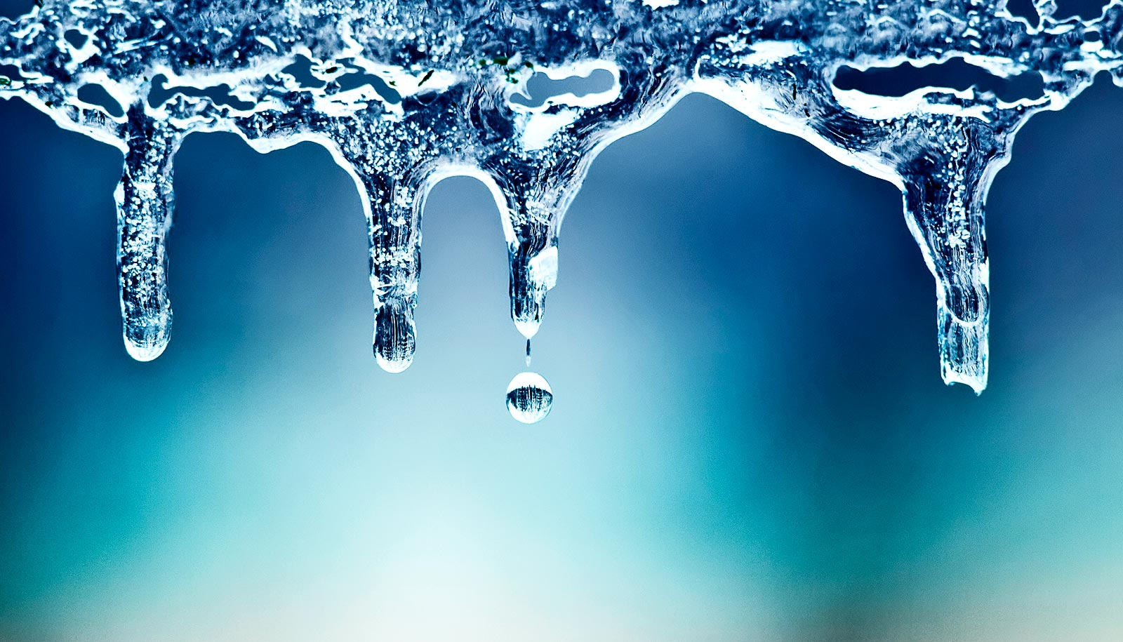
How do materials change when heated and cooled?

Slide 4
Chalk Talk – Thinking Routine
How the Chalk Talk works:
Kagan table groups will visit one page at a time for a predetermined amount of time.
Each member of the group silently reads and responds to the question on the page with a thought or a question.
As other people begin to respond, think about:
Does an idea need to be elaborated further? Add an elaboration to an idea by drawing a line off it and adding your thought.
Does this idea have a connection to your idea? If so, how? Add your connection by drawing a line to your idea and writing how they connect on the connecting line you drew.
Do you agree with and support the idea of another person? If so, why? Add a tick to show you agree and explain why you agree with this idea.
Here are today’s question prompts:
How do materials change when heated and cooled?
Are all solids and/or liquids affected by adding or removing heat?
How do we use the changing state of materials in our lives?
How might we explore and investigate these questions further?
Alice Vigors 2020
TUNING IN

Slide 5
Does an idea need to be elaborated further? Add an elaboration to an idea by drawing a line off it and adding your thought.
Does this idea have a connection to your idea? If so, how? Add your connection by drawing a line to your idea and writing how they connect on the connecting line you drew.
Do you agree with and support the idea of another person? If so, why? Add a tick to show you agree and explain why you agree with this idea.

Slide 6
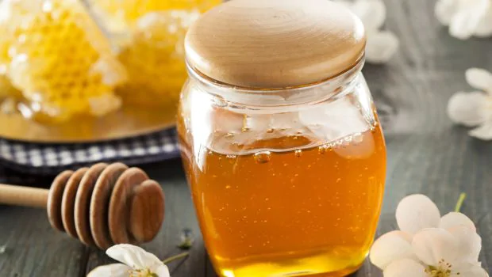
Are all solids and/or liquids affected by adding or removing heat?

Slide 7
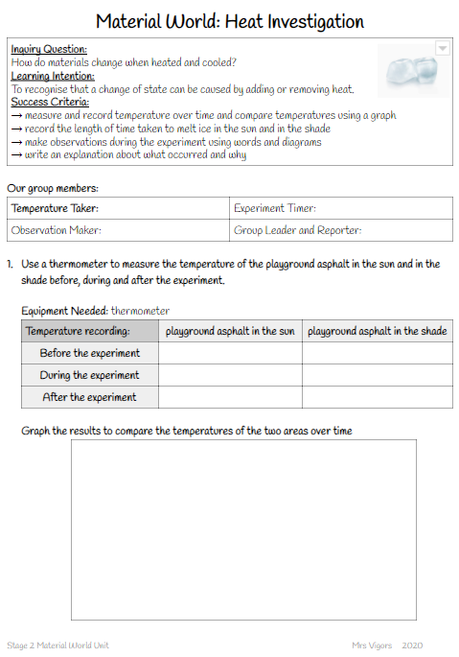
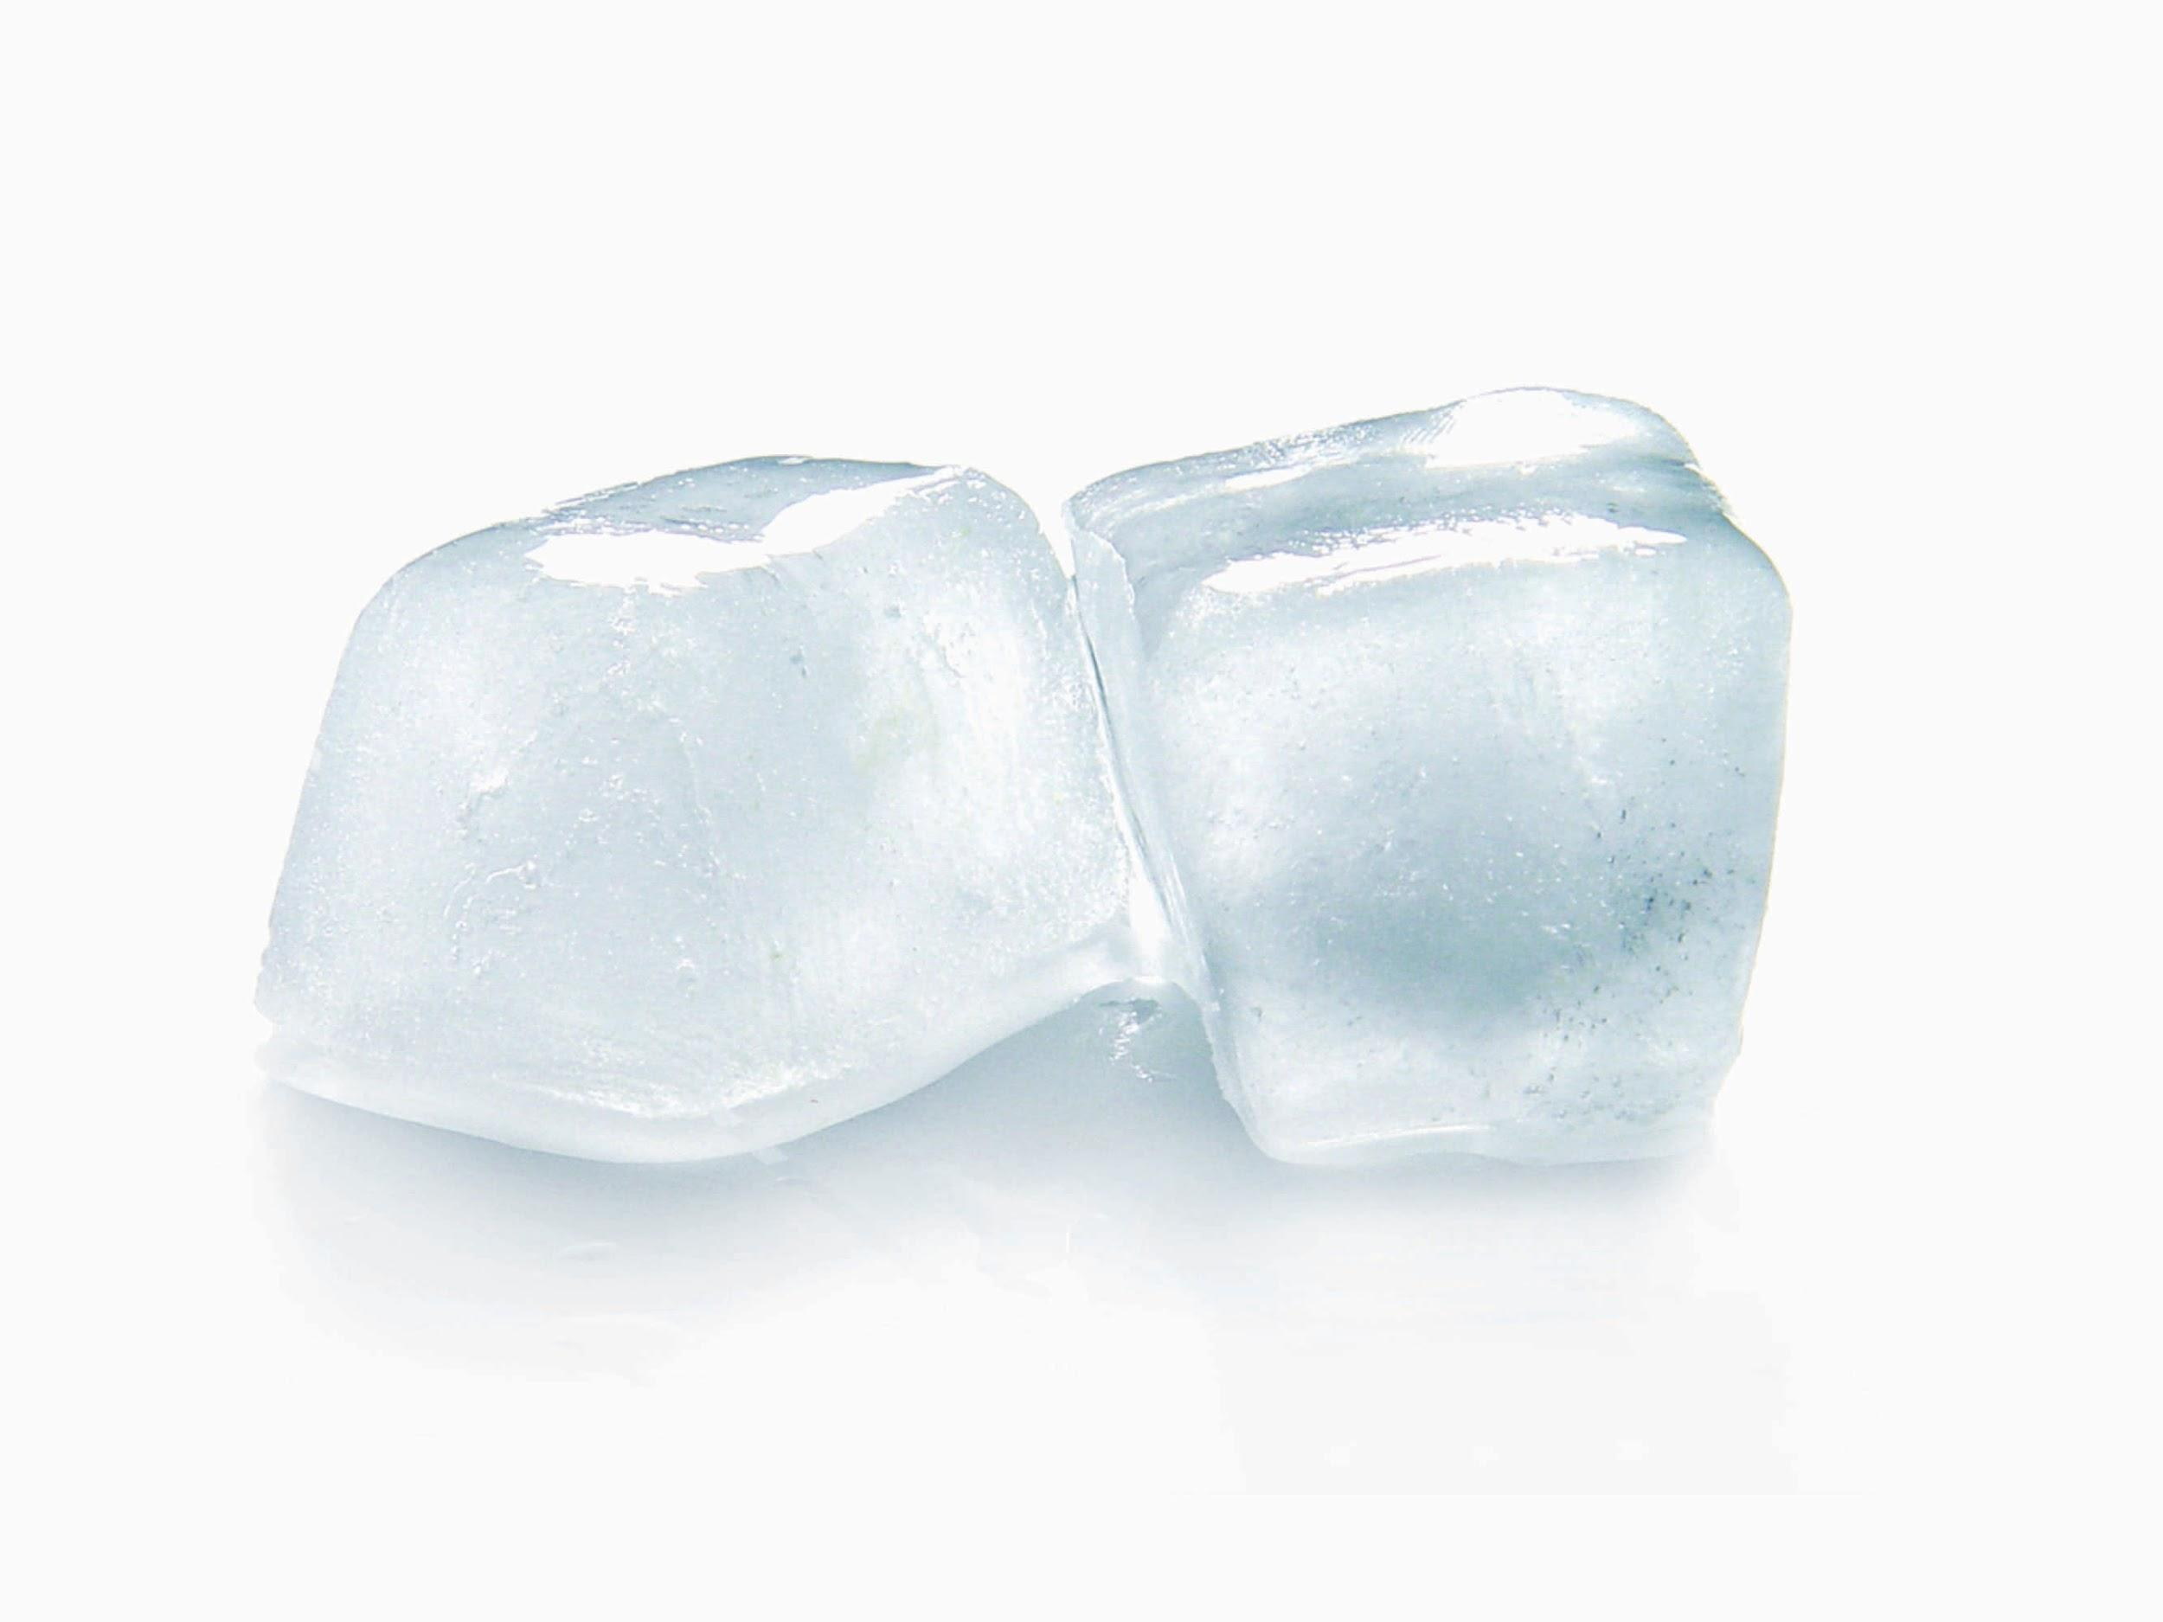
Heat Investigation
Learning Intention:
To recognise that a change of state can be caused by adding or removing heat.
Group Roles:
Temperature Taker
Temperature Taker
Experiment Timer
Experiment Timer
Observation Maker
Group Leader and Reporter
Success Criteria:
measure and record temperature over time and compare temperatures using a graph
record the length of time taken to melt ice in the sun and in the shade
make observations during the experiment using words and diagrams
write an explanation about what occurred and why
Alice Vigors 2020
SHARED INQUIRY

Slide 8
Working Together
Group Leader and Reporter leads the group through a discussion about the results and observations made during the experiment using the Talking Chips Kagan Structure.
Write an explanation about what occurred in the experiment and why you and your group think this.
Alice Vigors 2020
SHARED INQUIRY

Slide 9
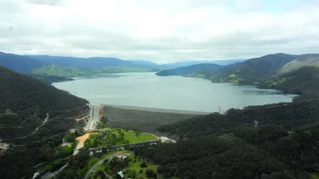
Going Further
Why do you think we used a ziplock bag to conduct this experiment?
How do we capture and store water? What makes you say that?
How might this experiment help us to understand how dams work?
Source: Sydney Morning Herald
Alice Vigors 2020
GOING FURTHER

Slide 10
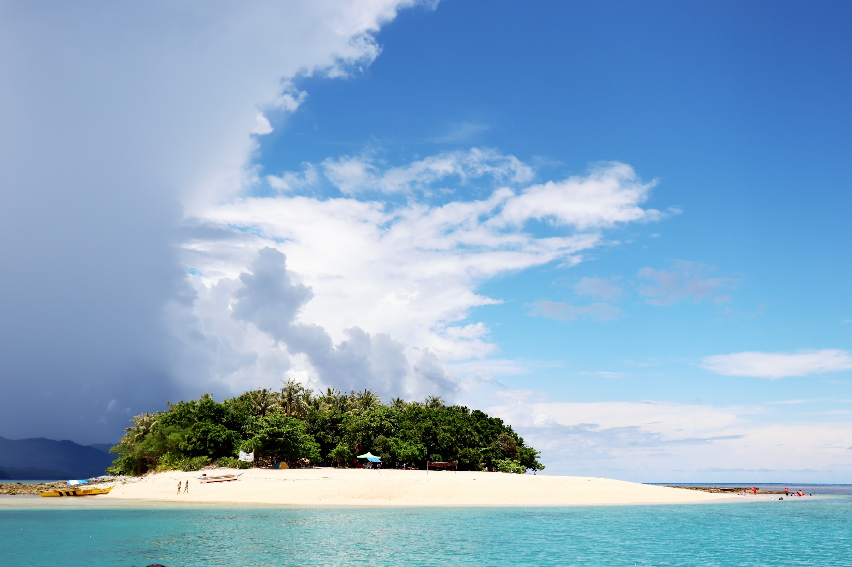
Imagine...
Imagine if you were stranded on an island and you wanted to make a canoe. What would you use?
Alice Vigors 2020
SHARED INQUIRY

Slide 11
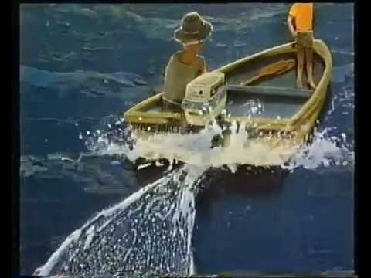
Alice Vigors 2020
Where the Forest Meets the Sea
SHARED INQUIRY

Slide 12
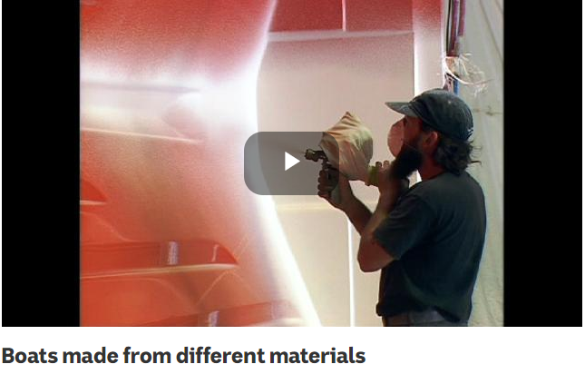
Alice Vigors 2020
ABC Education video
SHARED INQUIRY

Slide 13
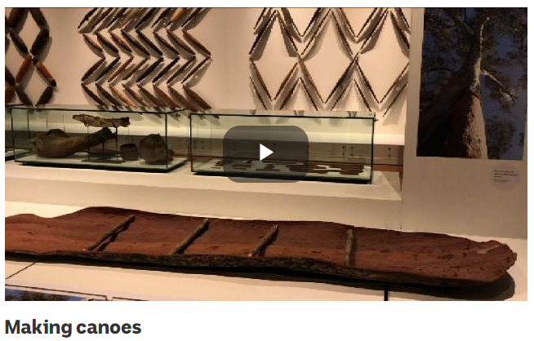
Alice Vigors 2020
ABC Education video
SHARED INQUIRY

Slide 14
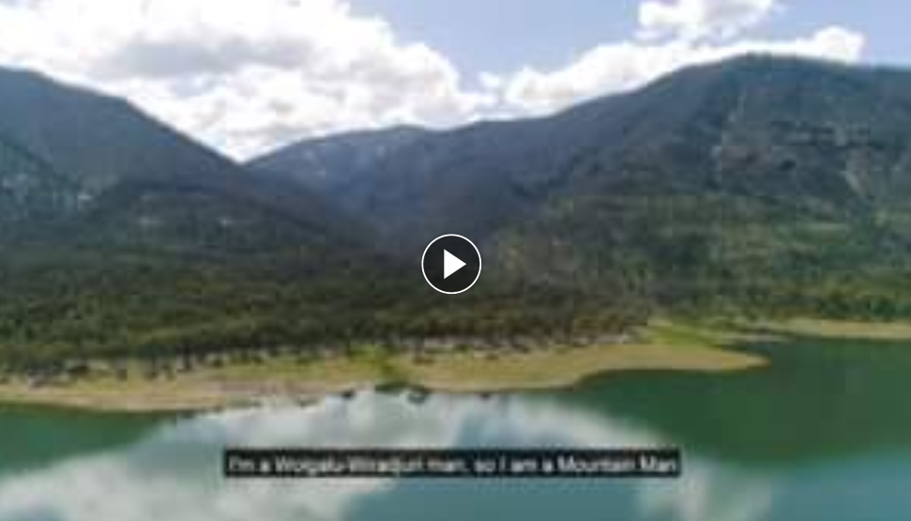
Eastern Riverina Arts video

Slide 15
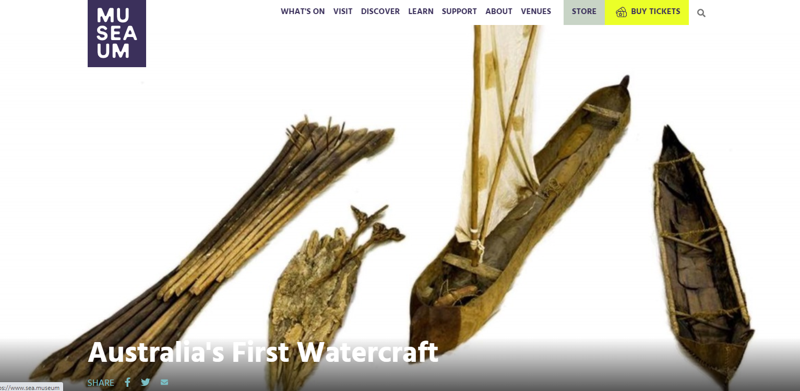
Alice Vigors 2020
Sea Museum
SHARED INQUIRY

Slide 16
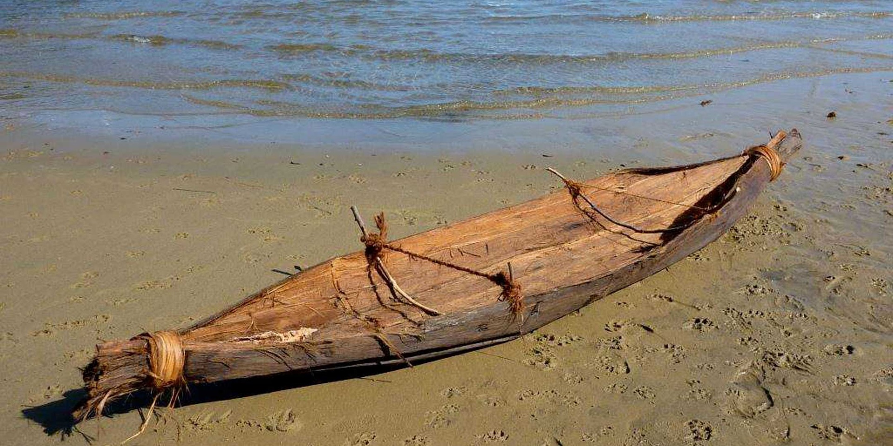
Exploring Our Thinking
What materials can be used to make boats? Can you think of three types of materials?
Why are those materials used to make boats?
How do Aboriginal peoples build canoes? How do they make their canoe waterproof?
Why is fibreglass used to make boats? How is the fibreglass applied to the mould?
What do you still wonder?
Alice Vigors 2020
SHARED INQUIRY

Slide 17
Food Related Materials Investigation
Learning Intention:
To investigate the impact heating and cooling has on different food related materials
What happens to honey when it is heated and cooled?
Does salt melt?
What happens when you heat lemon?
What happens when you heat milk?
Temperature Taker
Success Criteria:
Make a hypothesis and identify scientific variables
Record observations about the appearance of the substance when cooled in the freezer
Describe what happens when heat is applied to the substance.
Sharend describe observations with peers
Alice Vigors 2020
SHARED INQUIRY

Slide 18
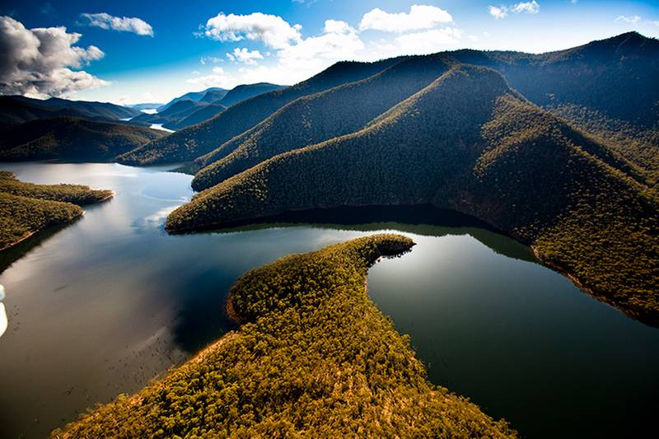
How do we use the changing state of materials in our lives?

Slide 19
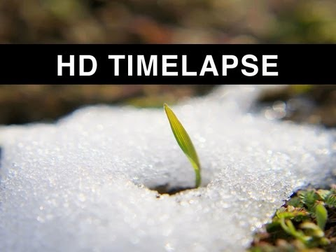
Alice Vigors 2020
TUNING IN

Slide 20
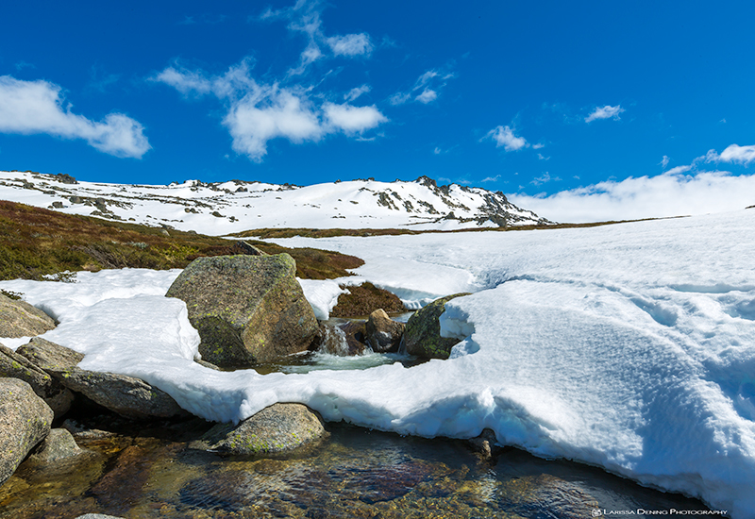
Unpacking Our Thinking
Why does snow melt?
What happens to the snow when it melts?
Where does the snow that’s melted end up?
How do we capture and store the snow that has melted?
Source: Larissa Dening Photography
Alice Vigors 2020
TUNING IN

Slide 21
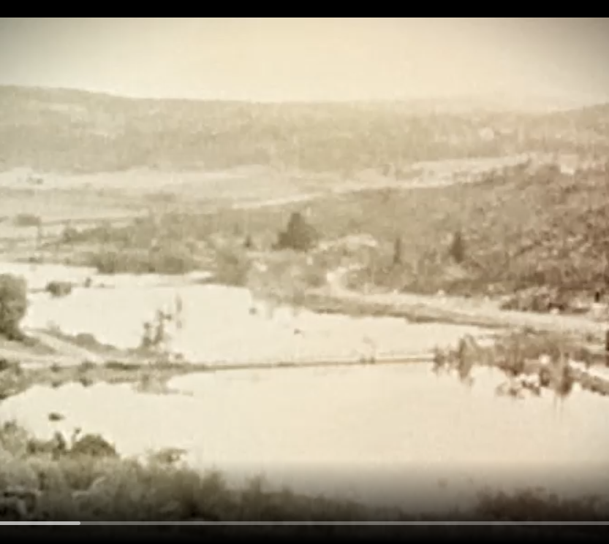
Snowy Mountains Scheme: Behind The News
Alice Vigors 2020
SHARED INQUIRY

Slide 22
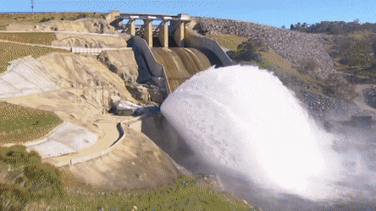
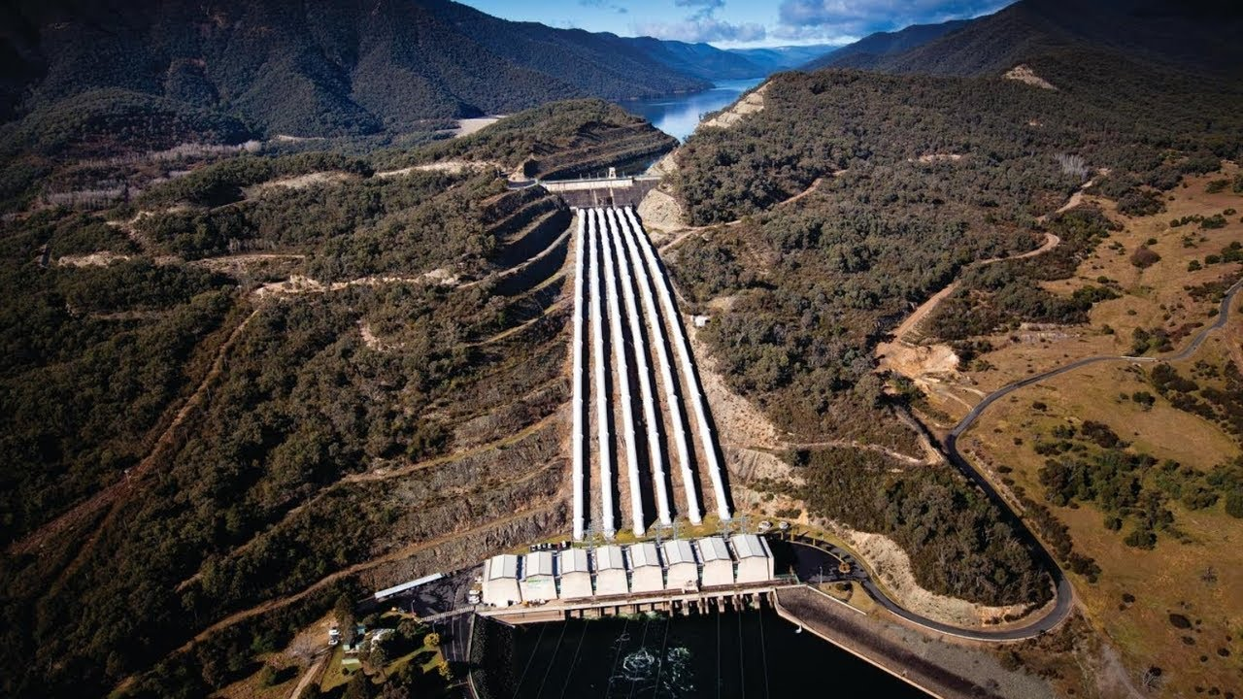
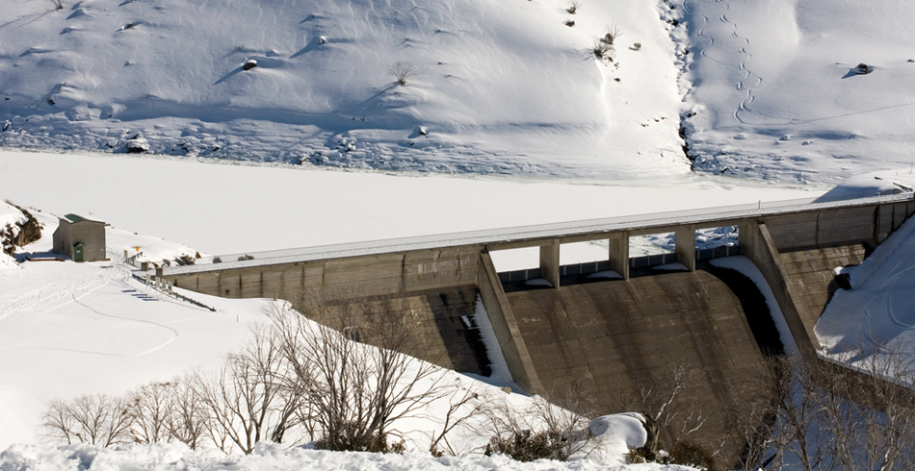
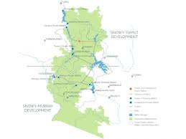
Alice Vigors 2020
SHARED INQUIRY

Slide 23
3, 2, 1 Bridge Thinking Routine
3 things you think you know
2 questions you have
1 connection you have
Alice Vigors 2020
SHARED INQUIRY

Slide 24
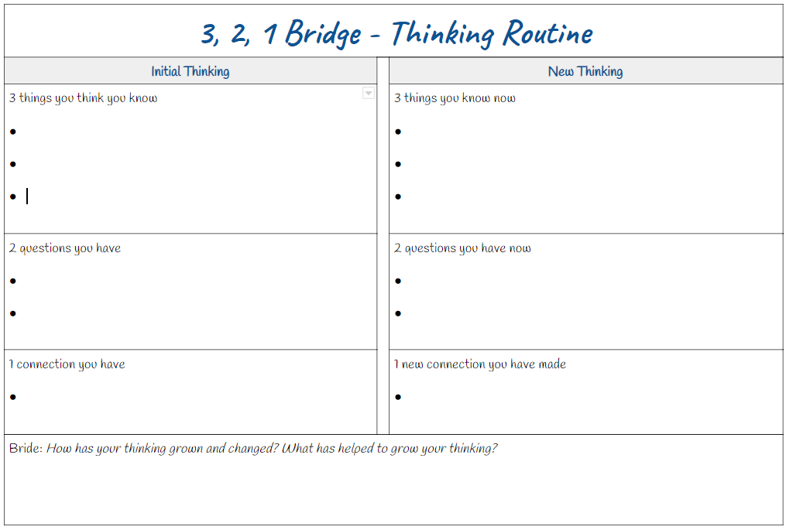
What is your current understanding about this topic?
What do you wonder about this topic?
What connections do you have to this topic?
Alice Vigors 2020
SHARED INQUIRY

Slide 25
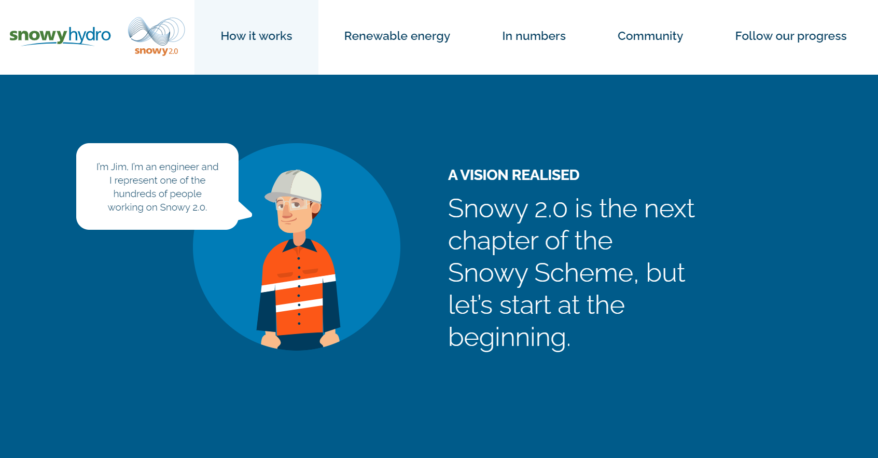
Source: Snowy Hydro Popup Book
Alice Vigors 2020
SHARED INQUIRY

Slide 26
Alice Vigors 2020
Source: Snowy Hydro 2.0
SHARED INQUIRY

Slide 27
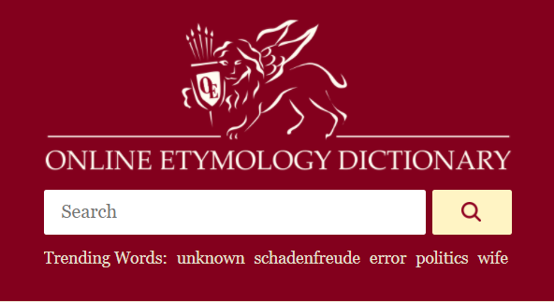
Vocabulary Exploration
Hydro
Word:
Origin or Type:
Meaning:
Connected Words:
Example Sentence:
Alice Vigors 2020
SHARED INQUIRY

Slide 28
Vocabulary Exploration
Hydroelectricity
Word:
Origin or Type:
Meaning:
Connected Words:
Example Sentence:
Alice Vigors 2020
SHARED INQUIRY

Slide 29
Vocabulary Exploration
Turbine
Reversible
Generate
Word:
Origin or Type:
Meaning:
Connected Words:
Example Sentence:
Energy
Sustainable
Impact
Recycling
Alice Vigors 2020
SHARED INQUIRY

Slide 30
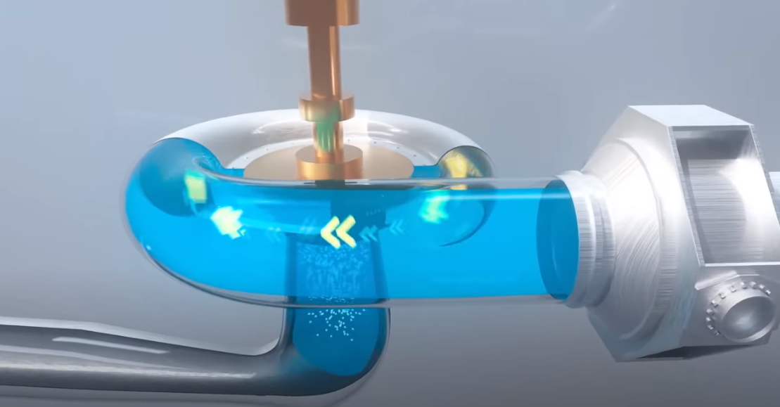
Hydroelectricity - How does it work?
Kagan Group Task:
Develop an explanation of how hydroelectricity works using words and pictures
Select one team member to share the groups explanation
Alice Vigors 2020
Source: Snowy Hydro 2.0
SHARED INQUIRY

Slide 31
What happens when water and electricity mix?
Alice Vigors 2020
Source: Snowy Hydro 2.0
SHARED INQUIRY

