Slide 1
Fractions & decimals II
Stage Three, Year 6
Alice Vigors
2017

Slide 2
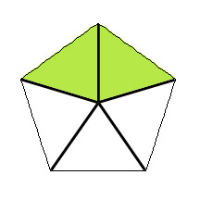
Teaching and learning sequence
We are learning to find a fraction of a quantity
Session 1
Session 2
We are learning to investigate and calculate percentage discounts
Session 3
Session 4
Session 5
describes and represents mathematical situations in a variety of ways using mathematical terminology and some conventions MA3-1WM
selects and applies appropriate problem-solving strategies, including the use of digital technologies, in undertaking investigations MA3-2WM
gives a valid reason for supporting one possible solution over another MA3-3WM
compares, orders and calculates with fractions, decimals and percentages MA3-7NA
Alice Vigors 2017
Notes:
Find a simple fraction of a quantity where the result is a whole number, with and without the use of digital technologies
calculate unit fractions of collections, with and without the use of digital technologies, eg calculate 1/5 of 30
describe the connection between finding a unit fraction of a collection and the operation of division (Communicating, Problem Solving)
calculate a simple fraction of a collection/quantity, with and without the use of digital technologies, eg calculate 2/5 of 30
explain how unit fractions can be used in the calculation of simple fractions of collections/quantities, eg 'To calculate 3/8 of a quantity, I found 1/8 of the collection first and then multiplied by 3' (Communicating, Reasoning)
solve word problems involving a fraction of a collection/quantity
Make connections between equivalent fractions, decimals and percentages
represent simple fractions as decimals and as percentages
Investigate and calculate percentage discounts of 10%, 25% and 50% on sale items, with and without the use of digital technologies
equate 10% to 1/10 , 25% to ¼ and 50% to ½
calculate common percentages (10%, 25%, 50%) of quantities, with and without the use of digital technologies
choose the most appropriate equivalent form of a percentage to aid calculation, eg 25% of $200=1/4 of $200=$200÷4=$50 (Problem Solving)
use mental strategies to estimate discounts of 10%, 25% and 50%, eg '50% off the price of $122.70: 50% is the same as ½ , so the discount is about $60'
calculate the sale price of an item after a discount of 10%, 25% and 50%, with and without the use of digital technologies, recording the strategy and result

Slide 3
Session one
Can you find a fraction of a quantity?
Alice Vigors 2017

Slide 4
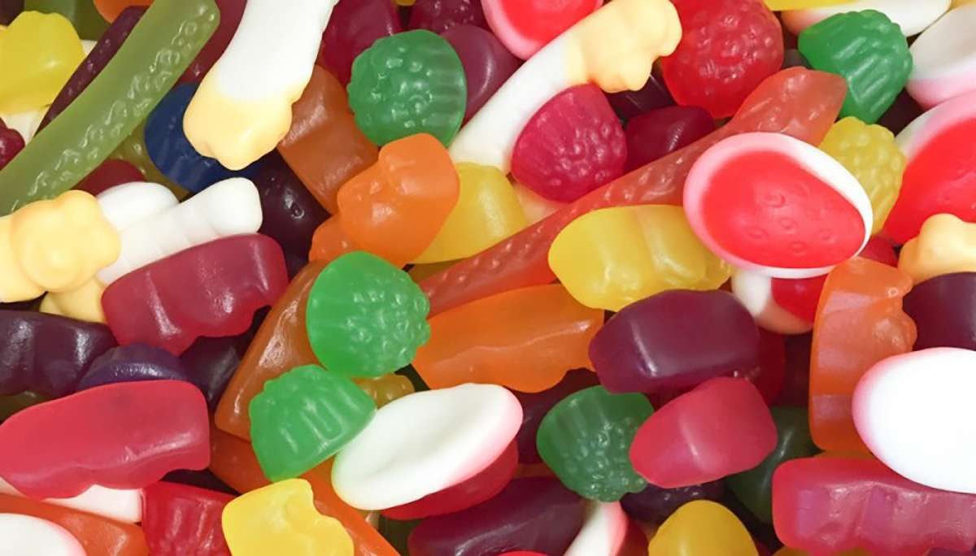
Can you find a fraction of a quantity?
You have 48 lollies.
You can choose between having 4/6 or 5/8 of the total amount of lollies.
Which would give you the most amount of lollies?
Alice Vigors 2017
Notes:
→Display the problem: You have 48 lollies. You can choose between having 4/6 or 5/8 of the total amount of lollies. Which would give you the most amount of lollies?
→Discuss what the problem is asking. Allow pairs time to explore this question before sharing ways we might solve it.

Slide 5
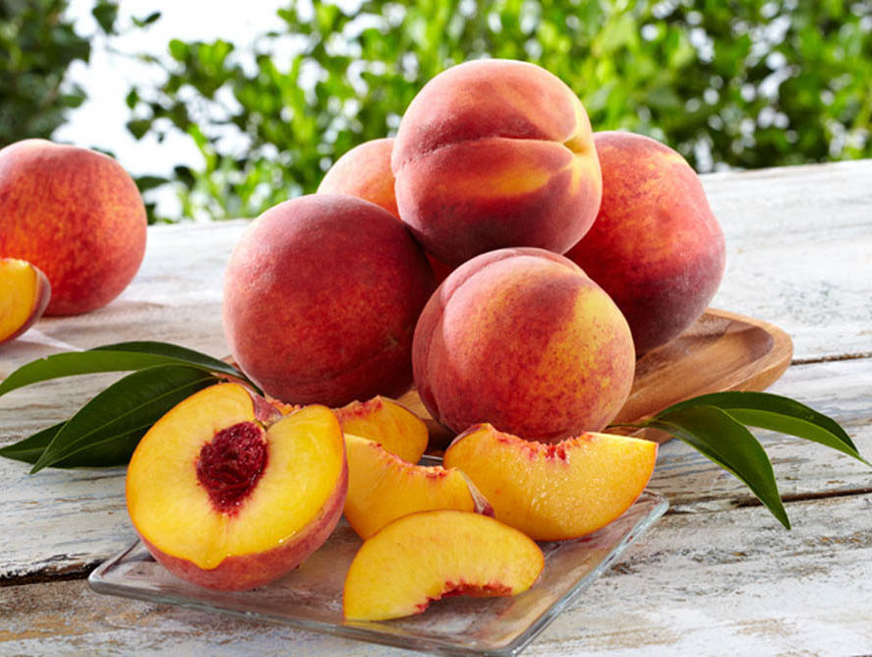
Can you find a fraction of a quantity?
Task 1: A little monkey had 60 peaches.
On the first day he decided to keep ¾ of his peaches. He gave the rest away. Then he ate one.
On the second day he decided to keep 7/11 of his peaches. He gave the rest away. Then he ate one.
On the third day he decided to keep 5/9 of his peaches. He gave the rest away. Then he ate one.
On the fourth day he decided to keep 2/7 of his peaches. He gave the rest away. Then he ate one.
On the fifth day he decided to keep 2/3 of his peaches. He gave the rest away. Then he ate one.
How many did he have left at the end?
Task 2: A little monkey had 75 peaches.
Each day, he kept a fraction of his peaches, gave the rest away,
and then ate one. These are the fractions he decided to keep:
½, ¼, ¾, 3/5, 5/6, 11/15
In which order did he use the fractions so that he was left
with just one peach at the end?
Alice Vigors 2017
Notes:
→Investigation: Students work independently or in pairs to solve the following problems, including showing their working out. (NB: problem sourced from Nrich Maths: https://nrich.maths.org/2312 )
A little monkey had 60 peaches. On the first day he decided to keep ¾ of his peaches. He gave the rest away. Then he ate one. On the second day he decided to keep 7/11 of his peaches. He gave the rest away. Then he ate one. On the third day he decided to keep 5/9 of his peaches. He gave the rest away. Then he ate one. On the fourth day he decided to keep 2/7 of his peaches. He gave the rest away. Then he ate one. On the fifth day he decided to keep 2/3 of his peaches. He gave the rest away. Then he ate one. How many did he have left at the end?
A little monkey had 75 peaches. Each day, he kept a fraction of his peaches, gave the rest away, and then ate one. These are the fractions he decided to keep: ½, ¼, ¾, 3/5, 5/6, 11/15
In which order did he use the fractions so that he was left with just one peach at the end?
Whenever the monkey has peaches, he always keeps a fraction of them each day, gives the rest away, and then eats one. I wonder how long he could make his peaches last for?
Here are his rules:
Each fraction must be in its simplest form and must be less than 1.
The denominator is never the same as the number of peaches left (for example, if there were 45 peaches left, he would not be allowed to keep 44/45 of them).
Can you start with fewer than 100 peaches and choose fractions so that there is at least one peach left after a week?
What is the longest that you can make them last, starting with fewer than 100 peaches?

Slide 6
Can you find a fraction of a quantity?
Task 3: Whenever the monkey has peaches, he always keeps a fraction of them each day, gives the rest away, and then eats one. I wonder how long he could make his peaches last for?
Here are his rules:
Each fraction must be in its simplest form and must be less than 1.
The denominator is never the same as the number of peaches left (for example, if there were 45 peaches left, he would not be allowed to keep 44/45 of them).
Task 4: Can you start with fewer than 100 peaches and
choose fractions so that there is at least one peach left
after a week?
Task 5: What is the longest that you can make them last,
starting with fewer than 100 peaches?
Alice Vigors 2017
Notes:
→Investigation: Students work independently or in pairs to solve the following problems, including showing their working out. (NB: problem sourced from Nrich Maths: https://nrich.maths.org/2312 )
A little monkey had 60 peaches. On the first day he decided to keep ¾ of his peaches. He gave the rest away. Then he ate one. On the second day he decided to keep 7/11 of his peaches. He gave the rest away. Then he ate one. On the third day he decided to keep 5/9 of his peaches. He gave the rest away. Then he ate one. On the fourth day he decided to keep 2/7 of his peaches. He gave the rest away. Then he ate one. On the fifth day he decided to keep 2/3 of his peaches. He gave the rest away. Then he ate one. How many did he have left at the end?
A little monkey had 75 peaches. Each day, he kept a fraction of his peaches, gave the rest away, and then ate one. These are the fractions he decided to keep: ½, ¼, ¾, 3/5, 5/6, 11/15
In which order did he use the fractions so that he was left with just one peach at the end?
Whenever the monkey has peaches, he always keeps a fraction of them each day, gives the rest away, and then eats one. I wonder how long he could make his peaches last for?
Here are his rules:
Each fraction must be in its simplest form and must be less than 1.
The denominator is never the same as the number of peaches left (for example, if there were 45 peaches left, he would not be allowed to keep 44/45 of them).
Can you start with fewer than 100 peaches and choose fractions so that there is at least one peach left after a week?
What is the longest that you can make them last, starting with fewer than 100 peaches?

Slide 7
Session Two
Can you find a fraction of a quantity?
Alice Vigors 2017

Slide 8
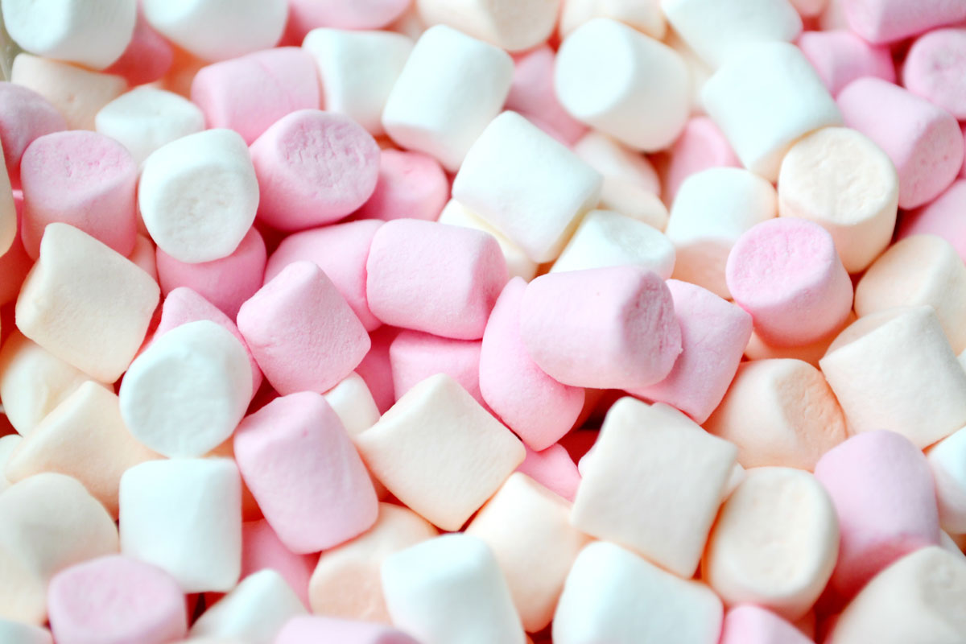
Can you find a fraction of a quantity?
You have 56 marshmallows to share at a party. But you have to give some to your brother.
You can either keep 3/7 or ½ of the marshmallows to share at your party.
Explain which fraction you would choose so that you had the greatest amount to share at your party.
Alice Vigors 2017
Notes:
→Display the problem: You have 56 marshmallows to share at a party. But you have to give some to your brother. You can either keep 3/7 or ½ of the marshmallows to share at your party. Explain which fraction you would choose so that you had the greatest amount to share at your party.
→Discuss what the problem is asking. Allow pairs time to explore this question before sharing ways we might solve it.

Slide 9
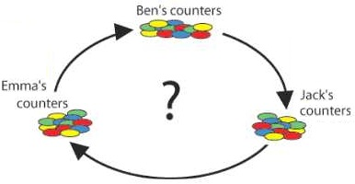
Can you find a fraction of a quantity?
Ben, Jack and Emma were playing a game with a box of 40 counters - they were not using all of them.
They each had a small pile of counters in front of them.
All at the same time, Ben passed a third of his counters to Jack, Jack passed a quarter of his counters to Emma, and Emma passed a fifth of her counters to Ben.
They all passed on more than one counter.
After this they all had the same number of counters.
How many could each of them have started with?
Alice Vigors 2017
Notes:
→Extension: Students work independently or in pairs to solve the problem: Ben, Jack and Emma were playing a game with a box of 40 counters - they were not using all of them. They each had a small pile of counters in front of them. All at the same time, Ben passed a third of his counters to Jack, Jack passed a quarter of his counters to Emma, and Emma passed a fifth of her counters to Ben. They all passed on more than one counter. After this they all had the same number of counters. How many could each of them have started with?
(NB: problem sourced from Nrich Maths: https://nrich.maths.org/2382 )

Slide 10
Session three
Can you investigate and calculate percentage discounts?
Alice Vigors 2017

Slide 11
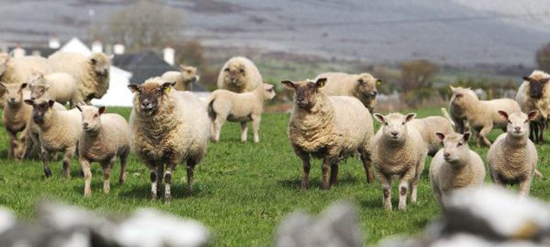
Can you investigate and calculate percentage discounts?
When Jim the farmer passed away, his will said that he wanted to leave 50% (1/2) of his sheep to his oldest child, 25% (1/4) of his sheep to his middle child and 20% (1/5) to his youngest child.
Jim only had 19 sheep, so his neighbour Harry lent Jim’s family another sheep to make the numbers easier.
How did Jim’s family manage to share the sheep out and give Harry’s sheep back?
Alice Vigors 2017
Notes:
→Display the problem: When Jim the farmer passed away, his will said that he wanted to leave 50% (1/2) of his sheep to his oldest child, 25% (1/4) of his sheet to his middle child and 20% (1/5) to his youngest child. Jim only had 19 sheep, so his neighbour Harry lent Jim’s family another sheep to make the numbers easier. How did Jim’s family manage to share the sheep out and give Harry’s sheep back?
→Discuss what the problem is asking. Allow pairs time to explore this question before sharing ways we might solve it.

Slide 12
Can you investigate and calculate percentage discounts?
Task 1: Spending Spree
You are setting up your home entertainment system and you need to buy a TV, Speaker System and Game Console. Dan has decided to do you a special deal.
He will give you 30% off the TV, 25% off the Speaker System and 15% off the Game Console Bundle.
You decide to take the extra 3-year warranty on each of the products.
Calculate the total cost to set up your home entertainment system.
Task 2: Camera Crazy
You are interested in taking a photography course, but will need to buy a new digital camera, a memory card and a laptop to upload your photos.
Dan loves photography, so he has offered you a 5% discount on the camera and a 12% discount on the laptop.
You decide to take the extra 3-year warranty just for the camera.
How much will it cost you to get set up for your course?
Alice Vigors 2017
Notes:
→Investigation: Students work independently or in pairs to solve problems using Dan’s Digital World brochure.
Spending Spree: You are setting up your home entertainment system and you need to buy a TV, Speaker System and Game Console. Dan has decided to do you a special deal. He will give you 30% off the TV, 25% off the Speaker System and 15% off the Game Console Bundle. You decide to take the extra 3-year warranty on each of the products. Calculate the total cost to set up your home entertainment system.
Camera Crazy: You are interested in taking a photography course, but will need to buy a new digital camera, a memory card and a laptop to upload your photos. Dan loves photography, so he has offered you a 5% discount on the camera and a 12% discount on the laptop. You decide to take the extra 3-year warranty just for the camera. How much will it cost you to get set up for your course?

Slide 13
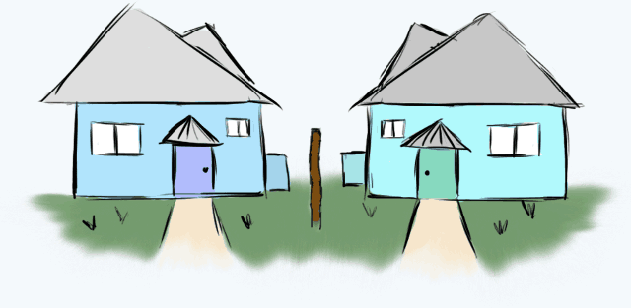
Can you investigate and calculate percentage discounts?
A property developer sells two houses, each for $252,000.
Based on the prices he paid, he made a 20% loss on one of the houses and a profit of 20% in the other.
Overall, did he make a profit or loss? How much?
Alice Vigors 2017
Notes:
→Extension: Students work independently or in pairs to solve the problem: A property developer sells two houses, each for $252,000. Based on the prices he paid, he made a 20% loss on one of the houses and a profit of 20% in the other. Overall, did he make a profit or loss? How much?

Slide 14
Session four
Can you investigate and calculate percentage discounts?
Alice Vigors 2017

Slide 15
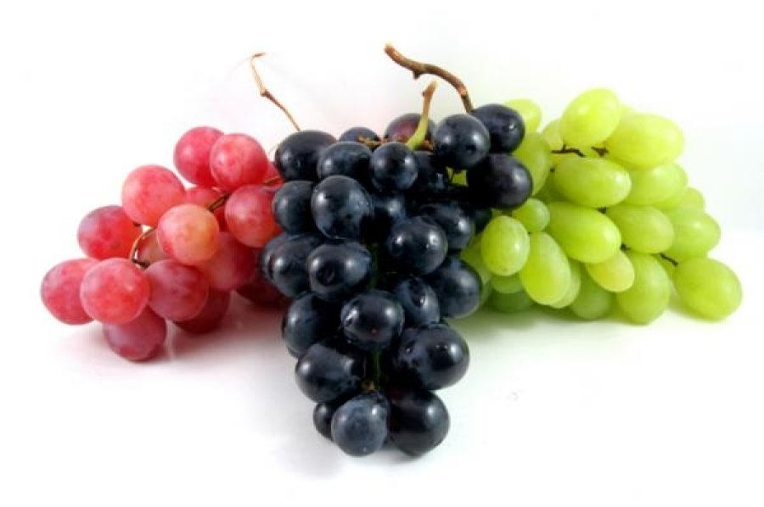
Can you investigate and calculate percentage discounts?
Brooke sold 10% of her grapes at the fruit market?
How many grapes might she have taken to the market?
Alice Vigors 2017
Notes:
→Display the problem: Brooke sold 10% of her grapes at the fruit market? How many grapes might she have taken to the market?
→Discuss what the problem is asking. Allow pairs time to explore this question before sharing ways we might solve it.

Slide 16
Can you investigate and calculate percentage discounts?
Task 1: Tricky Tablets
Your office needs to buy tablets for each of its staff members. You have 15 staff.
Dan likes the idea of selling so many tablets in one transaction, so he has offered you 10% off the first 5 tablets, 15% off the next 5 tablets and 20% off the last 5 tablets.
What is the total cost for the tablets? Your boss has given you a budget of $7000.
How many tablets can you get the extra 3-year warranty for?
Task 2: Screen Saver
You are looking at buying the 15” Notebook with HD Webcam but you are afraid the screen will be too small. Dan has agreed to let you upgrade to the 18” screen for an extra 23%. Dan’s major rival, Donny’s Digital World has the 18” Notebook with HD Webcam on sale for $749.00.
What percentage off (whole number) the 18” Notebook would you need to negotiate with Dan to ensure you are getting a better deal with him than at Donny’s?
Alice Vigors 2017
Notes:
→Investigation: Students work independently or in pairs to solve problems using Dan’s Digital World brochure.
Tricky Tablets: Your office needs to buy tablets for each of its staff members. You have 15 staff. Dan likes the idea of selling so many tablets in one transaction, so he has offered you 10% off the first 5 tablets, 15% off the next 5 tablets and 20% off the last 5 tablets. What is the total cost for the tablets? Your boss has given you a budget of $7000. How many tablets can you get the extra 3-year warranty for?
Screen Saver: You are looking at buying the 15” Notebook with HD Webcam but you are afraid the screen will be too small. Dan has agreed to let you upgrade to the 18” screen for an extra 23%. Dan’s major rival, Donny’s Digital World has the 18” Notebook with HD Webcam on sale for $749.00. What percentage off (whole number) the 18” Notebook would you need to negotiate with Dan to ensure you are getting a better deal with him than at Donny’s?

Slide 17
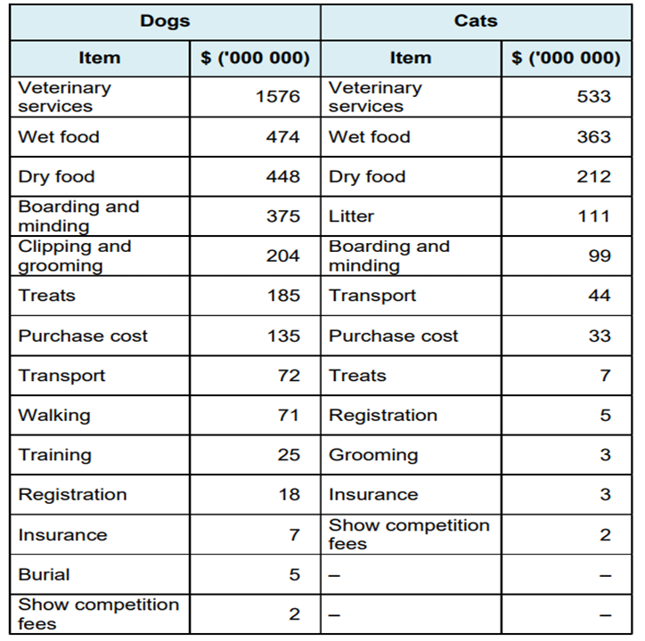
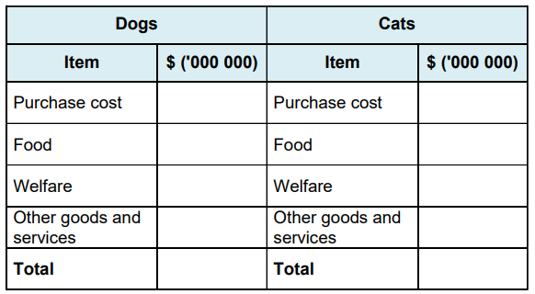
Can you investigate and calculate percentage discounts?
A pet magazine has compiled a comparative list of the amount of money spent in one year on cats and dogs in Australia.
Compile a summary table and determine the percentage that Australian’s spend in each category on a yearly basis.
Can you represent this comparative information in a graph?
Alice Vigors 2017
Notes:
→Extension: Students work independently or in pairs to solve the problem: A pet magazine has compiled a comparative list of the amount of money spent in one year on cats and dogs in Australia. Compile a summary table and determine the percentage that Australian’s spend in each category on a yearly basis. Can you represent this comparative information in a graph?

Slide 18
Session five
Can you investigate and calculate percentage discounts?
Alice Vigors 2017

Slide 19
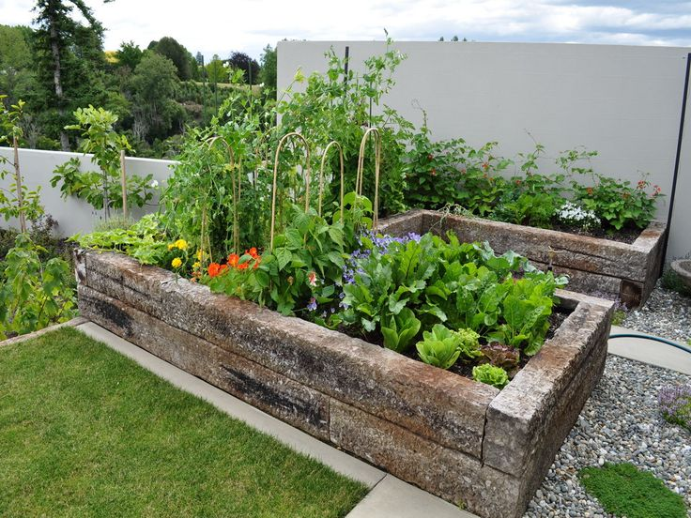
Can you investigate and calculate percentage discounts?
Alex divided his garden bed so that
50% of the garden was planted with carrots,
25% is planted with potatoes,
15% is planted with corn and
10% is planted with peas.
What might his garden bed look like?
Alice Vigors 2017
Notes:
→Display the problem: Alex divided his garden bed so that 50% of the garden was planted with carrots, 25% is planted with potatoes, 15% is planted with corn and 10% is planted with peas. What might his garden bed look like?
→Discuss what the problem is asking. Allow pairs time to explore this question before sharing ways we might solve it.

Slide 20
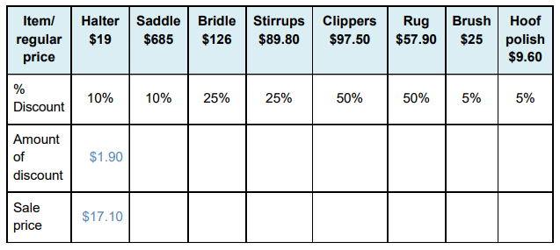
Can you investigate and calculate percentage discounts?
During sale times, businesses reduce the cost of their stock.
Task 1:
The table below lists the cost of horse equipment sold at a pet shop. Calculate the sale price of each item by deducting the discount from the original price, and write your result in the correct space in the table. The first one has been done for you.
Alice Vigors 2017
Notes:
→Investigation: Students work independently or in pairs to solve a range of number and word problems (Assessment) During sale times, businesses reduce the cost of their stock.
The table below lists the cost of horse equipment sold at a pet shop. Calculate the sale price of each item by deducting the discount from the original price, and write your result in the correct space in the table. The first one has been done for you.
The pet shop owner is given a discount of 25% on the bulk purchase of 15 pond filters, each priced at 96 dollars. What are the total savings made by the shop owner? Show your working out.
The shop owner is given a discount of 30% on the bulk purchase of 62 bird ladders that usually cost $3.50 each. How much will the shop save? Show your working out.
Choose 8 items from the Petbarn website (https://www.petbarn.com.au/) that you might buy for a pet of your choice. List each item and its advertised price. Calculate the sale prices if each item were marked down by 10%, 25% and 30%.
If you order the items online you get a further 15% off each item. What would the new cost of each item be?

Slide 21
Can you investigate and calculate percentage discounts?
During sale times, businesses reduce the cost of their stock.
Task 2:
The pet shop owner is given a discount of 25% on the bulk purchase of 15 pond filters, each priced at 96 dollars. What are the total savings made by the shop owner? Show your working out.
Task 3:
The shop owner is given a discount of 30% on the bulk purchase of 62 bird ladders that usually cost $3.50 each. How much will the shop save? Show your working out.
Alice Vigors 2017
Notes:
→Investigation: Students work independently or in pairs to solve a range of number and word problems (Assessment) During sale times, businesses reduce the cost of their stock.
The table below lists the cost of horse equipment sold at a pet shop. Calculate the sale price of each item by deducting the discount from the original price, and write your result in the correct space in the table. The first one has been done for you.
The pet shop owner is given a discount of 25% on the bulk purchase of 15 pond filters, each priced at 96 dollars. What are the total savings made by the shop owner? Show your working out.
The shop owner is given a discount of 30% on the bulk purchase of 62 bird ladders that usually cost $3.50 each. How much will the shop save? Show your working out.
Choose 8 items from the Petbarn website (https://www.petbarn.com.au/) that you might buy for a pet of your choice. List each item and its advertised price. Calculate the sale prices if each item were marked down by 10%, 25% and 30%.
If you order the items online you get a further 15% off each item. What would the new cost of each item be?

Slide 22
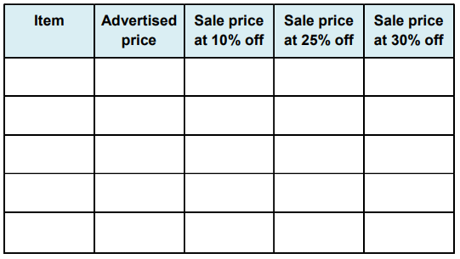
Can you investigate and calculate percentage discounts?
During sale times, businesses reduce the cost of their stock.
Task 4:
Choose 8 items from the Petbarn website (https://www.petbarn.com.au/ ) that you might buy for a pet of your choice. List each item and its advertised price. Calculate the sale prices if each item were marked down by 10%, 25% and 30%.
Task 5:
If you order the items online you get a further 15% off each item. What would the new cost of each item be?
Alice Vigors 2017
Notes:
→Investigation: Students work independently or in pairs to solve a range of number and word problems (Assessment) During sale times, businesses reduce the cost of their stock.
The table below lists the cost of horse equipment sold at a pet shop. Calculate the sale price of each item by deducting the discount from the original price, and write your result in the correct space in the table. The first one has been done for you.
The pet shop owner is given a discount of 25% on the bulk purchase of 15 pond filters, each priced at 96 dollars. What are the total savings made by the shop owner? Show your working out.
The shop owner is given a discount of 30% on the bulk purchase of 62 bird ladders that usually cost $3.50 each. How much will the shop save? Show your working out.
Choose 8 items from the Petbarn website (https://www.petbarn.com.au/) that you might buy for a pet of your choice. List each item and its advertised price. Calculate the sale prices if each item were marked down by 10%, 25% and 30%.
If you order the items online you get a further 15% off each item. What would the new cost of each item be?

