Slide 1
Fractions and Decimals
Stage Three
Alice Vigors
2017

Slide 2
Teaching & Learning Sessions
Session One:
Session Three:
We are learning to subtract fractions with like denominators and mixed numerals
Session Four:
We are learning to multiply simple fractions by whole numbers using repeated addition, leading to a rule
Session Five:
We are learning to multiply simple fractions by whole numbers using repeated addition, leading to a rule
Session Six:
We are learning to generate equivalent fractions, by multiplying or dividing the numerator and the denominator by the same number
Session Two:
We are learning to add mixed numerals
We are learning to add fractions with same or related denominators
Session Seven:
We are learning to write fractions in their ‘simplest’ form by dividing the numerator by a common factor
Describes and represents mathematical situations in a variety of ways using mathematical terminology and some conventions MA3-1WM
Selects and applies appropriate problem-solving strategies, including the use of digital technologies, in undertaking investigations MA3-2WM
Gives a valid reason for supporting one possible solution over another MA3-3WM
Compares, orders and calculates with fractions, decimals and percentages MA3-7NA
Linked outcomes: Addition and Subtraction MA3-5NA Patterns and Algebra MA3-8NA
Multiplication and Division MA3-6NA
Alice Vigors 2017

Slide 3
Session One
We are learning to add fractions with same and related denominators
Alice Vigors 2017

Slide 4
We are learning to add fractions with same and related denominators
The answer is 3 ¾ . What could the question be?
Alice Vigors 2017

Slide 5
We are learning to add fractions with same and related denominators
Sally ate 2/10 of a pizza, while Melanie ate 3/10 of a pizza. What fraction of the pizza did they eat?
Alice Vigors 2017

Slide 6
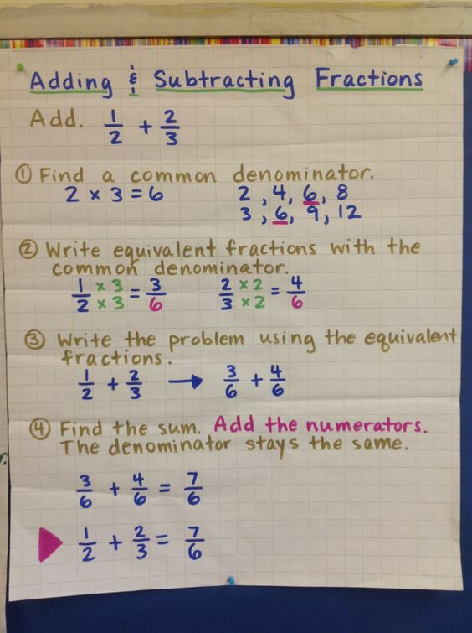
We are learning to add fractions with same and related denominators
Record the thinking and strategies you used to solve these fraction problems:
¼ + 2/4 =
3/9 + 7/9 =
4/7 + 2/7 =
¼ + 6/8 =
1/5 + 8/10 =
Alice Vigors 2017

Slide 7
We are learning to add fractions with same and related denominators
Record the thinking and strategies you used to solve these fraction problems:
Mary has read 2 books for school. She read 7/12 of the first book and 1/12 of the second book. What total fraction of these two books has Mary read? Write the fraction in its simplest form. Draw that fraction.
Jason planted 7/9 rows of carrots and 4/9 rows of beans. In total, how many vegetables did Jason plant? Convert to a mixed numeral.
Bob planted 6/9 rows of carrots and 4/9 rows of beans. He also planted ¼ of rose bushes. In total, how many vegetables did Bob plant? Convert to a mixed numeral.
Extension: Billy and his family were eating Easter eggs. Billy ate half of the Easter eggs, then his mum ate 2/3 of what was left? His sister took the remaining eggs and ate 1/5 of them. Dad ate the remaining 12 eggs. How many Easter eggs did the family eat altogether?
Alice Vigors 2017

Slide 8
Session Two
We are learning to add mixed numerals
Alice Vigors 2017

Slide 9
We are learning to add mixed numerals
The answer is 10 1/5 . What could the question be?
Alice Vigors 2017

Slide 10
We are learning to add mixed numerals
1 2/4 + 2 ¼ =
Alice Vigors 2017

Slide 11
We are learning to add mixed numerals
Record the thinking and strategies you used to solve these fraction problems:
2 2/8 + 3 1/8 =
5 ¼ + 2 2/4 =
2 2/9 + 4 7/9 =
3 1/8 + 5 6/8 =
7 1/5 + 2 3/5 =
9 4/5 + 2 2/10 =
Create your own mixed numeral addition problems.
Alice Vigors 2017

Slide 12
We are learning to add mixed numerals
Record the thinking and strategies you used to solve these fraction problems:
Extension: A ball is dropped from a height of 125 cm. Each time it hits the ground, it bounces to 3/5 of the height from which it fell. How high does it bounce after hitting the ground the third time?
Alice Vigors 2017

Slide 13
Session Three
We are learning to subtract fractions with like denominators and mixed numerals
Alice Vigors 2017

Slide 14
We are learning to subtract fractions with like denominators and mixed numerals
The answer is -3 1/3 . What could the question be?
Alice Vigors 2017

Slide 15
We are learning to subtract fractions with like denominators and mixed numerals
5 2/4 – 2 1/4=
Alice Vigors 2017

Slide 16
We are learning to subtract fractions with like denominators and mixed numerals
Record the thinking and strategies you used to solve these fraction problems:
2 2/8 + 3 1/8 =
5 ¼ + 2 2/4 =
2 2/9 + 4 7/9 =
3 1/8 + 5 6/8 =
7 1/5 + 2 3/5 =
9 4/5 + 2 2/10 =
You have 2 ¾ boxes of chocolates and you eat 1 ¼ boxes. How many boxes do you have left?
Create your own mixed numeral addition problems.
Alice Vigors 2017

Slide 17
We are learning to subtract fractions with like denominators and mixed numerals
Record the thinking and strategies you used to solve these fraction problems:
When Sam and his friends divide up these lollies, he gets 2/5 of the mini chocolate and ¼ of the Chuppa chups. How many of each does he get?
George wanted all the gob stoppers. In a tense negotiation with Sam, he managed to score 2/3 of them. How many did he get? How many did he miss out on?
To get his share of the gobstoppers, Sam has to trade off ½ of the Chuppa chups he received. How many does he lose?
Mara gets all the wiz fizz, ½ the all day suckers, and the remaining 3/5 of the chocolate bars. In total how many items does she get?
Total:
50 mini chocolate bars
18 gob stoppers
16 Chuppa cups
12 wiz fizz
4 all day suckers
2 Easter eggs
1 turnip
Alice Vigors 2017

Slide 18
Session Four
We are learning to multiply simple fractions by whole numbers using repeated addition, leading to a rule
Alice Vigors 2017

Slide 19
We are learning to multiply simple fractions by whole numbers using repeated addition, leading to a rule
What numbers could go in these boxes? How do you know?
Alice Vigors 2017

Slide 20
We are learning to multiply simple fractions by whole numbers using repeated addition, leading to a rule
How can we use repeated addition to solve this number problem?
3 x 3
12
Alice Vigors 2017

Slide 21
We are learning to multiply simple fractions by whole numbers using repeated addition, leading to a rule
Record the thinking and strategies you used to solve these fraction problems:
3 x 2/7 =
5 x 1/8 =
3 x 2/9 =
6 x ½ =
5 x 2/5 =
8 x 2/4 =
15 x 3/5 =
Sam thinks that 6 x 2/6 is the same as 5 x 2/5. Is he right? Show how you know.
Alice Vigors 2017

Slide 22
We are learning to multiply simple fractions by whole numbers using repeated addition, leading to a rule
How can we use an algorithm to make this process simpler?
3 x 3
5
Alice Vigors 2017

Slide 23
We are learning to multiply simple fractions by whole numbers using repeated addition, leading to a rule
Record the thinking and strategies you used to solve these fraction problems. Record your answers as both proper and improper fractions:
4 x ¾ =
4 x 2/3 =
5 x 2/4 =
3 x 3/6 =
2 x 4/5 =
5 x 2/3 =
A cake recipe needs ¾ cups of milk. I have 6 cups of milk. How many cakes can I make using this recipe before I run out of milk?
Extension: 2/3 of 5/6 of a number X is the same as ¾ of 4/5 of a number Y. What is the value of X/Y as a fraction?
(https://nrich.maths.org/2878 )
Alice Vigors 2017

Slide 24
Session Five
We are learning to multiply simple fractions by whole numbers using repeated addition, leading to a rule
Alice Vigors 2017

Slide 25
We are learning to multiply simple fractions by whole numbers using repeated addition, leading to a rule
How might we solve this problem? How could we record the answer?
5 x 8
10
Alice Vigors 2017

Slide 26
We are learning to multiply simple fractions by whole numbers using repeated addition, leading to a rule
Record the thinking and strategies you used to solve these fraction problems:
A cookie recipe calls for ¾ of a cup of sugar. How much sugar should I use if I want to make 5 batches?
Mr Jones gave 1/3 of a cupcake to 8 of his students. How many cupcakes did Mr Jones give out?
Each of the 5 members of the Clarke family get 2/3 cup of rice with their dinner. How much rice will they need?
Tammy drank 2/3 cup of lemonade. Suzie drank 3 times more. How much did she drink?
Rose ate 1/8 of the soup in the pot. Kristy ate 4 times more than Rose did. How much did she eat?
Jen has 20 shirts. She donated 4/5 of them to charity. How much did she give away?
Extension: Last week, Becky went to dance class 4 times. Each class was 3/2 hours. This week, Becky went to dance class 5 times. Each class was 1 hour. Which week did Becky spend more time in dance class?
Alice Vigors 2017

Slide 27
Session Six
We are learning to generate equivalent fractions, by multiplying or dividing the numerator and the denominator by the same number
Alice Vigors 2017

Slide 28
We are learning to generate equivalent fractions, by multiplying or dividing the numerator and the denominator by the same number
How can I use multiplication to find larger equivalent fractions?
Alice Vigors 2017

Slide 29
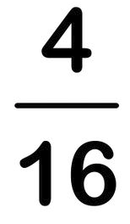
We are learning to generate equivalent fractions, by multiplying or dividing the numerator and the denominator by the same number
How can I use division to find smaller equivalent fractions?
Alice Vigors 2017

Slide 30
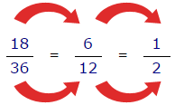
We are learning to generate equivalent fractions, by multiplying or dividing the numerator and the denominator by the same number
Use multiplication to find larger equivalent fractions. Record your thinking and strategies.
½
3/5
2/10
¾
6/12
Use division to find smaller equivalent fractions. Record your thinking and strategies.
4/8
4/12
30/42 = 5/7 What did I divide by?
I used division to simplify this fraction. The number I divided by was different both times. What did I divide by?
Alice Vigors 2017

