Slide 1
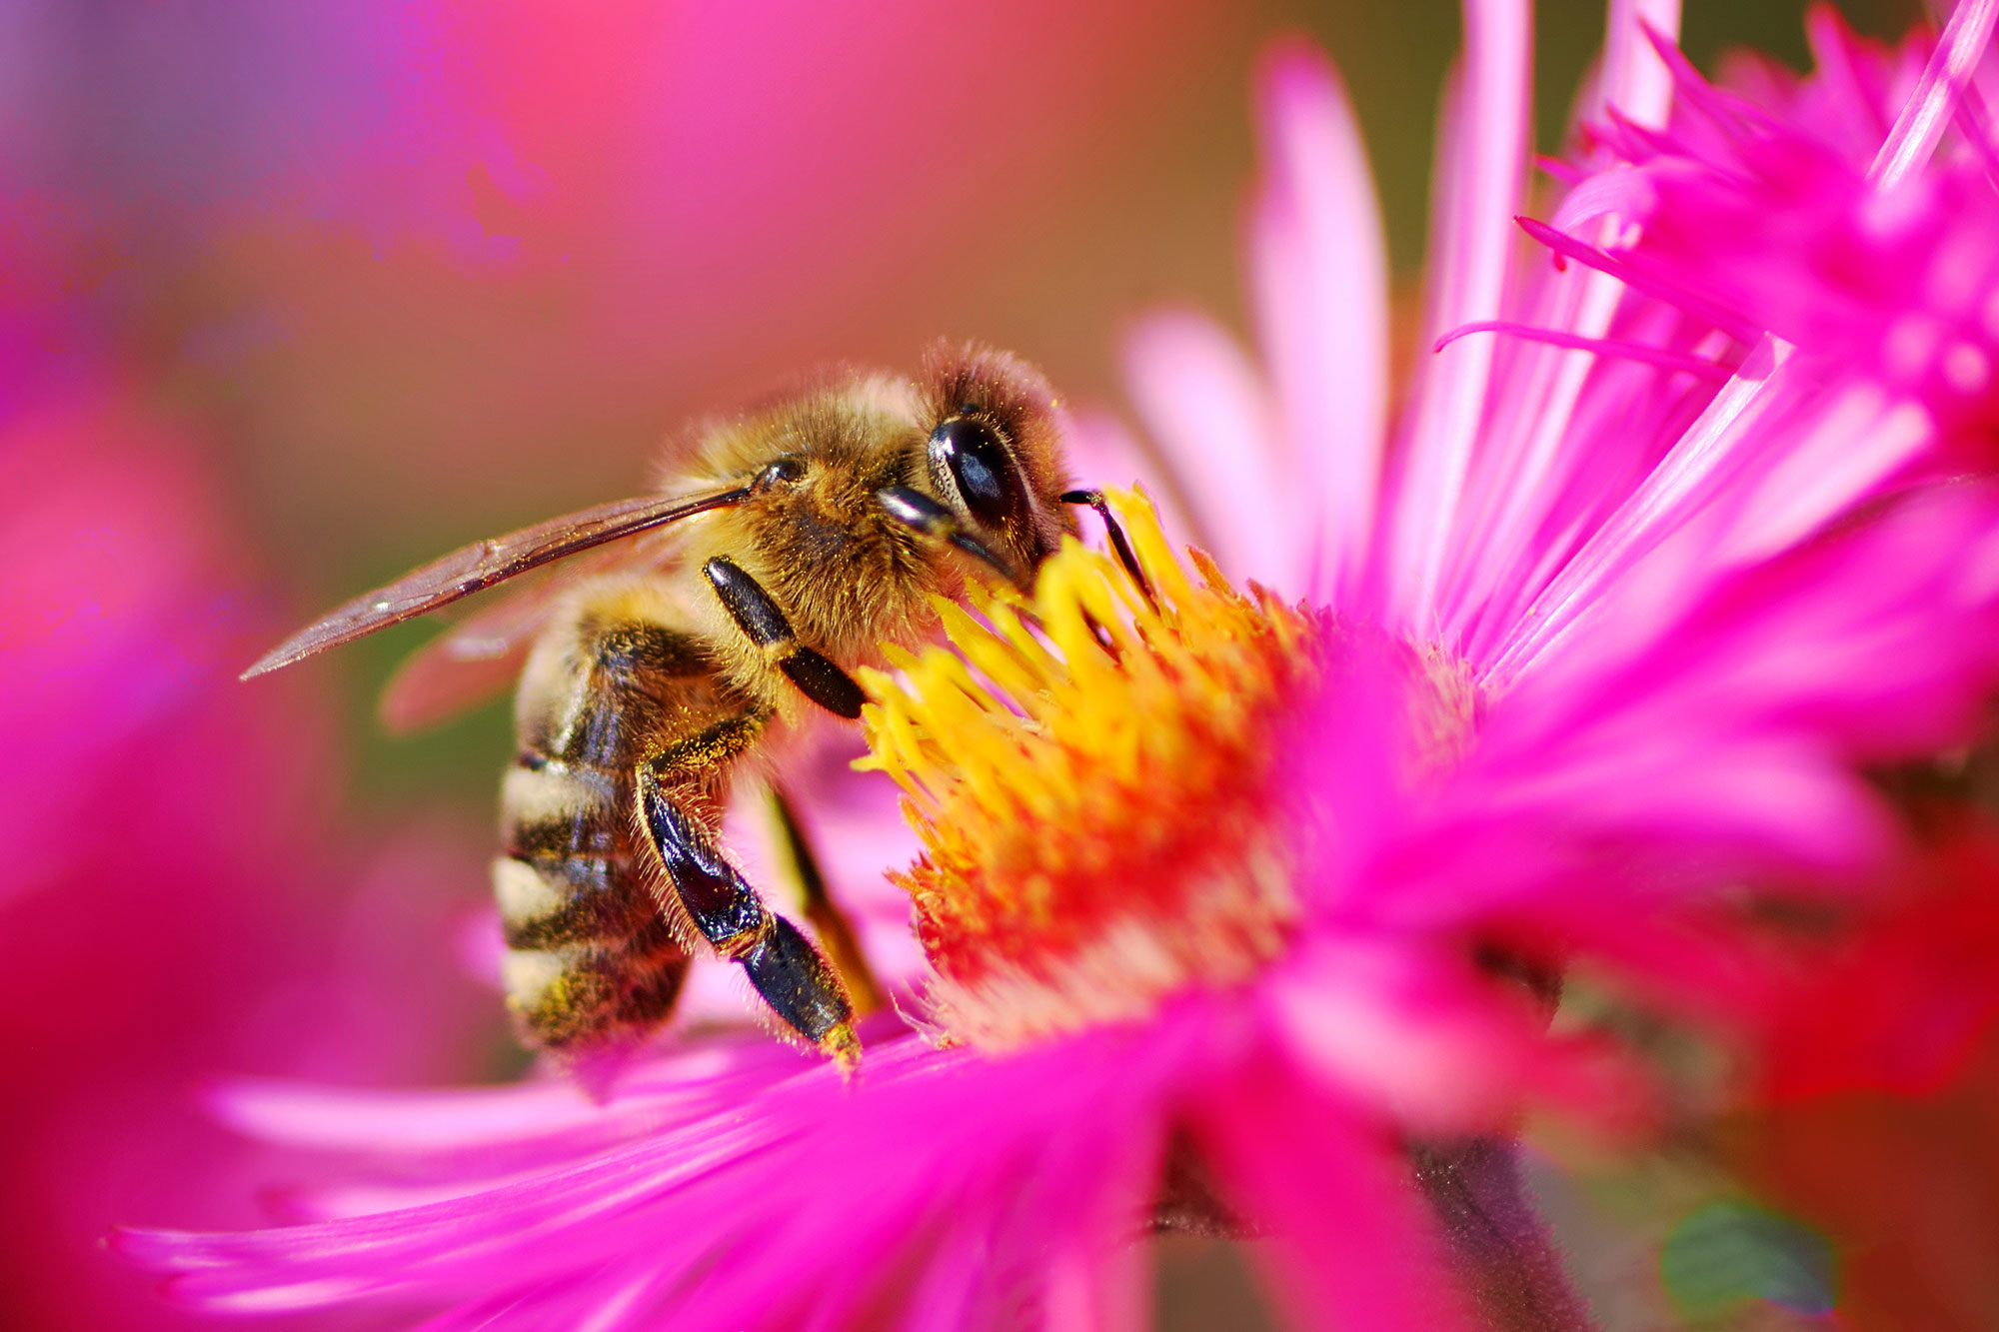
Life Cycles and Survival
Stage 2 Living World
Science and Technology
Alice Vigors 2020
Source: SciTech Daily

Slide 2
Key Inquiry Questions
What are the similarities and differences between the life cycles of living things?
How are environments and living things interdependent?
Life Cycles of Living Things
Survival of Living Things
Alice Vigors 2020

Slide 3
Life Cycles of Living Things
What are the similarities and differences between the life cycles of living things?
Source: Training Industry
Alice Vigors 2020

Slide 4
Source: Kelli Anderson & Tinybop
TUNING IN

Slide 5
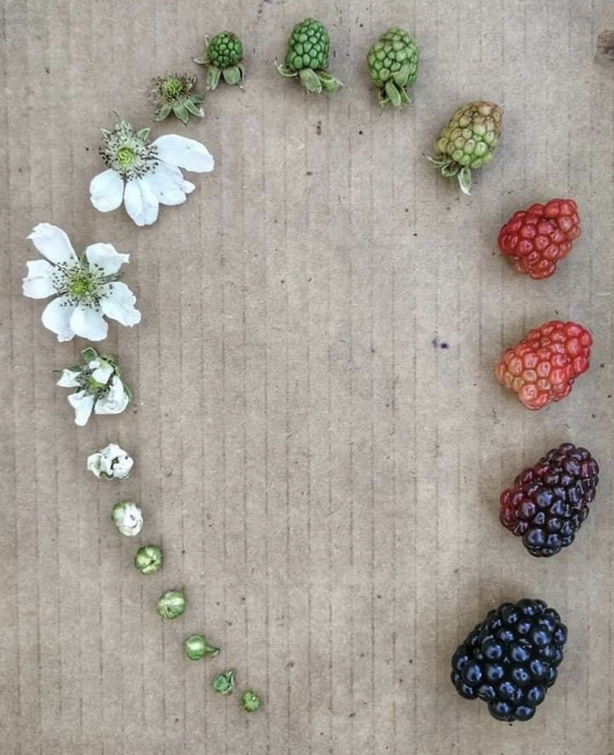
See Think Wonder - Thinking Routine
What do you see, observe or notice?
Why do you think this was represented this way?
What other plants do you think follow this same pattern of growth?
What do you wonder?
Alice Vigors 2020
Source: Reddit
TUNING IN

Slide 6
Life Cycles
Use the thinking routine Think Puzzle Explore to explore what life cycles mean and what we already know about them.
What do you think the term ‘life cycle’ means?
What questions or puzzles do you have about ‘life cycles’?
How might we explore the similarities and differences between the life cycle of familiar living things?
Alice Vigors 2020
TUNING IN

Slide 7
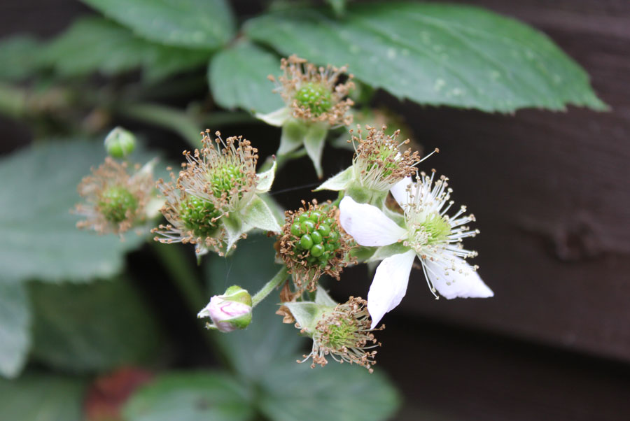
What are the similarities and differences between the life cycles of living things?

Slide 8
What makes fruit appealing to you and animals?
Why do plants grow fruit?
Alice Vigors 2020
Source: ABC Education
SHARED INQUIRY

Slide 9
Chalk Talk – Thinking Routine
How the Chalk Talk works:
Groups will visit one page at a time for a pre-determined amount of time.
Each member of the group silently reads and responds to the question on the page simultaneously.
As other people begin to respond, think about:
Does an idea need to be elaborated further? Add an elaboration to an idea by drawing a line off it and adding your thought.
Does this idea have a connection to your idea? If so, how? Add your connection by drawing a line to your idea and writing how they connect on the connecting line you drew.
Do you agree with and support the idea of another person? If so, why? Add a tick to show you agree and explain why you agree with this idea.
After visiting all the prompts, return to the starting prompt and as a group discuss the ideas written on the page and highlight the big ideas or most important ideas that address the question on the page. Share findings with the class.
Here are today’s question prompts:
What do we know about fruits?
Why are some vegetables considered fruit?
Why are the seeds in the fruit important to the survival of the plant?
Do all fruits contain seeds? Explain why or why not.
Do all plants that produce fruit begin by producing a flower first?
Alice Vigors 2020
SHARED INQUIRY

Slide 10
Generating Ideas and Explaining Choices
Generate a list of fruit (and vegetables that are actually fruit)
Decide on ways to categorise them
Share categories and provide reasons for grouping them this way.
Alice Vigors 2020
SHARED INQUIRY

Slide 11
Investigation: Cherry Tomatoes
Why do you think tomatoes are considered a fruit?
Why do we call them vegetables?
Alice Vigors 2020
Source: Gardening Know How
SHARED INQUIRY

Slide 12
See Think Wonder - Thinking Routine
What do you see, observe or notice?
Why do you think tomatoes contain seeds?
How do you think we could grow cherry tomatoes from these seeds?
What do you wonder?
SHARED INQUIRY
Alice Vigors 2020

Slide 13
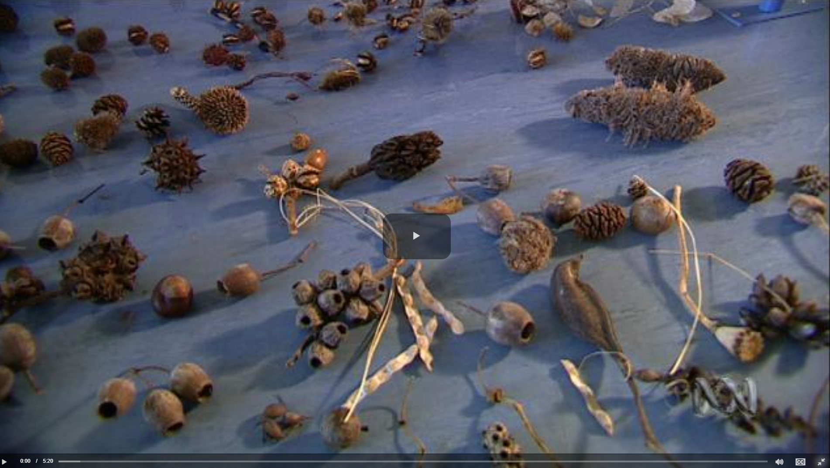
Source: ABC Education
SHARED INQUIRY
Alice Vigors 2020

Slide 14
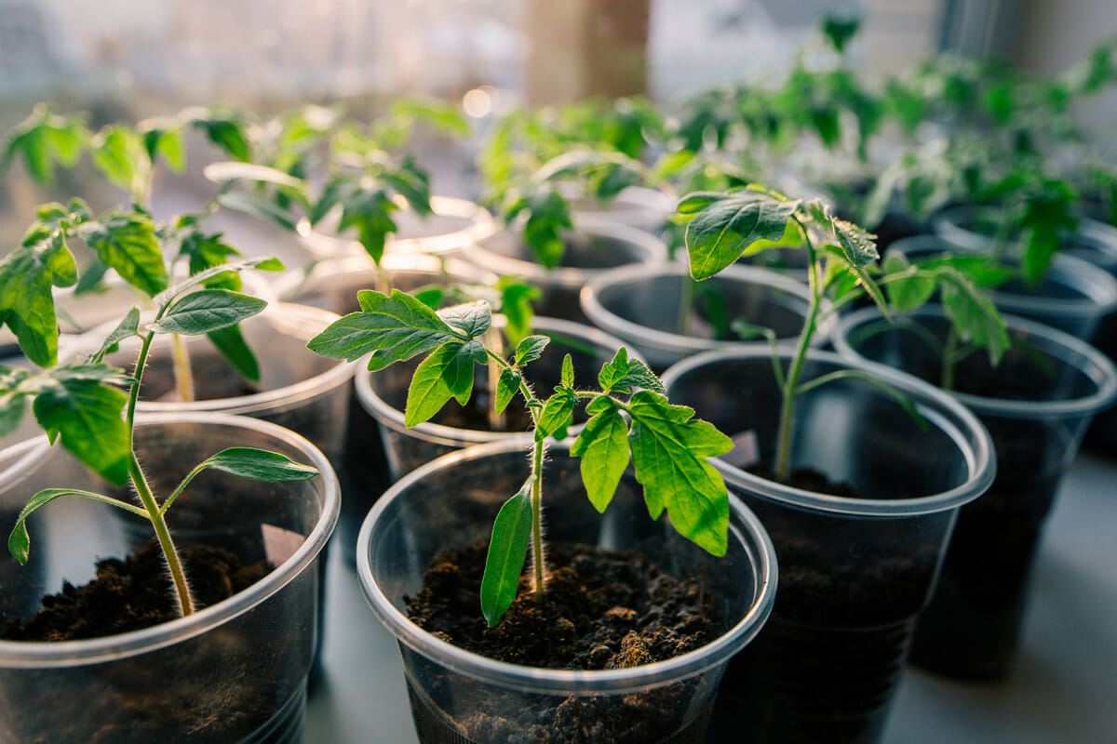
Investigation – Cherry Tomatoes
List the key components required to successfully grow a plant
Make predictions about how long it will take for the seeds to sprout and then become seedlings ready to plant.
Plant some seeds from inside a cherry tomato into a cup
Document the growth of the plant each week over the course of the term, using drawings and journal entries.
Write a procedure for how to grow tomatoes from a cherry tomato plant.
Assessment For Learning
Source: Iris Gardening
Alice Vigors 2020
SHARED INQUIRY

Slide 15
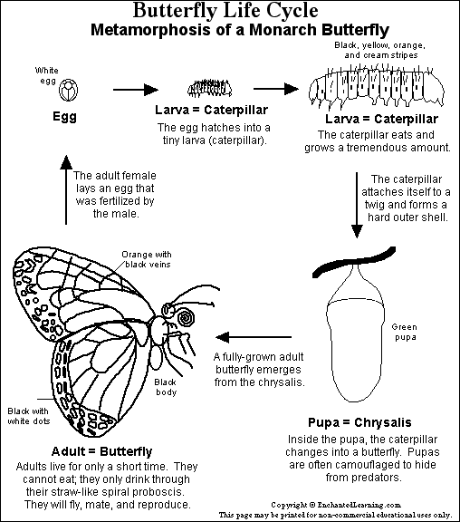
Research Task – Life Cycles of Fruit Producing Plants
Choose two plants, with at least one that produces fruit.
Research and gather information about life cycles of the two plants, using pictures and words
Record information in your own words
Make sure information is reliable and accurate
Make a flowchart to represent the stages of growth for both of the plants.
Assessment For Learning
Source: Enchanted Learning
Alice Vigors 2020
SHARED INQUIRY

Slide 16
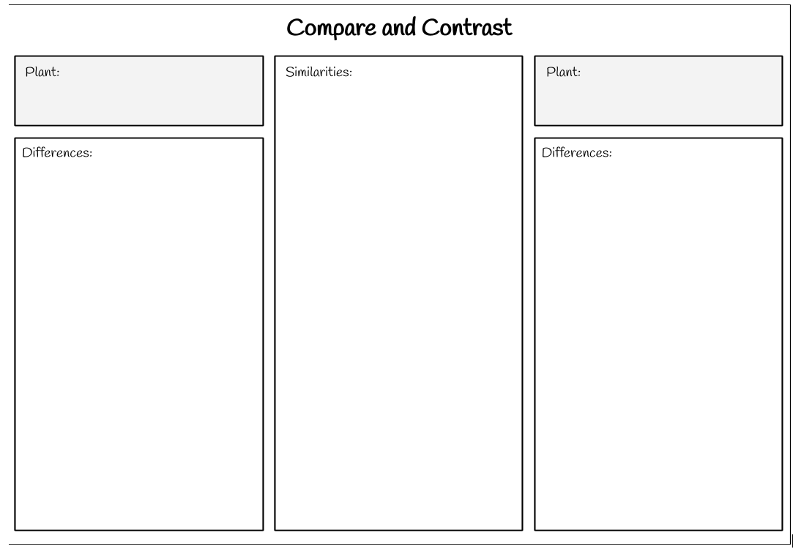
Compare and contrast the similarities and differences between the life cycles of the two different plants you researched.
Assessment Of Learning
Alice Vigors 2020
SHARED INQUIRY

Slide 17
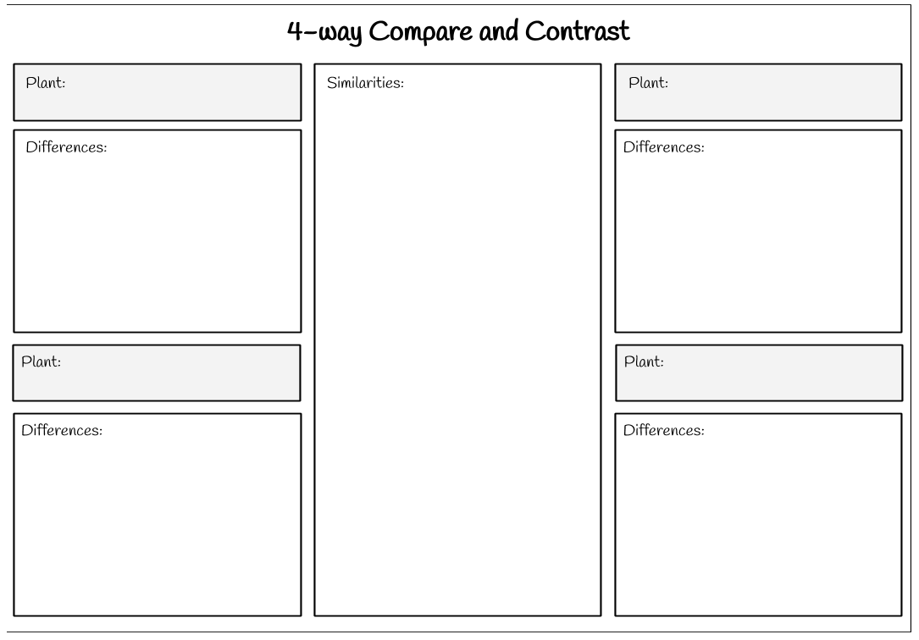
Share your research with a partner who explored different plants and compare the similarities and differences between the life cycles of the four different plants.
Assessment Of Learning
Alice Vigors 2020
SHARED INQUIRY

Slide 18
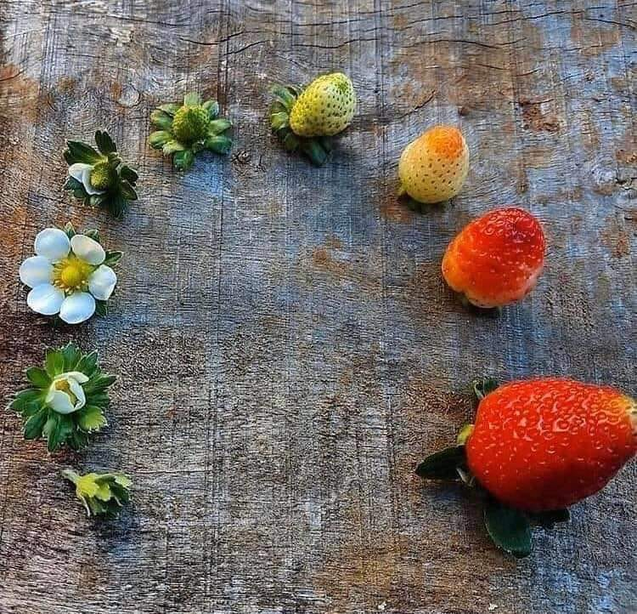
Reflecting on Learning – Connect Extend Challenge
How did our learning connect to what you already knew about the life cycles of living things?
How was your understanding of the life cycles of living things extended by our learning?
What still challenges you about the life cycles of living things? What do you still wonder?
Assessment As Learning
Alice Vigors 2020
Source: Reddit
SHARED INQUIRY

Slide 19
Survival of Living Things
How are environments and living things interdependent?
Source: The New York Times
Alice Vigors 2020

Slide 20
Alice Vigors 2020
Source: Mari Ann’s Book Nook
TUNING IN

Slide 21
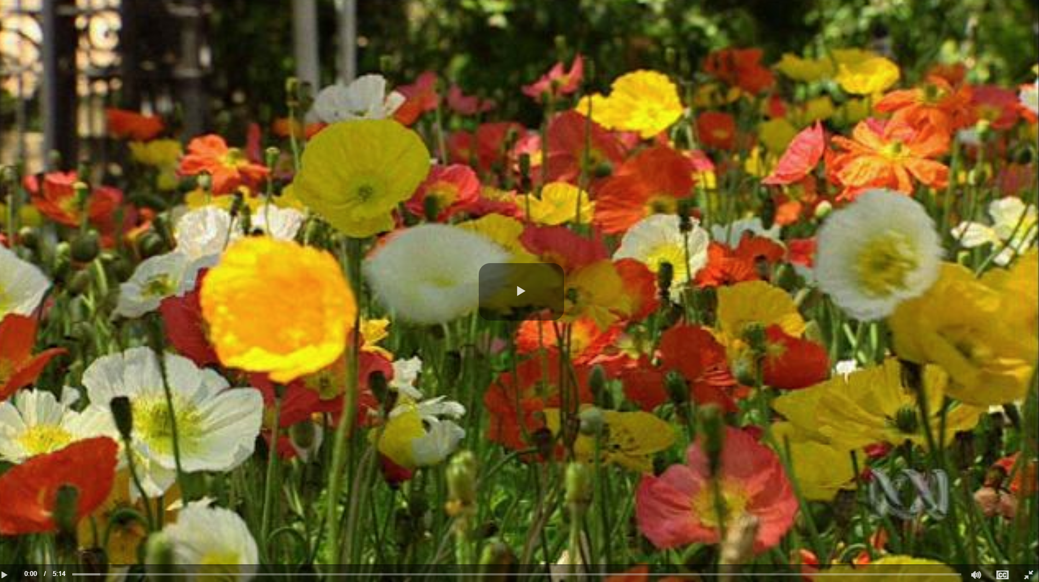
Alice Vigors 2020
Source: ABC Education
TUNING IN

Slide 22
3 2 1 Bridge – Thinking Routine
3 things you think you know about the relationship between plants, animals and the environment
2 questions you have about these relationships
1 thing that currently challenges or puzzles you about these relationships
Alice Vigors 2020
TUNING IN

Slide 23
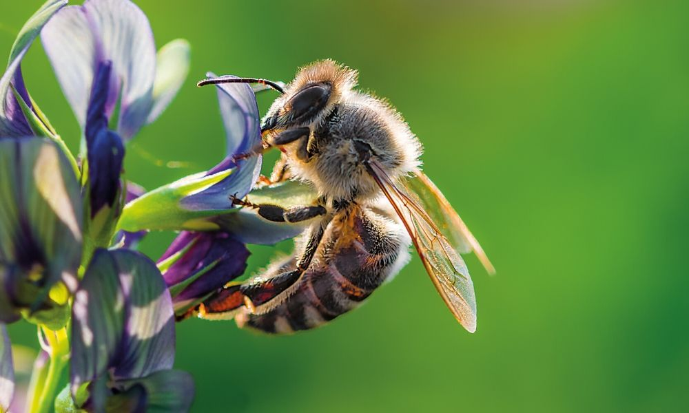
How are environments and living things interdependent?

Slide 24
Exploring Vocabulary
interdependent
relationship
environment
Alice Vigors 2020
SHARED INQUIRY

Slide 25
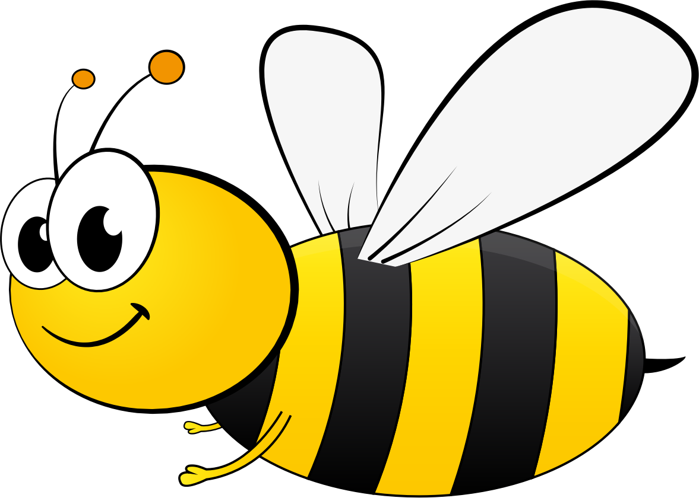
Research Task – The Bee
Task:
Gather information using a variety of sources to answer the following questions:
Why do we need bees?
What happens when bees collect nectar?
Where did our honey bees come from? Why?
What are three types of honey bees living in a beehive?
Why are our honey bees in danger?
What impact would this have on other living things?
Why might the honey bee be important to the survival of plants?
How might we protect and reduce the threat to honey bees across Australia?
Success Criteria:
Present information in an informative brochure about the importance of bees to other living things, including:
Explanation of the role of the honey bee in food production and the impact on us and other living things if it disappeared
Outline ways to protect the honey bee
Appropriate information, facts and statistics gathered and recorded in students own words
Use of informative text features, such as headings, subheadings and technical vocabulary
Use of appropriate images, text and/or multimedia to support the informative text
List sources used
Assessment For Learning
Alice Vigors 2020
SHARED INQUIRY

Slide 26
The 3 Y’s – Thinking Routine
Why do honey bees matter to me?
Why do honey bees matter to my community?
Why might honey bees matter to the world?
Assessment Of Learning
Alice Vigors 2020
SHARED INQUIRY

Slide 27
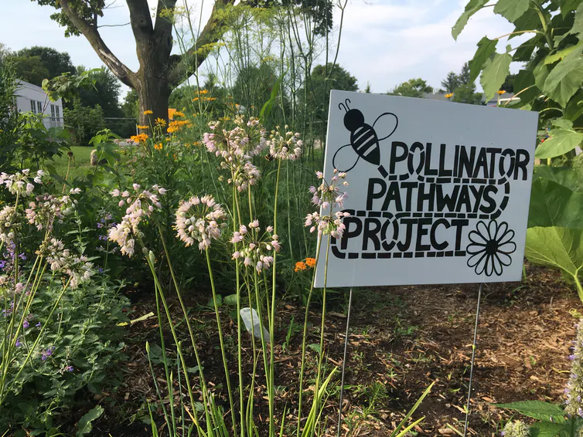
Bee Friendly Garden – Design Challenge
Task: Investigate and develop a proposal for a school garden that is bee friendly.
What things might we need to consider?
What challenges might we face?
What solutions might solve help us overcome the challenges of this project?
Assessment For Learning
Source: The Conversation
Alice Vigors 2020
SHARED INQUIRY

Slide 28
Bee Friendly Garden – Design Challenge
Exploring the School Grounds:
Use the iPad devices to take photographs of potential places a bee friendly garden could be established.
Record the locations on a blank map of the school.
Assessment For Learning
Source: NSW Government
Alice Vigors 2020
SHARED INQUIRY

Slide 29
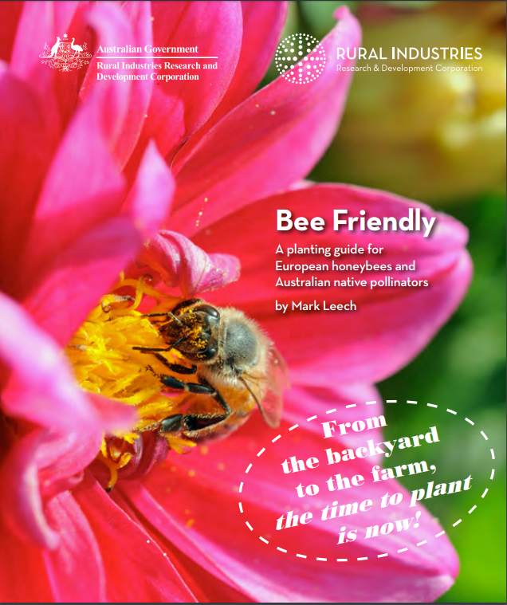
Bee Friendly Garden – Design Challenge
Task I: Examine suitable plants for our bee friendly garden.
What climate zone do we live in?
What kind of plants best grow in this climate zone?
Which plants would be most suitable for a school garden?
Task II: Design the garden using grid paper.
Include a colour key for the plants
Include measurements to show the size of the garden
Include a title for your garden design.
Identify the location of the garden in the school.
Challenge: determine how much it might cost to install the garden at school.
Assessment For Learning
Source: Rural Industries
Alice Vigors 2020
SHARED INQUIRY

Slide 30
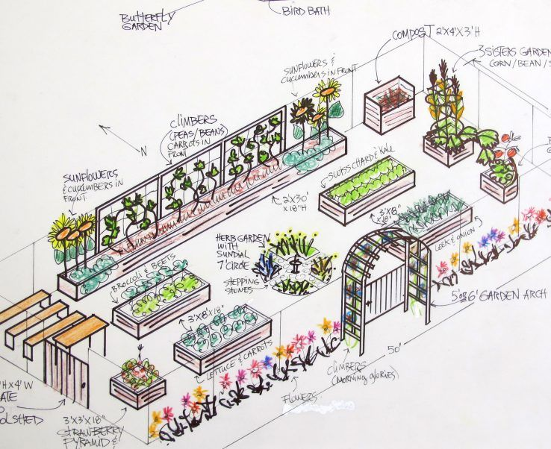
Bee Friendly Garden – Design Challenge
Write a proposal to the Principal explaining why this garden should be built in our school and the benefits to us, our community and to bees, including the garden design.
Assessment Of Learning
Alice Vigors 2020
SHARED INQUIRY

Slide 31
3 2 1 Bridge – Thinking Routine
3 things you know now
2 questions you still have
1 thing that still challenges or puzzles you
Assessment As Learning
How does your thinking now, connect to or has shifted from your initial thinking? What makes you say that?
Alice Vigors 2020
SHARED INQUIRY

