Slide 1
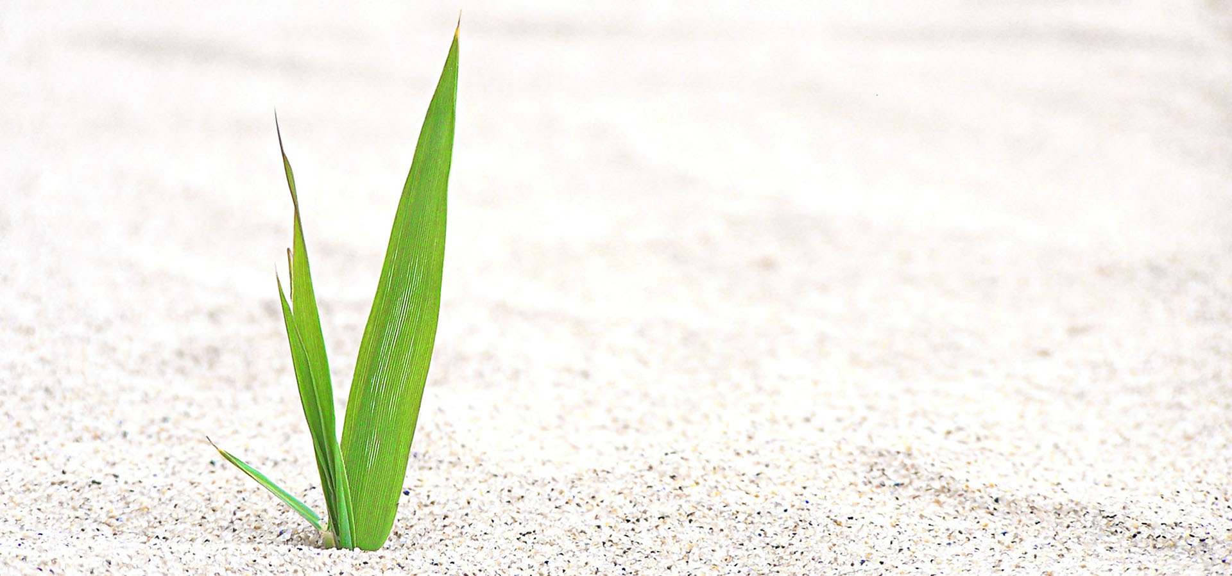
Living World
Image sourced from pngtree.com
-Adapting and Surviving
Year 5
Science & Technology

Slide 2
Unit Overview
This unit focuses on the growth and survival of living things and how their adaptations over time suit their environment. This strand further develops students’ knowledge and understanding of the environmental and biological sciences.
OUTCOMES
Working Scientifically
ST3-1WS-S plans and conducts scientific investigations to answer testable questions, and collects and summarises data to communicate conclusions
Design & Production
ST3-2DP-T plans and uses materials, tools and equipment to develop solutions for a need or opportunity
Living World
ST3-4LW-S examines how the environment affects the growth, survival and adaptation of living things
Alice Vigors 2018

Slide 3
Content & Skills Focus
Working Scientifically
Questioning and predicting
pose testable questions
make and justify predictions about scientific investigations
Planning and conducting investigations
identify questions to investigate scientific ideas
plan and apply the elements of scientific investigations to answer problems
identify potential risks in planning investigations
manage resources safely
decide which variable(s) is to be changed, measured and kept the same, in fair tests
select appropriate measurement methods, including formal measurements and digital technologies, to record data accurately and honestly (ACSIS087, ACSIS104)
reflect on and make suggestions to improve fairness, accuracy and efficacy of a scientific investigation
manage investigations effectively, individually and in groups
Processing and analysing data
construct and use a range of representations, including tables and graphs, to represent and describe observations, patterns or relationships in data
employ appropriate technologies to represent data
compare data with predictions
present data as evidence in developing explanations
Design & Production
Identifying and defining
examine and critique needs, opportunities or modifications using a range of criteria to define a project
define a need or opportunity according to functional and aesthetic criteria for an audience
consider availability and sustainability of resources when defining design needs and opportunities
investigate materials, components, tools, techniques and processes required to achieve intended design solutions
Researching and planning
research, identify and define design ideas and processes for an audience
consider functional and aesthetic needs in planning a design solution
develop, record and communicate design ideas, decisions and processes using appropriate technical terms
produce labelled and annotated drawings including digital graphic representations for an audience
consider sustainability of resources when researching and planning design solutions
manage projects within time constraints
Growth & Survival of Living Things
plan and conduct a fair test to show the conditions needed for a particular plant or animal to grow and survive in its environment
describe how changing physical conditions in the environment affect the growth and survival of living things, for example:
Aboriginal Peoples’ use of fire-stick farming
temperature of water in aquatic environments
test predictions by gathering data and use evidence to develop explanations of events and phenomena
understand that scientific and technological knowledge is used to solve problems and inform personal and community decisions
Adaptations of Living Things
describe adaptations as existing structures or behaviours that enable living things to survive in their environment
describe the structural and/or behavioural features of some native Australian animals and plants and why they are considered to be adaptations, for example:
− shiny surfaces of leaves on desert plants
− rearward facing pouch of a burrowing wombat
− spines on an echidna
Alice Vigors 2018

Slide 4
Essential Inquiry Questions
How do physical conditions affect the survival of living things?
How do the structural and behavioural features of living things support survival?
Alice Vigors 2018

Slide 5
Tuning In to the inquiry
Notes:
Teaching and Learning Sequence:
Small groups examine a range of 6-9 objects on a tray (e.g. rock, cup of water, balloon filled with air) that show different states of matter
▪ Use the thinking routine See Think Wonder to help students/groups scaffold their discussion, thinking and wonderings about states of matter
▪ Use the thinking routine Think Puzzle Explore to gauge understanding & misconceptions
▪ Watch Changing Water: States of Matter (stop video at 2:44) https://www.youtube.com/watch?v=tuE1LePDZ4Y
▪ Use the thinking routine +1 identify key ideas from the video and generate questions or puzzles about the concepts of matter, mixtures and materials.
Assessment (Diagnostic)
FOR THE TEACHER:
▪ How can we assess students’ prior knowledge and experience in relation to this context?
▪ How will we record this information for later assessment?
▪ What can we do to PROVOKE interest/enthusiasm/curiosity/motivation?
▪ How can we assist students to make “conceptual connections” and see relationships to and links with their own lives?

Slide 6
My Country – Dorothea Mackellar
The love of field and coppice,
Of green and shaded lanes.
Of ordered woods and gardens
Is running in your veins,
Strong love of grey-blue distance
Brown streams and soft dim skies
I know but cannot share it,
My love is otherwise.
I love a sunburnt country,
A land of sweeping plains,
Of ragged mountain ranges,
Of droughts and flooding rains.
I love her far horizons,
I love her jewel-sea,
Her beauty and her terror -
The wide brown land for me!
A stark white ring-barked forest
All tragic to the moon,
The sapphire-misted mountains,
The hot gold hush of noon.
Green tangle of the brushes,
Where lithe lianas coil,
And orchids deck the tree-tops
And ferns the warm dark soil.
Core of my heart, my country!
Her pitiless blue sky,
When sick at heart, around us,
We see the cattle die -
But then the grey clouds gather,
And we can bless again
The drumming of an army,
The steady, soaking rain.
Alice Vigors 2018
Source: Poem Hunter
Notes:
Examine a range of images, poetic and literary texts, as well as multimedia resources that evoke curiosity and wonder and how and why plants and animals can live in a range of harsh Australian environments. For example:
VIDEO: Australian Wildlife and Ted Egan Central Australia: The Eighth Wonder (long version) or (short version)
Artwork by Margaret Preston (National Gallery of Australia)
Poem ‘My Country’ by Dorothea Mackeller

Slide 7
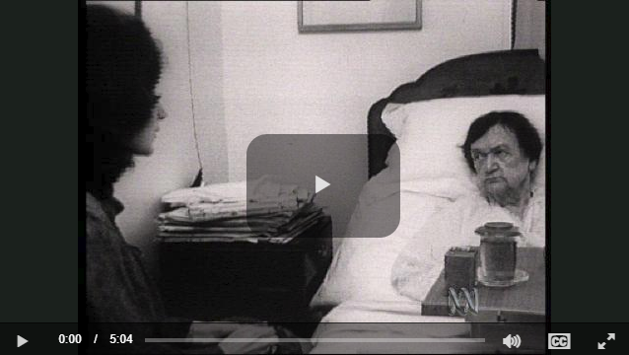
My Country – Dorothea Mackellar
Core of my heart, my country!
Land of the Rainbow Gold,
For flood and fire and famine,
She pays us back threefold -
Over the thirsty paddocks,
Watch, after many days,
The filmy veil of greenness
That thickens as we gaze.
An opal-hearted country,
A wilful, lavish land -
All you who have not loved her,
You will not understand -
Though earth holds many splendours,
Wherever I may die,
I know to what brown country
My homing thoughts will fly.
Source: Lance Scoular
Alice Vigors 2018
Source: Poem Hunter
Source: ABC Education

Slide 8
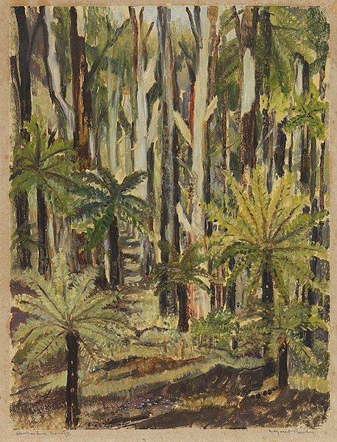
Margaret Preston
Margaret Preston 'Rocks in Roper River Valley N.T.' 1953 colour stencil Collection of the National Gallery of Australia © Margaret Preston. Licensed by VISCOPY, Australia more detail
Margaret Preston 'Old Banksia tree' c.1936 woodblock print National Gallery of Australia © Margaret Preston. Licensed by VISCOPY, Australia more detail
Margaret Preston ’Fern Trees, Laura' c.1946 colour ink print National Gallery of Australia © Margaret Preston. Licensed by VISCOPY, Australia more detail
Alice Vigors 2018
Source: National Gallery of Australia
Notes:
Examine a range of images, poetic and literary texts, as well as multimedia resources that evoke curiosity and wonder and how and why plants and animals can live in a range of harsh Australian environments. For example:
VIDEO: Australian Wildlife and Ted Egan Central Australia: The Eighth Wonder (long version) or (short version)
Artwork by Margaret Preston (National Gallery of Australia)
Poem ‘My Country’ by Dorothea Mackeller

Slide 9
Marvellous Australia
Source: Australian Wildlife
Source: Ted Egan Central Australia – The 8th Wonder
Alice Vigors 2018
Notes:
Examine a range of images, poetic and literary texts, as well as multimedia resources that evoke curiosity and wonder and how and why plants and animals can live in a range of harsh Australian environments. For example:
VIDEO: Australian Wildlife and Ted Egan Central Australia: The Eighth Wonder (long version) or (short version)
Artwork by Margaret Preston (National Gallery of Australia)
Poem ‘My Country’ by Dorothea Mackeller

Slide 10
See Think Wonder - Thinking Routine
See What do you see, observe or notice? | Think What does it make you think? How do you think you might classify these objects? | Wonder What does it make you wonder?
Adapted from Ron Ritchhart
Alice Vigors 2018
Notes:
Examine a range of images, poetic and literary texts, as well as multimedia resources that evoke curiosity and wonder and how and why plants and animals can live in a range of harsh Australian environments. For example:
VIDEO: Australian Wildlife and Ted Egan Central Australia: The Eighth Wonder (long version) or (short version)
Artwork by Margaret Preston (National Gallery of Australia)
Poem ‘My Country’ by Dorothea Mackeller

Slide 11
Think Puzzle Sort - Thinking Routine
Think What do you think you know about how plants and animals survive in a range of Australian environments? | Puzzle What puzzles or questions do you have? | Sort How might we group or categorise these questions?
Adapted from Ron Ritchhart
Alice Vigors 2018
Notes:
Use the adapted thinking routine Think Puzzle Explore to elicit background knowledge and wonderings – categorise these wonderings to fit into the two content areas Growth & Survival and Adaptations

Slide 12
Shared Inquiry Teaching & Learning Sequence
Notes:
FOR THE TEACHER:
What questions did the students pose that could help you drive learning in the shared inquiry phase?
Students need learning experiences that help them find and sort information in order to make sense and build understanding about the concept of matter and it’s uses.

Slide 13
How do the structural and behavioural features of living things support survival?
Alice Vigors 2018

Slide 14
How do physical conditions affect the survival of living things?
Alice Vigors 2018

Slide 15
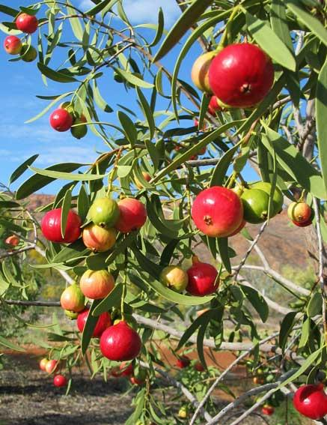
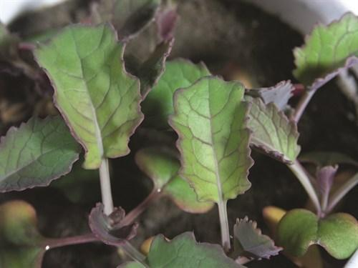
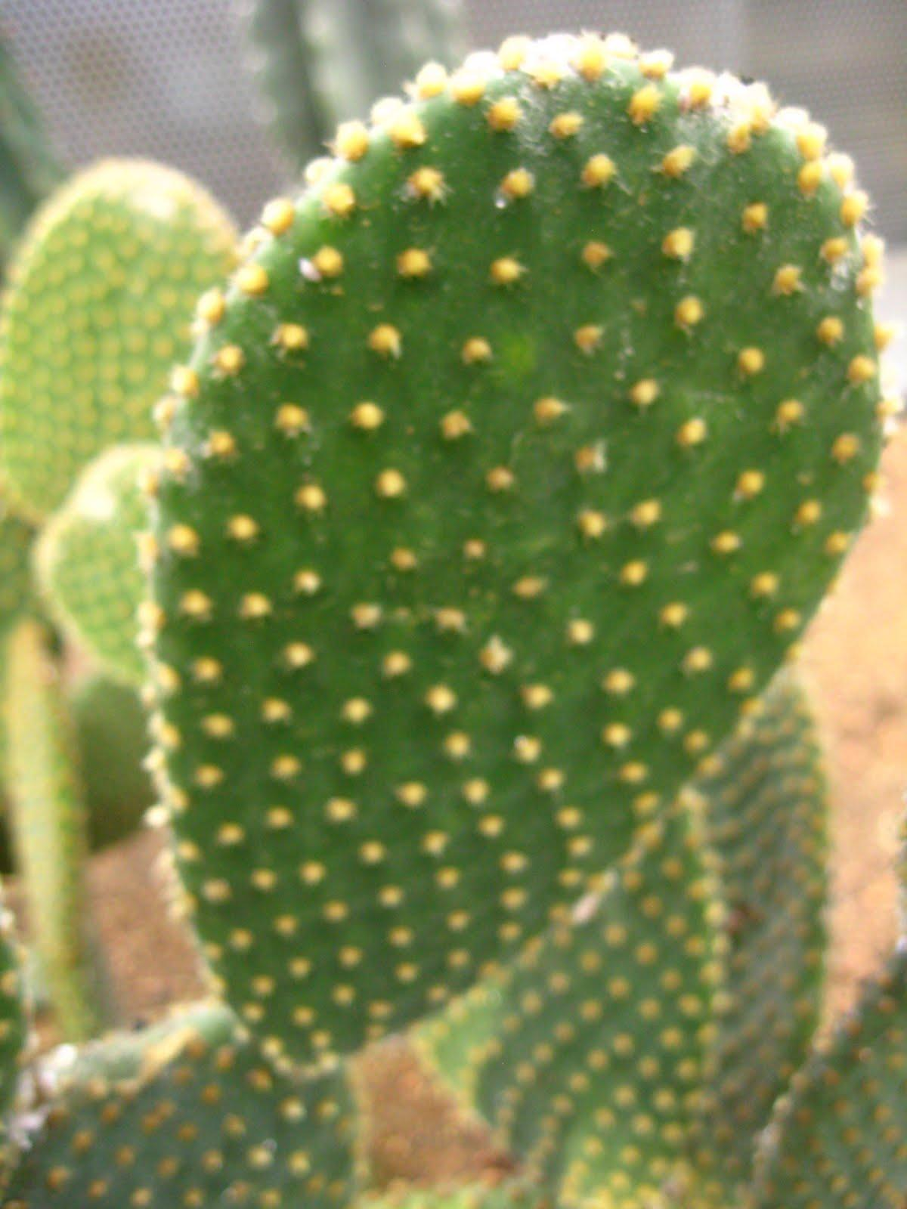
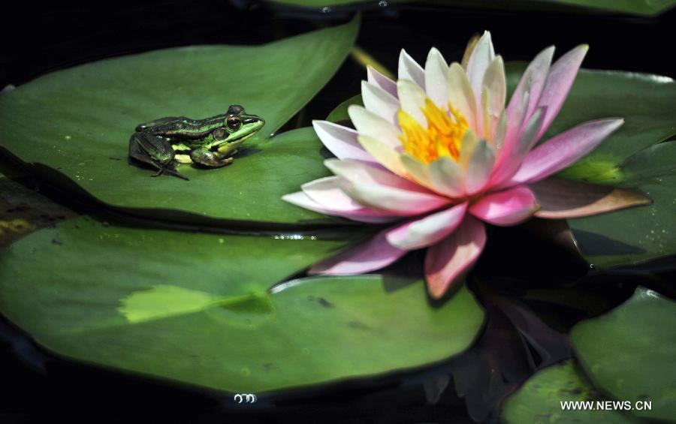
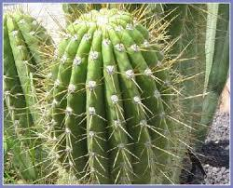
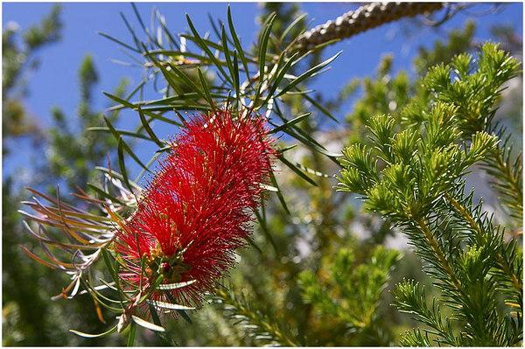
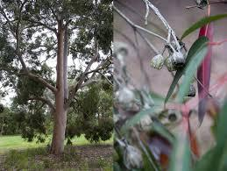
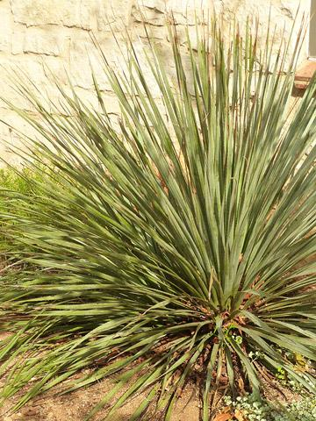
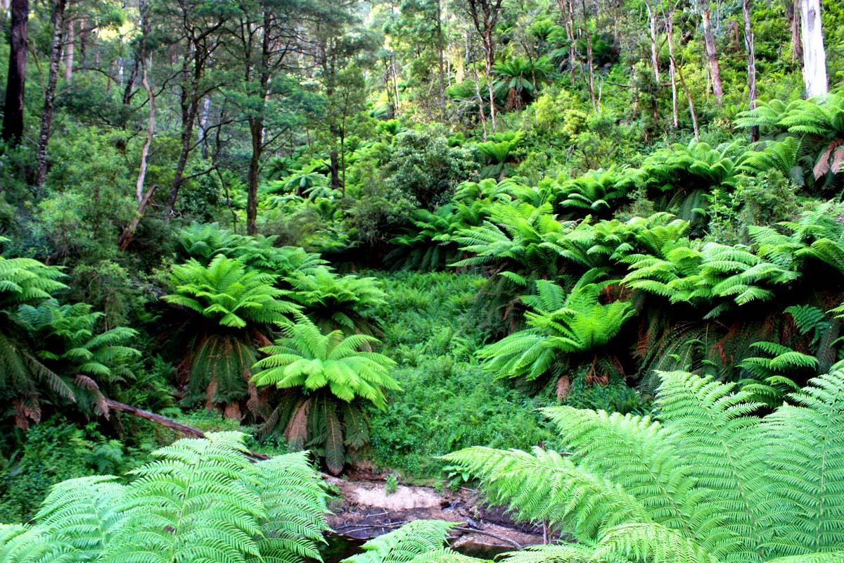
Categorising Plants
Examine the images of these plants that live in different environments around Australia. Sort and classify the plants, explaining the specific features and why you grouped them that way.
Alice Vigors 2018
Source: Oakhill Drive Public School unit
Notes:
Examine a range of plants that live in different environments around Australia. Students categorise and classify the plants and provide an explanation of the specific features of each plant.

Slide 16
Key Terms
Adaptation:
Habitat:
Survival:
Environment:
Impact:
Change:
Alice Vigors 2018
Notes:
Define the key terms adaptation, habitat, survival, environment, impact, change

Slide 17
VIDEO: Animal Adaptations
Source: Scholastic
Alice Vigors 2018
Notes:
Watch the Videos: Animal Adaptations and Structural Adaptations to examine how structural and behavioural adaptations assist an organism to function within its environment. Use the thinking routine The Explanation Game to name and explain the different types of adaptations and provide examples for each one.
Name: What is the adaptation?
Explain: How might you describe what this adaptation is?
Examples: What examples can you give to support this adaptation?

Slide 18
VIDEO: Adaptations In Action
Alice Vigors 2018
Source: Thought-Provoking Science via Scootle portal
Notes:
Watch the Videos: Animal Adaptations and Adaptations In Action to examine how structural and behavioural adaptations assist an organism to function within its environment. Use the thinking routine The Explanation Game to name and explain the different types of adaptations and provide examples for each one.
Name: What is the adaptation?
Explain: How might you describe what this adaptation is?
Examples: What examples can you give to support this adaptation?

Slide 19
Explanation Game - Thinking Routine
Name What is the adaptation? | Explain How might you describe and explain what this adaptation is? | Examples What examples can you give to support this adaptation?
Adapted from Ron Ritchhart
Alice Vigors 2018
Notes:
Watch the Videos: Animal Adaptations and Structural Adaptations to examine how structural and behavioural adaptations assist an organism to function within its environment. Use the thinking routine The Explanation Game to name and explain the different types of adaptations and provide examples for each one.
Name: What is the adaptation?
Explain: How might you describe and explain what this adaptation is?
Examples: What examples can you give to support this adaptation?

Slide 20
What do you know about plants and how they survive?
3, 2, 1 Bridge - Thinking Routine
Initial Response | Bridge | Final Response
3 things you think you know about how plants survive. 2 questions you have 1 labelled diagram | What learning has supported your new understanding? | 3 things you think you know about how plants survive. 2 questions you have 1 labelled diagram
Adapted from Ron Ritchhart
Alice Vigors 2018
Notes:
Pose the question What do you know about plants and how they survive?
Record initial student responses. The thinking routine 3, 2, 1 Bridge would be a useful tool to scaffold student thinking. This could then be revisited and added to after undertaking a range of learning experiences.
o 3 things you think you know about how plants survive
o 2 questions you have
o 1 labelled diagram

Slide 21
VIDEO: Meet Spiky, Thorny, Carnivorous Plants
Alice Vigors 2018
Source: ABC Education
Notes:
As an introduction to plant adaptations, ask why some plants have thorns? As part of the discussion, connect the structural feature of thorns (an adaptation) that helps protect the plant from predators feeding on its leaves. o Watch the video ‘Meet Spiky, Thorny and Carnivorous Plants’ ABC Education ▪ Identify other plant adaptations and discuss the purpose (function) of the adaptation
▪ Describe the adaptations as a response to the plant meeting its needs of space, water, light, nutrients and ability to reproduce or to limit predation.
▪ Sketch some of the different plants and label the parts that make these plants ‘great survivors’.

Slide 22
VIDEO: Plant Leaves
Alice Vigors 2018
Source: ABC Education
Notes:
Watch the video Plant Leaves ABC Education and identify how leaves make their own food and transport energy to the rest of the plant.

Slide 23
VIDEO: Meet Spiky, Thorny, Carnivorous Plants
Alice Vigors 2018
Source: Christopher Brunson
Notes:
What is a fair test and what are the scientific variables?
Watch Scientific Variables and discuss the 3 variables (dependent, independent and control).

Slide 24
See Think Wonder - Thinking Routine
See What do you see, observe or notice about these plants and their features? | Think Why do you think it grows like this or in this location? What structural or behavioural features help it to survive in this environment? | Wonder What questions or puzzles do you have?
Adapted from Ron Ritchhart
Alice Vigors 2018
Notes:
Take a tour of the school grounds and look for examples of different plants that live in different environments within the school. Use scientific drawing and record notes on at least 3 locations within the school and the plants that live there. The thinking routine See Think Wonder would help students as they undertake this exploration. ▪ What do you see, observe or notice about these plants and their features?
▪ Why do you think it grows like this or in this location? What structural or behavioural features help it to survive in this environment?
▪ What questions or puzzles do you have?

Slide 25
Key Terms
Water retention:
Surface area:
Condensation:
Drought:
Alice Vigors 2018
Notes:
Define the key terms water retention, surface area, condensation, drought

Slide 26
Investigation I
Hypothesis – What do you think will happen? Explain why.
Variables –
What will be the dependent variable? What are you going to measure?
What will be the independent variable? What are you going to change?
What variables will you need to control? What will you need to keep the same?
Assessment
Alice Vigors 2018
Notes:
Take a tour of the school grounds and collect samples of different types of plant leaves (NB: it may be useful for teachers to gather other examples for this experiment, e.g. succulent leaves). Students investigate in small groups what happens to leaves enclosed in plastic bags – (NB: 1 bag with no leaves needed) o Hypothesis – What do you think will happen? Explain why.
o Variables – ▪ What will be the dependent variable? What are you going to measure?
▪ What will be the independent variable? What are you going to change?
▪ What variables will you need to control? What will you need to keep the same?
o Day Two & Onwards – record the appearance of the bag contents using an annotated drawing, including the date and time of observation. Students need to pay particular attention to the amount of condensation that builds in the bag compared to the size of the leaves. Students make predictions about why they think these differences are occurring.
o Measure and compare the surface area of different leaf samples using 1cm x 1cm grid paper. Graph the results and include an explanation of findings.
o Pose the claim: The surface area of leaves affects water retention in plants. Use the collected evidence and knowledge about structural adaptations that might impact water retention in leaves. Annotated drawings and pictures can be used to support explanation. The thinking routine Claim Support Question would be useful to help scaffold student thinking.
Assessment (ST3-1WS-S, ST3-2DP-T and ST3-4LW-S)

Slide 27
Investigation I
Record the appearance of the bag contents using an annotated drawing, including the date and time of observation.
Assessment
Alice Vigors 2018
Source: Primary Connections – Desert Survivors
Notes:
Take a tour of the school grounds and collect samples of different types of plant leaves (NB: it may be useful for teachers to gather other examples for this experiment, e.g. succulent leaves). Students investigate in small groups what happens to leaves enclosed in plastic bags – (NB: 1 bag with no leaves needed) o Hypothesis – What do you think will happen? Explain why.
o Variables – ▪ What will be the dependent variable? What are you going to measure?
▪ What will be the independent variable? What are you going to change?
▪ What variables will you need to control? What will you need to keep the same?
o Day Two & Onwards – record the appearance of the bag contents using an annotated drawing, including the date and time of observation. Students need to pay particular attention to the amount of condensation that builds in the bag compared to the size of the leaves. Students make predictions about why they think these differences are occurring.
o Measure and compare the surface area of different leaf samples using 1cm x 1cm grid paper. Graph the results and include an explanation of findings.
o Pose the claim: The surface area of leaves affects water retention in plants. Use the collected evidence and knowledge about structural adaptations that might impact water retention in leaves. Annotated drawings and pictures can be used to support explanation. The thinking routine Claim Support Question would be useful to help scaffold student thinking.
Assessment (ST3-1WS-S, ST3-2DP-T and ST3-4LW-S)

Slide 28
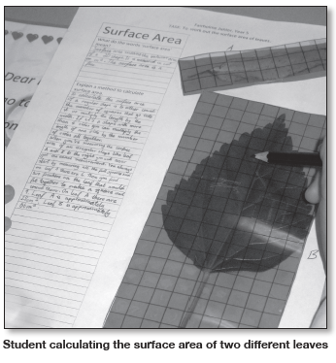
Investigation I
Measure and compare the surface area of different leaves using 1cm x 1cm grid paper.
Graph the results and include and explanation of your findings.
Assessment
Alice Vigors 2018
Source: Primary Connections – Desert Survivors
Notes:
Take a tour of the school grounds and collect samples of different types of plant leaves (NB: it may be useful for teachers to gather other examples for this experiment, e.g. succulent leaves). Students investigate in small groups what happens to leaves enclosed in plastic bags – (NB: 1 bag with no leaves needed) o Hypothesis – What do you think will happen? Explain why.
o Variables – ▪ What will be the dependent variable? What are you going to measure?
▪ What will be the independent variable? What are you going to change?
▪ What variables will you need to control? What will you need to keep the same?
o Day Two & Onwards – record the appearance of the bag contents using an annotated drawing, including the date and time of observation. Students need to pay particular attention to the amount of condensation that builds in the bag compared to the size of the leaves. Students make predictions about why they think these differences are occurring.
o Measure and compare the surface area of different leaf samples using 1cm x 1cm grid paper. Graph the results and include an explanation of findings.
o Pose the claim: The surface area of leaves affects water retention in plants. Use the collected evidence and knowledge about structural adaptations that might impact water retention in leaves. Annotated drawings and pictures can be used to support explanation. The thinking routine Claim Support Question would be useful to help scaffold student thinking.
Assessment (ST3-1WS-S, ST3-2DP-T and ST3-4LW-S)

Slide 29
Investigation I
The surface area of leaves affects water retention in plants.
Use your collected evidence and knowledge of structural adaptations to support this claim. Annotated drawings and pictures may also be included as part of your support with an explanation.
What questions or puzzles do you still have?
Assessment
Alice Vigors 2018
Notes:
Take a tour of the school grounds and collect samples of different types of plant leaves (NB: it may be useful for teachers to gather other examples for this experiment, e.g. succulent leaves). Students investigate in small groups what happens to leaves enclosed in plastic bags – (NB: 1 bag with no leaves needed) o Hypothesis – What do you think will happen? Explain why.
o Variables – ▪ What will be the dependent variable? What are you going to measure?
▪ What will be the independent variable? What are you going to change?
▪ What variables will you need to control? What will you need to keep the same?
o Day Two & Onwards – record the appearance of the bag contents using an annotated drawing, including the date and time of observation. Students need to pay particular attention to the amount of condensation that builds in the bag compared to the size of the leaves. Students make predictions about why they think these differences are occurring.
o Measure and compare the surface area of different leaf samples using 1cm x 1cm grid paper. Graph the results and include an explanation of findings.
o Pose the claim: The surface area of leaves affects water retention in plants. Use the collected evidence and knowledge about structural adaptations that might impact water retention in leaves. Annotated drawings and pictures can be used to support explanation. The thinking routine Claim Support Question would be useful to help scaffold student thinking.
Assessment (ST3-1WS-S, ST3-2DP-T and ST3-4LW-S)

Slide 30
TEXT: The Story of Rosy Dock
Alice Vigors 2018
Source: Jeannie Baker
Notes:
Read the text The Story of Rosy Dock. This could be undertaken in English. Compare to the animated version.

Slide 31
Investigation II
Hypothesis – What do you think will happen? Explain why.
Variables –
What will be the dependent variable? What are you going to measure?
What will be the independent variable? What are you going to change?
What variables will you need to control? What will you need to keep the same?
Assessment
Alice Vigors 2018
Notes:
Investigate the impact of different physical conditions on the survival of plants. Plant 5 beans in clear plastic cups – depriving 4 of one of the essential elements needed for survival ▼ No soil: seeds in a plastic cup
▼ No water: seeds in soil
▼ No light: seeds in soil placed in a dark cupboard
▼ No air: seeds in soil inside a zip lock bag
▼ Seeds in soil receiving all essential elements
o Hypothesis – What do you think will happen? Explain why.
o Variables – ▪ What will be the dependent variable? What are you going to measure?
▪ What will be the independent variable? What are you going to change?
▪ What variables will you need to control? What will you need to keep the same?
o Observe the plants over the next two weeks, using annotated drawings to record changes and growth.
o Measure and compare the growth of the plants over the course of two weeks using an appropriate unit and measuring device. Students are encouraged to estimate first before measuring and describe how a length was estimated and measured. Graph the results and include an explanation of findings.
o Pose the claim: Changing the physical conditions in the environment affects the growth and survival of living things. Use the collected evidence and knowledge about adaptations that might impact growth and survival of living things, in particular plants. Annotated drawings, pictures and data can be used to support explanation. The thinking routine Claim Support Question would be useful to help scaffold student thinking.
Assessment (ST3-1WS-S, ST3-2DP-T and ST3-4LW-S)

Slide 32
Investigation II
Record the changes and growth of the seeds over the next two weeks using annotated drawings, including the date and time of observation.
Assessment
Alice Vigors 2018
Notes:
Investigate the impact of different physical conditions on the survival of plants. Plant 5 beans in clear plastic cups – depriving 4 of one of the essential elements needed for survival ▼ No soil: seeds in a plastic cup
▼ No water: seeds in soil
▼ No light: seeds in soil placed in a dark cupboard
▼ No air: seeds in soil inside a zip lock bag
▼ Seeds in soil receiving all essential elements
o Hypothesis – What do you think will happen? Explain why.
o Variables – ▪ What will be the dependent variable? What are you going to measure?
▪ What will be the independent variable? What are you going to change?
▪ What variables will you need to control? What will you need to keep the same?
o Observe the plants over the next two weeks, using annotated drawings to record changes and growth.
o Measure and compare the growth of the plants over the course of two weeks using an appropriate unit and measuring device. Students are encouraged to estimate first before measuring and describe how a length was estimated and measured. Graph the results and include an explanation of findings.
o Pose the claim: Changing the physical conditions in the environment affects the growth and survival of living things. Use the collected evidence and knowledge about adaptations that might impact growth and survival of living things, in particular plants. Annotated drawings, pictures and data can be used to support explanation. The thinking routine Claim Support Question would be useful to help scaffold student thinking.
Assessment (ST3-1WS-S, ST3-2DP-T and ST3-4LW-S)

Slide 33
Investigation II
Measure and compare the growth of the plants over the course of two weeks using an appropriate unit and measuring device.
Graph the results and include and explanation of your findings.
Assessment
Alice Vigors 2018
Source: Primary Connections – Desert Survivors
Notes:
Investigate the impact of different physical conditions on the survival of plants. Plant 5 beans in clear plastic cups – depriving 4 of one of the essential elements needed for survival ▼ No soil: seeds in a plastic cup
▼ No water: seeds in soil
▼ No light: seeds in soil placed in a dark cupboard
▼ No air: seeds in soil inside a zip lock bag
▼ Seeds in soil receiving all essential elements
o Hypothesis – What do you think will happen? Explain why.
o Variables – ▪ What will be the dependent variable? What are you going to measure?
▪ What will be the independent variable? What are you going to change?
▪ What variables will you need to control? What will you need to keep the same?
o Observe the plants over the next two weeks, using annotated drawings to record changes and growth.
o Measure and compare the growth of the plants over the course of two weeks using an appropriate unit and measuring device. Students are encouraged to estimate first before measuring and describe how a length was estimated and measured. Graph the results and include an explanation of findings.
o Pose the claim: Changing the physical conditions in the environment affects the growth and survival of living things. Use the collected evidence and knowledge about adaptations that might impact growth and survival of living things, in particular plants. Annotated drawings, pictures and data can be used to support explanation. The thinking routine Claim Support Question would be useful to help scaffold student thinking.
Assessment (ST3-1WS-S, ST3-2DP-T and ST3-4LW-S)

Slide 34
Investigation II
Changing the physical conditions in the environment affects the growth and survival of living things
Use your collected evidence and knowledge of structural adaptations to support this claim. Annotated drawings, pictures and data may also be included as part of your support with an explanation.
What questions or puzzles do you still have?
Assessment
Alice Vigors 2018
Notes:
Investigate the impact of different physical conditions on the survival of plants. Plant 5 beans in clear plastic cups – depriving 4 of one of the essential elements needed for survival ▼ No soil: seeds in a plastic cup
▼ No water: seeds in soil
▼ No light: seeds in soil placed in a dark cupboard
▼ No air: seeds in soil inside a zip lock bag
▼ Seeds in soil receiving all essential elements
o Hypothesis – What do you think will happen? Explain why.
o Variables – ▪ What will be the dependent variable? What are you going to measure?
▪ What will be the independent variable? What are you going to change?
▪ What variables will you need to control? What will you need to keep the same?
o Observe the plants over the next two weeks, using annotated drawings to record changes and growth.
o Measure and compare the growth of the plants over the course of two weeks using an appropriate unit and measuring device. Students are encouraged to estimate first before measuring and describe how a length was estimated and measured. Graph the results and include an explanation of findings.
o Pose the claim: Changing the physical conditions in the environment affects the growth and survival of living things. Use the collected evidence and knowledge about adaptations that might impact growth and survival of living things, in particular plants. Annotated drawings, pictures and data can be used to support explanation. The thinking routine Claim Support Question would be useful to help scaffold student thinking.
Assessment (ST3-1WS-S, ST3-2DP-T and ST3-4LW-S)

Slide 35
What do you know about plants and how they survive?
3, 2, 1 Bridge - Thinking Routine
Initial Response | Bridge | Final Response
3 things you think you know about how plants survive. 2 questions you have 1 labelled diagram | What learning has supported your new understanding? | 3 things you think you know about how plants survive. 2 questions you have 1 labelled diagram
Adapted from Ron Ritchhart
Alice Vigors 2018
Notes:
Pose the question What do you know about plants and how they survive?
Record initial student responses. The thinking routine 3, 2, 1 Bridge would be a useful tool to scaffold student thinking. This could then be revisited and added to after undertaking a range of learning experiences.
o 3 things you think you know about how plants survive
o 2 questions you have
o 1 labelled diagram
Re-examine the 3, 2, 1 Bridge from earlier in the learning sequence and compose new responses. Then examine the learning that has supported their growth in understanding

Slide 36
Research Task
Research and describe the structural; and/or behavioural features of some native plants and animals, and describe why they are considered adaptations.
What kind of environment does this plant or animal live in?
How has this animal or plant adapted to suit its environment?
Identify and describe the adaptations as a structural and/or behavioural feature.
How does this adaptation help this living thing to survive?
How might this adaptation differ according to the environment in which they live?
What could happen to this adaptation if the environment changed in some way?
Assessment
Research choices: Bar-Tailed Godwit, Swimming Crabs & Mud Crabs, Mangroves, Spinifex Grass
Presentation
Present information to peers in a detailed, informative and engaging way that answers the research prompts, including a clear definition of adaptation and type.
Include other examples of this adaptation (if possible)
Use diagrams, images, scientific drawings to support your explanation.
Choose the way you present your information – poster, booklet (physical), booklet (digital-Book Creator), infographic (Canva), slideshow (Google Slides) or a website (Google Site)
Alice Vigors 2018
Notes:
Research and describe the structural and/or behavioural features of some native plants and animals and describe why they are considered adaptations. Some prompts may include: o What kind of environment does this plant or animal live in?
o How has this animal or plant adapted to suit its environment?
o Identify and describe the adaptations as a structural and/or behavioural feature.
o How does this adaptation help this living thing to survive?
o How might this adaptation differ according to the environment in which they live?
o What could happen to this adaptation if the environment changed in some way?
o Bar-tailed Godwit (migratory behaviour from Alaska to Australia, including local lake Tuggerah Lakes). ▪ Australian Museum
▪ Birdlife Australia
▪ The text Circle by Jeannie Baker explores this migration journey
o Swimming Crabs & Mud Crabs (structural adaptation of swimming paddles and placement of teeth, behavioural adaptation of shedding shell) ▪ Queensland Museum
▪ Video
▪ NSW Department of Primary Industries
▪ WA Department of Fisheries
▪ Shedding shell Video
o Mangroves (structural adaptation of ‘breathing’ roots) ▪ NSW Department of Primary Industries
▪ NSW Ecosystems on Show - mangroves
▪ Excursion possibility: Visit Carawah Reserve, Gosford to examine the mangrove & wetland environments and explore the adaptations made by the plants and animals that live there. Mud crabs are also present in this environment.
o Spinifex Grass - found on sand dunes (structural adaptation of each shoot have own water supply, behavioural adaptation of releasing seeds after rain ▪ Biology weebly
▪ Spinifex powerpoint
o Other examples include those suggested in the Syllabus, such as shiny surfaces on leaves in the desert, rearward facing pouch of a wombat and spines on an echidna (NB: teachers could also link in Indigenous dreamtime stories to support this ).
NB: teachers may like to take a local perspective to allow students to make local connections.
Presentation: present information to peers in a detailed, informative and engaging way that answers the research prompts, including a clear definition of adaptation and type, include other examples of this adaptation, use diagrams, images, scientific drawings to support explanation Assessment (ST3-1WS-S and ST3-4LW-S)

Slide 37
Generate, Sort, Connect, Elaborate
What is a wetland environment? What kind of living things live in wetlands?
What adaptations do they have that enable them to survive in these environments?
How might a change in a wetland environment impact living things?
What happens to those that cannot adapt to the conditions?
Generate a list of ideas or thoughts that come to mind when exploring these questions. Record your thinking of small post-it notes.
Sort your ideas according to environments, adaptations and impact due to change. Place environments closest to the centre with related adaptations as a middle layer and impacts as an outer layer.
Connect your ideas by drawing connecting lines between ideas that have something in common. Explain and write in a short sentence how these ideas are connected.
Elaborate on any ideas/ thoughts you have written by adding new ideas that expand/extend/add to initial ideas.
Assessment
Alice Vigors 2018
Notes:
Use the thinking routine Generate Sort Connect Elaborate to examine and unpack the following questions: o What different Australian environments do plants and animals live in?
o What is a wetland environment? What kind of living things live in wetlands?
What adaptations do they have that enable them to survive in these environments?
How might a change in a wetland environment impact living things?
o What happens to those that cannot adapt to the conditions? ▪ Generate a list of ideas or thoughts that come to mind when exploring these questions. Record your thinking of small post-it notes
▪ Sort your ideas according to environments, adaptations and impact due to change. Place environments closest to the centre with related adaptations as a middle layer and impacts as an outer layer.
▪ Connect your ideas by drawing connecting lines between ideas that have something in common. Explain and write in a short sentence how these ideas are connected.
▪ Elaborate on any ideas/ thoughts you have written by adding new ideas that expand/extend/add to initial ideas – NB: a gallery walk may be useful at this point in time.
Assessment (ST3-1WS-S and ST3-4LW-S)

Slide 38
Tuggerah Lakes Estuary
Alice Vigors 2018
Notes:
Examine a range of images of birds that inhabit the local wetland environment. Discuss ways they get food and water, what they may use for shelter and what might be the threats to heir survival in this environment. NB: this could link to a research task in English.

Slide 39
Beak Investigation
Different birds have different shaped and sized beaks. How might these help them find specific kinds of food in their environment?
Hypothesis – What do you think will happen? Explain why.
Variables –
What will be the dependent variable? What are you going to measure?
What will be the independent variable? What are you going to change?
What variables will you need to control? What will you need to keep the same?
Alice Vigors 2018
Image Source: Love Our Living Lakes
Notes:
Investigate in small groups, how different beak adaptations of birds help them to find food in specific environments. (See investigation planner) o Discuss the range of ‘beaks’ and food’ with the group. ▪ Hypothesis: What do you think will be the best beak for each food?Explain why.
o Variables – ▪What will be the dependent variable? What are you going to measure?
▪What will be the independent variable? What are you going to change?
▪ What variables will you need to control? What will you need to keep the same?

Slide 40
Beak Investigation
Develop a table to record the amount of ‘food’ collected in 30 seconds by each beak
Use grid paper to graph the data you have gathered to show comparisons
Alice Vigors 2018
Image Source: Love Our Living Lakes
Notes:
Groups develop a table to record the amount of ‘food’ collected in 30 secs by a particular beak, e.g. amount of rice collected in 30 sec by the tweezer beak
o Use grid paper to graph the data to show comparisons.
o Pose the claim: Bird beaks have adapted to suit their habitats and food source. Use the collected evidence and knowledge about structural/behavioural adaptations. Recorded and graphed data can be used to support the claim. The thinking routine Claim Support Question would be useful to help scaffold student thinking.
Beak type
Amount of rice collected in 30 sec
Tweezers
Chop Sticks
Use grid paper to graph the data to show comparisons.
o Pose the claim: Bird beaks have adapted to suit their habitats and food source. Use the collected evidence and knowledge about structural/behavioural adaptations. Recorded and graphed data can be used to support the claim. The thinking routine Claim Support Question would be useful to help scaffold student thinking.

Slide 41
Beak Investigation
Bird beaks have adapted to suit their habitats and food source.
Use the collected evidence and knowledge about structural/behavioural adaptations. Recorded and graphed data can be used to support the claim.
What questions or puzzles do you still have?
Alice Vigors 2018
Notes:
Groups develop a table to record the amount of ‘food’ collected in 30 secs by a particular beak, e.g. amount of rice collected in 30 sec by the tweezer beak
o Use grid paper to graph the data to show comparisons.
o Pose the claim: Bird beaks have adapted to suit their habitats and food source. Use the collected evidence and knowledge about structural/behavioural adaptations. Recorded and graphed data can be used to support the claim. The thinking routine Claim Support Question would be useful to help scaffold student thinking.
Beak type
Amount of rice collected in 30 sec
Tweezers
Chop Sticks
Use grid paper to graph the data to show comparisons.
o Pose the claim: Bird beaks have adapted to suit their habitats and food source. Use the collected evidence and knowledge about structural/behavioural adaptations. Recorded and graphed data can be used to support the claim. The thinking routine Claim Support Question would be useful to help scaffold student thinking.

Slide 42
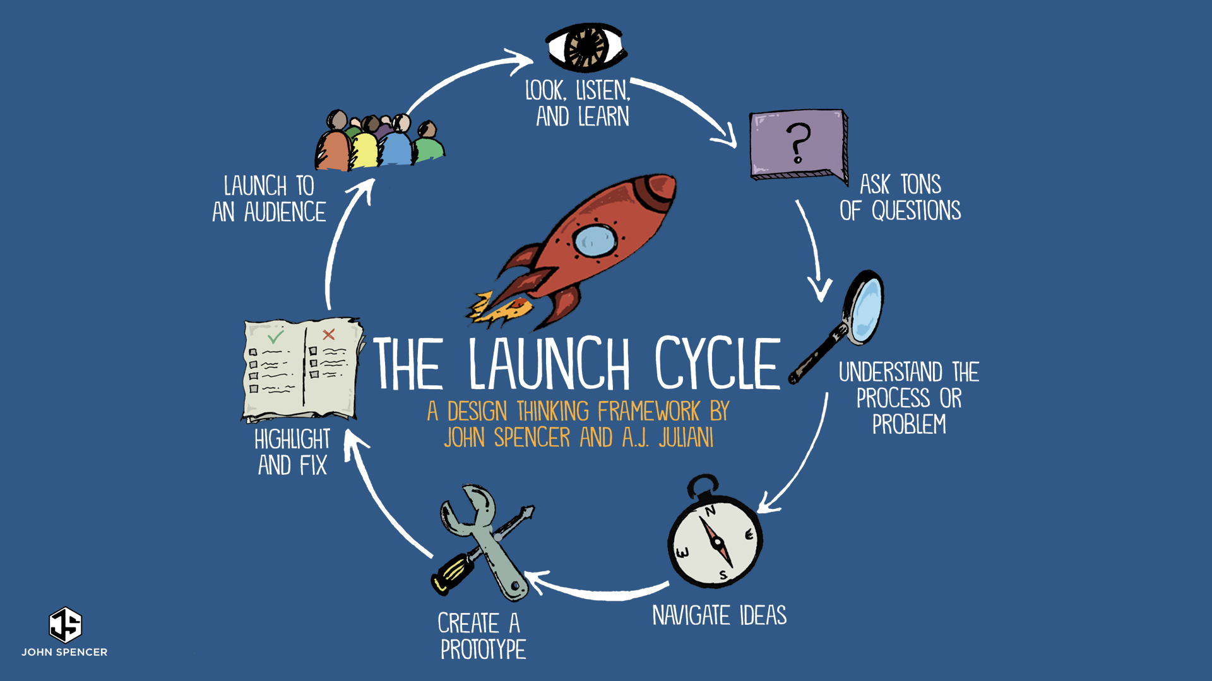
Design and Produce Task
Alice Vigors 2018
A small ecological disaster has occurred on Tuggerah Lakes that impacts the bird life near Saltwater Creek. How could you provide nesting grounds in an alternate location to help them survive until the impacted area has been cleaned up?
Assessment
Image Source: John Spencer & A.J. Juliani
Notes:
Pose the problem: A small ecological disaster has occurred on Tuggerah Lakes that impacts the bird life near Saltwater Creek. How could you provide nesting grounds in an alternate location to help them survive until the impacted area has been cleaned up? ▪ Examine the Design Thinking ‘Launch Cycle’ to guide process

Slide 43
Design and Produce Task
Alice Vigors 2018
A small ecological disaster has occurred on Tuggerah Lakes that impacts the bird life near Saltwater Creek. How could you provide nesting grounds in an alternate location to help them survive until the impacted area has been cleaned up?
Design alternative nesting grounds for your chosen bird species, including:
What requirements does your bird species need in the alternative environment?
What resources might be required to create this alternative environment?
How might we source or use these sustainably?
What components of the design need to be functional (fit purpose)? What components are purely aesthetic?
Create labelled and annotated drawings, including identification of major features – you may choose to do this digitally
Develop a prototype of the alternative environment – considering sustainability of resources
Plan, rehearse and deliver research and design solution to an audience.
Assessment
Notes:
Design alternative nesting grounds for your chosen bird species, including:
What requirements does your bird species need in the alternative environment?
What resources might be required to create this alternative environment?
How might we source or use these sustainably?
What components of the design need to be functional (fit purpose)? What components are purely aesthetic?
Create labelled and annotated drawings, including identification of major features – students may choose to do this digitally
Develop a prototype of the alternative environment – considering sustainability of resources
Plan, rehearse and deliver research and design solution to an audience
Select and sequence appropriate information and multimodal elements suitable for the intended audience and purpose
Make appropriate choices for modality and emphasis during the presentation
Vary conventions of spoken interactions to engage the audience
Communicate design ideas, decisions and processes using appropriate technical terms
Assess their own and others’ presentations against a co-constructed criterion
Formulate questions, in response to presentations, for specific purposes, e.g. to clarify and reflect
Assessment (ST3-1WS-S, ST3-2DP-T and ST3-4LW-S)

Slide 44
Design and Produce Task
Alice Vigors 2018
A small ecological disaster has occurred on Tuggerah Lakes that impacts the bird life near Saltwater Creek. How could you provide nesting grounds in an alternate location to help them survive until the impacted area has been cleaned up?
Research information about one bird species that lives in the Tuggerah Lakes Estuary environment, include information about:
What type of environment does this bird species inhabit?
Where might this bird species nest? What kind of ‘nest’ do they use?
Does the bird species migrate to or from other places/environments? Why?
What Structural and behavioural adaptations does this animal have? How does this help them to survive in this environment?
What are the major food sources?
What is the biggest threat to their survival?
Assessment
Notes:
Design alternative nesting grounds for your chosen bird species, including:
What requirements does your bird species need in the alternative environment?
What resources might be required to create this alternative environment?
How might we source or use these sustainably?
What components of the design need to be functional (fit purpose)? What components are purely aesthetic?
Create labelled and annotated drawings, including identification of major features – students may choose to do this digitally
Develop a prototype of the alternative environment – considering sustainability of resources

Slide 45
Thankyou for using this powerpoint to support student learning. Share examples at thinkingpathways@gmail.com Visit the website: https://thinkingpathwayz.weebly.com/
Alice Vigors 2018

