Slide 1
Patterns & Algebra
Stage 3, Year 6
Alice Vigors
2017

Slide 2
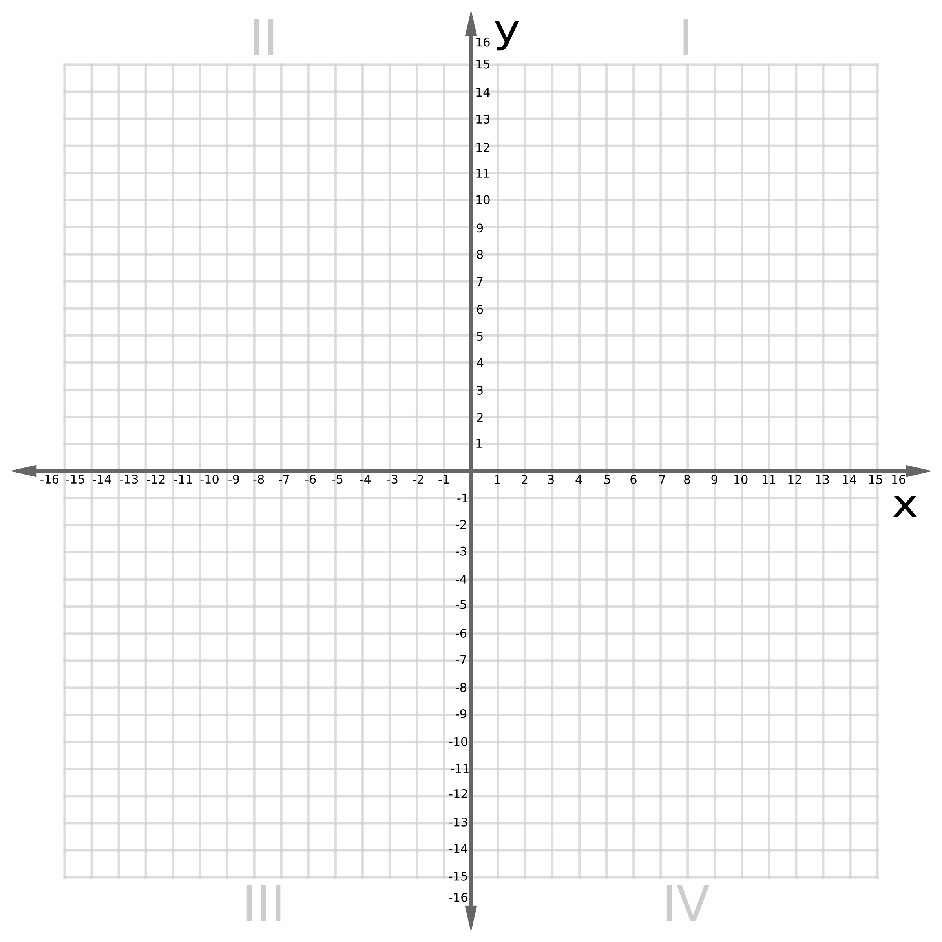
Learning Sequence
Can we use the Cartesian coordinate system?
Session 1
Session 2
Can we use function tables with the Cartesian coordinate system?
Session 3
Session 4
describes and represents mathematical situations in a variety of ways using mathematical terminology and some conventions MA3-1WM
selects and applies appropriate problem-solving strategies, including the use of digital technologies, in undertaking investigations MA3-2WM
gives a valid reason for supporting one possible solution over another MA3-3WM
analyses and creates geometric and number patterns, constructs and completes number sentences, and locates points on the Cartesian plane MA3-8NA
Alice Vigors 2017
Notes:
Indicators:
complete a table of values for number patterns involving one operation (including patterns that decrease)
recognise that the number plane (Cartesian plane) is a visual way of describing location on a grid
recognise that the number plane consists of a horizontal axis (x-axis) and a vertical axis (y-axis), creating four quadrants
recognise that the horizontal axis and the vertical axis meet at right angles (Reasoning)
identify the point of intersection of the two axes as the origin, having coordinates (0, 0)
plot and label points, given coordinates, in all four quadrants of the number plane
plot a sequence of coordinates to create a picture (Communicating)
identify and record the coordinates of given points in all four quadrants of the number plane
recognise that the order of coordinates is important when locating points on the number plane, eg (2, 3) is a location different from (3, 2) (Communicating)

Slide 3
Session One
Can we use the Cartesian coordinate system?
Alice Vigors 2017

Slide 4
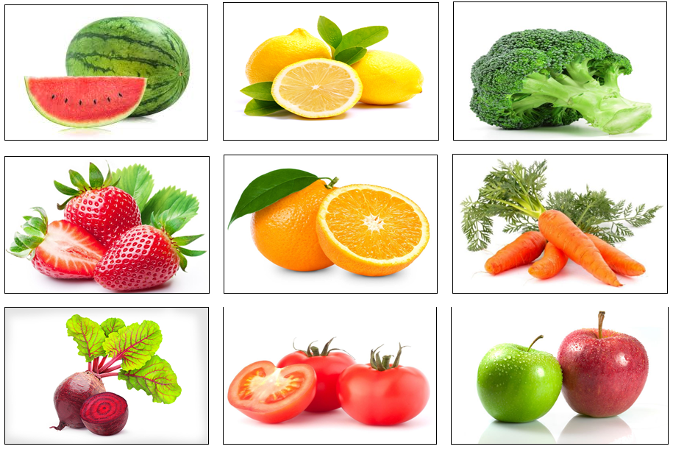
Can we use the Cartesian coordinate system?
Use the clues to locate the fruit or vegetable on the Cartesian plane.
Identify the ordered pairs for each.
Alice Vigors 2017
Notes:
→ Place the 9 picture cards randomly over the four quadrants of the large class cartesian plane. In pairs, students are given clues to locate and identify the ordered pairs for each picture card.

Slide 5
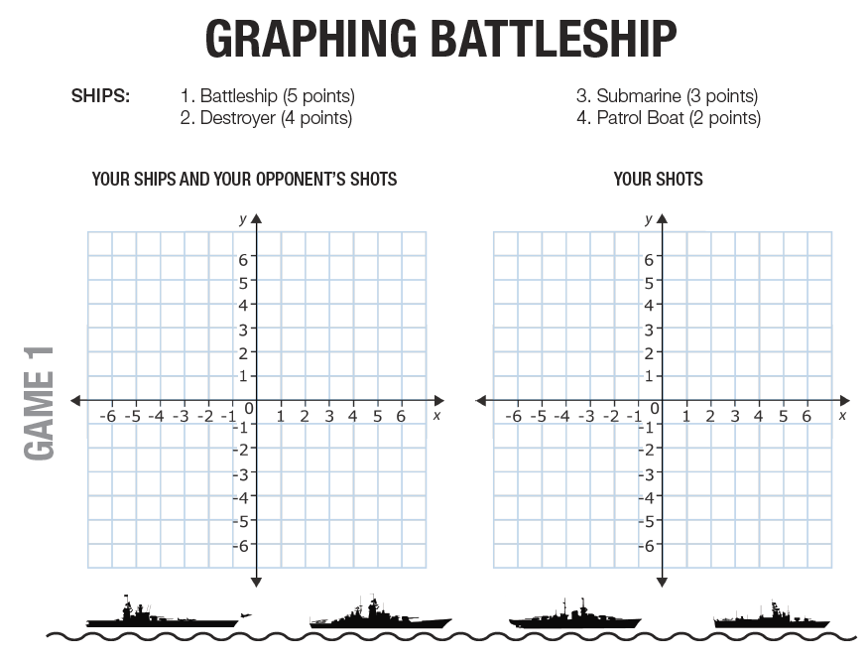
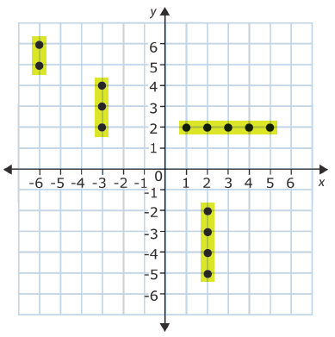
Can we use the Cartesian coordinate system?
Battleship
Use a pen to mark the locations of your ships on the coordinate plane and highlight them. Ships can be diagonal, horizontal or vertical.
Decide who will go first, begin guessing where the other student has placed their points. This is done by calling out a single ordered pair, e.g. (-3,2).
The opponent calls out ‘hit’ or ‘miss’.
If a player gets a ‘hit’, they put an X on the coordinate.
If a player gets a ‘miss’, they put a dot on the specified coordinate.
If a player has hit the last dot on the ship, the opponent calls out You sunk my ship!
The 1st player to sink all of the opponents ships wins the game.
Alice Vigors 2017
Notes:
→Battleship game: Students record and graph ordered pairs to identify the position of their ships. Students use both visual and verbal recognition of ordered pairs on the coordinate plane to attempt to sink their partners battleships.
Extension: The Mystery of the contaminated chocolate
→Exit ticket: What challenged my thinking… What questions do I still have?

Slide 6
Session Two
Can we use the Cartesian coordinate system?
Alice Vigors 2017

Slide 7
Can we use the Cartesian coordinate system?
Abigail is recording information about her pets on a coordinate plane. Each ordered pair shows the age (in years) and the mass (in kilograms), respectively, of one of her pets.
Ginger: 3,4;
Daisy 2,20;
Buddy 7,8.
Abigail also has a dog named Snuggles that is 1 year younger than Buddy and has 4 times Buddy’s mass.
Alice Vigors 2017
Notes:
How will I know which quadrant to work in?
What should I label my axes? Do they relate to specific data?

Slide 8
Can we use the Cartesian coordinate system?
Scavenger Hunt
Around the room are 3 sets of coordinate cards. Each set contains 6 ordered pairs and are colour coordinated.
Locate the ordered pairs.
Use a matching colour to label each ordered pair on the coordinate plane (yellow, blue, green)
Compare and contrast the ordered pairs in each set and describe the points on the plane.
Alice Vigors 2017
Notes:
→Place the coordinate cards around the room. Pairs locate and label each set of points on the coordinate plane (using the corresponding colour). Pairs compare and contrast the order pairs in each set and describe the points on the plane → a. -2,7, -2,4, -2,9, -2,-5, -2,0.8, -1.5,2 b. -11,9, -6,4, -4,2, 3,-1, 6,-3, 0,0 and c. -9,-8, 7,-8, 0,-10, 12,-8, -5,-8, -3, -6
Extension: The Mystery of the contaminated chocolate

Slide 9
Session Three
Can we use function tables with the Cartesian coordinate system?
Alice Vigors 2017

Slide 10
Can we use function tables with the Cartesian coordinate system?
Afternoon Walks
Sally goes for a walk every afternoon with Kate. Kate walks an extra 1km each way to meet Sally at her house before they go for a walk.
Use the formula y = x + 2 to help create a function table to show how much further Kate (y) walks than Sally (x) (4km, 2km, 6km, 9km, 3km).
Write the ordered pairs, and graph the data on the coordinate plane.
What would the data look like if Sally met Kate at her place instead?
Alice Vigors 2017
Notes:
→Sally goes for a walk every afternoon with Kate. Kate walks an extra 1km each way to meet Sally at her house before they go for a walk. Use the formula y = x + 2 to help create a function table to show how much further Kate (y) walks than Sally (x) → 4, 2, 6, 9, 3. Write the ordered pairs, and graph the data on the coordinate plane. What would the data look like if Sally met Kate at her place instead?

Slide 11
Can we use function tables with the Cartesian coordinate system?
Gym Membership
There is a $25 annual fee for membership at the gym. It also costs $5 per visit.
Create a function table to show the cost of x visits to the gym using the formula: y = 25 + 5x.
Write the ordered pairs, and graph the data on the coordinate plane.
If you visit the gym 5 times, how much will it cost?
Alice Vigors 2017
Notes:
→There is a $25 annual fee for membership at the gym. It also costs $5 per visit. Create a function table to show the cost of x visits to the gym (Formula: y = 25 + 5x). Write the ordered pairs, and graph the data on the coordinate plane. If you visit the gym 5 times, how much will it cost?
Extension: The Mystery of the contaminated chocolate or https://nrich.maths.org/public/leg.php?group_id=13&code=142#results

Slide 12
Session Four
Can we use function tables with the Cartesian coordinate system?
Alice Vigors 2017

Slide 13
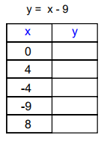
Can we use function tables with the Cartesian coordinate system?
What does this formula tell us?
How can we use it to complete the function table?
What ordered pairs have we created?
What would these look like on the Cartesian plane?
Challenge: Can you think of a real-world problem that might be represented by this formula?
Alice Vigors 2017
Notes:
→

Slide 14
Can we use function tables with the Cartesian coordinate system?
Learning Pathway 1 | Learning Pathway 2
Use the formula’s to complete each of the function tables. Write the ordered pairs and graph the data on the Cartesian plane. Challenge: Can you create a real-world problem that might be represented by this formula? | Create your own real-word problems that could be represented by a formula. Write the ordered pairs and graph the data on the Cartesian plane. Challenge: Can you create an algebraic formula that utilises the other quadrants of the Cartesian plane?
Alice Vigors 2017
Notes:
→Extension: The Mystery of the contaminated chocolate or https://nrich.maths.org/public/leg.php?group_id=13&code=142#results

Slide 15
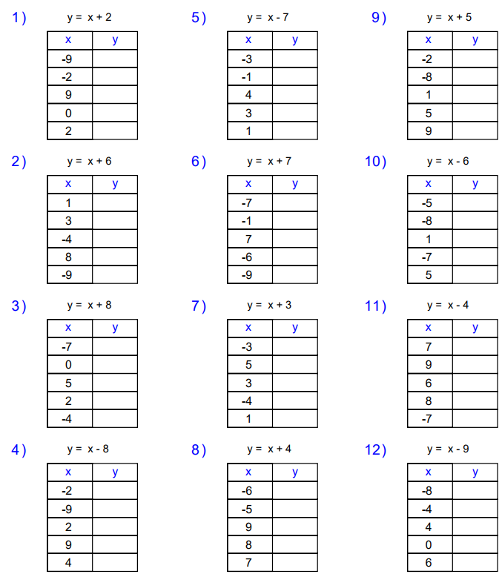
Alice Vigors 2017

