Slide 1
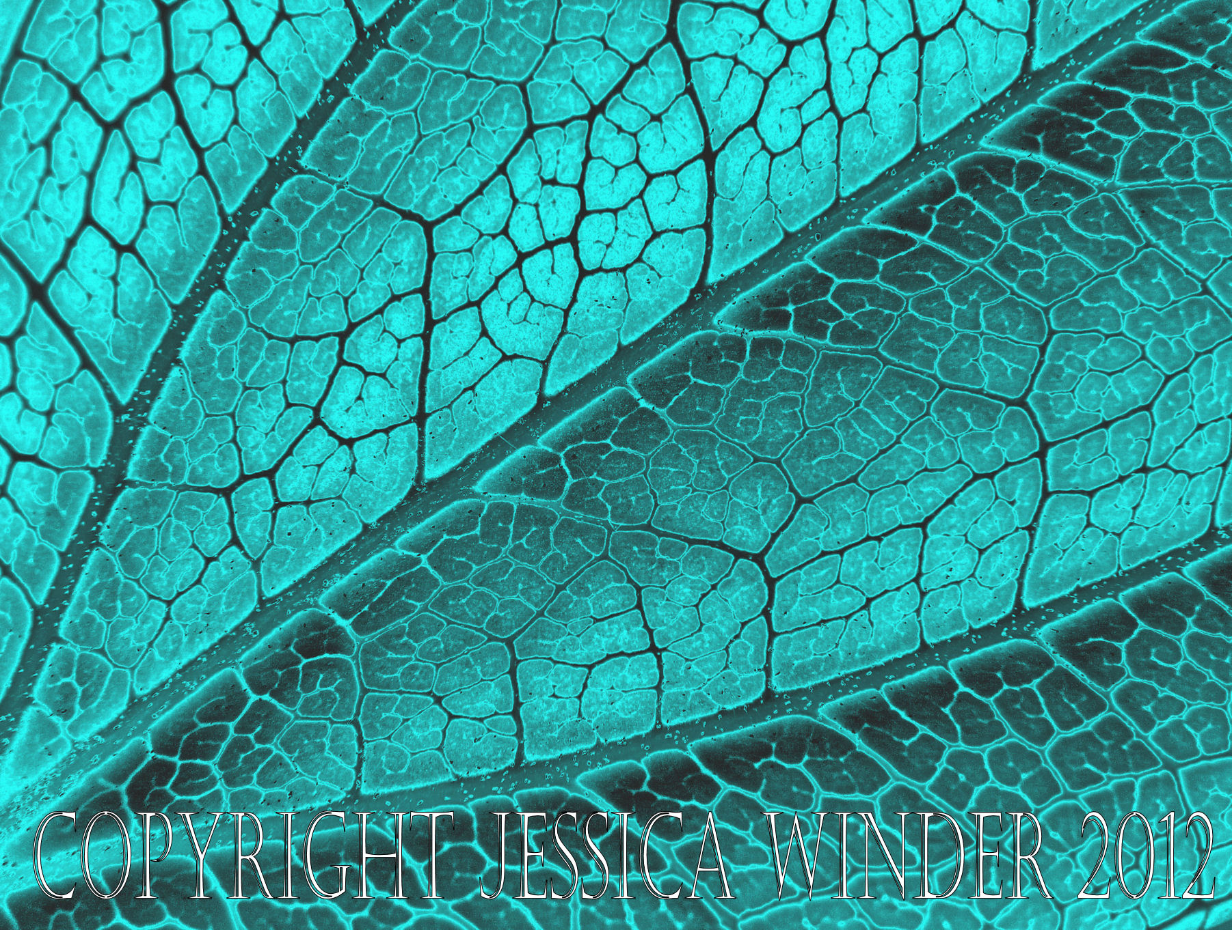
Patterns and Algebra
Stage 3
Alice Vigors
2017

Slide 2
Teaching and Learning Sessions
Can we continue and create number patterns and describe how they are created?
Can we create simple geometric patterns?
Can we identify the rule to describe the pattern and calculate the corresponding value for a larger number?
Describes and represents mathematical situations in a variety of ways using mathematical terminology and some conventions MA3-1WM
Selects and applies appropriate problem-solving strategies, including the use of digital technologies, in undertaking investigations MA3-2WM
Gives a valid reason for supporting one possible solution over another MA3-3WM
Analyses and creates geometric and number patterns, constructs and completes number sentences, and locates points on the Cartesian plane MA3-8NA
Alice Vigors 2017
Notes:
Indicators Addressed:
Continue and create sequences involving whole numbers, fractions and decimals; describe the rule used to create the sequence
Continue and create number patterns, with and without the use of digital technologies, using whole numbers, fractions and decimals, eg 14, 18, 116, … or 1.25, 2.5, 5, …
Describe how number patterns have been created and how they can be continued (Communicating, Problem Solving)
Create simple geometric patterns using concrete materials, eg △,△△,△△△,△△△△, …
Complete a table of values for a geometric pattern and describe the pattern in words
Describe the number pattern in a variety of ways and record descriptions using words, eg 'It looks like the multiplication facts for four'
Determine the rule to describe the pattern by relating the bottom number to the top number in a table, eg 'You multiply the number of squares by four to get the number of matches'
Use the rule to calculate the corresponding value for a larger number, eg 'How many matches are needed to create 100 squares?'

Slide 3
Session One
Can we continue and create number patterns and describe how they are created?
Alice Vigors 2017

Slide 4
Can we continue and create number patterns and describe how they are created?
1
3
6
10
What do you see, observe or notice?
What does this make you think, in terms of how the pattern is created? How it is repeated?
What questions or puzzles do you still have about these numbers?
Alice Vigors 2017
Notes:
→Display a number pattern.
→Discuss and highlight the terms in this number pattern.
→Undertake a See Think Wonder asking: What do you see, observe or notice? What does this make you think? What questions or puzzles do you have about these numbers?
→Share thinking.

Slide 5
Can we continue and create number patterns and describe how they are created?
Independent Investigation:
Can you use this number pattern to determine the missing terms?
What strategies can we use to determine a term in a number pattern? Can you show your thinking in a number of ways?
Group One | 2 6 10 14 | 5th, 8th and 10th terms
Group Two | 7 17 27 37 | 5th, 10th, 15th and 25th terms
Group Three | 5 ¼ 25 ½ 45 ¾ 65 ¼ | 5th, 10th, 31st, 64th and 112th terms
Alice Vigors 2017
Notes:
NB: set this task out like the number pattern displayed at the beginning of the lesson. Students who are more confident can include a table of values with their work.

Slide 6
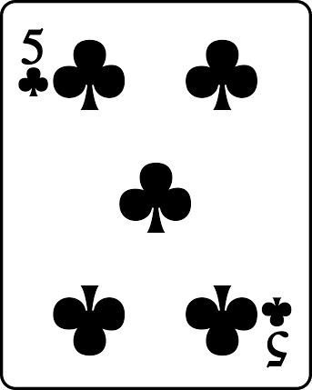
Can we continue and create number patterns and describe how they are created?
Independent Investigation:
Can you create your own number pattern and describe how it was created?
Turn over ONE number card from a deck of playing cards.
Use this number to create a number pattern.
Describe the pattern that has been created
Alice Vigors 2017
Notes:
NB: increase challenge by making the beginning number larger, using fractions and decimals.

Slide 7
Session Two
Can we create simple geometric patterns?
Alice Vigors 2017

Slide 8
Can we create simple geometric patterns?
What do you see, observe or notice?
What does this make you think, in terms of how the pattern is created? How it is repeated?
What questions or puzzles do you still have about these numbers?
Pairs: Determine the next term in this pattern.
Alice Vigors 2017
Notes:
→Display a geometric pattern.
→Undertake a See Think Wonder asking: What do you see, observe or notice? What does this pattern make you think? What questions or puzzles do you have about this geometric pattern?
→Share thinking.
→Students determine the next term in this pattern (pairs).

Slide 9
Can we create simple geometric patterns?
How can we use this visual representation to create a table of values to show the pattern?
Term in the pattern (T)
Blocks needed (B)
Alice Vigors 2017
Notes:
→Discuss how we use this visual representation to create a table of values to show the pattern

Slide 10
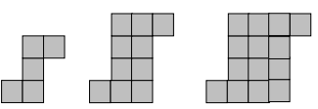
Can we create simple geometric patterns?
Independent Investigation:
Group One | Group Two | Group Three
Create this geometric pattern using blocks: | Create this geometric pattern using counters: | Create this geometric pattern using matchsticks:
Create a table of values about your geometric pattern. | Create a table of values about your geometric pattern. | Create a table of values about your geometric pattern.
Repeat your pattern 3 more times. | Repeat your pattern 3 more times. | Repeat your pattern 3 more times.
Challenge: What would the 10th term be? | Challenge: What would the 10th and 15th terms be? | Challenge: What would the 15th and 32nd terms be?
Alice Vigors 2017
Notes:
→Discuss how we use this visual representation to create a table of values to show the pattern

Slide 11
Session Three
Can we identify the rule to describe the pattern and calculate the corresponding value for a larger number?
Alice Vigors 2017

Slide 12
Can we identify the rule to describe the pattern and calculate the corresponding value for a larger number?
What do you notice about how the pattern changes from the 1st term to the 2nd term?
What do you notice about how the pattern is arranged?
What do you think is happening here?
What questions or puzzles do you have about this pattern?
How might we work out what the 3rd term would look like?
Alice Vigors 2017
Notes:
→Display the following pattern.
→What do you notice about how the pattern changes from the 1st term to the 2nd term? What do you notice about how the pattern is arranged? What do you think is happening here? What questions or puzzles do you have about this pattern? How might we work out what the 3rd term would look like?

Slide 13
Assessment – MA3-8NA
Can we continue and create number patterns and describe how they are created?
Independent Investigation:
Use matchsticks/ popsicle sticks to create a geometric pattern with two terms.
Draw the visual representation of your pattern.
Use a table of values to describe the pattern you have created. What is the rule for this pattern?
Repeat the pattern two more times using this rule.
What would the 5th, 10th, 25th, 50th and 100th terms be for this pattern?
Term in the pattern (T)
Matchsticks needed (M)
Alice Vigors 2017
Notes:
NB: increase challenge by making the beginning number larger, using fractions and decimals.

