Slide 1
Alice Vigors 2020

Slide 2
Key Inquiry Questions
What do we know about the lives of people in Australia’s colonial past and how do we know?
How did an Australian colony develop over time and why?
How did colonial settlement change the environment?
How do people’s connections to places affect their perception of them?
Alice Vigors 2020

Slide 3
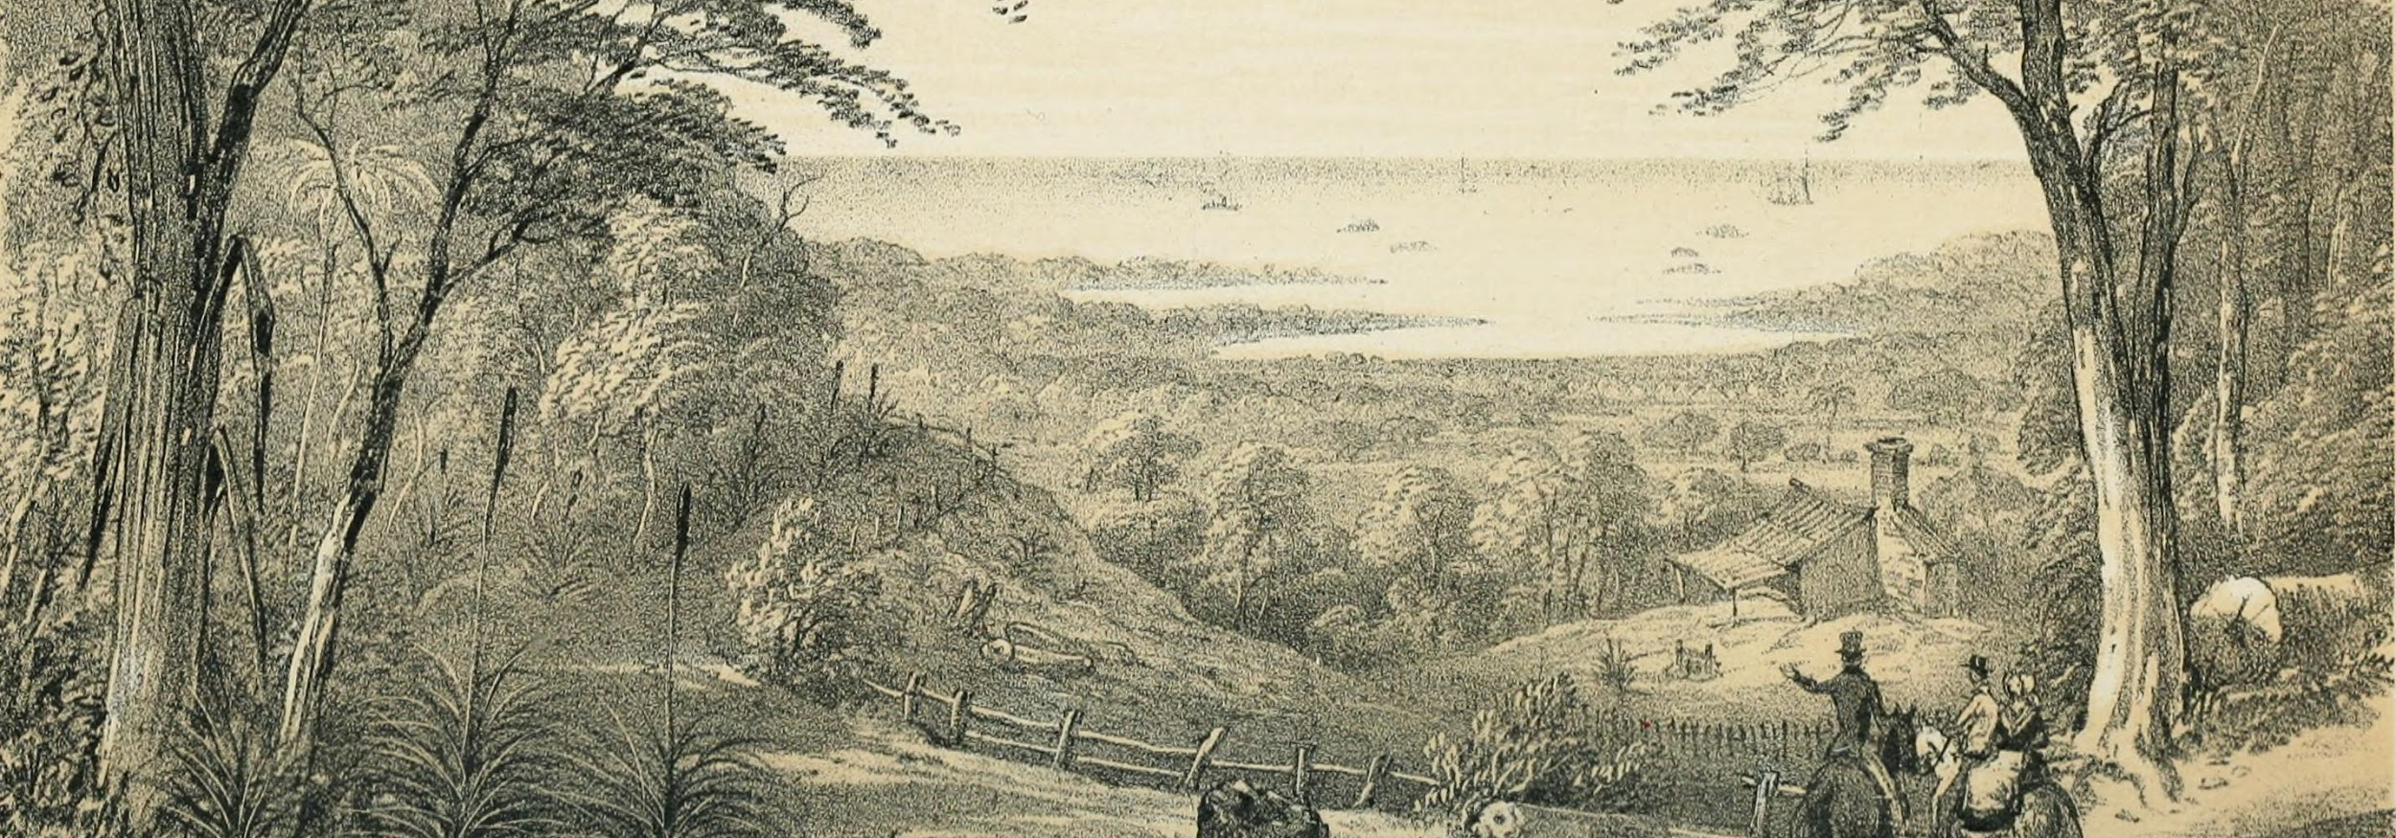
How did an Australian colony develop over time and why?

Slide 4
Alice Vigors 2020
Source: Ryebuck Media
TUNING IN

Slide 5
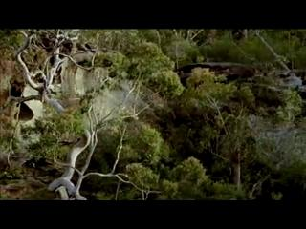
Alice Vigors 2020
Source: NFSA
TUNING IN

Slide 6
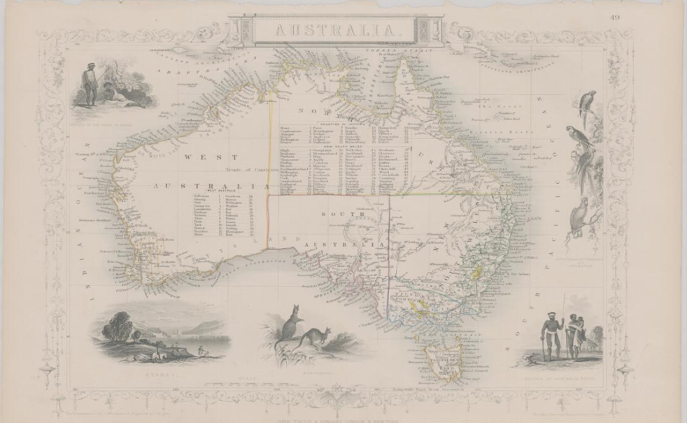
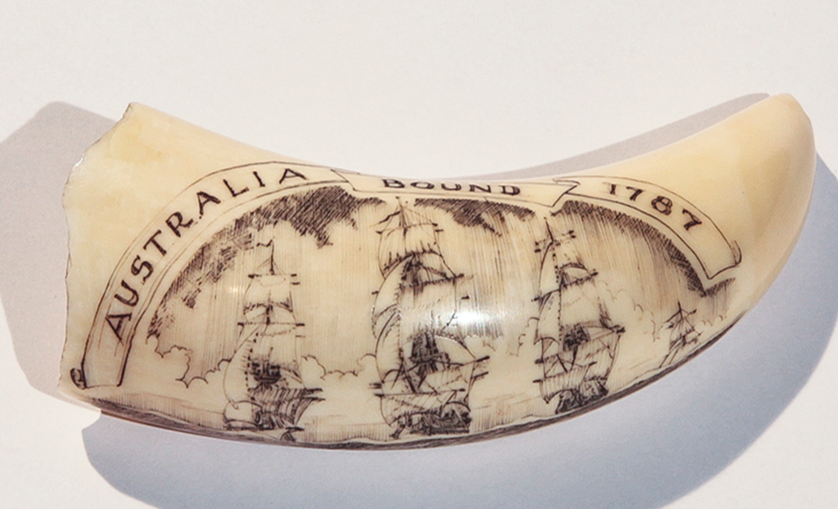
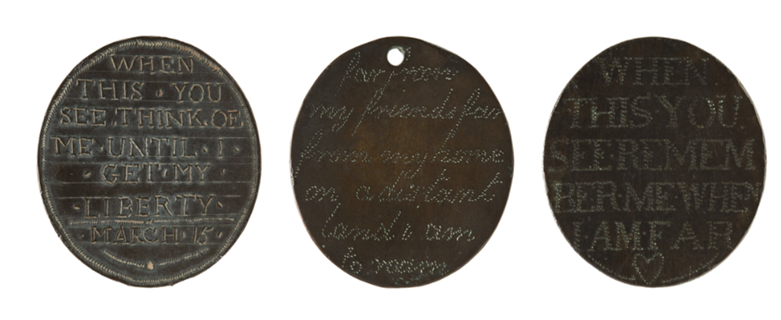
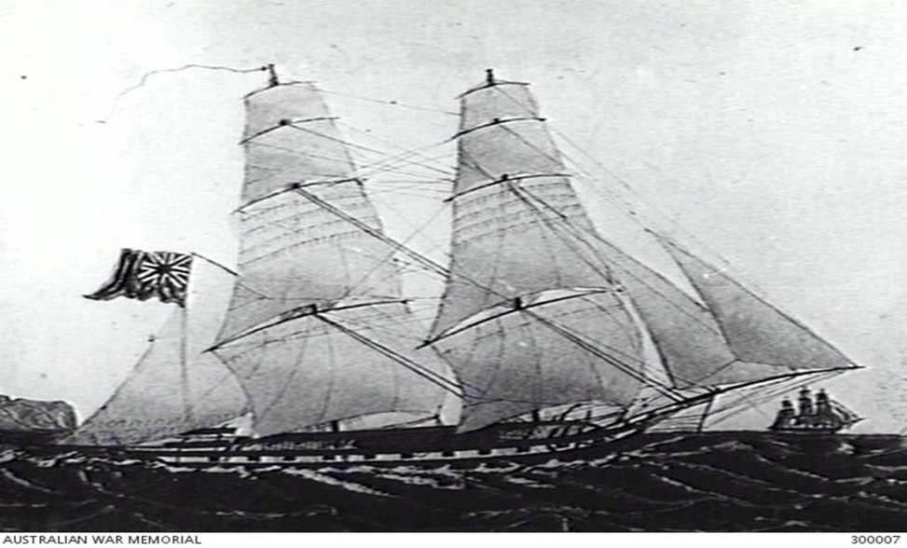
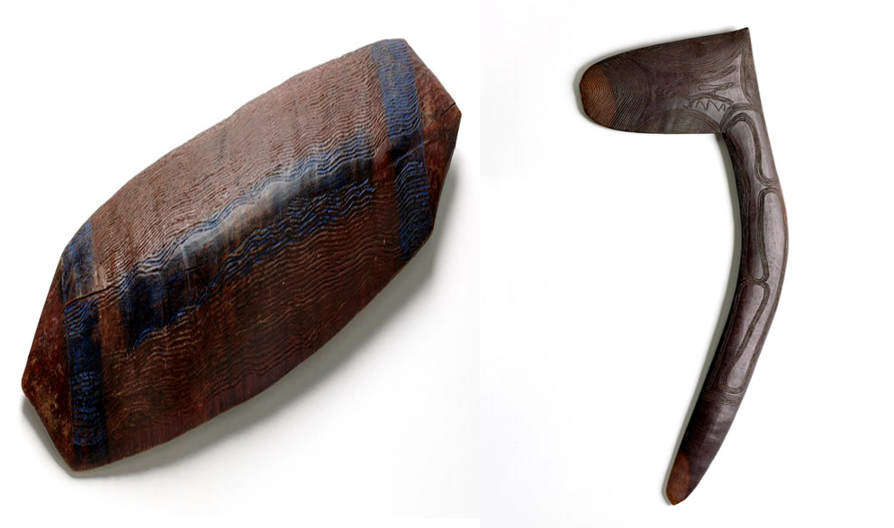
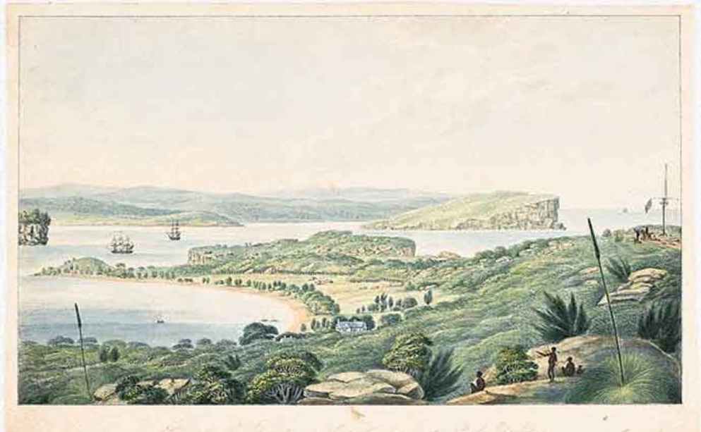
See Think Wonder
What do you see, observe or notice?
What does it make you think?
What do you wonder?
Assessment For Learning
Alice Vigors 2020
TUNING IN

Slide 7
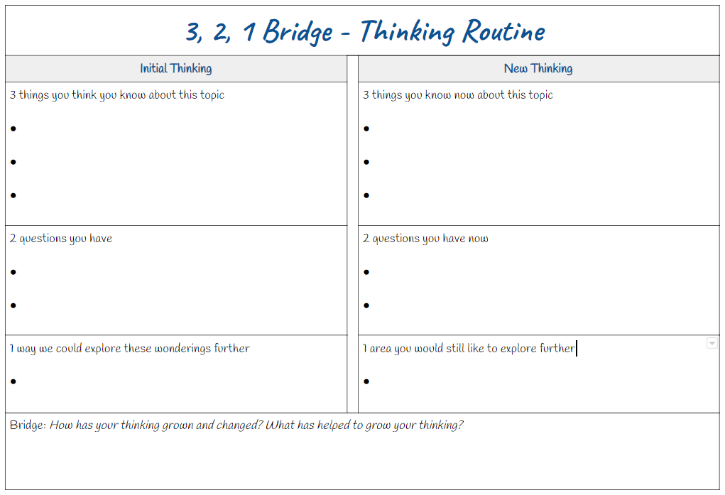
Assessment As Learning
What do you think you know about this topic?
What do you wonder about this topic?
What is one way we could explore these wonderings further?
Alice Vigors 2020
TUNING IN

Slide 8
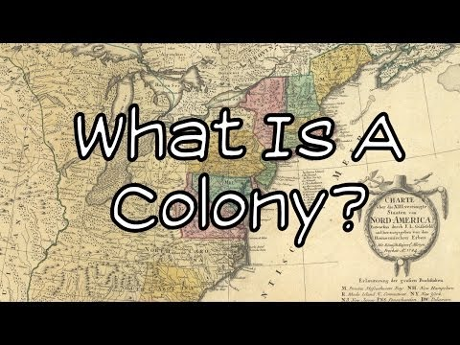
Alice Vigors 2020
Source: Mr Corwin
SHARED INQUIRY

Slide 9
Definition
What is an Australian colony?
Alice Vigors 2020
SHARED INQUIRY

Slide 10
Alice Vigors 2020
SHARED INQUIRY

Slide 11
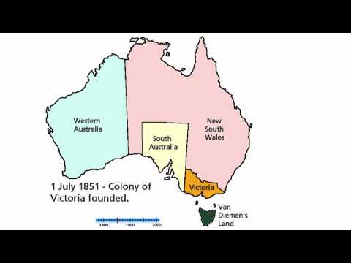
Alice Vigors 2020
Source: Earth Direct
SHARED INQUIRY

Slide 12
Making Judgements
What are the advantages and disadvantages to have 6 separate colonies?
Alice Vigors 2020
SHARED INQUIRY

Slide 13
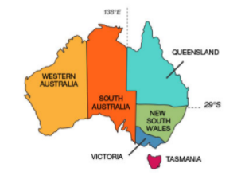
Research Task
Success Criteria:
C
Research the development of ONE colony that includes:
When it was first settled by Europeans – date settled, reasons why the colony was formed
Identify the First Nations tribes that lived in the colony
What were the sources of the population - convicts or free settlers or both
When were they granted self-governance from Britain (allowed to govern themselves)?
What is the name of the first official Governor of the colony?
Create a timeline of some of the key history and development that occurred for the colony prior to Federation in 1901.
Present research findings to the class as a research report (using a template).
Assessment For Learning
SHARED INQUIRY

Slide 14
What do you you know about the topic now?
Assessment As Learning
What do you still wonder about this topic?
What area would you still like to explore further?
How has you thinking changed? What helped you grow?
Alice Vigors 2020
SHARED INQUIRY

Slide 15
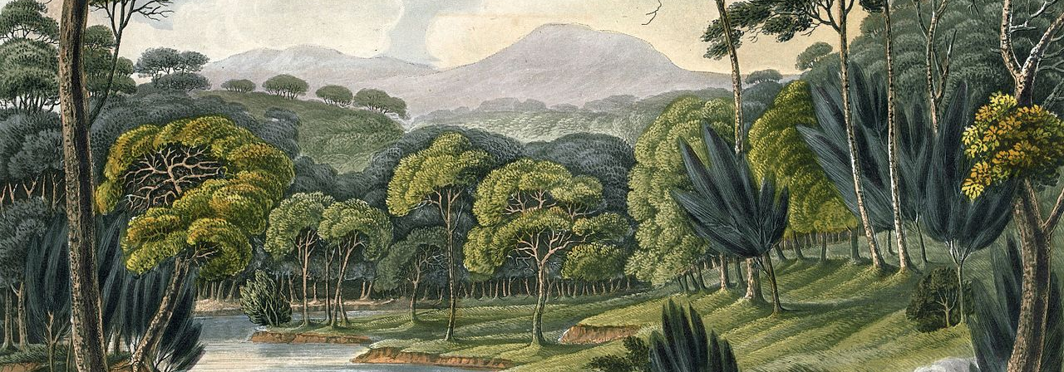
What do we know about the lives of people in Australia’s colonial past and how do we know?

Slide 16
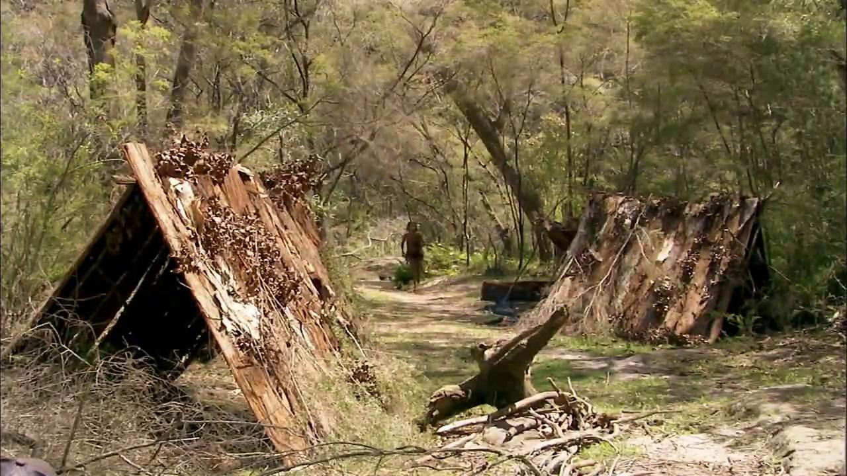
Alice Vigors 2020
Source: My Place
TUNING IN

Slide 17
Alice Vigors 2020
Source: My Place
TUNING IN

Slide 18
Unpacking The Videos . . .
Compare and contrast where and how Dan and Waruwi live
What are the differences in culture, principles of ownership and authority?
Alice Vigors 2020
TUNING IN

Slide 19
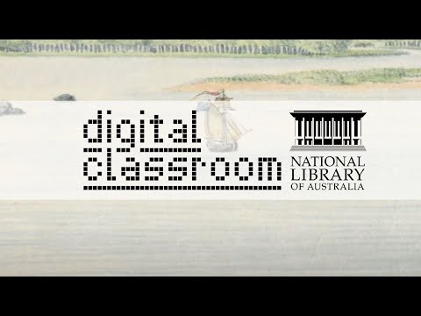
Alice Vigors 2020
Source: National Library of Australia
TUNING IN

Slide 20
Art Appreciation
What can we learn about the past from paintings?
How is a painting different from a photograph?
Do you think that paintings, including the above five by Lycett, are always accurate in what they show?
Alice Vigors 2020
SHARED INQUIRY

Slide 21
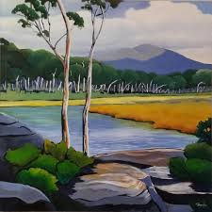
Get Creative . . .
Create an artwork that shows the environment in which you live.
Alice Vigors 2020
Source: Carol Massey
SHARED INQUIRY

Slide 22
Zoom In . . .
What do you see, observe or notice?
What do you think might be occurring in this painting?
What makes you say that?
What do you wonder?
Alice Vigors 2020
Source: National Library of Australia
SHARED INQUIRY

Slide 23
Zoom In . . . revealing more
What new things do you see, observe or notice?
How does this change your thinking about what might be happening in the painting?
Has the new information changed any of your wonders or changed your thinking?
What do you wonder now?
Alice Vigors 2020
Source: National Library of Australia
SHARED INQUIRY

Slide 24
Zoom In . . . Painting Reveal
What new things do you see, observe or notice?
How does this change your thinking about what might be happening in the painting?
Has the new information changed any of your wonders or changed you thinking?
What lingering questions remain for you about this painting?
Alice Vigors 2020
Source: National Library of Australia
SHARED INQUIRY

Slide 25
What does this painting tell you about European settlement of Australia and its impact on Aboriginal peoples?
What is the main story or perspective being shown in this painting?
What is happening to the other people in this painting? What’s their story?
What is the theme or key message hidden beneath the surface of these stories
Alice Vigors 2020
Source: National Library of Australia
SHARED INQUIRY

Slide 26
Alice Vigors 2020
SHARED INQUIRY

Slide 27
Unpacking The Text
Whose perspective is being represented in this text?
Would this be considered a true and accurate history of Phillip and Bennelong? What makes you say that?
How does this story help us to understand the tensions and relationships between First Nations people and the Europeans?
What challenges are highlighted in this text?
Alice Vigors 2020
SHARED INQUIRY

Slide 28
Peel The Fruit . . .
What events occured in the text?
How might we describe these?
How does this text highlight the tensions and relationships between First Nations people and Europeans? What occurred as a result?
Whose perspective is represented in the text? How could we view this from another perspective? What might that look like? Implications?
Assessment For Learning
OUTSIDE SKIN
BUILDING EXPLANATIONS
DIFFERENT VIEWPOINTS
UNDER THE SKIN
MAKING CONNECTIONS
CAPTURING THE HEART
What questions or puzzles does this text raise for you?
How does the text connect with what we already know?
Text-to-Text, Text-to-Self, Text-to-World
What themes are represented in the text?
Alice Vigors 2020
SHARED INQUIRY

Slide 29
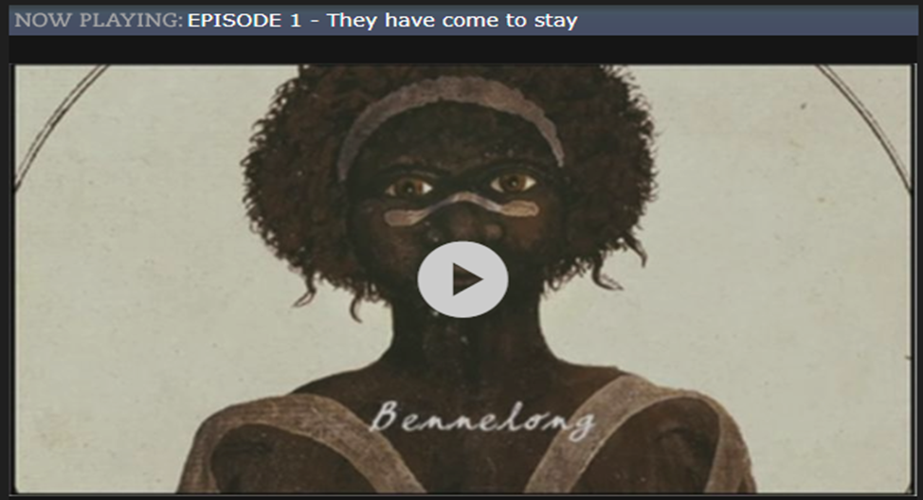
Alice Vigors 2020
Source: SBS First Australians
SHARED INQUIRY

Slide 30
Compare and Contrast . . .
How does the text and the SBS episode compare (similarities)?
How does the text and the SBS episode contrast (differences)?
Assessment Of Learning
SHARED INQUIRY
Alice Vigors 2020

Slide 31
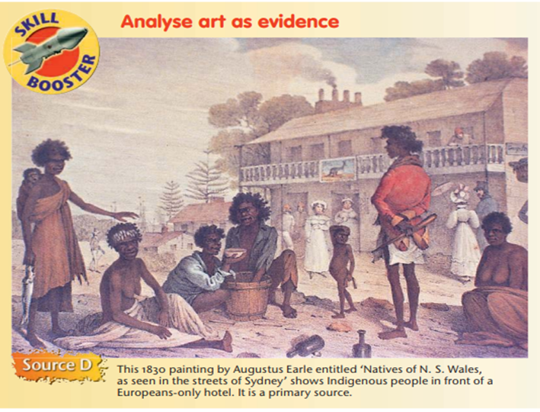
Art As Evidence . . .
Assessment For Learning
What perspective is being portrayed in this artwork?
What are the Indigenous people doing? What does this tell you?
Does their appearance or behaviour suggest some adherence to traditional Indigenous practices?
How are the Indigenous people and Europeans interacting? What does this suggest?
Is there anything to suggest the artist was influenced by stereotypes?
If an Indigenous artist had painted this scene in 1830, what differences (if any) might there have been? Would some things have been included or left out? How differently might the people have been drawn? Think about what this reveals about point of view.
Alice Vigors 2020
Source: Jacaranda Online
SHARED INQUIRY

Slide 32
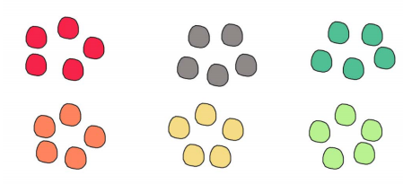
Jigsaw Cooperative Groups
Assessment For Learning
Round 1
Home Groups
- Form groups of 6
- Group members choose a coloured chip
Round 2
Expert Groups
- Students with the same coloured chip meet to share ideas and formulate a response to the question(s)
-All members MUST contribute and record answers in books
Round 3
Home Groups
- Students return to home groups
-Each member shares their expert response for other members to record
All students record any new questions or puzzles they have
Alice Vigors 2020
SHARED INQUIRY

Slide 33
Case Studies: Colonisation Resistance
Assessment For Learning
Examine one of the following four Indigeneous Australians:
Compile evidence about this person using the following prompts:
Who was this person? | Where did the events take place? | When did the events take place? | Why was there a need for resistance? | What was the main type of resistance shown? | How successful was the resistance? Why? | What is your personal opinion? | How is this person remembered today?
Alice Vigors 2020
Source: National Museum of Australia
SHARED INQUIRY

Slide 34
How did colonial settlement change the environment?

Slide 35
Environmental Impacts
What changes to the environment did Brendan’s family experience?
What might be the impact of these changes to Brendan’s family, community, the local flora and fauna of the area?
Alice Vigors 2020
Source: NACC
TUNING IN

Slide 36
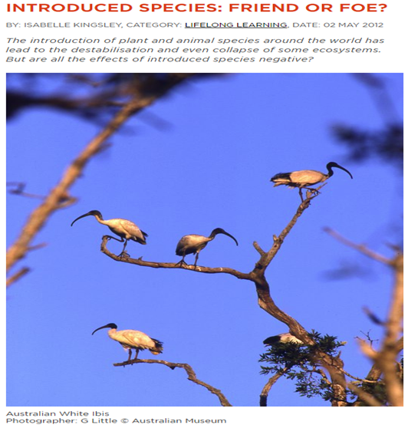
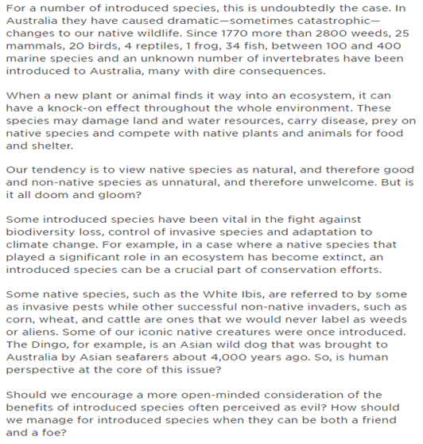
Introduced Species: Friend or Foe?
Alice Vigors 2020
Source: Australian Museum
SHARED INQUIRY

Slide 37
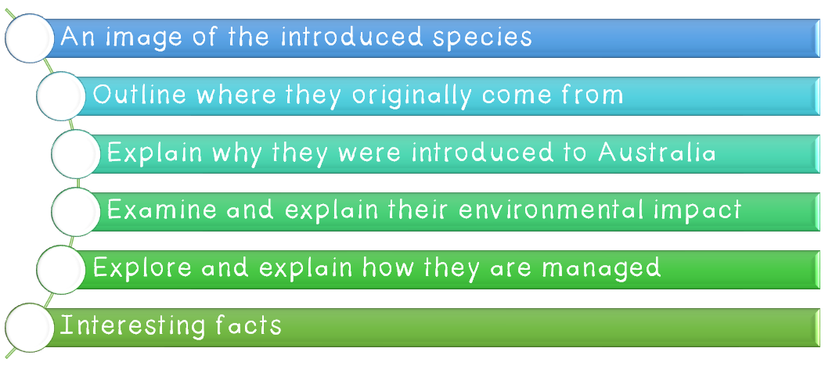
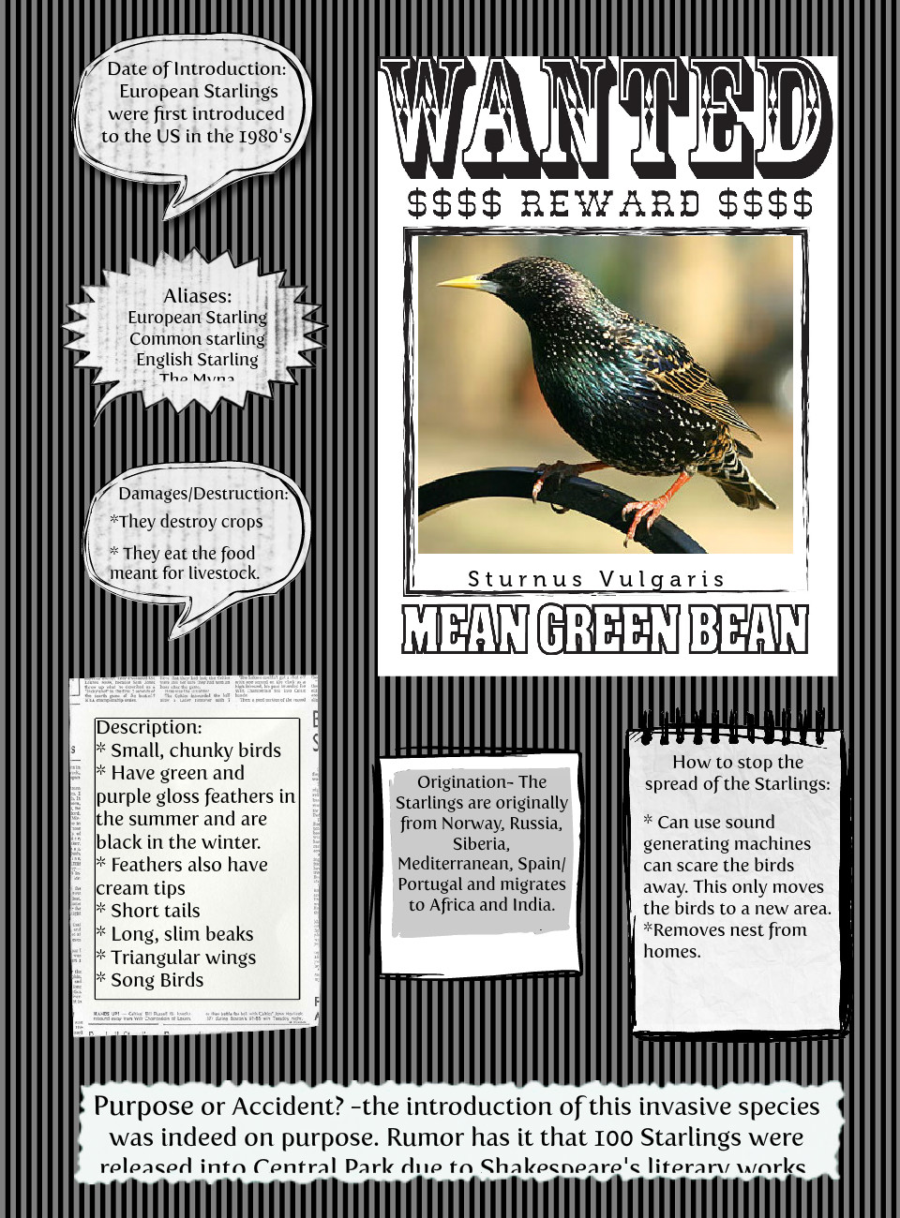
Research Task
Success Criteria:
C
Research and create a wanted poster about your chosen introduced species using the digital platform Canva, including:
An image of the introduced species
Outline where the animal originally came from
Explain why they were introduced
Examine the animals environmental impact
Explore how they are managed
Interesting facts
Assessment For Learning
SHARED INQUIRY

Slide 38
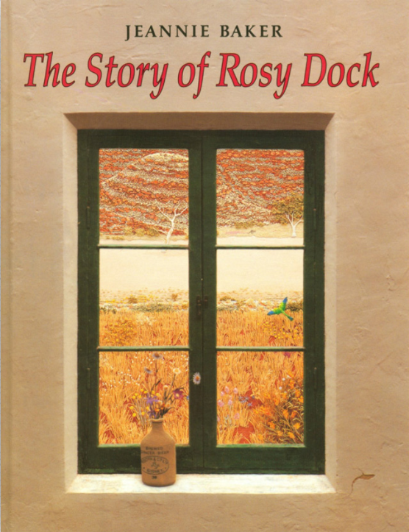
Text Analysis
Who or what is Rosy Dock?
What is the significance of the title of the book?
How did the landscape change throughout the book?
What is the difference between the landscape at the end of the book and the landscape after the desert storm?
How was the plant Rosy Dock spread after the woman planted it?
What consequences might the introduction of this foreign plant have on the natural environment? Other plants and animals?
SHARED INQUIRY

Slide 39
Compare and Contrast . . .
How does the book and the DVD compare (similarities)?
How does the book and the DVD contrast (differences)?
Alice Vigors 2020
SHARED INQUIRY

Slide 40
Main, Side, Hidden . . .
What is the main story or perspective being shown in this story?
What is the theme or key message hidden beneath the surface of these stories?
MAIN
HIDDEN
SIDE
What is happening to the other people in this story? What’s their story?
Alice Vigors 2020
SHARED INQUIRY

Slide 41
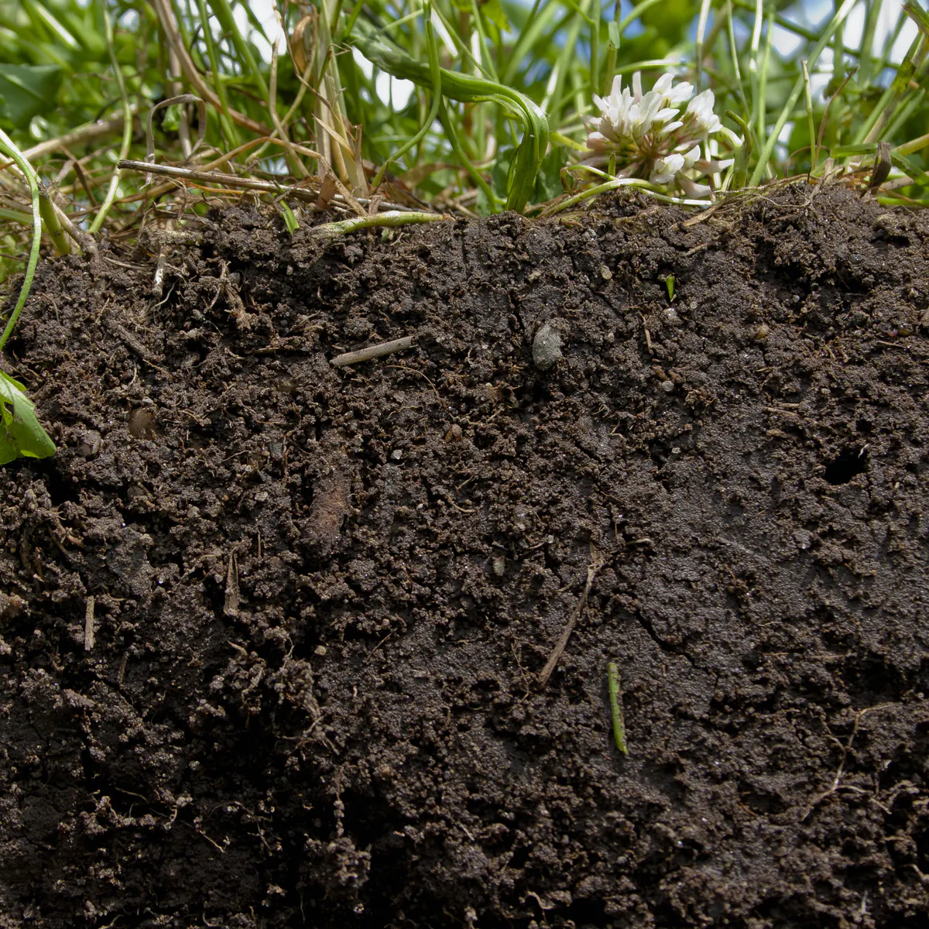
Why is healthy soil important?
What happens to the land when it is cleared?
SHARED INQUIRY
Alice Vigors 2020

Slide 42
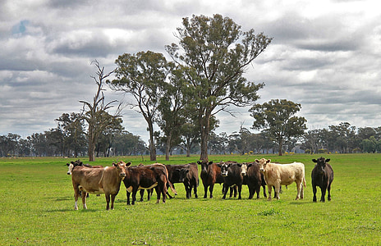
When European settlers arrived in Australia they established farms for exporting products such as wool. The
First Fleet brought sheep, cows and goats. Unlike Australian animals such as the kangaroo, these animals
had hooves that compacted the soil. They trampled and overgrazed fragile native vegetation, which led to
soil erosion and degradation.
Europeans cleared the land for farming and removed deep-rooted trees, which led to a change in the water
table and climate. Later, artificial fertilisers and chemicals were added to soils to make them more hospitable
to foreign crops and grasses. This practice continues today.
SHARED INQUIRY
Alice Vigors 2020

Slide 43
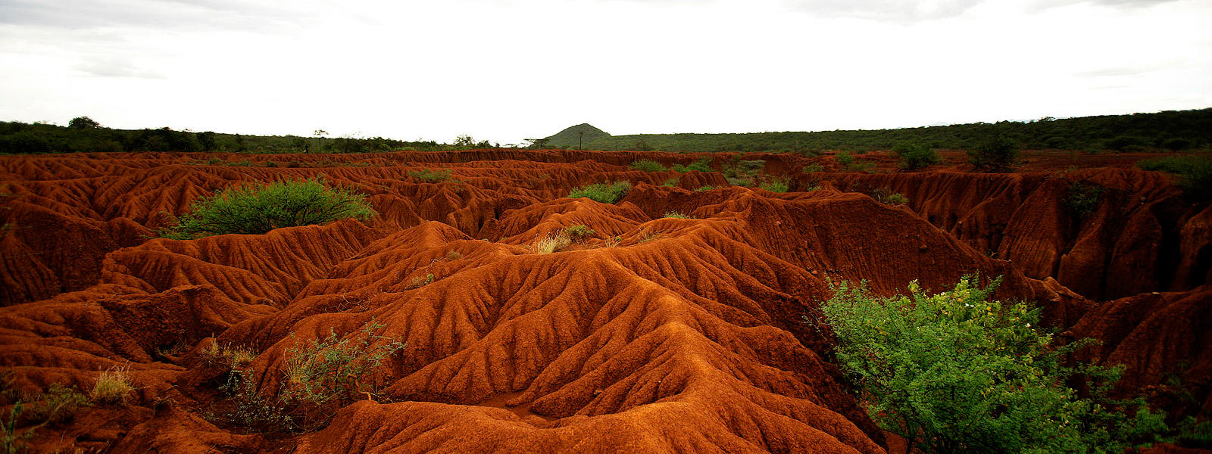
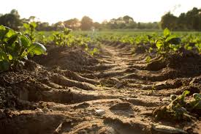
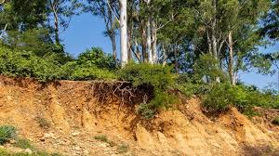
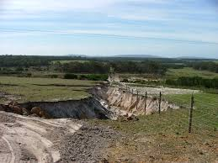
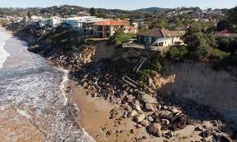
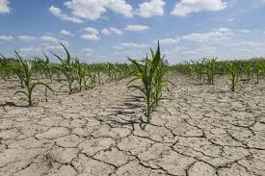
Soil Erosion Investigation
SHARED INQUIRY
Alice Vigors 2020

Slide 44
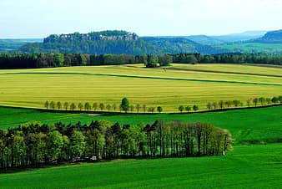
Planting trees along the boundaries of a property is one technique that farmers use to reduce the effects of wind erosion. You may be keen to push down on your soil, compacting it so that it won’t blow away. This is what hoofed animals do when they walk on it repeatedly. Unfortunately, it’s difficult for water to sink into compacted soil, which then makes the soil dry and difficult for plants to grow in.
SHARED INQUIRY
Alice Vigors 2020

Slide 45
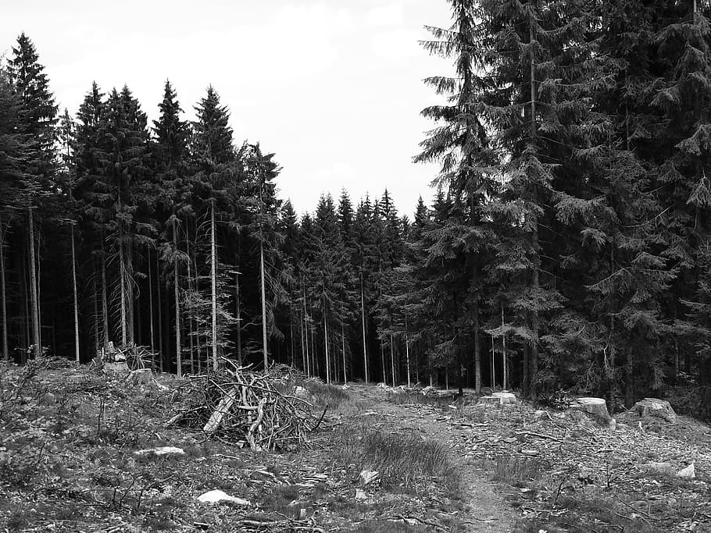
Explain the impact of land clearing on the environment and native flora and fauna, exploring reasons for and/or against continuing this practice today.
SHARED INQUIRY
Assessment Of Learning
Alice Vigors 2020

Slide 46
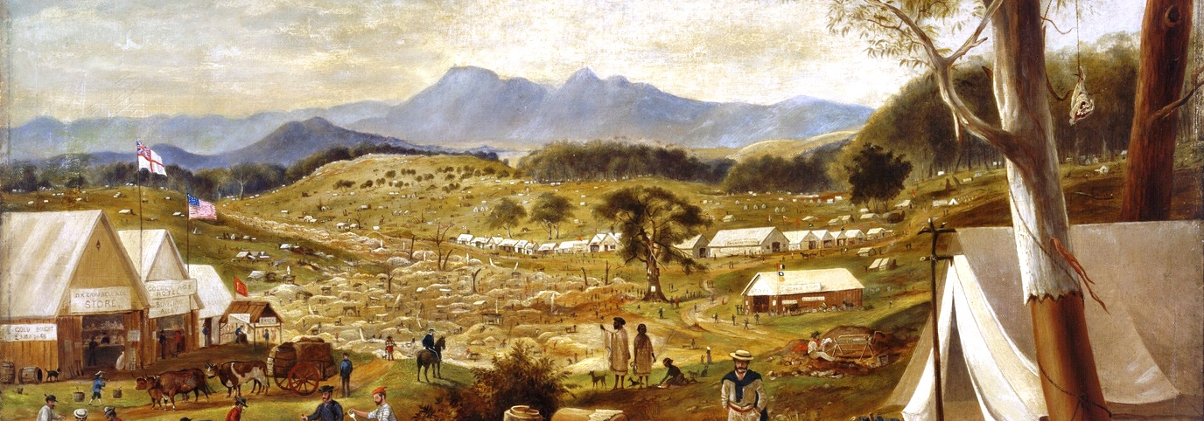
What were the significant events and who were the significant people that shaped Australian colonies?

Slide 47
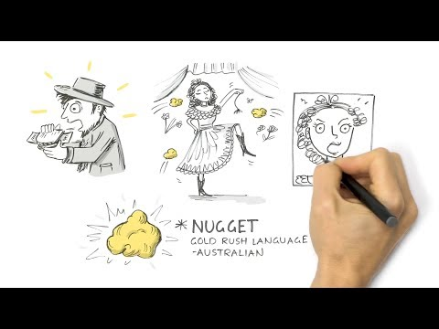
Alice Vigors 2020
Source: National Museum of Australia
TUNING IN

Slide 48
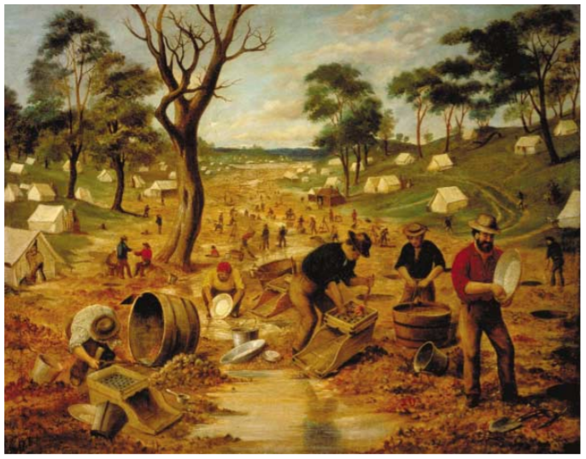
What does it tell you about how gold was mined on the goldfields? What equipment was used?
What people are represented in the painting? Do you think this is an accurate reflection of those who worked on the goldfields?
TUNING IN
Source: National Museum of Australia
Alice Vigors 2020

Slide 49
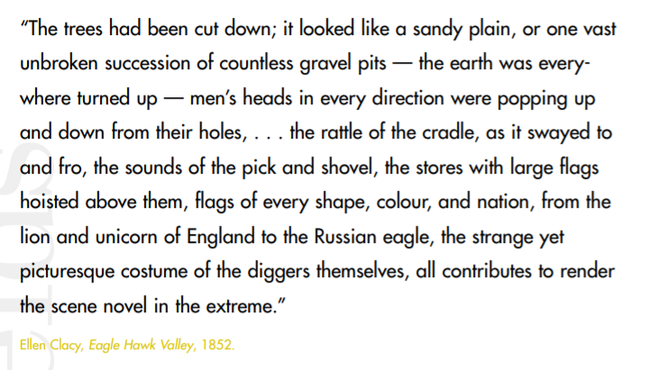
Life On The Goldfields . . .
TUNING IN
Alice Vigors 2020
Source: National Museum of Australia

Slide 50
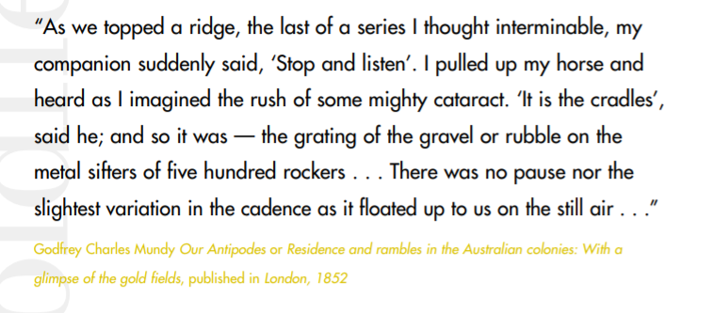
Life On The Goldfields . . .
TUNING IN
Alice Vigors 2020
Source: National Museum of Australia

Slide 51
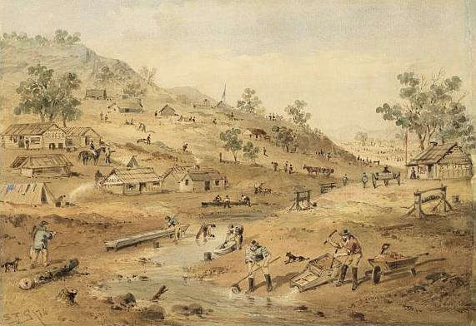
Do they give the same impression of life on the goldfields? How do they differ?
Alice Vigors 2020
TUNING IN

Slide 53
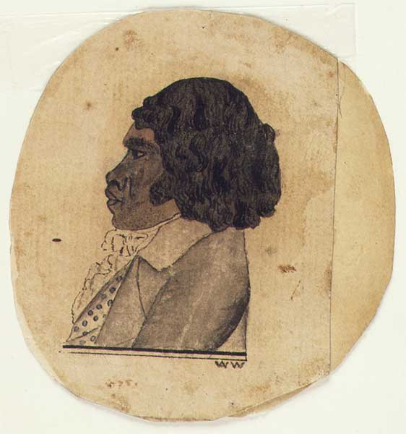
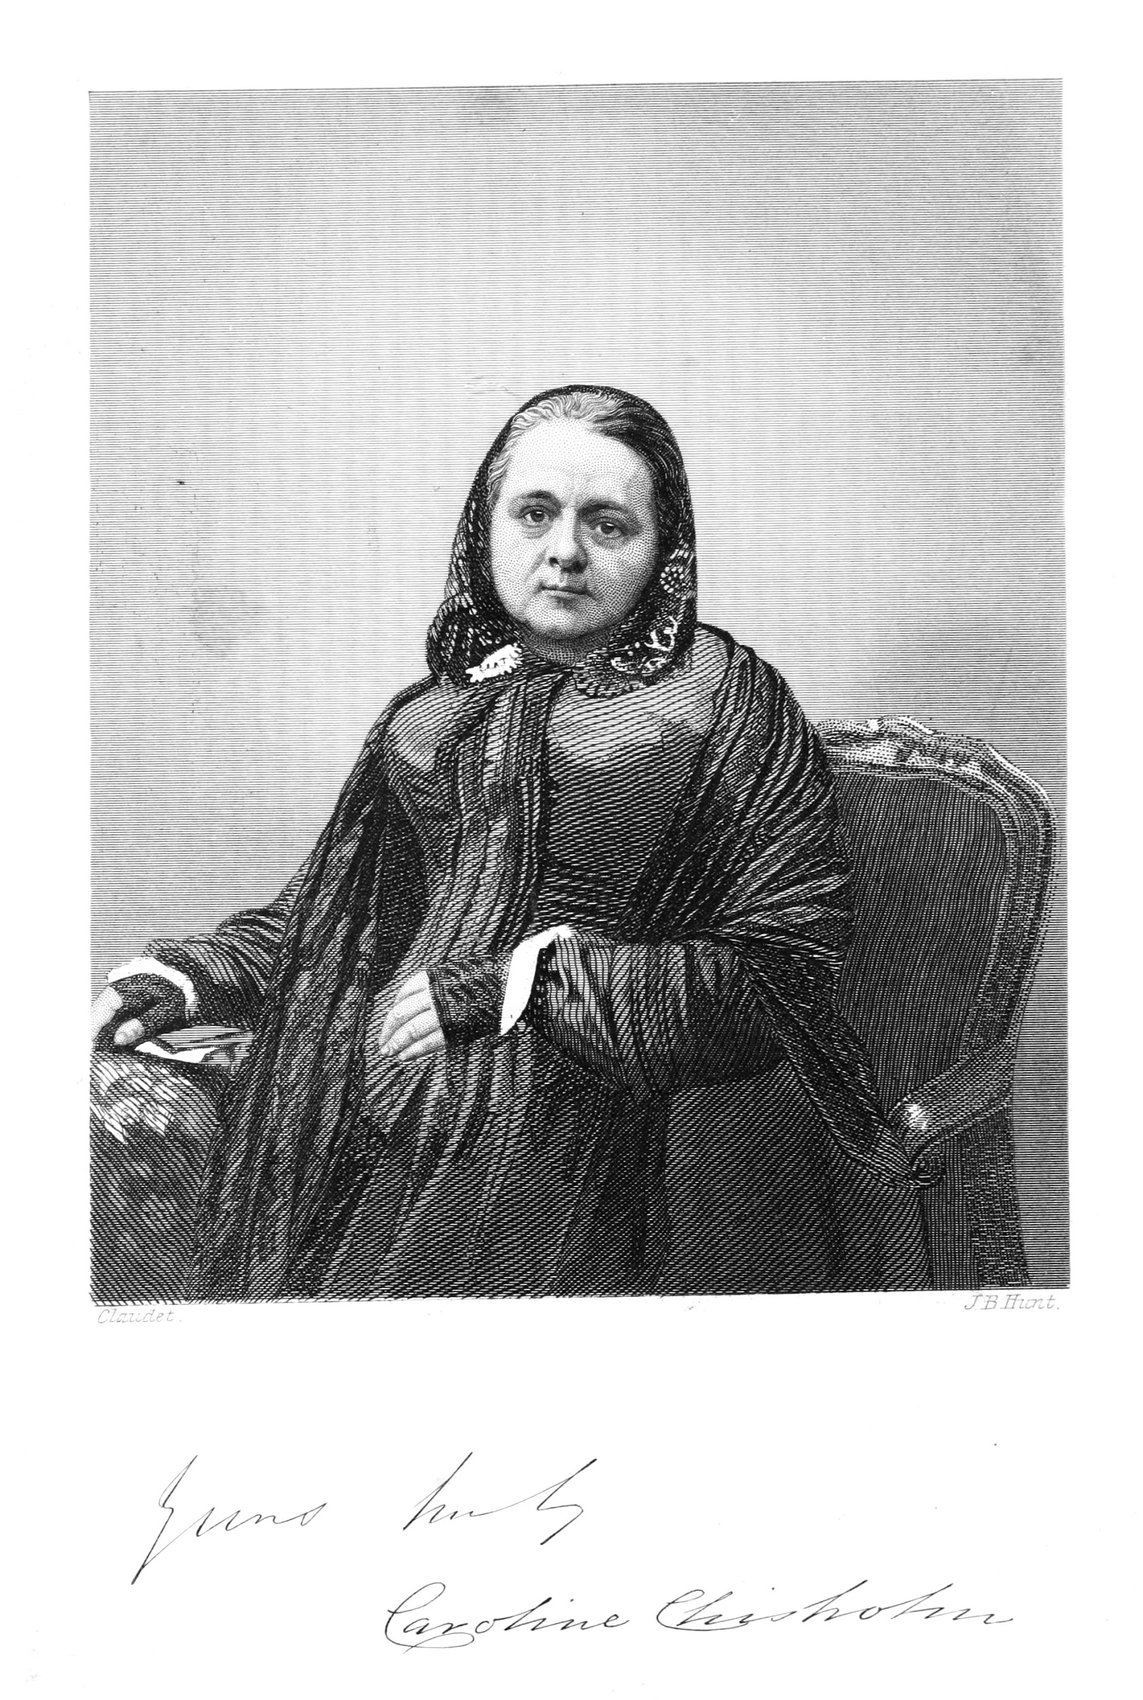
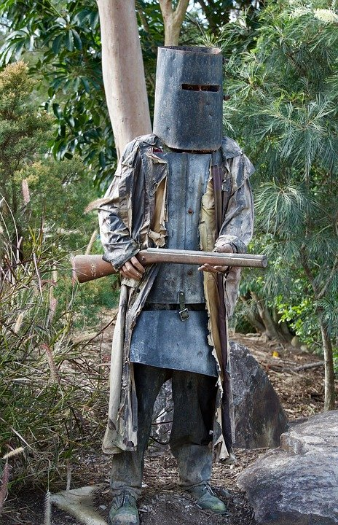
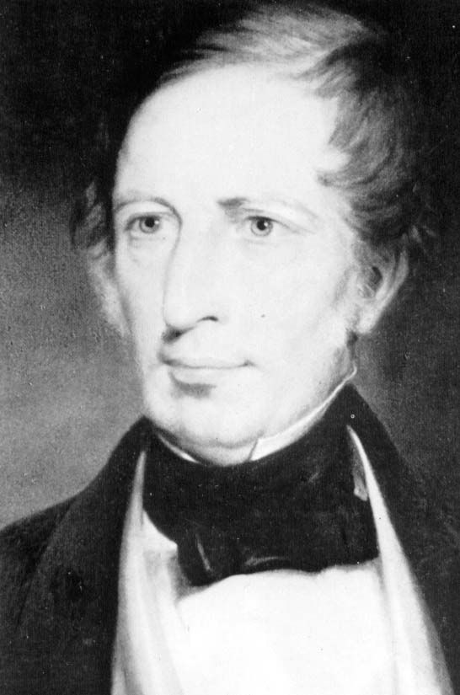
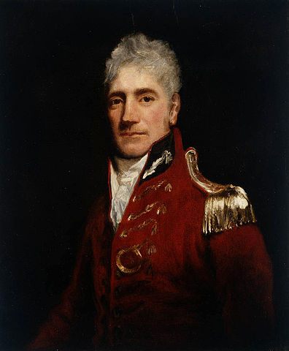
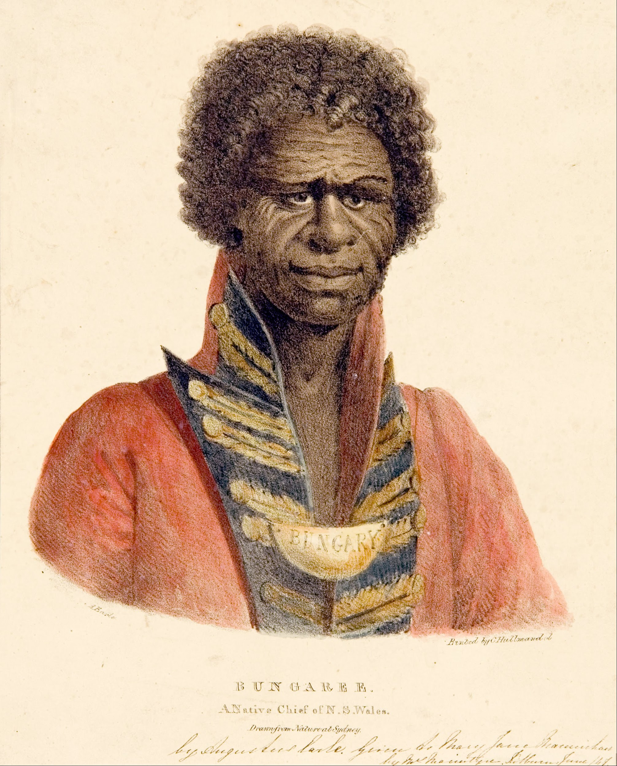
Research Project
Research and compose a biography about the life of one significant figure that helped shape the colony. Include:
Name of significant person – including a picture
Date and place of birth and death – including a map
Family information
What did they achieve? What were the challenges they faced? (chronological order) – include any paintings, photographs, letters or other artefacts
How did these help to shape the colony? – provide a detailed explanation
Interesting facts
Choose from the following list or negotiate another significant person with the teacher:
First Nations people: Bennelong, Jupiter Mosman, Bungaree
Humanitarian: Caroline Chisholm, Daisy May Bates,
Bushranger: Edward [Ned] Kelly,
Lachlan Macquarie, Charles Sturt,
Chinese Migrant/ community leader: Mei Quong Tart, William Liu,
Explorers: Burke & Wills, John Stuart
Barrister: William Ah Ket,
Overland Telegraph: Charles Todd
Assessment Of Learning
SHARED INQUIRY

Slide 54
SUCCESS CRITERIA | Working Towards | Working At | Working Beyond
Information -facts and events | Include some related facts and important events from the person's life, sometimes in your own words | Include a range of key facts and major events from the person’s life, in your own words | Include a range of key facts and major events from the person’s life and are able to explain how these shaped their lives, in your own words
Information -timeline in chronological order | Record some events in the order in which they happened. | Record most events in the order in which they happened. | Record all events in the order in which they happened, showing the links between events
Explanation | Give a short, basic explanation of how the person shaped the colony | Give a longer, more detailed explanation of how the person shaped the colony | Give an extended explanation of how the person shaped the colony that includes reasons supported by strong evidence
Images and Artefacts | Some images and artefacts used to support information in the biograph | Images and artefacts support information in the biography | Images and artefacts enhance information in the biography and add further meaning
Maps | A basic map showing place of birth and death | A detailed map showing place of birth, death | An extensive map showing place of birth, death and significant places
Interesting Facts | 1-2 interesting facts given | 3-5 interesting and relevant facts given | 8+ interesting and relevant facts given
Presentation - Booklet | A simple layout used with some attempt to engage the audience | Well-structured layout used that is easy to follow and is engaging to the audience | Thorough and engaging layout that shows evidence links between the task elements
Presentation - QR codes | No QR codes included | Some QR codes used that include links to additional information | A range of QR codes used to enhance the biographical information, eg. video
Sources | 1-3 sources used and referenced using CiteFast | 4-10 sources used and referenced using CiteFast | 10 or more sources used and referenced using CiteFast

Slide 55
The Gold Rush Era
Why did the authorities and others try to keep gold findings a secret until 1849?
What impact did the discovery of Gold have on colonies like Victoria?
Alice Vigors 2020
Source: Kids News
SHARED INQUIRY

Slide 56
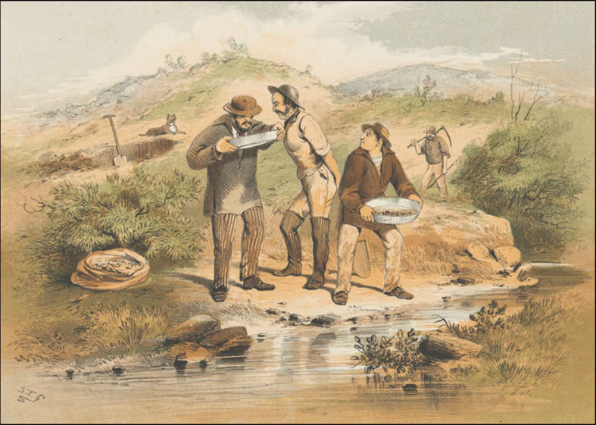
The Gold Rush Era
What do you see, observe or notice?
What does it make you think about mining techniques used by gold miners?
What do you wonder?
Alice Vigors 2020
Source: National Museum Australia
SHARED INQUIRY

Slide 57
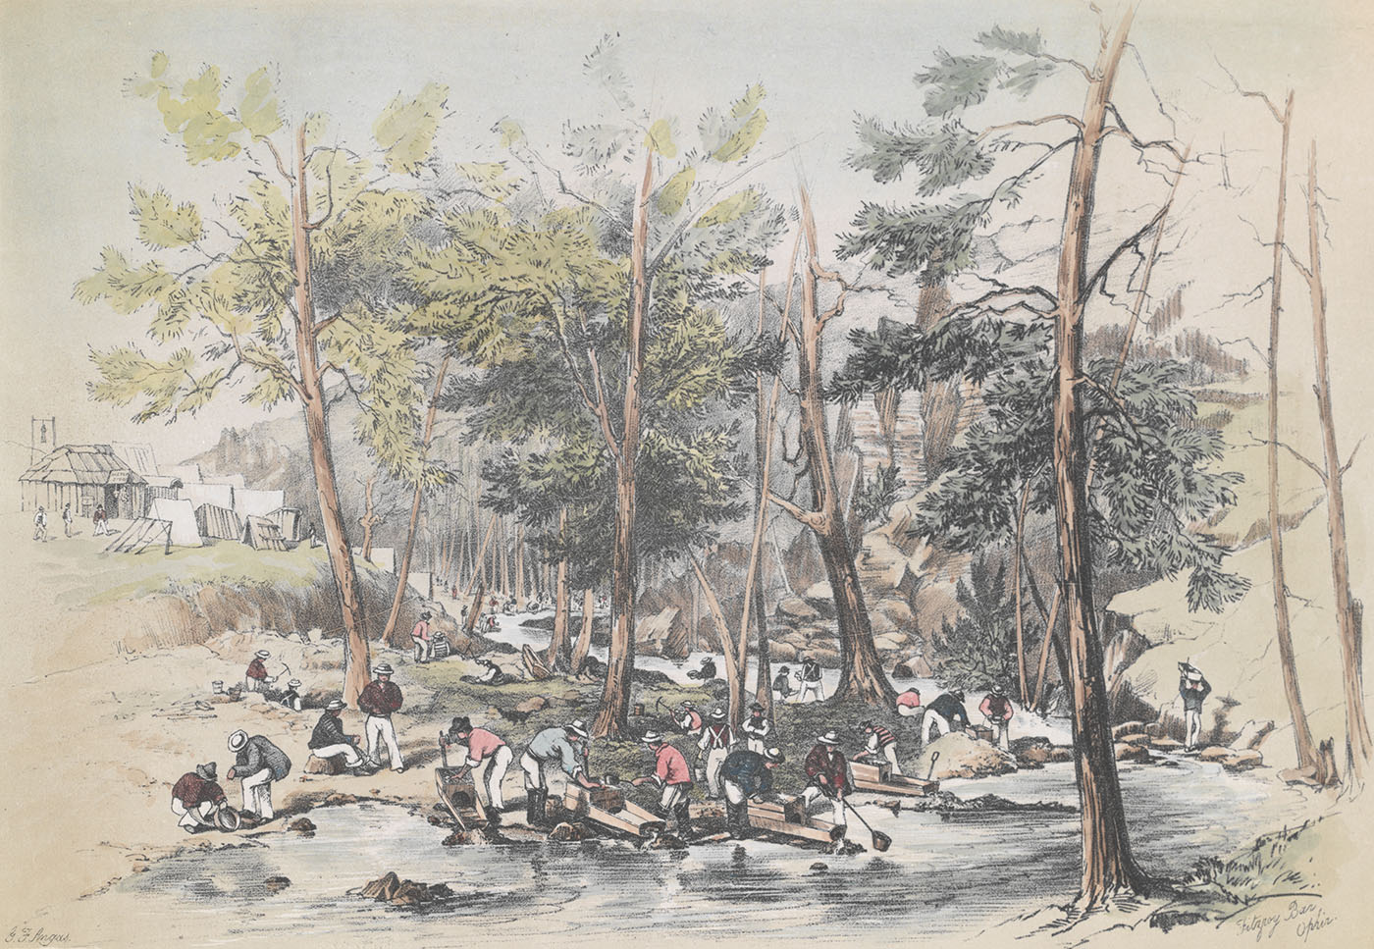
The Gold Rush Era
What do you see, observe or notice?
What does it make you think about mining techniques used by gold miners?
How and why do you think they are different to the previous painting?
What do you wonder?
Alice Vigors 2020
Source: National Museum Australia
SHARED INQUIRY

Slide 58
Alice Vigors 2020
Source: Kids News
SHARED INQUIRY

Slide 59
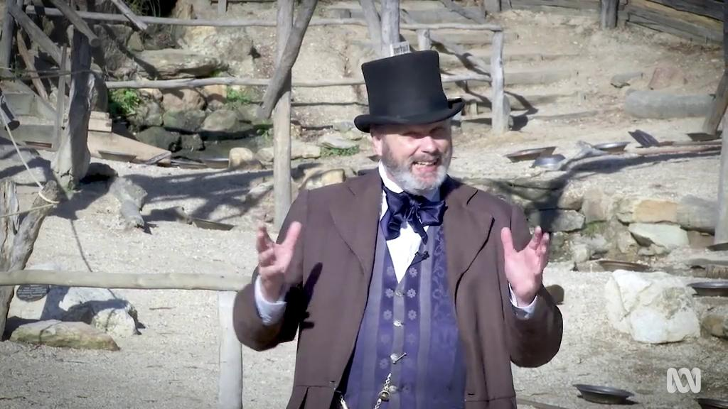
Gold Rush
What are the different eras of the gold rush?
What were the living conditions like on the gold fields?
What impact did the gold rush have on towns like Ballarat?
TASK: Build a timeline of the key eras of the gold rush
Alice Vigors 2020
Source: ABC Education
SHARED INQUIRY

Slide 60
The Promise of Gold
What would people have to consider if thinking about migrating to Australia?
Why might someone choose to migrate to Australia today?
Is the central image of Race to the Gold Diggings realistic? What makes you say that?
Alice Vigors 2020
Source: National Library of Australia
SHARED INQUIRY

Slide 61
The Gold Rush Era
What impact did migration have on
People on the gold fields?
Australia’s population?
Development of the colony?
Alice Vigors 2020
Source: Kids News
SHARED INQUIRY

Slide 62
Alice Vigors 2020
Source:Shaun Tan
SHARED INQUIRY

Slide 63
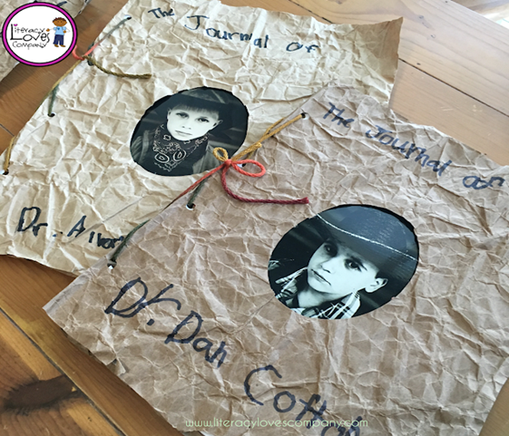
The Gold Rush Era
Compose a journal or narrative letter from the point of view of a person on the Australian gold fields. Include:
Location of the gold field
How they got there and the equipment they needed
Living conditions on the gold field - accommodation, food, sanitation
How they passed the time when not panning for gold
Alice Vigors 2020
Source: Kids News
SHARED INQUIRY

Slide 64
How did the gold rushes completely change the face of Australia?
Research the discoveries that led to the gold rushes in the following Australian colonies:
Represent your information in the form on an infographic using the online tool Canva. Include key information and graphics to support your explanation along with:
The year the discovery was made
The place or places gold was discovered
The events leading up to and just after the discovery
Any interesting facts that support your explanation
Assessment For Learning
Alice Vigors 2020
SHARED INQUIRY

Slide 65
Gold Trails - Riverina Region
Investigate the local Snowy Mountains gold history.
Choose one location
Locate the place on a map
When was gold first found at this location?
How long was gold mined for?
What kind of equipment was used?
What was the impact of gold mining in this area?
Alice Vigors 2020
Source: Gold Trails
SHARED INQUIRY

